Slide 1
Punctuation
Punctuation is used to create sense, clarity, and stress in sentence. We use punctuation marks to make well-structure and organize our writing.
Full Stop or Period(American)
Comma
Colon
Em-Dash
Semi-colon
Hyphen
Question mark
Exclamation
https://www.thepunctuationguide.com

Slide 2
Full stop: Full stop between two separate sentences.
Semi-colon: It is put between two separate clauses.
Comma: It is put between two clauses linked by and, but, and or
Hyphen: The rules about when to use a hyphen is not very exact.
Em-Dash: It is significantly longer than the hyphen. We use the em dash to create a strong break in the structure of a sentence.
Full stop
Declarative sentences
I write a letter daily.
It is raining.
Shakespeare wrote plays. He also acted on the stage.
Imperative sentences
Close the door.
Don’t do this.
Semi-colon
Full stop or semicolon shows there are two separate pieces of information.
Shakespeare wrote plays; he also acted on the stage.

Slide 3
Depending on the context, the em dash can take the place of commas, parentheses, or colons—in each case to slightly different effect.
The em dash can be used in place of a colon when you want to emphasize the conclusion of your sentence. The dash is less formal than the colon.
After months of deliberation, the jurors reached a unanimous verdict—guilty.
The white sand, the warm water, the sparkling sun—this is what brought them to Hawaii.
Comma:
After coordinating conjunction to combine at-least two clauses a (And, But, or, Yet, so )
She purchased the car, but she declined the extended warranty.
I lost my job, so I can’t afford to go to Europe this summer.

Slide 4
Depending on the context, the em dash can take the place of commas, parentheses, or colons—in each case to slightly different effect.
The em dash can be used in place of a colon when you want to emphasize the conclusion of your sentence. The dash is less formal than the colon.
After months of deliberation, the jurors reached a unanimous verdict—guilty.
The white sand, the warm water, the sparkling sun—this is what brought them to Hawaii.
Comma:
After coordinating conjunction to combine at-least two clauses a (And, But, or, Yet, so )
She purchased the car, but she declined the extended warranty.
I lost my job, so I can’t afford to go to Europe this summer.

Slide 5
Exclamation: The Exclamation mark is used to convey strong emotion.
I am really excited to visit a new country. // No emotion
I am really excited to visit a new country! // Excitement
Em-Dash —:
Upon discovering the errors (all 124 of them), the publisher immediately recalled the books.
Upon discovering the errors—all 124 of them—the publisher immediately recalled the books.
After three weeks on set, the cast was fed up with his direction (or, rather, lack of direction).
After three weeks on set, the cast was fed up with his direction—or, rather, lack of direction.

Slide 6
How to Form a Question
Hasan plays football every noon at our local field.
Does Hasan play football ? // Yes-No
What do you play ? // Answer might be a noun
Who play football? // Answer must be subject
Where does Hasan play?
When does Hasan play?
What time does Hasan play?
How does Hasan play?
How often does Hasan play?
Structure to form a question
Question word or Question phrase
Auxiliary verb
Subject
Main verb (Finite verb)
Question word/phrase + Auxiliary verb + Subject + Finite verb
What have you written? // A letter // I have written a letter
Have you written a letter? // yes/no

Slide 7
How to Form a Question
Yes/No or Confirmation
I have a pen?
Have I a pen?
You write a letter regularly?
Do you write a letter?
My name is Hasan?
What is your name?
Is your name Hasan?

Slide 8
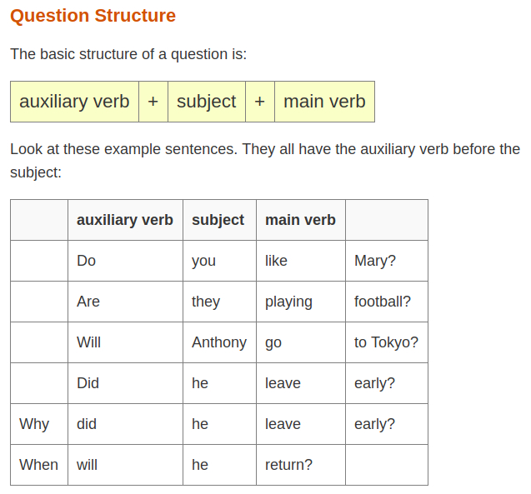

Slide 9
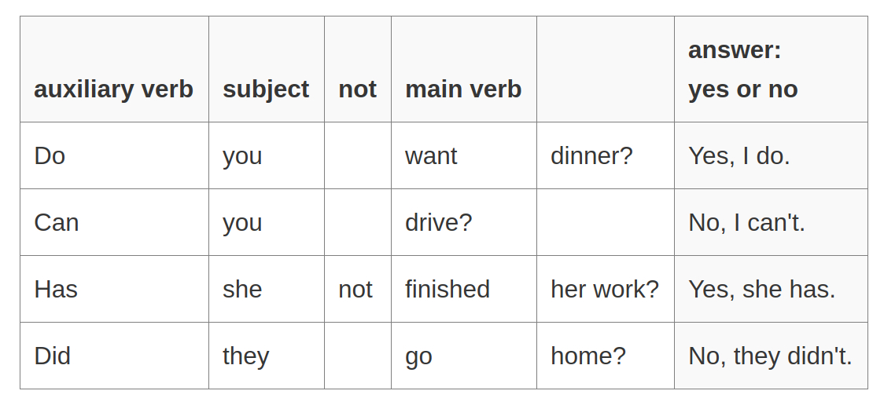

Slide 10
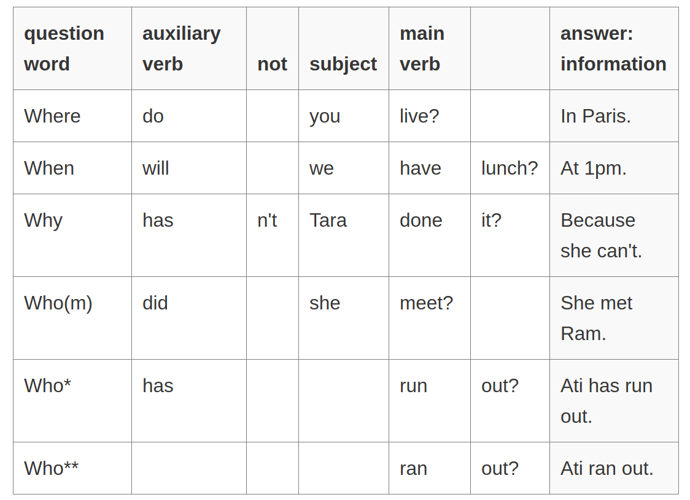

Slide 11
What? Which? (to ask about things)
Where? (to ask about locations)
Who? (to ask about people)
When? (to ask about time)
Why? (to ask for the reason)
How? (to ask about the way things happen or are done)
How many? How much? How often? (to ask about the number or amount)

Slide 12
I could have reserved a seat
Could I have reserved a seat?
They arrived at six o’clock.
Did they arrived at six?
When did they arrive?
What time did they arrive?
Who paid? = Who did pay money?
Following are look like a question but there role is different
Suggestion: Shall we take the early train?
Asking permission: Can I help you?

Slide 13
When Question words (Wh) are subject
Wh + Finite Verb
Wh + Auxiliary Verb + Subject + Finite Verb
Who write a letter?
What happens next?
How many people know the secret?
How
How can express means or manner
How do you open the door?
How wide is the river?
How soon can you let me know?
How is that?
How much money do you need?
How often do you play?
t

Slide 14
Question or Question Phrase
How often = Frequent
How much = Amount or Quantity
How long = Time
How many = Quantity
How could = Solution
Who what and which
Who refers to people.
Which refers to people or non-human
We use what, when there is an indefinite — number of possible answers
We use which when is a definite possible answer.
What newspaper do you read?
Which newspapers do you read?
t

Slide 15
Who what and which
What = Many possible answers. You can choose anything
Which = There are options. We have to choose.
What do you want to eat for lunch? // you can choose anything
Which do you want to eat? // Sandwich or Cake
Are you coming back today or tomorrow? Tomorrow or Today
Why pay more = Why should I pay more?
Why the panic? What is the reason for panic?
Who knows “who knows” as a phrase or an expression, not a question”
How come you're a reporter? // How it is possible that you can be a reporter.

Slide 16
Question: How warm is the water?
Exclamation: How warm the water is!
How lucky you are!
How lucky are you?
How we laughed!
How quickly the time passed!
What a journey we had!

