Slide 1
Present Perfect or Past Simple
Present Perfect
Rule: 1
You can not use present perfect if you mention time.
Rule: 2
When action is important than time, then use present perfect else use past simple

Slide 2
Present Perfect or Past Simple
The choice depends on whether the speaker sees the action related to present or as in the past
The shop has just opened. // So its open now
The shop opened last week. // Now close. Time is equally important with action.
It has been windy this morning // The morning is not yet over.
It was windy this morning // It is afternoon or evening or later day. Time is important to mention.
It has been windy today. // The day is not yet over.
It was windy today. // The day is over

Slide 3
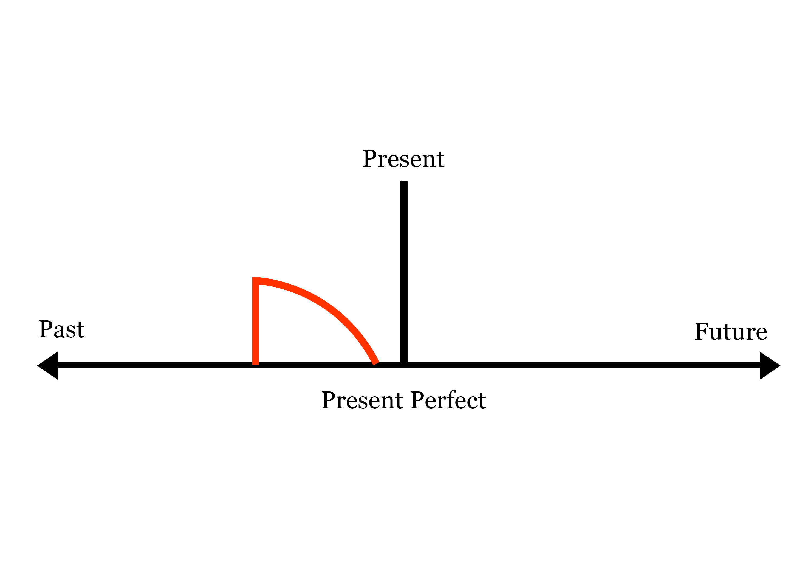

Slide 4
