Slide 1
Sentence Subject Complement
Minimum requirement to make a sentence
Subject + Verb.
I write.
We write.
You write.
They write.
He/She writes
Kevin writes.
It writes.
The writer wriets.
Peter, Kevin, He, She, It are Third person singular number.
I write a book.
I = I is Subject which is personal pronoun.
write a book = Predicate.

Slide 2
Sentence Subject Complement
Minimum requirement to make a sentence
Subject + Verb.
I write.
We write.
You write.
They write.
He/She writes
Kevin writes.
It writes.
The writer wriets.
Peter, Kevin, He, She, It are Third person singular number.
I write a book.
I , I is Subject which is personal pronoun.
write a book = Predicate.

Slide 3
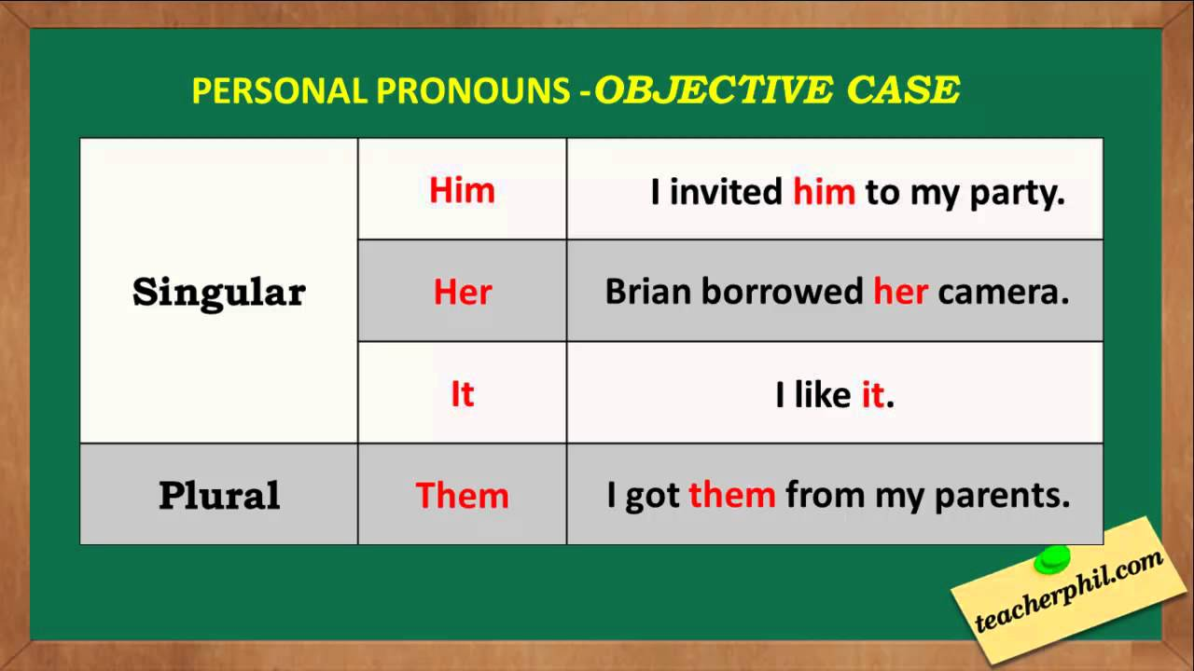

Slide 4
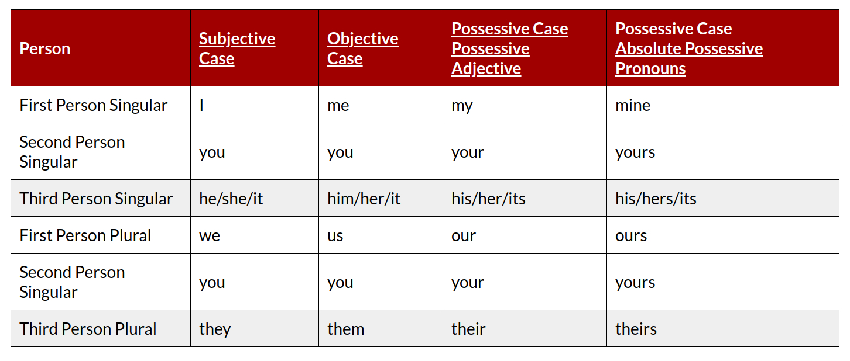
He is taller than me.
He is taller than I.
Complement

Slide 5
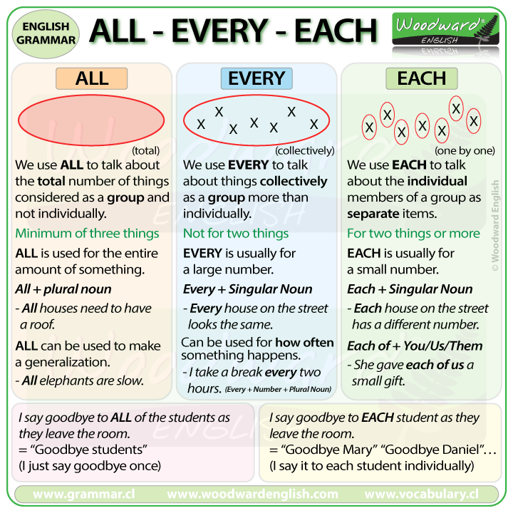

Slide 6
Nobody lives there.
Nobody live there.
Every country has a national flag.
All countries have a national flag.
Everybody needs to live in a society
Every soldier and every sailor has a rifle.
Each child has received a present.
Every person needs to work to lead a life

Slide 7
The mouse eats cheese.
My sister likes to listen music.
The family is going to Sydney tomorrow. (British)
The family are going to Sydney tomorrow. (American)
A box of chocolates is on the table.
A box of chocolates are on the table.
My partner and I are very interested in renting your garage.
My partner and I am very interested in renting your garage.
A lot of people speak English.
A lot of people speaks English.
People, Police are plural.
The police want to talk to anybody who saw the accident.
The team wants to arrange a meeting.

Slide 8
He is taller than me.
He is taller than I.
Complement
He is a student.
Honey tastes sweets.
He is handsome.
He is poor.
No object here, they are called complement as it describes subject.
Subject | Object | Possessive
I | Me | My
He/ Hasan | Him | His
She/ Julia | her | her

Slide 9
Linking words
However
We use ‘however’ and ‘nevertheless’ to express a contrast.
Usually, the first half of a sentence contrasts (opposes) the second half.
However is closer to ‘but’ and Nevertheless is closer to ‘in spite of’
Nevertheless emphasizes a stronger contrast than however.
Example
I already knew a lot about the subject; however, his presentation was still interesting.
I have already told on this topic. However, I am going to recapitulate once again what I told.
This is one solution to the problem. However, there are a number of others.
I'm a vegetarian. However, sometimes I eat fish.
I'm a vegetarian. Sometimes, however, I eat fish.

Slide 10
Nevertheless (তবুও)
Many know that too much sugar is bad for health. Nevertheless, many continue to eat a lot of it every day.
There are several serious problems with the car. Nevertheless, we will have to use it to drive to work this week.
Unless ( Condition or শর্ত )
The guard will not allow you to enter the theatre unless you show the ticket.
I will not go unless Peter gives my phone.

Slide 11
In addition
Players in Ac Milan are all good footballers. In addition, many of them have years of experience playing together.
He is kind, helpful and generous person. In addition, he is a sportsmen.
He is an popular actor. In addition, he often conducts program act as an anchor.

Slide 12
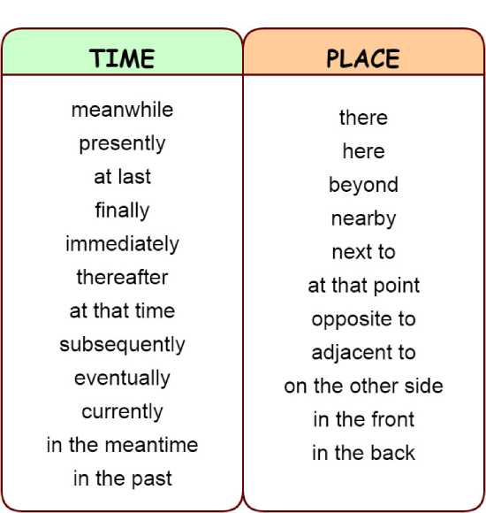

Slide 13
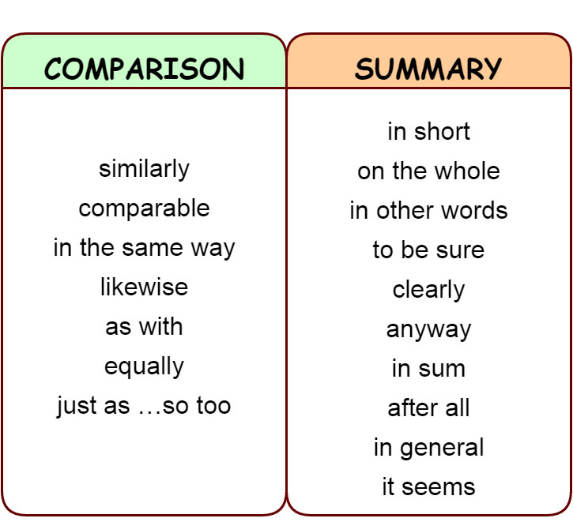

Slide 14
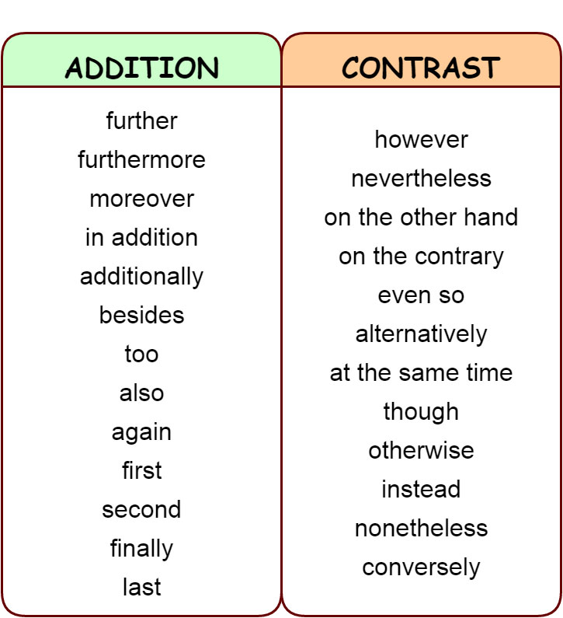

Slide 15
Phrasel Verb
1. Look after – Watch or protect; to keep safe
He look after his parents meticulously.
2. Look into – Investigate, explore, or consider
The college principal promised to look into the matter.
They set up a working party to look into the issue.
3. Look for = to search / to try to find
Peter is looking for a new job.
The detective is looking for clues to solve the case.

