Slide 1

Adjective clause

Slide 2
Clause
A clause is a structure that has a subject and a verb. There are two kinds of clauses: independent and dependent.
An adjective clause, also known as an adjectival clause, is a type of dependent clause that works to describe a noun in a sentence. It functions as an adjective even though it is made up of a group of words instead of just one word. In the case of an adjective clause, all the words work together to modify the noun or pronoun.

Slide 3
All adjective clauses are dependent clauses. A dependent clause is a group of words that consists of a subject and a verb, yet it is not a complete sentence that can stand alone. Adjective clauses begin with a relative pronoun, which connects them to the word they describe, such as:
that
where
when
who
whom
whose
which
why

Slide 4
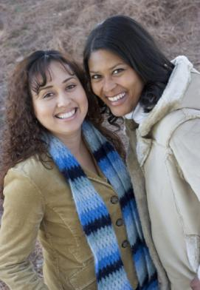
12-1 ADJECTIVE CLAUSES: INTRODUCTION
I have a terrific friend
who is very kind.
Notes:
<number>

Slide 5
12-1 ADJECTIVE CLAUSES: INTRODUCTION
adjective + noun
11-10 CPITALIZATION
(a) I have a terrific friend.
adjective + noun
(b) I have a thoughtful friend.
adjective modifies noun
Notes:
<number>

Slide 6
12-1 ADJECTIVE CLAUSES: INTRODUCTION
adjective + noun
11-10 CPITALIZATION
(a) I have a terrific friend.
adjective + noun
(b) I have a thoughtful friend.
adjective noun
(usually)
Notes:
<number>

Slide 7
12-1 ADJECTIVE CLAUSES: INTRODUCTION
noun + adjective clause
11-10 CPITALIZATION
(c) I have a friend who is always cheerful.
noun + adjective clause
11-10 CPITALIZATION
(d) I have a friend who is a doctor.
noun + adjective clause
11-10 CPITALIZATION
(e) I have a friend who lives next door.
adjective clause modifies noun
Notes:
<number>

Slide 8
12-1 ADJECTIVE CLAUSES: INTRODUCTION
noun + adjective clause
11-10 CPITALIZATION
(c) I have a friend who is always cheerful.
noun + adjective clause
11-10 CPITALIZATION
(d) I have a friend who is a doctor.
noun + adjective clause
11-10 CPITALIZATION
(e) I have a friend who lives next door.
noun adjective clause
Notes:
<number>

Slide 9
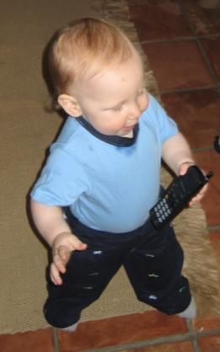
12-2 USING WHO AND WHOM IN ADJECTIVE CLAUSES
The boy who has the phone
is adorable.
Notes:
<number>

Slide 10

12-2 USING WHO AND WHOM IN ADJECTIVE CLAUSES
(a) The child is adorable.
He has the phone.
(b) The child is adorable.
who has the phone
is a subject pronoun
he
is a subject pronoun
who
who
he
adjective clause
Notes:
<number>

Slide 11
12-2 USING WHO AND WHOM IN ADJECTIVE CLAUSES
(a) The child is adorable.
(b) The child is adorable.
who has the phone
INCORRECT: The child is adorable
who has the phone.
noun adjective clause
Notes:
<number>

Slide 12
12-2 USING WHO AND WHOM IN ADJECTIVE CLAUSES
(c) The child was funny.
I saw him.
(d) The child was funny.
whom I saw
him
is an object pronoun
is an object pronoun
whom
whom
him
adjective clause
Notes:
<number>

Slide 13
12-2 USING WHO AND WHOM IN ADJECTIVE CLAUSES
(c) The child was funny.
(d) The child was funny.
who has the phone
noun + adjective clause
INCORRECT: The child was funny who has the phone.
Notes:
<number>

Slide 14
12-1,12-2 LET’S PRACTICE
who
two sentences one sentence
Jonah is in my English class.
He is an excellent student.
who is an excellent student
is in my English class.
Jonah
Notes:
<number>

Slide 15
12-1,12-2 LET’S PRACTICE
who
two sentences one sentence
Mary is an artist.
She is very talented.
who is very talented
is an artist.
Mary
Notes:
<number>

Slide 16

12-1,12-2 LET’S PRACTICE
Ø
two sentences one sentence
We see the vendors.
They are working in the floating market.
The vendors
whom we see are
working in the floating market.
Notes:
<number>

Slide 17
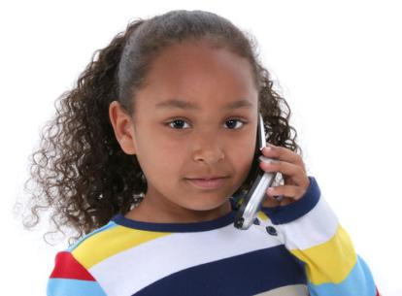
12-3 USING WHO, WHO(M), AND THAT IN ADJECTIVE CLAUSES
The girl that has the phone
is friendly.
Notes:
<number>

Slide 18
12-3 USING WHO, WHO(M), AND THAT IN ADJECTIVE CLAUSES
(a) The girl is friendly.
(b) The girl is friendly.
who has the phone
same
meaning
(c) The girl that has the phone is friendly.
INCORRECT: The girl has the phone is friendly.
Notes:
<number>

Slide 19
12-3 USING WHO, WHO(M), AND THAT IN ADJECTIVE CLAUSES
(a) The child is adorable.
He has the phone.
(c) The child is adorable.
that has the phone
is a subject pronoun
He
can be the subject
that
that
He
adjective clause
Notes:
<number>

Slide 20
12-3 USING WHO, WHO(M), AND THAT IN ADJECTIVE CLAUSES
S
O
(d) The child was funny. I knew her.
who(m)
that
(e) The child was funny.
who(m) I knew
(f) The child that I knew was funny.
(g) The child Ø I knew was funny.
object pronoun can be omitted
from adjective clause
Notes:
<number>

Slide 21
12-3 LET’S PRACTICE
?
CORRECT
OR
INCORRECT
The people who(m) I met last night
were really funny.
Notes:
<number>

Slide 22
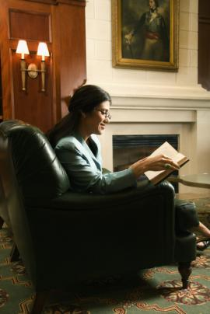
12-3 LET’S PRACTICE
?
CORRECT
OR
INCORRECT
The woman is reading is my sister.
Notes:
<number>
Animation is off.

Slide 23
12-3 LET’S PRACTICE
?
CORRECT
OR
INCORRECT
The woman that is reading is my sister.
Notes:
<number>
Animation is off

Slide 24
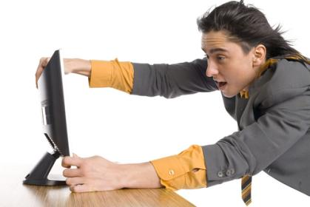
12-4 USING WHICH AND THAT IN ADJECTIVE CLAUSES
The computer that I just bought is really fast.
Notes:
<number>

Slide 25
12-4 USING WHICH AND THAT IN ADJECTIVE CLAUSES
s v
(a) My computer is really fast. It is new.
s v
(b) My computer which is new is really fast.
s v
(c) My computer that is new is really fast.
which things
that people / things
who, whom people
Notes:
<number>

Slide 26
12-4 USING WHICH AND THAT IN ADJECTIVE CLAUSES
(a) My computer is really fast. It is new.
(b) My computer which is new is really fast.
(c) My computer that is new is really fast.
It
which
adjective clause

Slide 27
12-4 USING WHICH AND THAT IN ADJECTIVE CLAUSES
(a) My computer is really fast. It is new.
(b) My computer which is new is really fast.
(c) My computer that is new is really fast.
It
that
adjective clause

Slide 28
12-4 USING WHICH AND THAT IN ADJECTIVE CLAUSES
(a) That computer is really fast. It is new.
(b) That computer which is new is really fast.
(c) That computer that is new is really fast.
INCORRECT: That computer is new is really fast.

Slide 29
12-4 USING WHICH AND THAT IN ADJECTIVE CLAUSES
s v o
(d) The old car needs work. I drive it.
o s v
(e) The old car which I drive needs work.
o s v
(f) The old car that I drive needs work.
s v
(g) The old car Ø I drive needs work.
which, that object in adjective clause
Notes:
<number>

Slide 30
12-4 USING WHICH AND THAT IN ADJECTIVE CLAUSES
(d) The old car needs work. I drive it.
(e) The old car which I drive needs work.
same meaning
(f) The old car that I drive needs work.
same meaning
(g) The old car Ø I drive needs work.

Slide 31
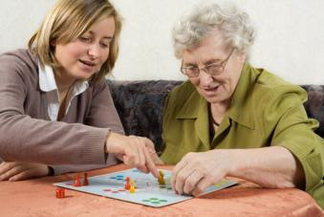
12-4 LET’S PRACTICE
which
two sentences one sentence
We played a game. The game was fun.
The game
which we played
was fun.
Notes:
<number>

Slide 32
12-4 LET’S PRACTICE
Ø
two sentences one sentence
We played a game. The game was fun.
The game
we played
was fun.
Notes:
<number>

Slide 33
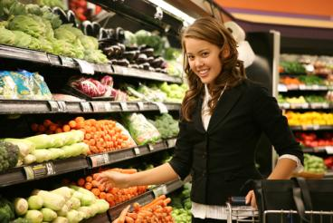
12-4 LET’S PRACTICE
that
two sentences one sentence
Where is the supermarket?
It sells great produce.
Where is
the supermarket
that sells great produce?
Notes:
<number>

Slide 34

12-5 SINGULAR AND PLURAL VERBS IN ADJECTIVE CLAUSES
I have a friend who is a wonderful gardener.
Notes:
<number>

Slide 35
12-5 SINGULAR AND PLURAL VERBS IN ADJECTIVE CLAUSES
(a) I have a friend who is a wonderful gardener.
singular noun singular verb
Notes:
<number>

Slide 36
12-5 SINGULAR AND PLURAL VERBS IN ADJECTIVE CLAUSES
(b) I have friends who are wonderful gardeners.
plural noun plural verb

