Slide 1
Our car broke down and we had to push it.
Tuhin grew up in a small town.
They are looking into the problem.
Hasan gave up smoking.
Scientists who carry out controversial research are often criticized in the media.
Our car stopped functioning and we had to push it.
Hasan stopped smoking.
They are investigating the problem.
Tuhin was live in a small town.

Slide 2
Phrasal Verb
A phrasal verb consists of a verb together with a preposition or adverb that modifies the sense of the same one.
Transitive Phrasal verbs take any object
Intransitive Phrasal Verbs do not take any object.
A phrasal verb = a verb + a particle
For example: put off
Put = verb
off = particle
I put off my trip. = I postponed my trip.

Slide 3
Common Phrasal verb that we use regularly
I look after of my parents.
I take care of my parents.
The pen has run out.
I have run out of time.
His mother passed away last week.
His mother died last week.
Take time to shop around for the best deal.
His wife stood by him during the war.
I will call you back later.
I can figure out how to do this.

Slide 4
The government has promised to uphold the principles of democracy.
The freedom of the press must be upheld.
I don't know how he puts up with their constant complaining.
Japanese footballers did not give in.
You should carry out your duty properly.
Dr Carter is carrying out research on early Christian art.
It is important to point out that it is not only major factor.

Slide 5
Let's put off the meeting until Friday.
Let's postpone the meeting until Friday.
Please take off your shoes when you enter the temple.
Please remove your shoes when you enter the temple.

Slide 6
put + off = postpone
put + on = to cover your body with clothes
put + back = to return something to its original place
put + away = to put something in its original place
I ran into my teacher at the movies last night.
run + into = meet
He ran away when he was 15.
run + away = leave home
Some phrasal verbs have more than one meaning.
keep on = to continue
keep on = not to remove something
take off = remove
take off = leave

Slide 7
There are two kinds of phrasal verbs
1. separable
2. inseparable
I am going to take on the project.
I am going to take the project on.
Separable
A phrasal verb is said to be separable when a noun or pronoun object can come between the verb and the particle that make up the phrasal verb.
Please turn off the TV. // the tv is a noun.
Please turn it off. // it is a pronoun
Tea companies have put up the prices.
Tea companies have put the prices up.

Slide 8
Some phrasal verbs have more than one meaning.
keep on = to continue
keep on = not to remove something
take off = remove
take off = leave
Preposition
go out
go after
Adverbs
go together
go away
She was looking for her books when he arrived.

Slide 9


Slide 10
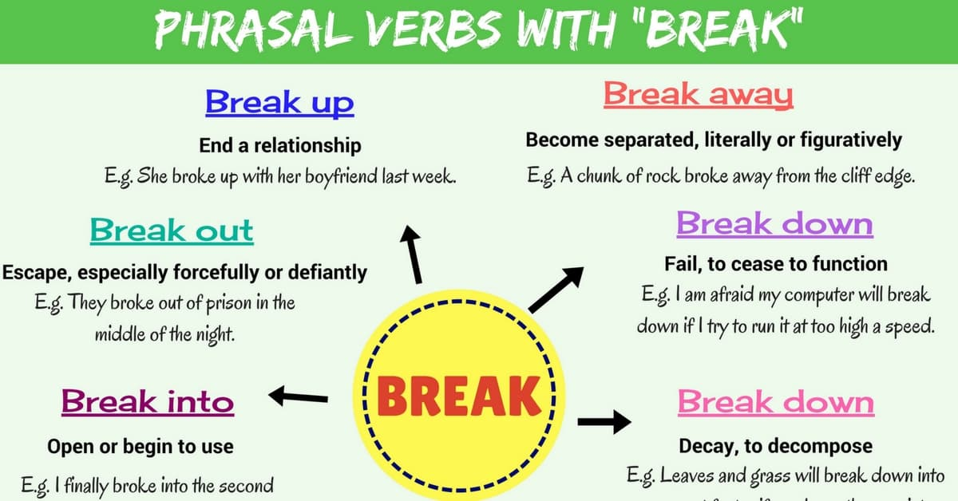

Slide 11

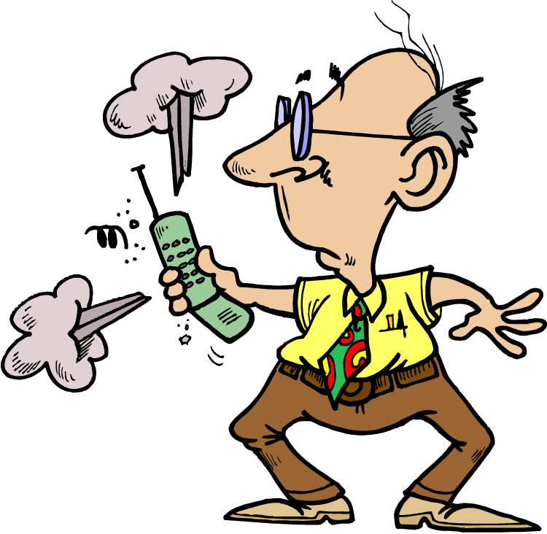
Cell Phone Help Line
This is my first cell phone. I’m trying to figure it out. I looked over the directions, but I’m still confused. When I make a phone call, all the buttons on the phone light up, and I don’t know what to do. Help!
Every time I want to call up someone on this cell phone, the phone cuts me off. I just heard a strange sound. I’m afraid this phone is going to blow up! Please help me out!

Slide 12

Transitive Phrasal Verbs 1
Most transitive phrasal verbs are separable. This means that noun objects can go after the particle or between the verb and the particle.
He can’t figure out the instructions.
noun object
He can’t figure the instructions out.
noun object

Slide 13
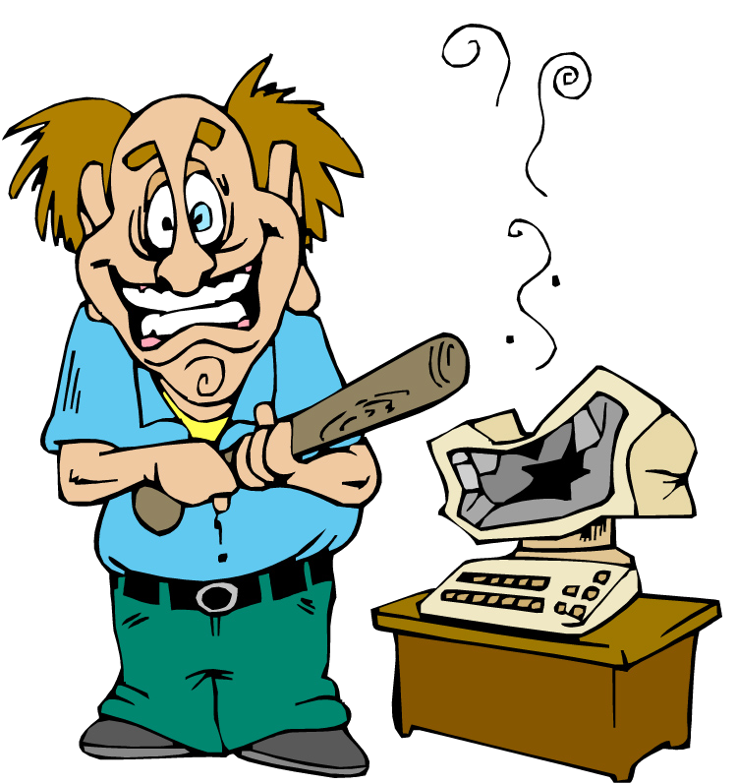
Be Careful!
If the direct object is a pronoun, it must go between the verb and the particle.
I turned off it.
I turned it off.

Slide 14
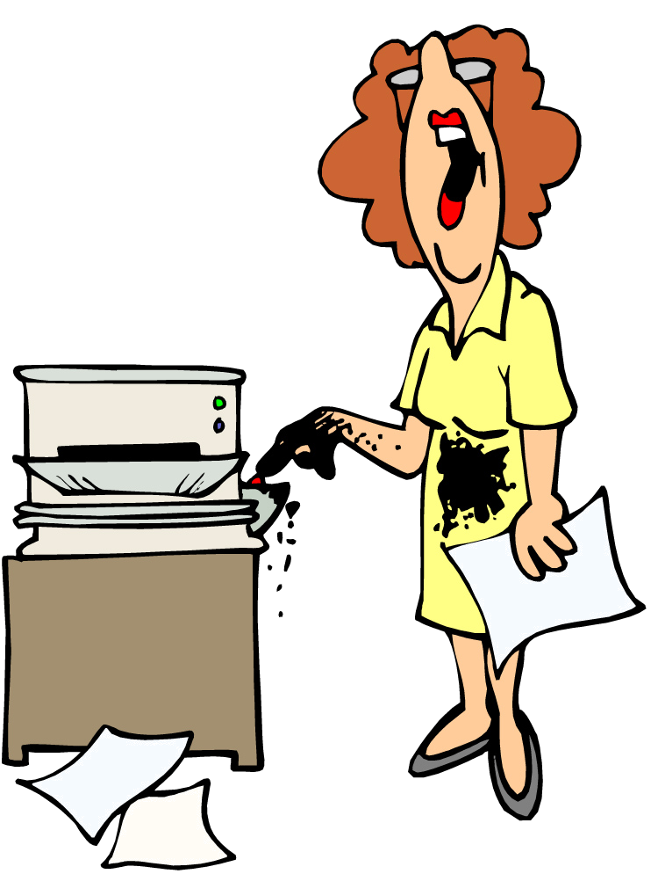
Practice 4
Use the intransitive phrasal verbs to describe your experiences with different forms of technology.
Example:
run out = not have enough
Last week the photocopy machine ran out of toner.
1.
close down = stop operating
4.
play around = have fun
2.
call back = return a call
5.
empty out = empty completely
3.
blow up = explode
6.
sign up = register

Slide 15
Step
step down
step up
step on
step back
step aside
step forward
step out
step in
step around

Slide 16
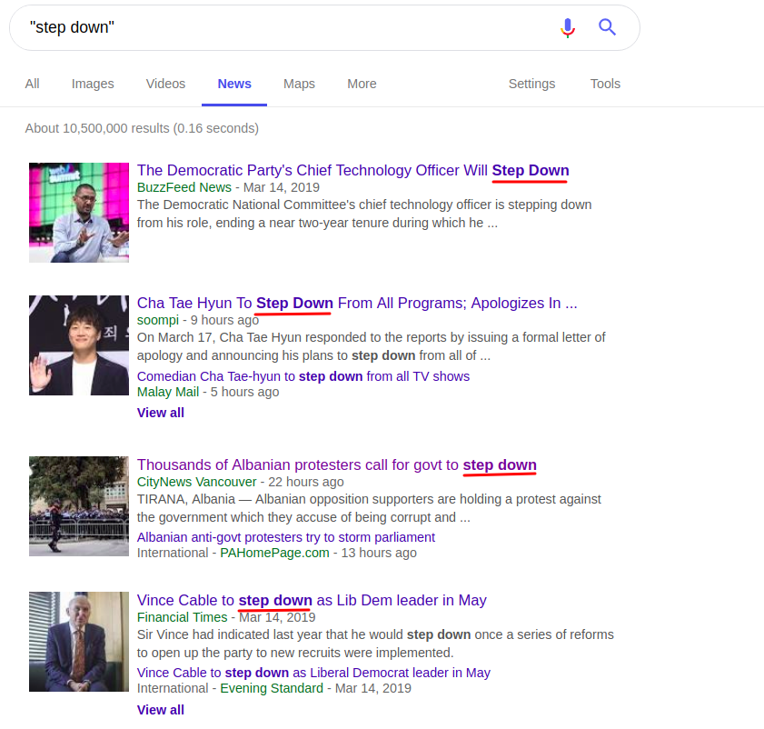

Slide 17
Security is being stepped up to deal with the increase in violence.
The chairman was forced to step down due to ill health.
Thousands of Albanian protesters call for govt to step down.
We should step back and try to see how our customers will view the scheme.
step back // Look at something from a different perspective
The politician step around the question.

Slide 18
down
break
fall
put
sit
tear
turn
write
Notes:
<number>

Slide 19
up
break
bring
call
cheer
clean
dress
fill
get
give
grow
hang
look
make
pick
show
speak
stand
stay
tear
turn
Notes:
<number>

Slide 20
back
bring
call
come
get
give
go
pay
put
sit
take
turn
Notes:
<number>

Slide 21
on
call
get
go
have
leave
put
try
turn
Notes:
<number>

Slide 22
off
call
get
lay
put
shut
turn
Notes:
<number>

Slide 23
in
come
fill
get
hand
Notes:
<number>

Slide 24
over
get
go
look
start
talk
think
turn
Notes:
<number>

Slide 25
Review
Three Word Phrasal Verbs

Slide 26
with
of
come along
fool around
get together
get along
get through
hang around
hand out
drop out
get out
move out
run out
tear out
Notes:
<number>

Slide 27
to
from
come over
go back
go over
move in
get back
keep away
Notes:
<number>

Slide 28
out
ask
blow
break
cross
eat
figure
fill
find
go
hand
help
point
print
put
take
throw
Notes:
<number>

