Slide 1
Noun
Noun: Name, Place, Things

Slide 2
Kinds of Noun
1) Proper noun
A particular person, place, or thing, e.g. Steven, Africa, London, Monday. In written English, proper nouns begin with capital letters.
2) Common noun
That refers to people or things in general, e.g. boy, country, bridge, city,

Slide 3
3) Collective nouns Collective nouns refer to groups of people or things, e.g. audience, family, government, team, jury.
4) Abstract noun
which refers to ideas, qualities, and conditions - things that cannot be seen or touched e.g. truth, danger, happiness, time, friendship.

Slide 4
5) Material noun
It is the name of material from which different things can be made e.g. milk, gold, wood
6) Countable noun
Those that can be countable: Pen, Paper, Table,
7) Uncountable noun
Those that can’t be countable: Water, Sugar, Hair

Slide 5
Pronoun
A word that is used instead of noun is called Pronoun.
Kinds of Pronoun
1. Personal pronoun: I, you, we, me
We are playing football.
Possessive Pronouns
Possessive Pronouns
2. Reflexive pronoun: myself, yourself
He hurt herself.
3. Relative pronoun:
The man who drive the car is my uncle.

Slide 6
4. Demonstrative Pronouns
This is Tanzina.
5. Interrogative Pronouns
What is your name?
6. Indefinite pronoun:
Anybody can do it if they try.

Slide 7
7. Distributive Pronouns
Each boy was given a prize.
8. Reciprocal Pronouns
They hate each other.
Peter and Harry help one another.

Slide 8
Verb
Verbs are the action words in a sentence that describe what the subject is doing.
Verbs are state or action.
State Verbs or Non-action Verbs:
I have a car.
I have two brothers and one sister.
Hasan is a boy.
He is from France.
The book is on the table.
Hasan likes to play football.
State verbs can not be used in -ing(Continuous) forms

Slide 9
Action Verbs:
The boys are playing in the field.
He is playing football.
Julia is eating noodles.
I am having a large family.
He is liking to play football.
No continuous form for state verbs.

Slide 10
Auxilary Verbs or Helping Verbs:
Am, is, are, was, were, have, had, shall, will
Modal Verbs:
Can, must, may, might, should,
Transitive Verbs:
Which required an object
Like, want, eat. write
I want a pen.
He writes a book.
Hansa kicked a ball.

Slide 11
Intransitive Verbs:
It does not take an object.
Cry, smile, live, die, sleep, sit,
The baby is crying.
The kids smiled.
The man laughed loudly.
He is sleeping.
The thief climbed and then escaped.
The thief climbed over the wall and then escaped.
Intransitive verbs which can not be changed into passive voice.

Slide 12
Finite and non-finite verbs
When a verb has a subject and a tense, it can be referred to as a finite verb.
Simply, if we can trace the tense from verb it is called Finite Verbs, otherwise non-finite verbs.
He gives me to eat.
He gave me to eat.
He will give me to eat.
He wanted to find a solution.

Slide 13
Regular verbs and
Regular verbs form their past and past participle forms by adding –ed.
Walk – walked – walked
Dance – danced – danced
Paint – painted – painted
Work – worked – worked
Irregular verbs
put – put – put
Go – went – gone

Slide 14
Adverb
Provide information about verbs, adjectives, even whole sentence.
Answer following question
Where
When
How
How much
How often … etc
He ate the sandwich quickly.(How)
He went to school yesterday.(When)
You can park here.(Where)
I sometimes drink coffee in the morning (How often)

Slide 15
Types of Adverbs
1. Adverbs of Degree or Manner
Really, Very, Extremely, Absolutely, Loudly, quietly
2. Adverbs of Place
Here, There, Somewhere, nearby, upstairs
3. Adverbs of Frequency
I meet him daily.
She is calling me again and again.
4. Adverbs of Time
I will go to school tomorrow.
I am still waiting for my friend.

Slide 16
Opinion: Fortunately, Personally, Sadly
Generally added by ‘ly’.
Friendly, Lovely are adjectives not adverb.
Position: Beginning, Middle, and end
Fortunately, I have a car.
I often go to park.
He laughs loudly.

Slide 17
Adjective
An Adjective modifies or describes noun or pronoun.
Types of Adjectives
1. Determiners: My, Our, Her, a/an, the
2. Descriptive Adjective
Beautiful, cold, tall, short, red, blue
That’s my car.
I have a car.
The window is broken.

Slide 18
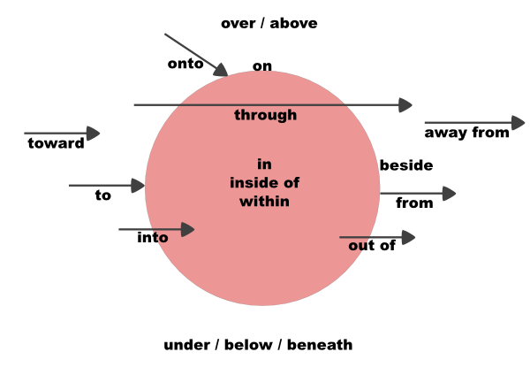
Preposition

Slide 19
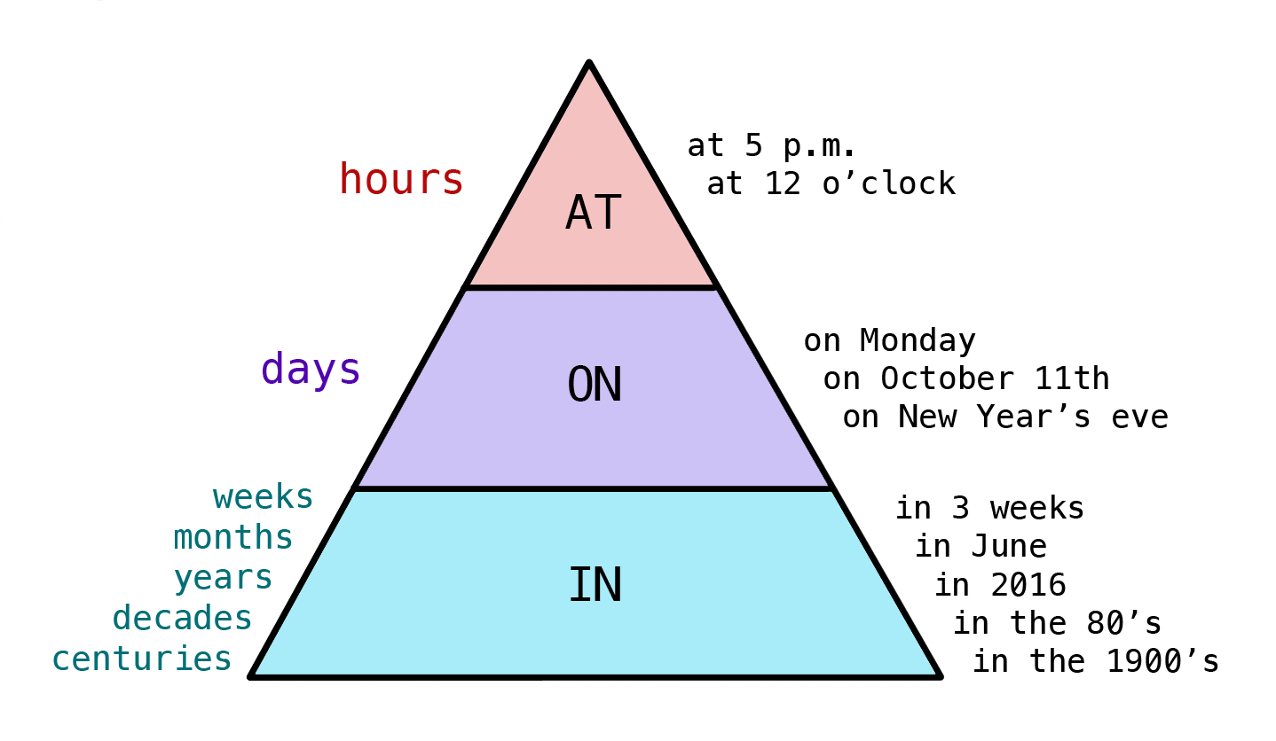
Day —————— on
Time —————— at
Year/month —————— in

Slide 20
'at' for Specific time
I start work at 8 o'clock.
I feel good in the morning
I feel bad in the evening.
I feel good at night.
He started his job on January 12, 2018.
He started his job in January 2018.
He started his job on the 1st of January 2000.
Jane is waiting for you at the bus stop.
The shop is at the end of the street.
When will you arrive at the office?
Do you work in an office?

Slide 21
I am in a taxi.
I am in the car.
I am on the train.
I am on the plain.
I am on the bus.
I ride on a motorcycle.
I ride on a horse.
I ride on an elephant.
at, in or in
at for a POINT
in for an ENCLOSED SPACE
on for a SURFACE

Slide 22
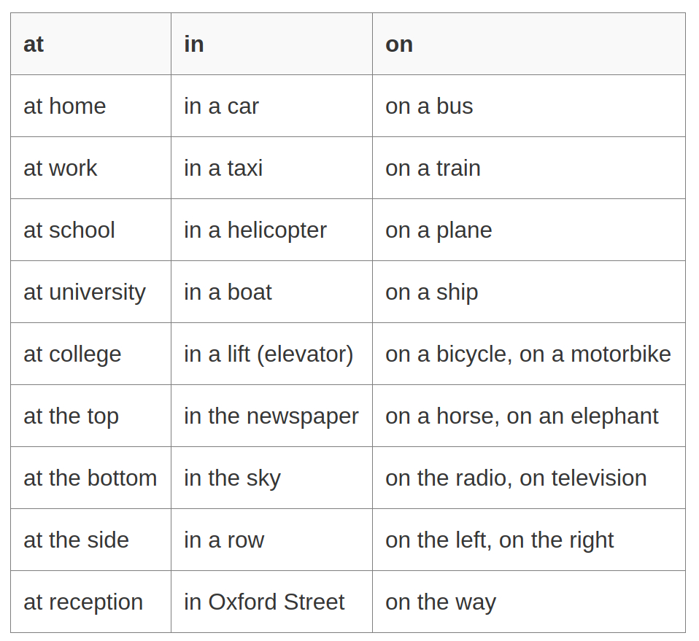

Slide 23
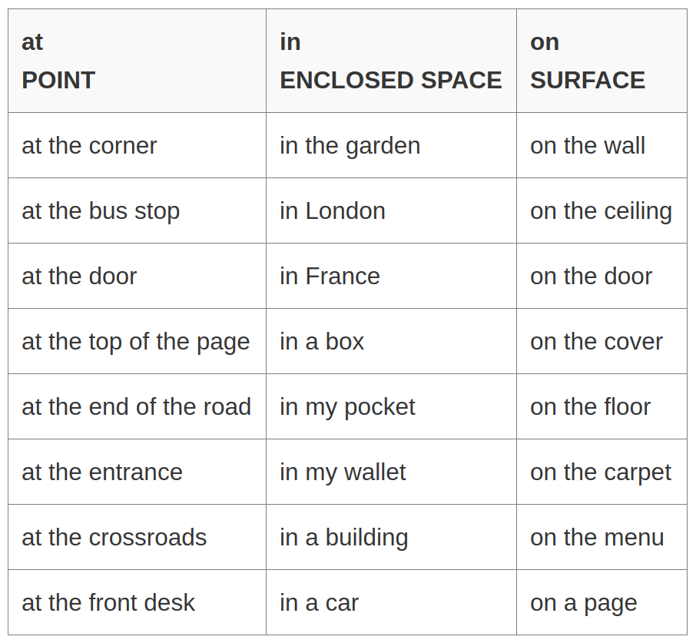

Slide 24
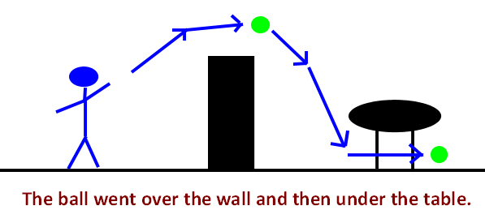
The ball went over the wall and then under the table.

Slide 25
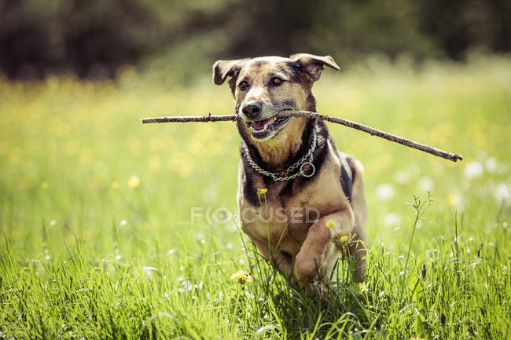
Towards is used to describe direction.
The dog is running towards me.
He kicked the ball towards the goal post.
Peter was carrying a suitcase and walking towards his friends.

Slide 26
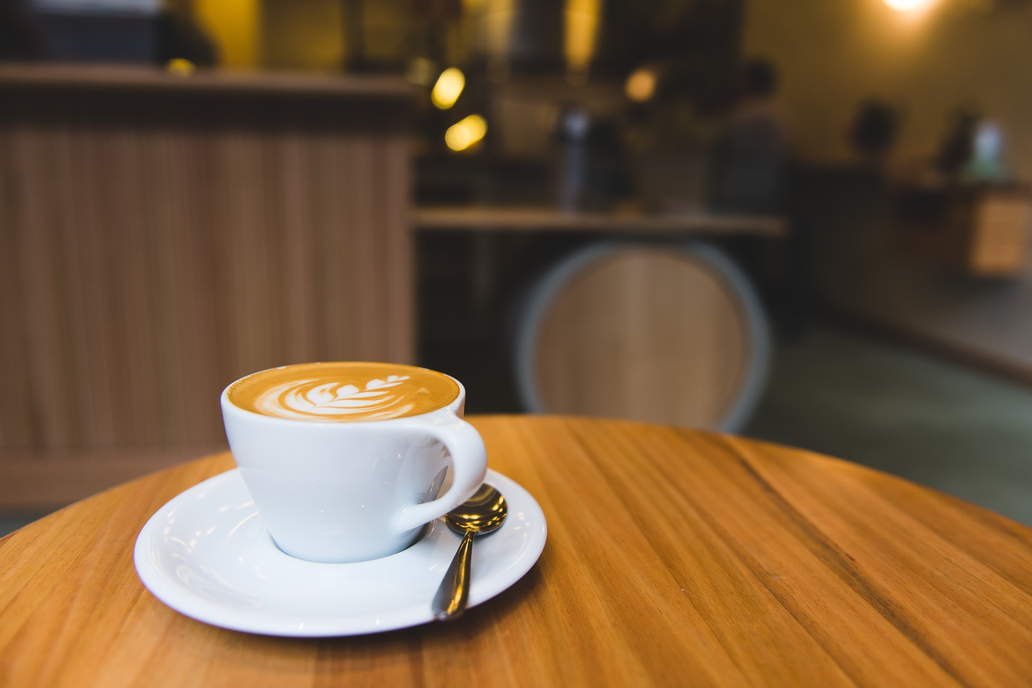
The cup is on the table

Slide 27
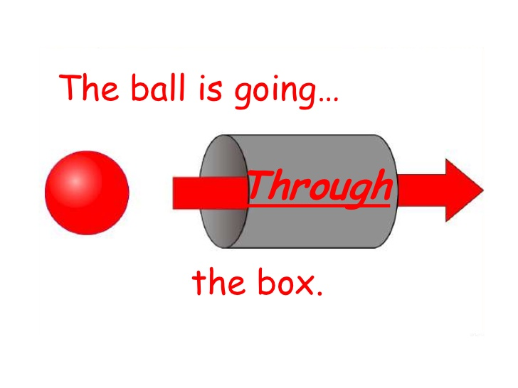
The ball is going through the box.

Slide 28
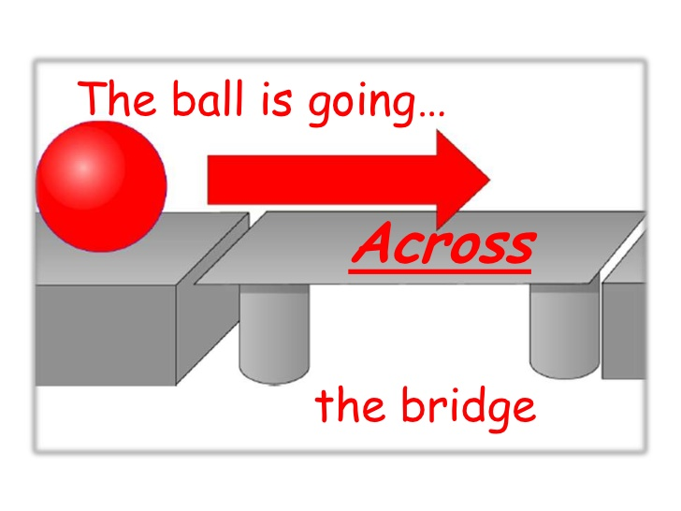
The ball is going across the bridge.

Slide 29
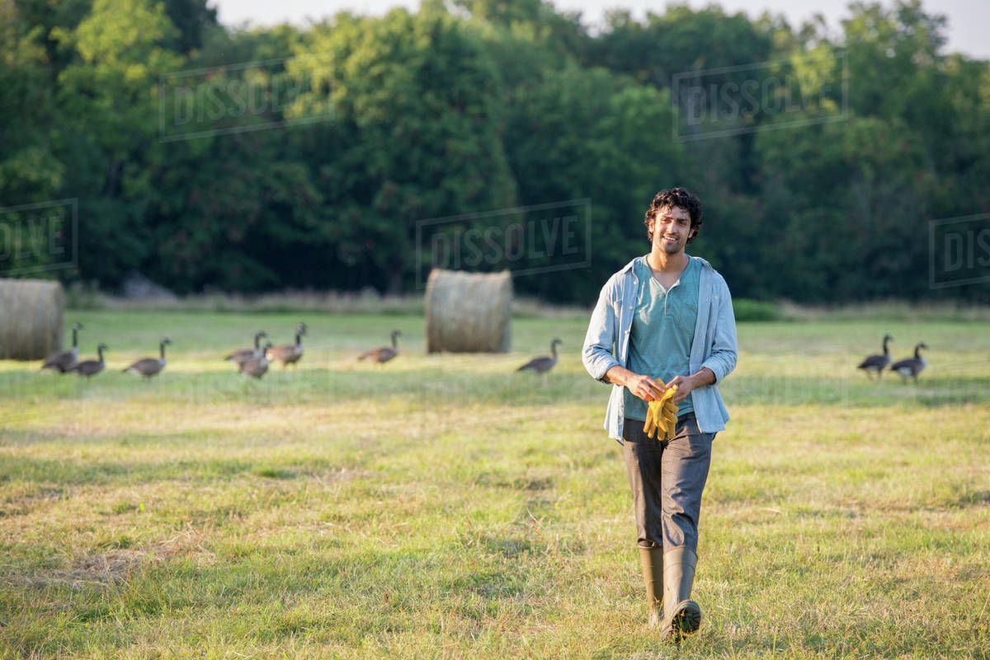
The man is walking across the field.

Slide 30
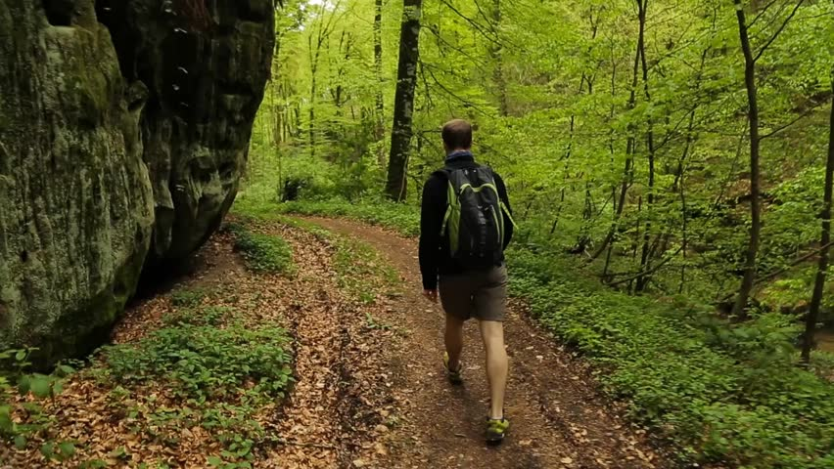
.
The man is walking through the jungle.

Slide 31
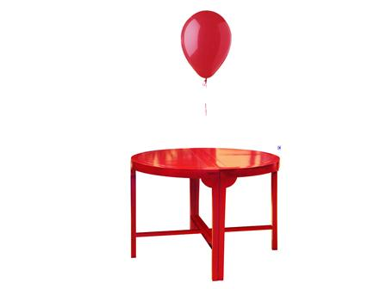
The balloon is above the table.(No movement, fixed)

Slide 32
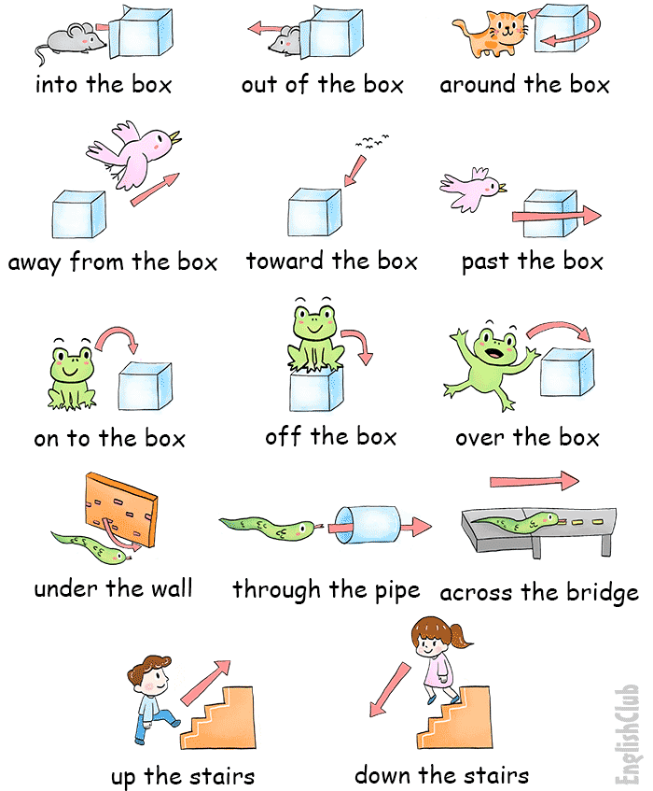

Slide 33
The rat got into the box.
The bird ran away from the cat and escaped.
The cat is moving around the box.
The frog jumped over the box
The snake goes through a tunnel.

Slide 34
Phrase Prepositions
Groups of words used with the force of a single preposition
according to
along with
away from
in course of
in front of
in order to
in place of
in case of

Slide 35
Example:
In order to avoid litigation, he accepted the offer.
There is a big tree in front of his house.

Slide 36
Why Parts of speech important
You can’t explain unless you master on
Parts of speech.
My have a pen
I have a pen.

Slide 37
To vs For
To is used when it is related to Transfer or Movement.
For is used to explain a motive/ reason.
I went to London to learn English
I went to market to buy apples.
I went to market for apples.
I made a cake for Hasan.
I gave the cake to Hasan.

Slide 38
Conjunction
Conjunctions are words that link other words, phrases, or clauses together.
Join:
Words
Phrases
Clauses
List of conjunctions :
and,
through,
after,
because,
why,
where,
when,
unless, than, that, if, till, until, as, so, yet

Slide 39
And - Similar Ideas or Equal Rank
But - Contrasting Ideas
Or - Choice
Peter came to my birthday.
Brown came to my birthday.
White did not come to my birthday.
Peter and Brown came to my birthday but White did not.
God made the country.
Man made the town.
God made the country and man made the town. (Similar)
I work quickly and carefully. (Similar)
Birds fly.
Fish swim.
Birds fly and fish swim. (Equally important)

Slide 40
I could not go to school because I was sick. (Reason)
She must weep, or she will die. (Choice)
He finished first though he began late.
Since you say so, I must believe it.
As he is is young and energetic, he can do this task easily.
He is energetic, enthusiastic and adventurous.
He is generous, kind and altruist.

Slide 41
Classification of Conjunction
1. Coordinating Conjunction
And, or, but, so, yet, for, not
2. Subordinating Conjunctions
because, after, , although, if, etc
3. Correlative Conjunction
Either, or, neither … nor
4. Conjunctive
However, Therefore, In addition

Slide 42
1.a) After he gets home from work, he likes to play badminton.
b) He likes to play badminton after he gets home from work.
2. a) Because we have an exam tomorrow, we are going to study all night.
b) We are going to study all night because we have an exam tomorrow.
Independent clause + Dependent Clause
Dependent Clause + Independent clause
A comma is inserted if dependent clause at the first.

Slide 43
How to write well?
1. Organize similar ideas and combine all the information in one sentence.
Combined this into a single sentence.
There were three men. They were poor. One day they found a bag in the jungle. The bag contained money.
It had been lost by some traveller.

Slide 44
One day three poor men found a bag of money in the jungle, which had been lost by some traveller.

Slide 45
Interjection
Wow !
Eww ! Opposite of WOW !
Hurray! I won the racec.
Argh! This car does not work.
Oops! I forgot to take the keys.

