Slide 1
Movie Taste Clustering using Linear Algebra
Spectral clustering and recommendation on MovieLens 100K
UE25MA242A: Mathematical Foundation for AI & Data Science
Mini Project | Problem 13: Social networks, clustering and eigenvalue problems
PES University, Department of CSE

Slide 2
Team Members
Achyutha N Kumar
Adithya Jayanth
PES1UG25CS020
PES1UG25CS023
Abhinav Kulkarni
Adithya S Maiya
PES1UG25CS014
PES1UG25CS026
UE25MA242A | Problem 13 | Movie taste clustering
2

Slide 3
Problem Statement
Platforms have thousands of users and movies, but each user rates only a few of them.
The ratings matrix is large, sparse and noisy.
Goal 1: find groups of users with similar taste (communities in a user network).
Goal 2: predict ratings and recommend movies a user has not seen.
Tool: linear algebra, from matrices to eigenvectors.
UE25MA242A | Problem 13 | Movie taste clustering
3

Slide 4
Data and Matrix Representation
MovieLens 100K
Ratings matrix R (200 x 200)
943 users, 1,682 movies, 100,000 ratings (1 to 5).
This is a public dataset of movies ratings, released by the GroupLens research group.
This is considered to be extremely popular, hence we decided to use it.
We keep the 200 most active users and the 200 most-rated movies.
Rows = users, columns = movies, entry = rating.
22,428 ratings observed (56.1% of the matrix filled).
Ratings are mean-centred per user; unrated cells become 0 (average opinion).
UE25MA242A | Problem 13 | Movie taste clustering
4

Slide 5
Solution Workflow
1. Data to matrix
2. RREF, rank, nullity
3. Basis selection
4. Gram-Schmidt
5. Projection
6. Least squares
7. Similarity graph
8. Eigenvectors
9. Diagonalization
10. Clusters
Navy: structure and prediction Teal: pattern discovery and final output
UE25MA242A | Problem 13 | Movie taste clustering
5

Slide 6
Matrix Simplification and Structure
Gaussian elimination / RREF
Rank and nullity
Applied to a dense 6 x 6 block of ratings.
Result: 5 pivot columns, so rank 5. The 6th movie column equals the 3rd in this block, so it is redundant.
rank(R) = 199, so nullity = 200 - 199 = 1.
The first 10 singular directions capture 32.7% of the energy: a few taste patterns explain a good share of the ratings.
UE25MA242A | Problem 13 | Movie taste clustering
6

Slide 7
Basis Selection and Gram-Schmidt
Remove redundancy
Orthogonalize
Pivoted QR picks 10 independent movies as a basis B, e.g. Pulp Fiction, Fargo, Star Wars, Grease, A Clockwork Orange.
rank(B) = 10.
Gram-Schmidt turns B into Q with orthonormal columns:
v = b - sum of (q.b) q
Check: Q^T Q = I (max deviation 3.3e-16).
UE25MA242A | Problem 13 | Movie taste clustering
7

Slide 8
Projection and Least Squares
Orthogonal projection
Least squares prediction
P = Q Q^T projects a movie's rating vector onto span(Q).
Raiders of the Lost Ark: length 12.23 = projection 8.43 + residual 8.86 (at right angles).
Solve Bw ~ y on 80% of users, predict the other 20%.
Same answer as the projection.
RMSE: baseline 0.874, least squares 0.836 (lower is better).
UE25MA242A | Problem 13 | Movie taste clustering
8

Slide 9
User Similarity Graph and Laplacian
Cosine similarity between mean-centred user rows gives S (symmetric).
Keep positive similarities as edge weights W, with no self loops, and keep only each user's 15 nearest neighbours (k-NN graph, made symmetric).
Degree matrix D: row sums of W.
Normalized Laplacian: L = I - D^(-1/2) W D^(-1/2).
L is symmetric and positive semidefinite, so its eigenvalues are real and non-negative.
UE25MA242A | Problem 13 | Movie taste clustering
9

Slide 10
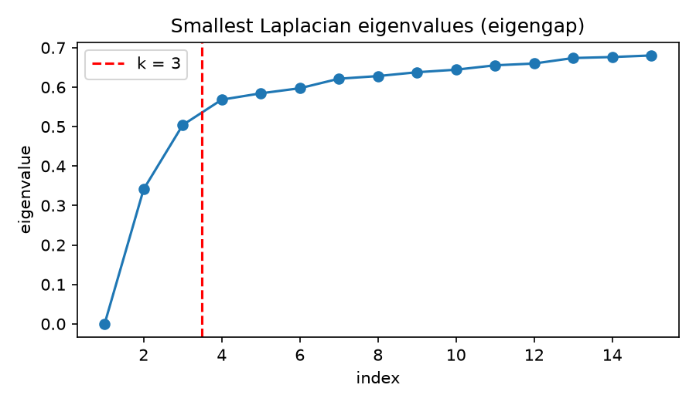
Eigenvalues, Eigenvectors, Diagonalization
Pattern discovery
Smallest eigenvalues: 0, 0.34, 0.50, 0.57, 0.58 ... The curve levels off after the 3rd, so k = 3.
Diagonalization
L = Q Lambda Q^T verified: reconstruction matches, eigenvectors orthonormal, all eigenvalues >= 0.
Eigenvalue plot: elbow at k = 3
UE25MA242A | Problem 13 | Movie taste clustering
10

Slide 11
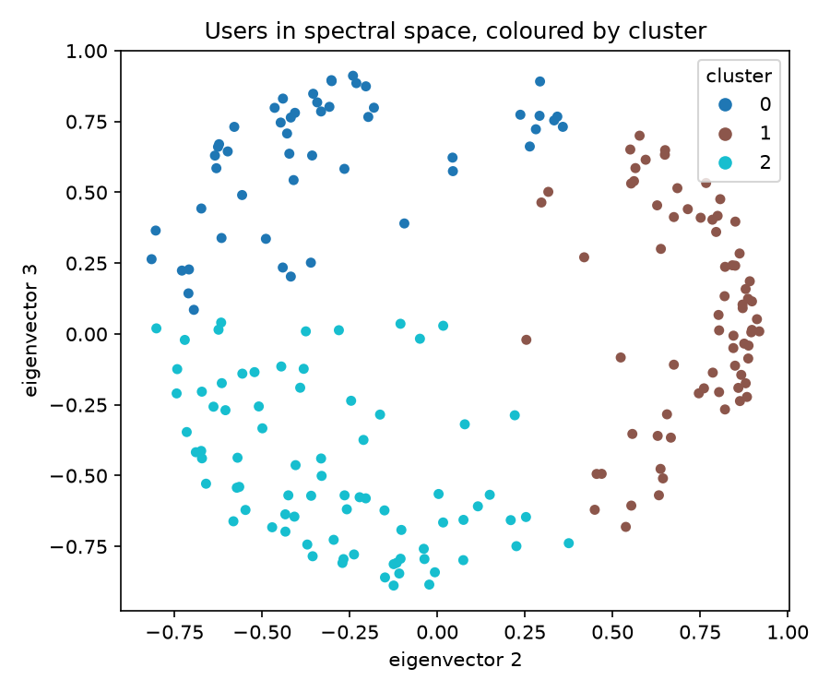
Spectral Clustering and Recommender
Embed each user using the first 3 eigenvectors (rows normalized)
k-means gives 3 clusters of 51, 71 and 78 users
The clusters are separate arcs in spectral space
Recommender: user ID, then the user's cluster, then top unseen movies of that cluster
UE25MA242A | Problem 13 | Movie taste clustering
11

Slide 12
Results: Taste Clusters
Cluster 0 (51 users)
Cluster 1 (71 users)
Cluster 2 (78 users)
Classic films
The Godfather, Casablanca, Rear Window, Citizen Kane, Psycho
Popular crowd-pleasers
Raiders of the Lost Ark, Star Wars, Titanic, Good Will Hunting
Acclaimed mix
The Usual Suspects, Shawshank Redemption, Casablanca, The Princess Bride
Demo: user 405 is in cluster 1 (rated Raising Arizona, The Fugitive, Field of Dreams highest). Recommended: Good Will Hunting, It's a Wonderful Life, Apt Pupil, Casablanca, Die Hard.
UE25MA242A | Problem 13 | Movie taste clustering
12

Slide 13
Conclusion
Rank and basis remove redundancy; projection and least squares predict ratings (RMSE 0.836 vs baseline 0.874).
Eigenvectors of a symmetric Laplacian split users into 3 taste clusters that drive recommendations.
Limitations: sparse data; missing ratings treated as average.
UE25MA242A | Problem 13 | Movie taste clustering
13

