Slide 1
CARS24 ORM Dashboard – Sell Side Analysis
Analytics & Strategy Intern Assignment | December 2024

Slide 2
Objective
Provide leadership a concise overview of customer sentiment on sell-side
Analyze online mentions across social platforms and forums
Evaluate effectiveness of ticket resolution and winback process
Identify key customer pain points and improvement areas

Slide 3
Data & Assumptions
Dummy data created for assessment purposes
Time period: December 2024
One row represents one customer mention
Tickets created mainly for negative mentions
Winback means issue resolved or post corrected
TAT measured in hours

Slide 4
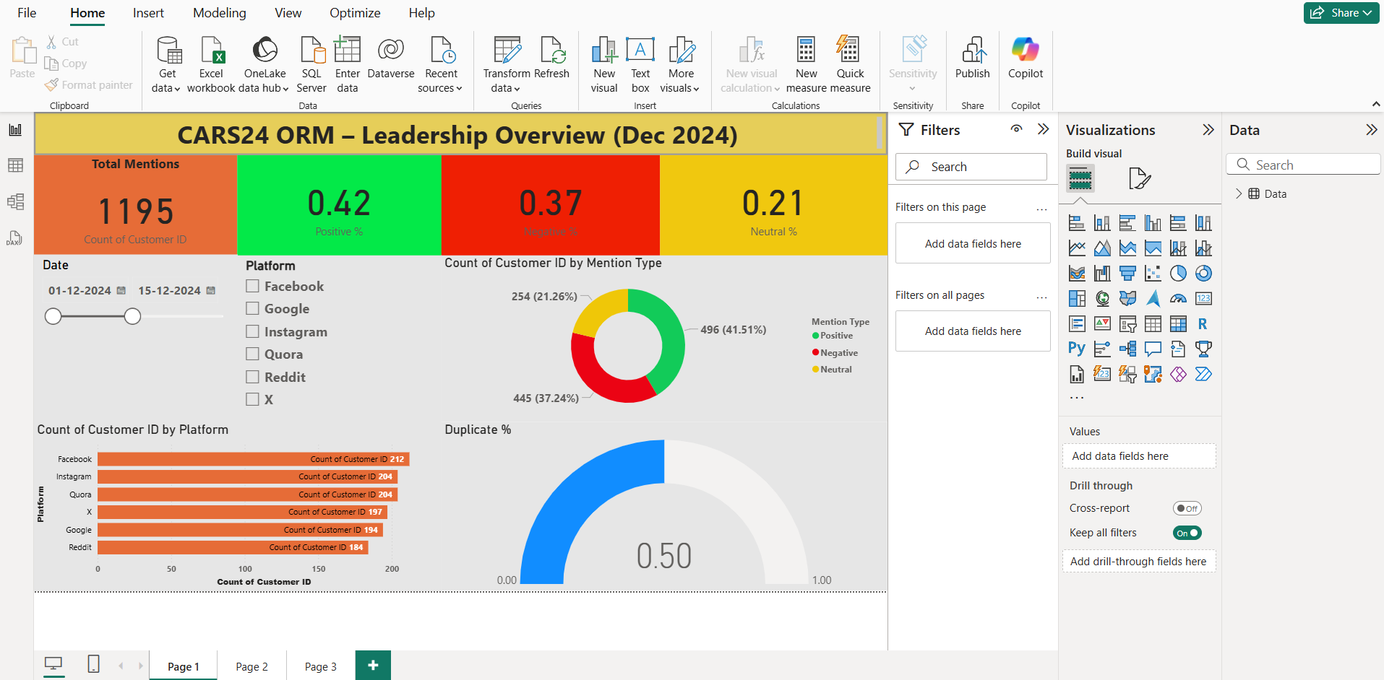
Page 1 – Leadership Overview

Slide 5
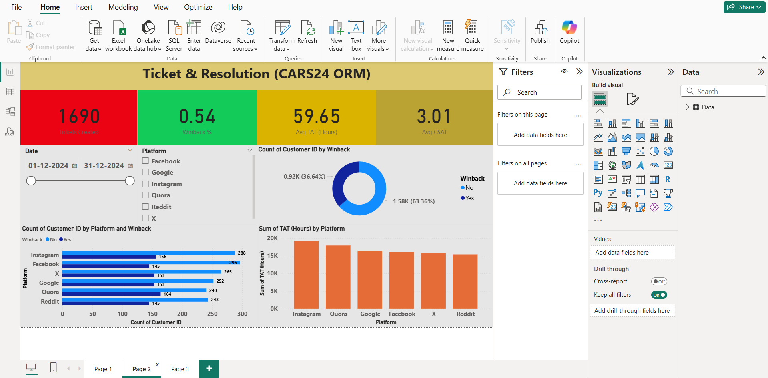
Page 2 – Ticket & Resolution

Slide 6
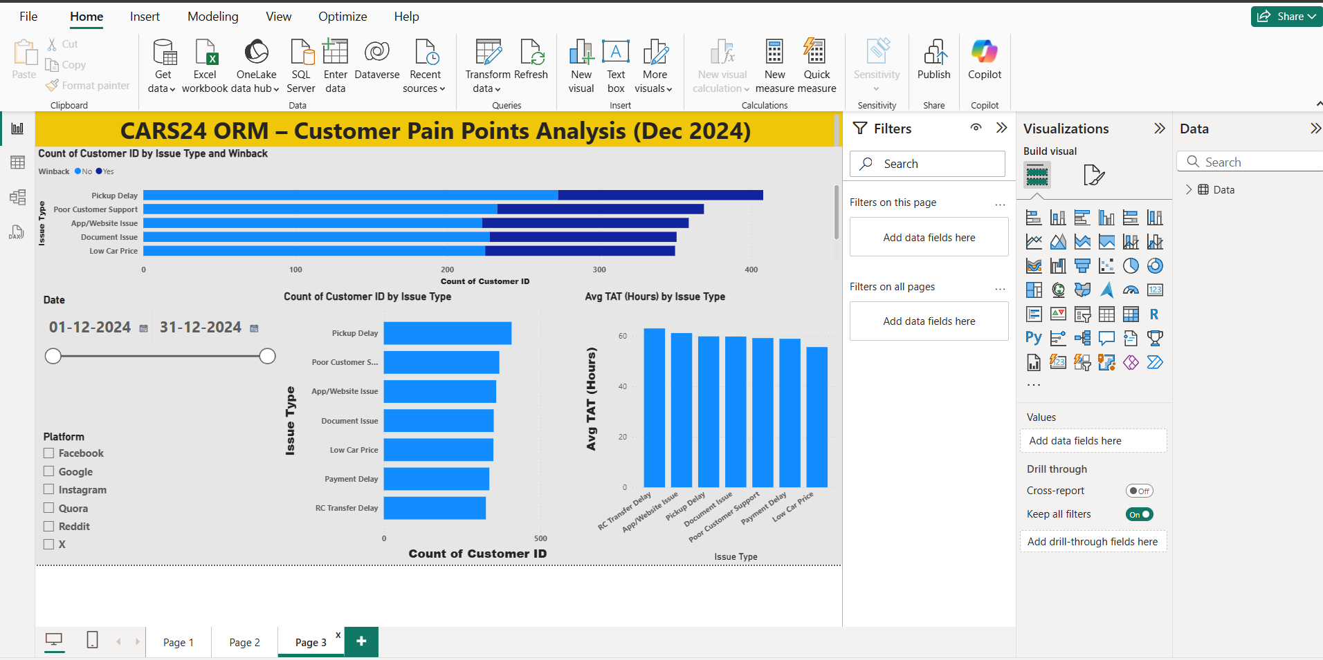
Page 3 – Customer Pain Points

Slide 7
Key Insights
Payment and pickup delays are major complaint drivers
Winback rate around 54% shows scope for improvement
Instagram and Facebook generate highest ORM volume
Higher TAT leads to lower CSAT
Duplicate mentions highlight unresolved issues

Slide 8
Recommendations
Reduce payment and pickup turnaround time
Improve RC transfer and documentation process
Focus ORM efforts on high-volume platforms
Proactively handle repeat complaints

