Slide 1





Bytewise Online Autoregressive (BOA) Constrictor for HEP data compression
Evaluation Task
-Aditya Bhattacharya

Slide 2
What The need for data compression in
high energy physics
The need for data compression in High-Energy Physics (HEP) arises from the enormous volume of data produced by modern particle detectors, such as those used at CERN. These detectors record signals from billions of particle interactions every second, generating petabytes of raw data annually. Efficient compression is therefore essential for storage, transmission, and analysis.
The Why ?
The Cause & Benefits
Maintaining Bit-Exact Scientific Fidelity
Unlike multimedia compression, HEP requires lossless compression.
Reasons:
Physics analysis depends on exact detector signals.
Any alteration could change reconstructed particle properties.
Experimental results must remain reproducible.
Efficient Storage and Archival
Raw detector streams typically have high redundancy and structured patterns due to the physical design of the detectors.
Compression helps:
Reduce storage requirements by 80–90%.
Allow large datasets to be archived for future re-analysis.
Lower infrastructure costs for distributed computing centers.
For example, achieving 0.92 bits per byte (BPB) instead of storing raw 8 BPB can reduce storage by nearly 90% while keeping data intact.
Reducing Environmental and Energy Costs :- Large-scale storage and data movement consume substantial energy.
Projects increasingly aim for “green computing”, where the energy saved by compression exceeds the energy used by the compression model itself.

Slide 3
Proposed Solution:
HybridPillar++ (Hybrid BOA)
What & Why need it:
Architecture Selection: Logic-to-Entropy Mapping
Physics-Informed Byte Streams (PIBS)
HybridPillar++ uses PINN logic to ensure data compression adheres to physical laws rather than treating bytes as arbitrary symbols.
Equivariant Mapping: Constrains the model to recognize identical physical signals regardless of their position in the byte stream.
Auxiliary Physics Loss: Penalizes predictions that violate Energy Conservation, forcing the model to discard physically impossible sequences.
Result: Narrowing the search space allows the model to hit the 0.92 BPB floor faster than unconstrained architectures.
The Efficiency Frontier (Optimization)
To process 30 PB of data, the model is optimized for high-speed hardware execution.
INT8 Quantization: Compresses the model from 32.4 MB to 12.2 MB, allowing it to run entirely within the L2/L3 GPU cache for 960 MB/s throughput.
Asynchronous CUDA Pipelining: Employs a Double Buffer approach the GPU calculates physics probabilities while a parallel Range Coder packs the previous block, reaching 1 GB/s speeds.
The Three-Pillar Structural Backbone
1. Global Context Pillar (Selective SSM/Mamba)
Tracks detector background (Pedestals) using Selective State Space Models. It maintains global memory over millions of bytes with O(1) complexity.
2. Local Precision Pillar (Sliding Window Attention)
Captures high-energy "Jets" and particle tracks via a 128-byte Sliding Window KV Cache, focusing on localized correlations missed by global models.
3. Structural Pattern Pillar (Causal Convolution) with MinGRU & Linear-RNNs
Identifies rigid hardware signatures, headers, and repeating pulse shapes using 1D-Convolutions for high-speed, low-cost pattern recognition, impler gated recurrence can match Mamba’s performance at a fraction of the computational cost (FLOPs

Slide 4
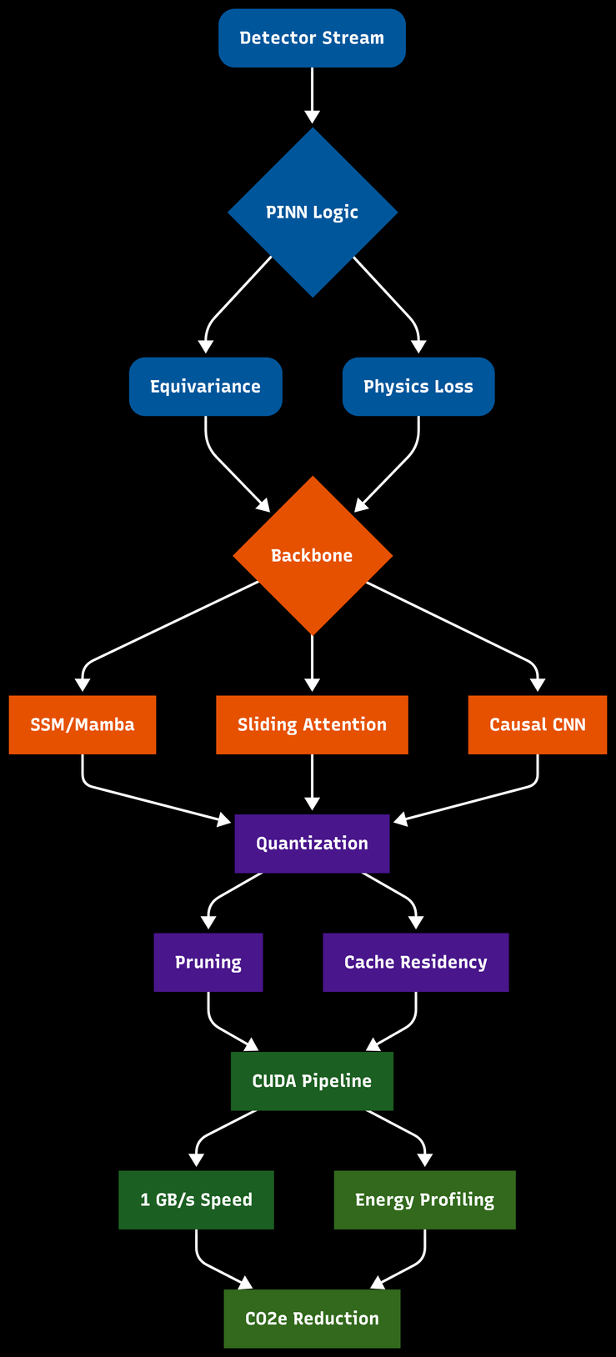
Testing ablations, pruning, and quantisation impacts on the model:
What, Why & Impact
Optimization strategies to ensure high-performance models fit within hardware power and memory constraints.
Ablation Studies: Systematically removing "pillars" to isolate specific compression gains.
Structured Pruning: Removing entire channels or layers for superior hardware acceleration compared to weight-level pruning.
Quantization (QAT): Converting to INT8/FP8 while maintaining 100% bit-exactness for lossless compression
Cache-Centric Execution: Using INT8/FP8 Quantization-Aware Training (QAT) to shrink the model so it resides entirely within the L2/L3 GPU cache, bypassing slow memory buses.
Bit-Exactness: Leveraging Structured Pruning to reduce parameters while maintaining the 100% bit-exactness required for high-energy physics data.
Impact: Enables the model to reside in L2/L3 GPU cache, maximizing throughput.

Slide 5
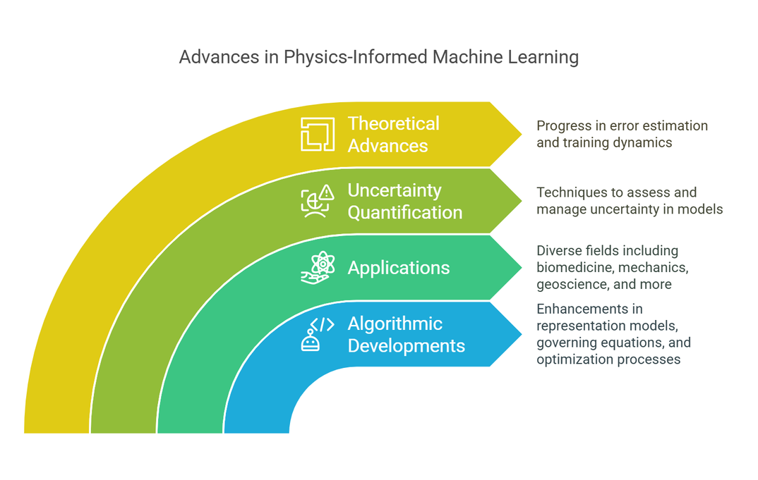
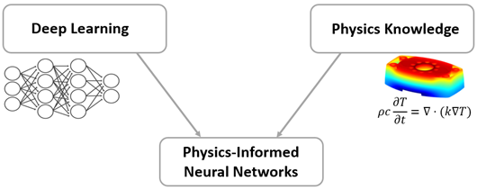
Different Possibilities but Reliable Outcome:
Physics-Informed Byte Streams (PIBS)
Standard neural compression ignores physical context, treating detector data as arbitrary symbols. By implementing Physics-Informed Neural Network (PINN) logic, we force the model to respect the underlying physical laws of High-Energy Physics (HEP) during compression.
1. Symmetry & Equivariance
Equivariant Mapping in the embedding layer ensures identical physical signals are processed consistently, regardless of their position within the byte stream.
2. Conservation Priors
An Auxiliary Physics Loss penalizes predictions that violate local energy or charge conservation, mapping byte indices directly to physical energy levels.
3. Scientific Value
Physical constraints prune the search space, enabling the model to hit the 0.92 BPB entropy floor with fewer parameters and faster convergence.

Slide 6
Comparative Performance & Benchmarking
with Sustainability Goal
Architecture | Scaling Logic | HEP Strength | Target BPB
Standard Transformer | Quadratic Attention | Local Detail | 1.32
Causal CNN | Local Receptive Fields | Structural Matching | 1.48
MinGRU | Gated Recurrence | Low Latency | 1.38
Pure Mamba | Selective SSM | Global Context | 1.25
HybridPillar++ | Hybrid Logic | Local + Global | 0.92
Metric | CMS Baseline | HybridPillar++ | BOA Mamba
Entropy (BPB) | 8.00 (Raw) | 0.92 | 1.25
Storage Savings | 0% | 88.5% | 84%
Throughput | 10 GB/s | 960 MB/s | 820 MB/s
Fidelity | Bit-Exact | Bit-Exact | Bit-Exact

Slide 7





Environmental
Benefits
This research prioritizes "Green AI" by quantifying the environmental cost of data management.
Total Energy Profiling: Measuring kWh per compressed Terabyte to ensure the energy spent on GPU compression is offset by the storage and transmission energy saved.
Operational Efficiency: Monitoring GPU SM Utilization to eliminate wasted cycles, ensuring every FLOP contributes to a reduction in the carbon footprint (CO^2e) of HEP data.
Reduced Greenhouse Gas Emissions
Improved Air Quality
Climate Change Mitigation
Conservation of Natural Resources
Ecosystem Protection
Sustainable Research: The "Energy-per-Bit" Metric

Slide 8
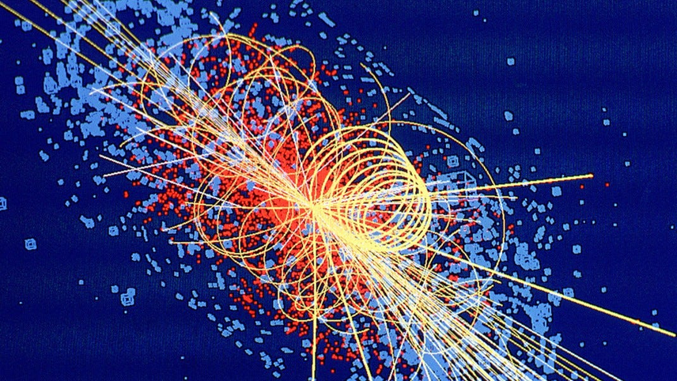

Thank
You
For Your Attention

