Slide 1


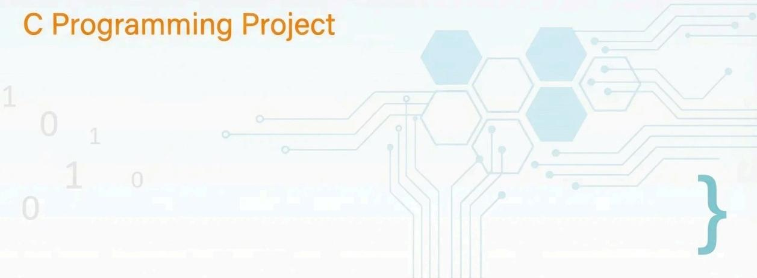
{
LibManage
Library Book Management System

Slide 2

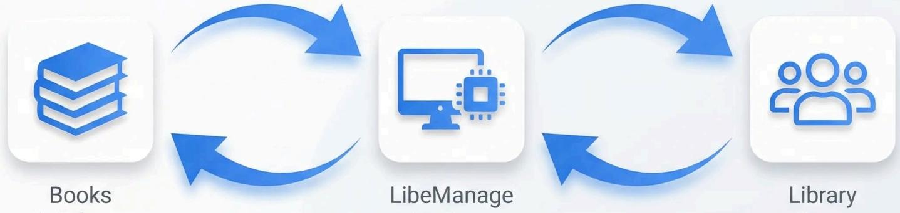
Project Overview
Books
Database
Library Users
System
Digital library system that seamlessly connects books and borrowers through intelligent
automation,providing efficient book tracking,user management,and streamlined borrowing
processes with an intuitive command-line interface.

Slide 3







Core Features
Add Books
Register new books with details
Remove Books
Delete books from inventory
Borrow Books
Issue books to library users
Return Books
Process book returns efficiently
Search Books
Find books by title or author
Sort Collection
Organize books alphabetically

Slide 4

Code Implementation
Data Structures
typedef struct {
int id;
char title[100];
char author[50];
int isAvailable; }Book;
typedef struct {
Array Management
Book library[MAX_BOOKS];
Borrower users[MAX_USERS];
int bookCount =0;
int userCount =0;
Bubble Sort Algorithm
void sortBooksByTitle(){
if (strcmp(library[j].title,library[j+1].title)>0){ Book temp =library[j];
library[j]=library[j+1];
int userId;
char name[50];
int borrowedBooks[5]; }Borrower;
for(int i=0;i<bookCount-1;i++){
for(int j=0;j<bookCount-i-1;j++){
library[j+1]=temp;

Slide 5

Demo Interface
===LibeManage System ===
1.Add Book
2.View Books
3.Borrow Book
4.Return Book
5.Search Books
6.Exit
Search Results:
ID:101 |Title: Data Structures |
Author:Smith |Status:Available
^{Enter} ^{choice:_} ^{Press} ^{any} ^{key} ^{to} ^{continue...}
Interactive command-line interface providing intuitive navigation and clear
system feedback for seamless library management operations.

Slide 6





Technical Foundation
Structs
Custom data types for
books and users
Pointers
Memory management and data linking
Arrays
Book collections and user databases
Sorting
Algorithms
Bubble sort for organized data
Input
Validation
Eror handling and data
integrity
Terminal
Styling
Colorful CLI user interface

Slide 7





Future Enhancements
Planned improvements to expand system capabilities
Database Integration
MySQL/PostgreSQL support for scalable data storage and multi- user accesS
Graphical Interface
User-friendly desktop application with intuitive design and visual book management
Network Capabilities
Multi-location access,cloud
synchronization,and remote library management
Advanced Search
Al-powered recommendations, complex queries,and intelligent book discovery

