Slide 1


{ }
LibeManage
Library Book Management System
A Command-Line Application in C
Student Name:[Your Name Here]
Course:[Course Code &Name]
Date:[Presentation Date]

Slide 2

Problem Statement &Overview
The Challenge
·Manual library
management is inefficient and error-prone
·Traditional systems lack accessibility for learning environments
·Need for hands-on C
programming application
Why CLI-Based C Solution?
·Perfect for first-year
engineering education
·Demonstrates core
programming concepts practically
·Cross-platform
compatibility with any C compiler
System Specifications
10 Pre-loaded Books
Maximum 100 Book
Capacity
Zero Memory Leaks
Guaranteed
Command-Line Interface
2/15

Slide 3






4
Key Features
View Library
Display all books with status
十
Add Books
Add new books to collection
一
Remove Books
Delete books from library
Borrow Books
Check out with borrower info
Return Books
Process book returns
三
Temporary Bubble Sort
Sort by title(preserves original)
Case-Insensitive Search
Search by name or author
3/15

Slide 4

Data Structures
Book Structure
·int id
·char title[100]
·char author[50]
·int year
·i nt available
Unique book identifier
Book title
Author name
Publication year
Availability status(1/0)
Borrower Structure
·char name[50] Borrower's name
·int id Borrower ID
·Borrower borrower Nested borrower data
Nested structure design enables comprehensive book and borrower management
4/15

Slide 5


C Programming Concepts Used
Concept Implementation Example
Arrays | Book library[MAX_BOOKS]-stores collection | Key Benefits
Structures | struct Book with nested struct Borrower | ·Memory-safe implementation
Pointers | Efficient string handling and data access | ·Modular and maintainable code
Loops | Menu system and data iteration (for/while) | ·Real-world application of
Functions | Modular design:add_book(),search_by_name() | theory
String Manipulation | fgets(),strcasecmp()for safe input
5/15

Slide 6
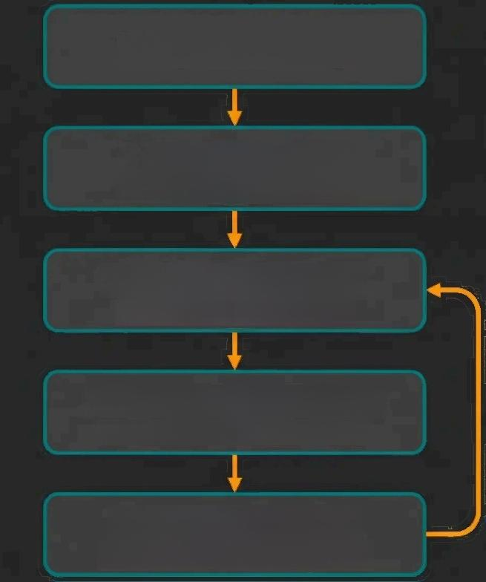

Program Flow
Program Startup
Initialize Library
Load 10 preloaded books
Display Main Menu
Show 8 available options
Process User Choice
Validate and execute function
Execute Function
Perform requested operation
Continuous Loop
Program runs until user selects exit option
Loop Until Exit
6/15

Slide 7

Function Overview
Function | Purpose | C Concept Used
main() | Program entry point and menu loop | Control structures,loops
initialize_library() | Sets up initial book data | Arrays,structures
add book() | Adds new books to collection | Structures,string handling
borrow book() | Manages book borrowing process | Nested structures,validation
bubble_sort_by_title() | Sorts books alphabetically | Algorithms,string comparison
search by name() | Finds books by title/author | String manipulation,loops
search by id() | Locates books by ID number | Linear search,conditionals
get safe int() | Validates integer input | Input handling,error checking
7/15

Slide 8
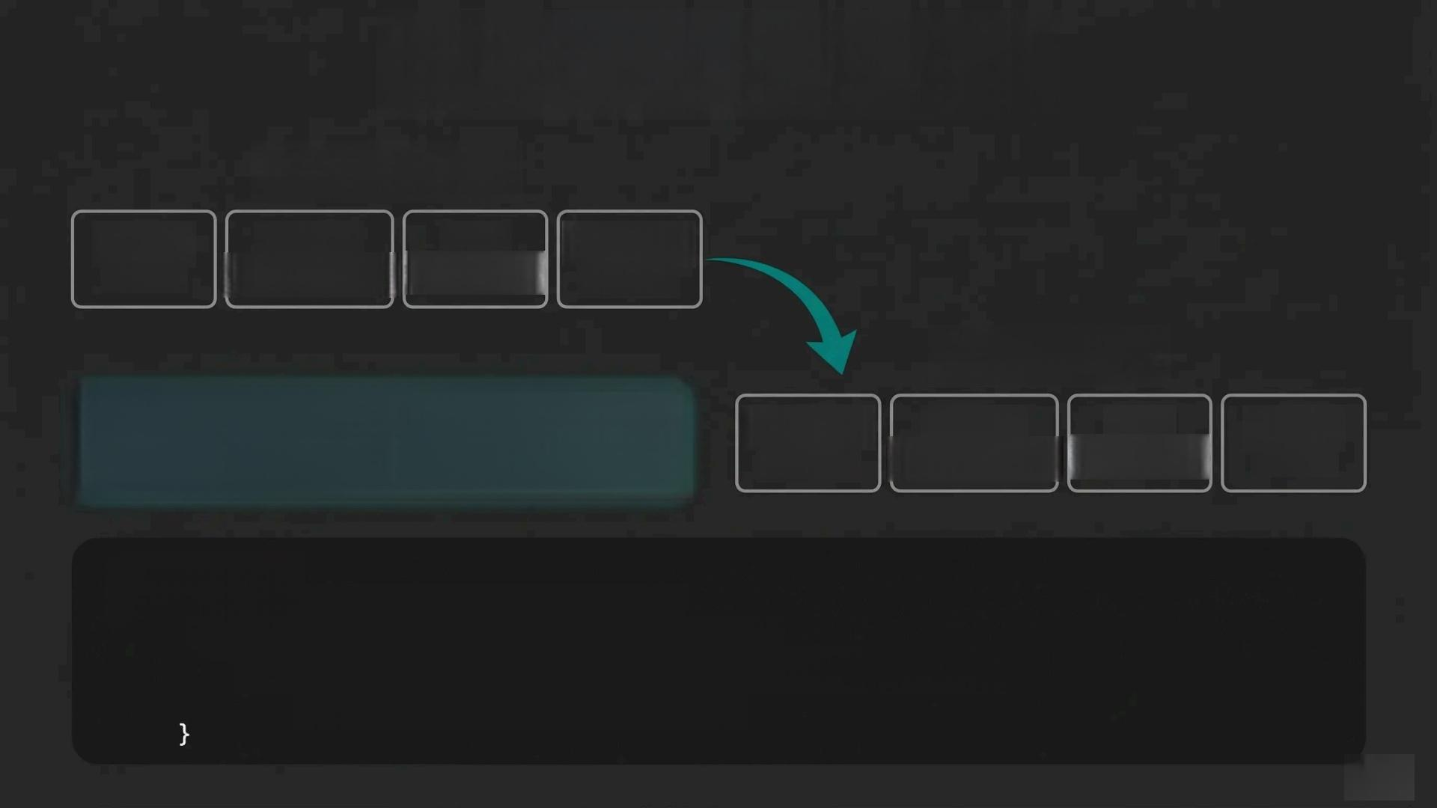
Bubble Sort Algorithm
Before Sorting
Applied Data Algorithm
Cryptography Structures Design
Python Guide
After Sorting
Applied Data
Cryptography Structures
Key Feature
Sorts TEMPORARY copy,original unchanged
Algorithm Design
Python Guide
Code Sample:
for(int i =0;i<count-1;i++){ for(intj=0;j<count-i-1;j++){
if(strcmp(temp[j].title,temp[j+1].title)>0) swap(&temp[j],&temp[j+1]);
8/15

Slide 9



Search Functionality
Q Search by Name
·Case-insensitive partial matching
·Searches through book titles
·User-friendly text input
Q Search by ID
·Direct numeric lookup
·Exact ID matching
·Fast retrieval method
Case-Insensitive Example
User Input:“crypto”
Matches:“Applied Cryptography”
9/15

Slide 10


Input Validation &Safety
Zero Crashes Guaranteed
Security Problem | LibeManage Solution
Buffer Overflow Attacks | fgets()instead of unsafe gets()
Invalid User Input | Validation loops with error messages
Integer Input Errors | get_safe_int()function with bounds checking
Memory Corruption | Static arrays,no dynamic allocation
Result:Robust,crash-free library management system
10/15

Slide 11



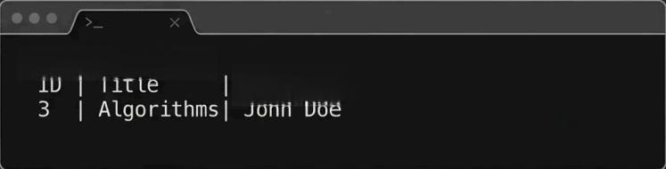
Live Demo Structure
Demo Step 1 Demo Step 2
LibeManage-Main Menu
1.View All Books
2.Add New Book
3.Borrow Book
4.Return Book
5.Search Books
6.Sort Books
7.Exit
ID |Title
The C Language
Data Structures
Year
2009
Status
Available Available
Demo Step 3
Demo Step 4
Books Sorted by Title(Temporary):
Applied Cryptography
Data Structures
The C Language
Borrowed Books:
Borrower
→—→—→
Live Demonstration Flow
11/15

Slide 12





Technical Highlights
Auto ID Normalization
Automatically eliminates gaps in book IDs when items are removed,
maintaining sequential order
Aligned Table Borders
Professional table formatting with perfectly aligned borders and consistent column spacing
ANSI Color Coding
Color-coded status indicators: Available books in green,borrowed books in red for instant recognition
Clean Memory Management
Zero dynamic allocation -uses static
arrays eliminating memory leaks and
crashes
Temporary Sorting Preserves Original Data Order
12/15

Slide 13

Limitations &Future Enhancements
Current Limitations
·No file persistence-data lost on exit
·Maximum 100 books capacity limit
·Command-line interface only
·No user authentication system
·Temporary sorting doesn't save order
Future Enhancements
·Database integration for data persistence
·User authentication &role management
·Web-based graphical interface
·Advanced statistics &reporting
·Multi-user concurrent access
·Enhanced search with filters
Growth Potential:Educational to Enterprise-Ready
13/15

Slide 14

Learning Outcomes &Compilation
Key Learning Outcomes Challenges Overcome
·Mastered C data structures and algorithms
·Implemented robust input validation techniques
·Applied modular
programming principles
·Developed real-world software solution
·Buffer overflow prevention with fgets()
·Memory management without malloc/free
·Case-insensitive string matching implementation
·User-friendly error handling design
Compilation &Execution
Compile:gcc libemanage.c-0 libemanage
Run:./libemanage
Requirements:Any C compiler
Platform:Cross-platform
compatible
Real-World Applicability:Foundation for database systems,file management,and enterprise software development
14/15

Slide 15





Thank You
Thank you for your attention during this presentation
Questions?
I'm ready to discuss any aspects of the LibeManage system
by
15/15

