Slide 1
Group no 24
Topic Name:Application of Transformers(DL) in image processing
Name | Roll No | PRN No
Abhijeet Kadam | 411021 | 22110721
Sandesh Kangude | 411024 | 22110260
Aditya Patil | 411037 | 22110016

Slide 2
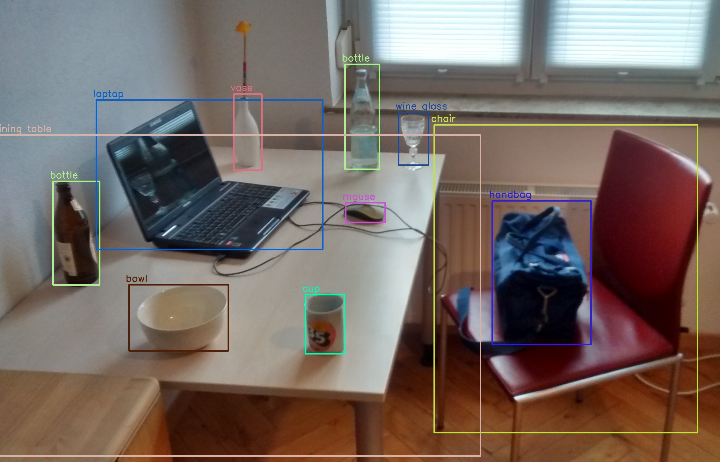
Introduction to Object Detection
1. Overview of Object Detection
Object detection is a computer vision task that involves identifying and localizing objects within an image or video frame.
2. Importance in Applications
Object detection is crucial for applications such as autonomous vehicles, security systems, and image/video analysis.
3. Transformers in Deep Learning
Transformers, a novel deep learning architecture, have demonstrated impressive performance in object detection tasks.

Slide 3

The COCO Dataset
1. Description
The COCO (Common Objects in Context) dataset is a large-scale, diverse dataset for object detection, segmentation, and captioning tasks.
2. Scale
The COCO dataset contains over 330,000 images and 80 common object categories.
3. Diversity
The dataset features a wide range of object sizes, poses, and contexts, making it challenging and representative of real-world scenarios.
4. Importance
COCO has become a benchmark dataset for evaluating the performance of object detection and other computer vision models.

Slide 4
Object Detection with Transformers
1.Transformer Architecture
Transformers, unlike traditional convolutional neural networks, use self-attention mechanisms to capture long-range dependencies in data.
2. Advantages for Object Detection
Transformers excel at tasks that require global context, such as object detection, by effectively modeling relationships between objects.
3. Performance on COCO
Transformer-based object detection models have achieved state-of-the-art results on the COCO dataset, outperforming conventional approaches.

Slide 5

Object Classification in the COCO Dataset
1
Person
The COCO dataset contains a wide variety of human poses and interactions.
2
Vehicle
A diverse range of vehicle types, including cars, trucks, buses, and more.
3
Animal
The dataset covers numerous animal species, from domesticated pets to wild creatures.

Slide 6
Annotations and Metadata in COCO
1. Bounding Boxes
Each object is annotated with a tight-fitting bounding box.
2. Segmentation Masks
Pixel-level segmentation masks are provided for each object.
3. Metadata
Additional metadata, such as object attributes and relationships, is also included.

Slide 7
Challenges and Future Directions
1.
1. Scale Variation
Detecting objects of vastly different sizes within the same image is a key challenge.
2.
2. Occlusion
Handling partially occluded objects is crucial for real-world applications.
3.
3. Transformer Advancements
Ongoing research aims to further improve Transformer-based object detection models.

Slide 8
Conclusion
This presentation has explored the use of Transformers for object detection tasks, leveraging the diverse and challenging COCO dataset. The powerful capabilities of Transformers, combined with the richness of the COCO data, have enabled significant advancements in this critical computer vision domain.

