Slide 1
VIT ID Card
Identification and
Classification through
Strap Colour Analysis
Atharva Deorukhkar – 21BCE1184
Karun Pramod – 21BCE1185

Slide 2
ABSTRACT
The Vellore Institute of Technology (VIT) ID cards are identified and categorized using this project's creative application of artificial intelligence, machine learning, and digital image processing techniques based on the colour of their straps. By combining these cutting-edge technologies, the identification process will be more accurate, effective, and flexible in a variety of situations.
The technology uses a computer vision-based method to take pictures of people showing their ID cards in real time. The strap region is extracted and isolated using digital image processing techniques, enabling accurate colour feature analysis. The study trains a model that can identify and categorize ID cards based on the distinctive colour signatures of their straps by utilising real-time machine learning (ML) technologies, such as convolutional neural networks (CNNs).

Slide 3
To enhance the classification process and dynamically modify identification criteria, the project also investigates the integration of AI-driven decision-making. The system’s resilience is evidenced by its capacity to adapt to changes in illumination, colour of the strap, and any occlusions.
The suggested solution has many benefits, such as enhanced access control process efficiency, less reliance on conventional techniques, and better ID card categorization accuracy. If this project is carried out effectively, VIT will be able to create a state-of-the-art ID card identification system that will also lay the groundwork for future improvements in campus administration and security.

Slide 4
WORKFLOW, PROCEDURE & ALGORITHM
1) Colour Histogram Feature Extraction:
Extracting the Colour Information:
The image is divided into its individual pixels.
For each pixel, its colour value is recorded (e.g., RGB values).
Building the Histogram:
Each pixel's colour value is counted and placed in the corresponding bin in the histogram.
So, bins with dominant colours in the image will have higher counts compared to less frequent colours.
Feature Vector:
The histogram itself can be used as the feature vector, but it can be quite large.
Often, a reduced version is created by summarizing the histogram with a smaller set of values. This can involve techniques like binning the colours into fewer ranges or calculating the statistical properties of the histogram.

Slide 5
2) Image classification algorithm (comparative study between CNN and KNN)
K-Nearest Neighbours (KNN):
Strengths:
Efficiency: KNN is a relatively simple algorithm with low computational complexity compared to other methods like CNNs. This makes it faster, allowing for potentially faster classification of images in real-time scenarios.
No training needed: Unlike methods that require training on large datasets, KNN utilizes existing data points for comparison. This eliminates the need for a separate training phase, saving time and potentially enabling real-time deployment.
Weaknesses:
Curse of dimensionality: KNN's performance suffers with high-dimensional data like large images with many colour channels. This can significantly slow down the classification process in real-time applications.
Data storage: KNN needs to store all training data points in memory for comparison. This can become memory intensive for large datasets, impacting real-time performance, especially on resource-constrained devices.

Slide 6
INFERENCE:
If real-time performance is your top priority, KNN could be a good choice, especially for simpler tasks with limited colour variations and smaller images.
It is best suited for simpler tasks with limited colour variations and smaller images to minimize the impact of dimensionality.
Requires careful consideration of data size and available resources to ensure real-time performance is achievable.
CONCLUSION:
The project classifies ID cards based on the strap colour which is limited to only 3-4 colours in VIT.
Also the strap is a small object with low dimensionality
It is also faster for real-time implementation due to low computational complexity.
Also we are running the application on local system which has limited space and resources.
HENCE, WE WILL IMPLEMENT THE KNN CLASSIFICATION ALGORITHM.

Slide 7

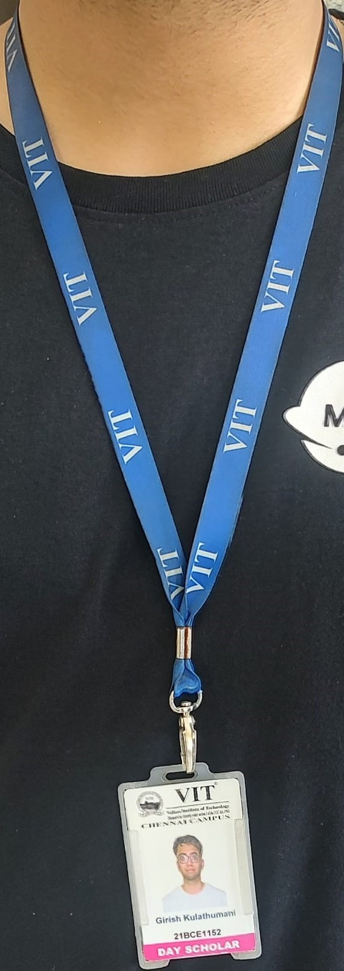


DATASET
The dataset comprises labelled data categorized into two groups: Day Scholar ID Cards, distinguished by a prominent dark blue-coloured strap as their primary feature, and Hosteller ID Cards, identifiable by a distinct light blue-coloured strap. The classification of ID cards is primarily based on the colouration of the straps.

Slide 8
FURTHER SCOPE
Our project aims to next include the classification of not only student ID cards but also faculty and research scholar ID cards. They are characterized by light green and olive-coloured straps. Through meticulous feature extraction, our objective is to implement a comprehensive classification system that can identify four distinct types of ID cards present on the campus.
Further, we plan to broaden its scope by trying to implement it in various companies and factories to segregate the employees/workers based on the department they work by their ID card.

Slide 9
LITERATURE REVIEW
Paper 1: Real-Time Colour Image Classification Based on Deep Learning Network
This work addresses the challenge of real-time image classification in computer vision using deep learning, specifically Convolutional Neural Networks (CNN). Leveraging the effectiveness of CNNs, particularly the hybrid GoogleNet pre-trained model, the proposed architecture incorporates fully connected layers to extract relevant features for classification. The model is evaluated on two datasets, 15 Scene and UC Merced Land-Use, achieving high accuracies of 92.4% and 98.8%, respectively. This underscores the model's proficiency in real-time image classification, emphasizing its potential for various applications.

Slide 10
Paper 2: A Study on Image Classification Based on Deep Learning and TensorFlow
This research explores image classification using Deep Neural Networks (DNN), specifically implemented with the TensorFlow framework in Python. The study focuses on classifying five types of flowers, demonstrating the efficacy of DNN in achieving high accuracy rates. The results reveal notable accuracy percentages, with roses achieving 90.585%, and an overall average exceeding 90% for the classification of various flower types.

Slide 11
Paper 3: Classification Of Objects in Video Records Using Neural Network Framework
Object classification, a vital aspect of image processing, has evolved from Haar cascade classifiers to sophisticated neural network models like Fast R-CNN and Faster R-CNN. This study explores both single-class and multi-class scenarios, emphasizing the transition from traditional Haar cascade methods to advanced techniques, using the COCO dataset for R-CNN implementation.

Slide 12
Paper 4: Product Image Classification Using Eigen Colour Feature with Ensemble Machine Learning
This study focuses on image feature extraction and classification in e-commerce product recognition. Artificial Neural Network (ANN) and Support Vector Machine (SVM) are employed as classifiers. Overfitting challenges in ANN integration with e-commerce, especially recommendation systems, are addressed through cross-validation, achieving a state-of-the-art 87.2% classification accuracy in product recognition, outperforming existing results.

Slide 13
Paper 5: Image Classification using a Hybrid LSTM-CNN Deep Neural Network
This research innovatively combines a Convolutional Neural Network (CNN) with Long Short-Term Memory (LSTM) in image classification. The synergy between LSTM's long-term pattern memorization and CNN's feature extraction enhances classification. The proposed model, a blend of recurrent and convolutional neural networks, demonstrates robustness across diverse classification tasks. Validation on standard datasets affirms its superiority over traditional classifiers.

Slide 14
THANK YOU

