Slide 1
InfraTwin
Predictive maintenance on one PostgreSQL database.
Time-series anomaly detection, failure-cascade graph and semantic search — three capabilities that normally mean three systems.
DBTHON 2026
5,090,501 sensor readings · PostgreSQL 16 · pgvector · 73× faster than the unoptimised baseline
Notes:
One database doing the work of three. Everything in this deck was measured on a live database, not estimated.

Slide 2
Three questions, three systems
Unplanned downtime costs a mid-size plant an estimated $50k per hour. The diagnosis is slow because the answers are scattered.
1
2
3
Is this machine behaving abnormally?
What else breaks if it fails?
When did this happen before, and what fixed it?
Needs a time-series database
Needs a graph database
Needs a vector database
Compare the last hour against this machine's own history — not a global threshold.
Walk the dependency chain upward: motor → pump → line → plant.
Search years of free-text maintenance reports by meaning, not keyword.
Three databases means three deployments, three backups, three security models — and the one question that matters most cannot be asked at all.
“Show me every machine downstream of the failing pump that has also had a heat-dissipation failure this month.” That is one join across all three.
Notes:
Lead with the cross-domain question. That is the one a three-system stack cannot answer in a single query, and it is the reason for the whole design.

Slide 3
So we put all three in one database
PostgreSQL 16 with pgvector. The capabilities are extensions of one engine, not three services.
The conventional stack
InfraTwin
InfluxDB / Timescale telemetry
Partitioned tables telemetry
Neo4j asset graph
WITH RECURSIVE asset graph
Pinecone / Milvus embeddings
pgvector + HNSW embeddings
PostgreSQL everything else
PostgreSQL everything else
4 deployments · 4 backups · 4 auth models
cross-domain joins written by hand in application code
no transaction spans them
1 deployment · 1 backup · 1 security model
cross-domain joins are ordinary SQL
one ACID transaction covers all of it
Where this stops being right: a dedicated time-series engine wins past ~10⁹ rows per table, and a dedicated vector database wins at billion-scale ANN. At plant scale, PostgreSQL is not the bottleneck — the integration tax is.
Notes:
Be ready for 'why not just use the right tool for each job'. The answer is the honest line at the bottom: we know where the ceiling is, and we are far below it.

Slide 4
How it fits together
One connection. Three query patterns. The results are joinable because they share a database.
SOURCES
PostgreSQL 16
THREE QUERIES
Sensor stream
one database · one connection
1
Anomaly detection
1 reading/min
101 machines
sensor_readings partitioned by day · 5.09M rows
roll-up + per-asset z-score
Asset registry
readings_hourly pre-aggregated roll-up
plant hierarchy
→
→
2
Failure cascade
asset_dependencies directed graph, self-referencing
WITH RECURSIVE, depth-bounded
AI4I 2020
339 real failures
maintenance_reports vector(384) + HNSW index
3
Similar failures
Technician notes
audit_logs append-only, trigger-written
HNSW nearest neighbour
free text
Streamlit dashboard reads all three
The payoff: because all three live in one database, the cascade result and the similar-failure result can be filtered by the same asset in a single statement. Across three systems that is three round trips and a join written by hand.
Notes:
Walk left to right: sources, one database, three queries. Land on the payoff box.

Slide 5
Technology stack
Every choice, and what it was chosen over.
Database
PostgreSQL 16
Everything. One engine, one backup, one security model.
Time-series
TimescaleDB hypertable or native PARTITION BY RANGE
Both ship. Detected at setup — the portable path needs no extension.
Vector search
pgvector 0.8 · HNSW, cosine
Embedding sits beside the failure record, so similarity results join directly.
Embeddings
sentence-transformers all-MiniLM-L6-v2
384-dim, CPU, ~80 MB. Offline lexical fallback if the model cannot be fetched.
Application
Python 3 · psycopg 3 · pandas · numpy
Server-side binding and native COPY for the bulk load.
Dashboard
Streamlit 1.40
Three panels in 190 lines instead of a hand-written frontend.
Packaging
Docker Compose · Makefile
make all runs the whole pipeline in about two minutes.
Testing
pytest · 34 tests · 28 runtime self-checks
Constraint violations are attempted and asserted to fail.
Dataset
AI4I 2020 (UCI, CC BY 4.0)
339 real failures across five documented modes.
Nothing here is a hosted service. The entire project runs on a laptop with Docker, or on a free hosted PostgreSQL if Docker is blocked.
Notes:
If a judge asks why not a managed vector DB: the answer is on slide 3, and the cost line here.

Slide 6
Database design
Entities, relationships, normalisation, constraints — and the decisions behind them
Notes:
Transition: this is the part the judging criteria weight most.

Slide 7
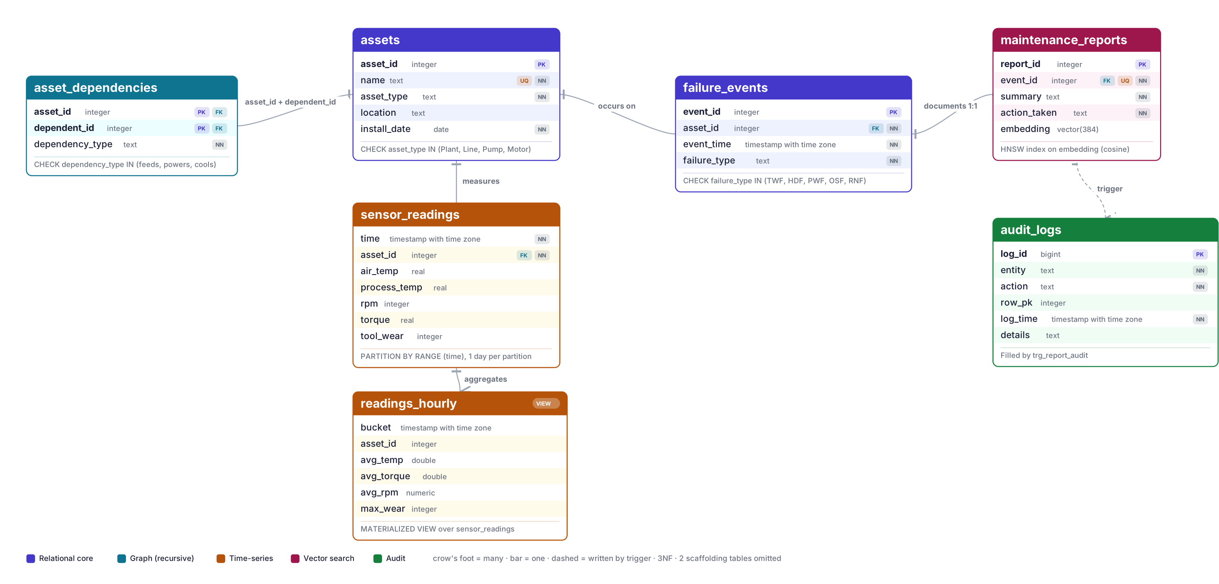
Database relations
Generated directly from the live pg_catalog — this diagram cannot drift from the schema. 9 tables · 1 materialized view · 17 indexes · 12 constraints.
Notes:
Point out: assets is the single source of asset identity; everything references it. The dashed line to audit_logs is a trigger, not a foreign key - an audit trail must survive the row it describes.

Slide 8
Three design decisions worth defending
1
2
3
An edge table, not a parent_id column
UNIQUE is what makes it 1:1
CHECK constraints over lookup tables
asset_dependencies is a self-referencing M:N on assets.
The foreign key alone would permit many reports per failure.
asset_type and failure_type are TEXT + CHECK, not foreign keys to a lookup table.
One asset, several parents
event_id INT NOT NULL UNIQUE
REFERENCES failure_events(event_id)
impossible → natural
Typed relationship
Both are closed sets — four physical types, five AI4I codes. A lookup table buys flexibility nobody needs and costs a join on every query. If the set became user-defined, the lookup table would be correct.
nowhere to put it → a column
Add a redundant feed
Without UNIQUE, the similar-failure search could return three rows that are all the same incident.
schema change → one INSERT
A pump fed by two lines is ordinary in a real plant. parent_id cannot express it.
Normal form: 3NF throughout. sensor_readings stores asset_id, never the machine's name or location — renaming a machine is one UPDATE, not five million. readings_hourly is the one deliberate denormalisation, and it is a measured trade.
Notes:
These are the three questions a database examiner asks. Decision 3 is the one to be humble about - name the condition under which the other choice wins.

Slide 9
Integrity lives in the database, not the application
Every rule holds no matter what connects — the app, psql, or a migration script.
CONSTRAINTS
The audit trigger
assets
UNIQUE (name)
Two machines with the same tag
AFTER INSERT OR UPDATE OR DELETE, FOR EACH ROW. It cannot be bypassed — it fires for the app, for psql and for a migration alike.
assets
CHECK asset_type IN (…)
Typos becoming new asset classes
asset_dependencies
PK (asset_id, dependent_id)
Duplicate edges
IF TG_OP = 'DELETE' THEN
v_pk := OLD.report_id;
ELSE
v_pk := NEW.report_id;
END IF;
asset_dependencies
CHECK asset_id <> dependent_id
A machine depending on itself
failure_events
CHECK failure_type IN (…)
Codes outside the AI4I set
maintenance_reports
UNIQUE (event_id)
More than one report per failure
Why the explicit branch
all foreign keys
ON DELETE CASCADE
Orphaned readings and edges
In a DELETE trigger NEW is unassigned. COALESCE(NEW.report_id, OLD.report_id) happens to work on PostgreSQL 16 — we tested it — but it relies on field access against an unassigned record returning NULL rather than raising. One IF removes the question.
verify.py attempts each violation and asserts it is rejected — 28 checks, all passing. These are demonstrated, not claimed.
Notes:
The trigger footnote is a good place to show we tested rather than assumed. We found the original pattern works on PG16 and hardened it anyway.

Slide 10
1
Time-series layer
Partitioning for the raw stream, a pre-aggregated roll-up for the baseline.
One partition per day
readings_hourly roll-up
CREATE TABLE sensor_readings (...)
PARTITION BY RANGE (time);
Hourly averages per asset, computed once, not on every dashboard load.
Storage cost
+10 MB on top of 551 MB
Partition pruning. A one-hour query reads one partition, not 48 — the planner discards the rest before executing.
Freshness cost
stale until refreshed
Cheap retention. Dropping old data is DROP TABLE — instant — instead of a DELETE that rewrites millions of rows.
30-day aggregate
1,200 ms → 44 ms
Two engines, one schema
TimescaleDB hypertable where available; native PARTITION BY RANGE where it is not. Column definitions, indexes and every downstream query are identical — only the partitioning mechanism differs. make schema detects which to use, so a locked-down lab PC or a hosted PostgreSQL with pgvector runs the same demo.
5,090,501
52 s
48
73×
sensor readings loaded
to generate and load them
daily partitions
faster point query
Notes:
The two-engines point is worth making: it is the difference between a demo that runs anywhere and one that needs a specific Docker image.

Slide 11
2
Graph layer
A recursive CTE walks the dependency graph upward from the failing machine.
WITH RECURSIVE impacted AS (
SELECT d.dependent_id, 1 AS depth
FROM asset_dependencies d
WHERE d.asset_id = :asset
UNION ALL
SELECT d.dependent_id, i.depth + 1
FROM asset_dependencies d
JOIN impacted i ON d.asset_id = i.asset_id
WHERE i.depth < 5)
SELECT a.name, a.asset_type, i.depth
FROM impacted i JOIN assets a USING (asset_id)
ORDER BY i.depth;
L3-P2-Motor-3 fails
Motor
the failure
Pump
depth 1 · powers
Line
depth 2 · feeds
Plant
depth 3 · feeds
3 assets impacted · 0.4 ms
depth < 5 is not decoration
Edge direction
A mis-entered pair — (A→B) and (B→A) — forms a cycle, and UNION ALL without a bound never terminates. The test suite inserts exactly that cycle and asserts the query still returns.
(asset_id) → (dependent_id)
Read as “dependent_id depends on asset_id”. A motor powers a pump, so the row is (motor, pump, 'powers') and a motor failure cascades upward to the plant.
Notes:
If asked why not Neo4j: depth-3 traversals over 100 edges are not where a graph database earns its keep. At depth 10 over millions of edges, it would.

Slide 12
3
Vector layer
Report text becomes a vector(384). Finding a similar past failure is one ORDER BY.
SELECT f.failure_type, r.summary, r.action_taken,
1 - (r.embedding <=> :qvec) AS similarity
FROM maintenance_reports r
JOIN failure_events f USING (event_id)
ORDER BY r.embedding <=> :qvec
LIMIT 3;
Operator types a symptom
“temperature rising while rotational speed is low, coolant problem”
HDF
HDF
sim 0.488
Process temperature reached 318.2 K, speed stayed low
<=> is cosine distance. Because the HNSW index is built on vector_cosine_ops, this is an index scan — not a scan of every report. The JOIN is the part a separate vector database cannot do.
HDF
HDF
sim 0.479
Heat dissipation failure, coolant could not carry heat away
The failure mode worth knowing
It works without the internet
Embedding stored reports with one model and queries with another produces no error at all. Both vectors are valid, the distances compute, the results are nonsense. seed.py and app.py therefore call the same loader, and the schema's vector(384) is checked against the model's width at load time.
If the model cannot be downloaded, seed.py falls back to a deterministic lexical embedder: synonym-folded bag of words, IDF-weighted, same 384 dimensions, same index, same queries. It returns the correct failure mode on all five test symptoms. The demo cannot be taken down by the venue's wifi.
Notes:
The offline fallback is a robustness story, not a shortcut. Mention that the schema and queries are byte-identical either way.

Slide 13
Measured, not estimated
Baseline is the identical rows in one unpartitioned heap, no indexes. Median of 7 runs, 5,090,501 readings — figures read live from benchmark_results.csv.
RAW TIMINGS
baseline
optimised
Avg temp, 1 machine, last 24h
236.3 ms
3.23 ms
Daily averages, all machines, 30 days
1253.2 ms
44.92 ms
Readings above threshold, 1-hour window
252.9 ms
57.01 ms
Similar-report search, 20k vectors
15.5 ms
2.13 ms
10 MB answers the 30-day question that would otherwise scan 551 MB
The cost, stated plainly: the optimised table occupies 551 MB against the baseline's 293 MB. The indexes are 88% more storage. That is the deal we are making — disk is cheap, the operator waiting on a dashboard is not.
Notes:
Volunteer the storage cost before a judge finds it. It reads as rigour, not weakness.

Slide 14
What we got wrong, and fixed
Three findings from testing against a live database rather than reasoning about it.
A z-score alone raised a false positive
The HNSW index is ignored on a small table
The demo decayed as the clock advanced
On a machine whose hourly average varies by 0.1 K, a 0.3 K drift crosses z > 3. Testing surfaced exactly one such alert at z = 3.0, alongside the three real ones.
On a few hundred reports PostgreSQL picks a sequential scan — correctly, because scanning that many rows is cheaper than walking a graph index.
The anomaly is injected relative to seed time, but the query compares windows relative to now(). After an hour the injected rows drift into the baseline they are measured against and the z-scores collapse.
FIXED
FIXED
FIXED
The query now requires an absolute rise of 1.0 K as well. Three injected anomalies, three detected, no false positives.
The benchmark uses 20,000 vectors, where HNSW wins by the margin on the results slide. The test suite asserts the index is used there and records the sequential scan on the small table rather than hiding it.
make demo reverts the previous injection exactly and re-applies it at the current time, in one transaction. Run it before presenting.
Everything in this deck was run against a live PostgreSQL 16 database. 34 tests and 28 runtime self-checks pass.
Notes:
This is the slide that separates a project that was built from one that was only designed. Do not skip it to save time.

Slide 15
One database. Three capabilities. 73× faster.
Run it yourself: docker compose up -d · make all · make app
Where it goes next
What it already proves
Streaming ingestion with logical replication; alert routing from the cascade result; compression policies on chunks older than 7 days.
Time-series, graph and vector workloads coexist in PostgreSQL at plant scale — with one backup, one security model and joins across all three.
Notes:
Close on the proof line, then take questions. Have the dashboard already running on a second window.

