Slide 1

Introduction to Environmental Disasters
Environmental disasters are catastrophic events that can have severe impacts on the natural environment, ecosystems, and human populations. These disasters can be triggered by natural phenomena or human activities, and understanding their causes and effects is crucial for effective disaster preparedness and response.

Slide 2
Causes of Environmental Disasters
Natural Causes
Human-Induced Causes
Climate Change
Natural events such as earthquakes, volcanoes, floods, and hurricanes can lead to environmental disasters that disrupt ecosystems and human settlements.
Human activities like pollution, deforestation, and industrial accidents can also trigger environmental disasters that have long-lasting consequences for the planet.
The ongoing effects of climate change, including rising sea levels, extreme weather patterns, and ecosystem disruption, are increasing the frequency and severity of environmental disasters.

Slide 3
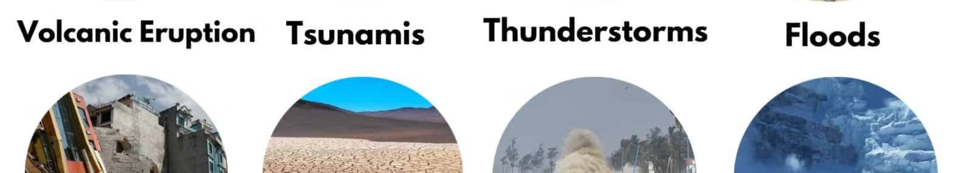
Types of Environmental Disasters
1
Natural Disasters
2
Technological Disasters
3
Biological Disasters
Earthquakes, volcanic eruptions, wildfires, floods, and hurricanes can have devastating impacts on the environment and human populations.
Pandemics, invasive species, and outbreaks of disease can disrupt ecosystems and threaten biodiversity.
Industrial accidents, oil spills, and nuclear disasters can release large amounts of pollutants and contaminants into the environment.

Slide 4
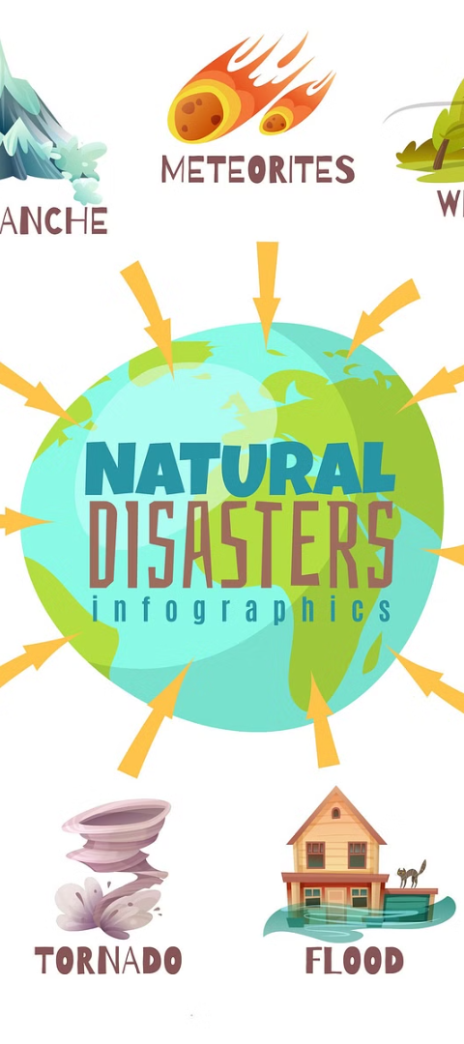
Impacts of Environmental Disasters
1
Ecological Impacts
Environmental disasters can lead to habitat destruction, species extinction, and the disruption of fragile ecosystems.
2
Economic Impacts
These disasters can cause significant economic losses through damage to infrastructure, disruption of supply chains, and the cost of recovery efforts.
3
Social Impacts
Environmental disasters can displace populations, disrupt livelihoods, and exacerbate existing social inequalities and vulnerabilities.

Slide 5
Case Studies of Major Environmental Disasters
Chernobyl Nuclear Disaster
The Exxon Valdez Oil Spill
The Deepwater Horizon Oil Spill
In 1989, the Exxon Valdez oil tanker ran aground in Alaska, spilling millions of gallons of crude oil and devastating the local marine ecosystem.
The 1986 explosion at the Chernobyl nuclear power plant in Ukraine released large amounts of radioactive material, leading to long-term environmental and health impacts.
The 2010 explosion of the Deepwater Horizon oil rig in the Gulf of Mexico resulted in the largest marine oil spill in history, with severe environmental consequences.

Slide 6
Disaster Preparedness and Response
Early Warning Systems
Emergency Planning
Developing effective early warning systems can help communities prepare for and respond to environmental disasters.
Comprehensive emergency plans and regular drills are crucial for minimizing the impact of environmental disasters.
Community Resilience
International Cooperation
Empowering local communities to be self-reliant and adaptable can enhance their ability to withstand and recover from environmental disasters.
Coordinating disaster response efforts at the global level can improve the efficiency and effectiveness of disaster management.

Slide 7
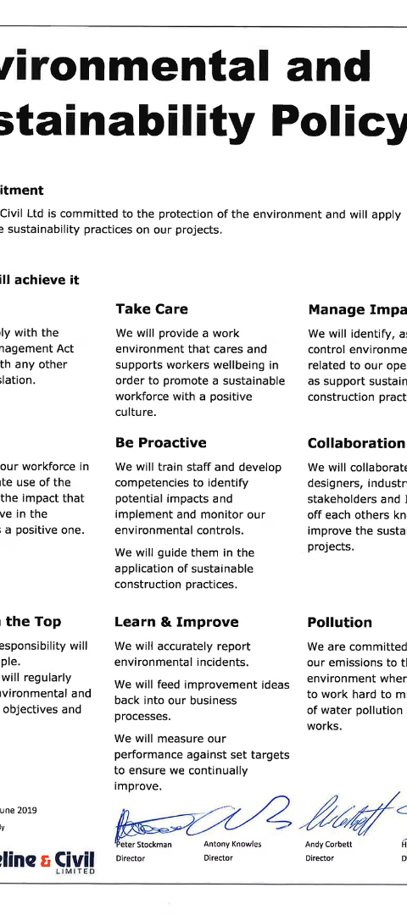



Environmental Regulations and Policies
Emissions Controls
Regulations on greenhouse gas emissions and industrial pollution can help mitigate the causes of environmental disasters.
Habitat Conservation
Policies that protect natural habitats and ecosystems can enhance their resilience and reduce the risk of environmental disasters.
Disaster Management
Comprehensive disaster management policies and plans can improve the response and recovery efforts for environmental disasters.

Slide 8




Role of Individuals in Mitigating Environmental Disasters
Recycling
Energy Conservation
Sustainable Living
Community Engagement
Reducing waste and properly recycling materials can help minimize the environmental impact of human activities.
Making eco-friendly choices in daily life, such as reducing consumption and supporting sustainable businesses, can contribute to environmental disaster mitigation.
Adopting energy-efficient practices and using renewable energy sources can help address the root causes of environmental disasters.
Participating in local initiatives and advocating for environmental policies can empower individuals to be agents of change in their communities.

Slide 9
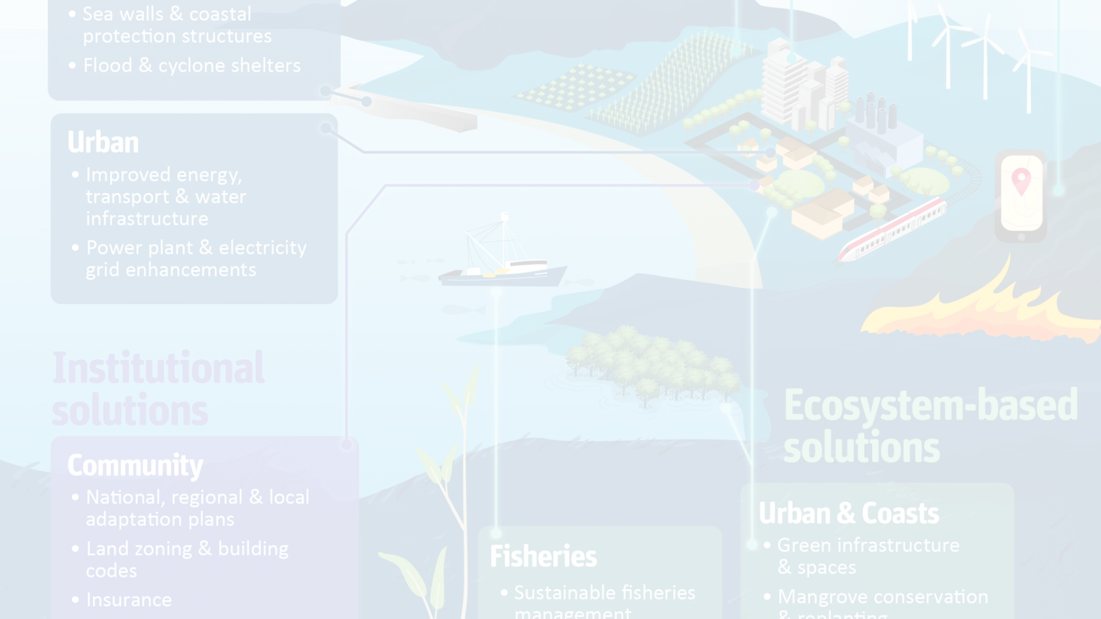
Conclusion and Call to Action
Environmental disasters pose a significant threat to our planet and all living beings. By understanding the causes, impacts, and ways to mitigate these disasters, we can work together to create a more sustainable and resilient future. Let's take action today to protect our environment and ensure the well-being of generations to come.

