Slide 1

SUKOON
WHERE WE STRIVE FOR A CHANGE,
AND WE CREATE A CHANGE!

Slide 2
AIM OF OUR ORGANIZATION
TO PROVIDE RESOURCES TO THE NEEDY
In times of famine, flood, draughts and other natural calamities, which India is quite prone to, we often see how a small speck of help is what people expect, which is still delivered late.
A small helping hand on our part, can create a huge impact on the lives of many, which is what our motto is.
TO CONTRIBUTE TO THE OPEN_SOURCE
As engineers, we learn a lot in our Btech and Mtech days of college. This knowledge, if imparted could benefit many. However, it is sad to see that unable to get a proper platform to express themselves, hidden talents remain silent without reaching out to the world.
Our platform, no matter small or big, will help them in overcoming that barrier, as well as providing anonymity, freedom to express, and the opportunity to implement new ideas.
More info on our goals, our future plans and details about our organization can be found here : site ka link
<number>

Slide 3
1. OUR CONTRIBUTION TO THE POOR
Let’s start with our contributions to the poor and the economically challenged people of the society. This includes children, people caught by natural calamities, and people who need financial support to start a business.

Slide 4
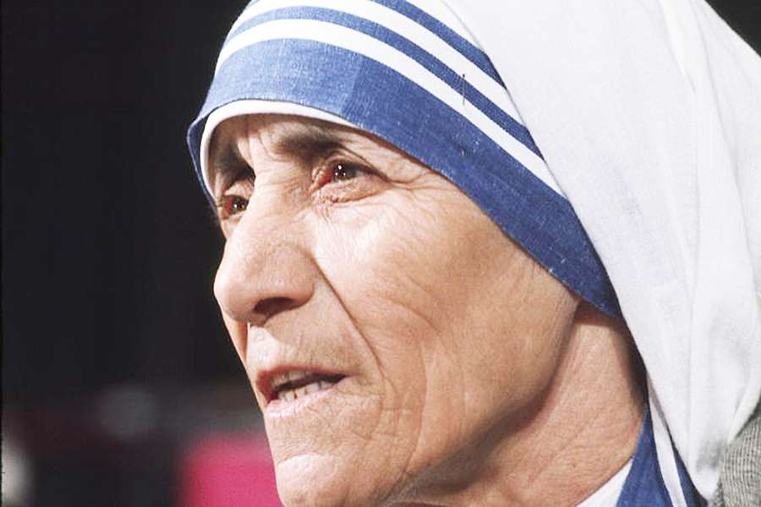
“Kind words can be short and easy to speak, but their echoes are truly endless.
If you can't feed a hundred people, then feed just one.
” - Mother Teresa
<number>

Slide 5
Our Main Contributions
Fed around 500+ people during covid lockdown in Kolkata
Visited Orphanage homes several times, offered clothes, books, crayons and toys for children.
Hosted sessions on financial literacy, importance of education, job opportunities, business opportunities for them in the future.
Not every kind deed can be listed, and this list is too short for what’s yet to come.
<number>

Slide 6
OUR CONTRIBUTION TOWARDS PROTECTING NATURE
From our school days, we’ve been hearing about preserving nature, and raising issues about global warming, deforestation and pollution.
Instead of waiting in hope for a change, we decided to take a step forward in being the change!
<number>

Slide 7
SOME OF OUR WORKS
Planting Trees
We plant neem trees in areas which have good soil fertility and proper water supply and retainment, on a monthly basis.
Distributing dustbins, soaps, hand-sanitizers
To promote awareness is better than to create awareness. We motivate people to change their livelihood with small steps at a time.
<number>

Slide 8
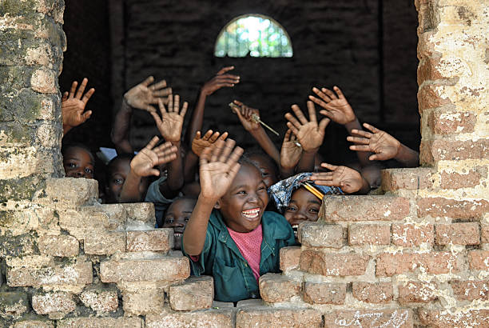
A PICTURE IS WORTH A THOUSAND WORDS
The goal of our organization is to make a change, which will further lead to others connecting together and helping us reach out to people on a global scale.
<number>

Slide 9

WANT A BIG IMPACT?
All you need is to start. Once you start with an idea, if your intension is pure and your motivation is strong, people will be inspired and follow.
<number>

Slide 10
HOW YOUR SMALL CONTRIBUTIONS CAN LEAD TO A BIG CHANGE
DONATING TO ONE CHILD
PLANTING ONE TREE
POSTING ONE VIDEO TEACHING NEW SKILLS
THOUSANDS OF PEOPLE CHANGING IT TO A MASSIVE SCALE
<number>

Slide 11
OUR CENTRES
Find more ABOUT US at our site
<number>

Slide 12
TREES WE’VE PLANTED : 3000+
CHILDREN WE’VE SENT TO SCHOOL : 50+
BOOKS WE’VE DISTRIBUTED : 500+
PEOPLE WE’VE HELPED DURING
NATIONAL EMERGENCY : 1000+
Whoa! That’s a big number, isn’t it?
YOUR contributions help us make it even bigger!
<number>

Slide 13
OUR PROCESS IS EASY
START SMALL
CONNECT WITH PEOPLE
CONVERT IT TO LARGE SCALE
Everyone starts small. What matters is the motive.
Connecting with different people, bringing about new ideas, implementing them in our locality fuels our starting journey.
As we connect with different people, our team grows and we reach out to more people, not physically, but through our members, across the country.
<number>

Slide 14
4000
3000
2000
1000
0
You can insert graphs from Excel or Google Sheets
<number>

Slide 15
TIMELINE
Blue is the colour of the clear sky and the deep sea
Red is the colour of danger and courage
Black is the color of ebony and of outer space
Yellow is the color of gold, butter and ripe lemons
White is the color of milk and fresh snow
Blue is the colour of the clear sky and the deep sea
JAN
FEB
MAR
APR
MAY
JUN
JUL
AUG
SEP
OCT
NOV
DEC
Yellow is the color of gold, butter and ripe lemons
White is the color of milk and fresh snow
Blue is the colour of the clear sky and the deep sea
Red is the colour of danger and courage
Black is the color of ebony and of outer space
Yellow is the color of gold, butter and ripe lemons
<number>

Slide 16
ROADMAP
Blue is the colour of the clear sky and the deep sea
Red is the colour of danger and courage
Black is the color of ebony and of outer space
1
3
5
2
4
6
Yellow is the color of gold, butter and ripe lemons
White is the color of milk and fresh snow
Blue is the colour of the clear sky and the deep sea
<number>

Slide 17
TEAM MEMBERS
-MEHUL KUMAR
-SATYAM SORAB
-PRIYANSHU SINGH
-ARNAB JHA
-ADITYA PANJIYAR
-ABHISHEK THAKUR
-MD. FAIZAN
-SAGAR JANA
<number>

Slide 18
THANK YOU

