Slide 1
Password Cracking Using Hashcat
Internship Project Report – IIT Jammu
Aditya Singh Rana | ID CARD NO:TEC/IIT/SS25/148
RAHUL KUMAR | ID CARD NO:TEC/IIT/SS25/083
ANIKET | ID CARD NO:TEC/IIT/SS25/214

Slide 2
Abstract
This project explores password security by performing ethical password cracking using Hashcat.
The goal is to understand password vulnerabilities through dictionary and brute-force attacks,
demonstrated using the passwords 'dragon' and '@Eagle1234' respectively.

Slide 3
Introduction
Passwords are a primary defense mechanism in cybersecurity. However, weak or common passwords can be
cracked easily. This project simulates password cracking using Hashcat to raise awareness about
strong password policies.

Slide 4
Objective
- Understand how password cracking works
- Use Hashcat for dictionary and brute-force attacks
- Demonstrate real examples for both attack types
- Emphasize ethical cybersecurity practices

Slide 5
Tools & Setup
- OS: Kali Linux
- Tool: Hashcat v6.x
- Wordlist: rockyou.txt (includes 'dragon')
- Hash Types: MD5, SHA1
- Terminal Shell: Bash
- Hardware: CPU/GPU

Slide 6
Dictionary Attack Example: 'dragon'
- Password: dragon
- Hash generated using: echo -n 'dragon' | md5sum
- Saved hash in file: hashes.txt
- Command: hashcat -m 0 -a 0 hashes.txt rockyou.txt
- Result: Successfully cracked using dictionary attack
- Reason: 'dragon' is a common password present in wordlists

Slide 7
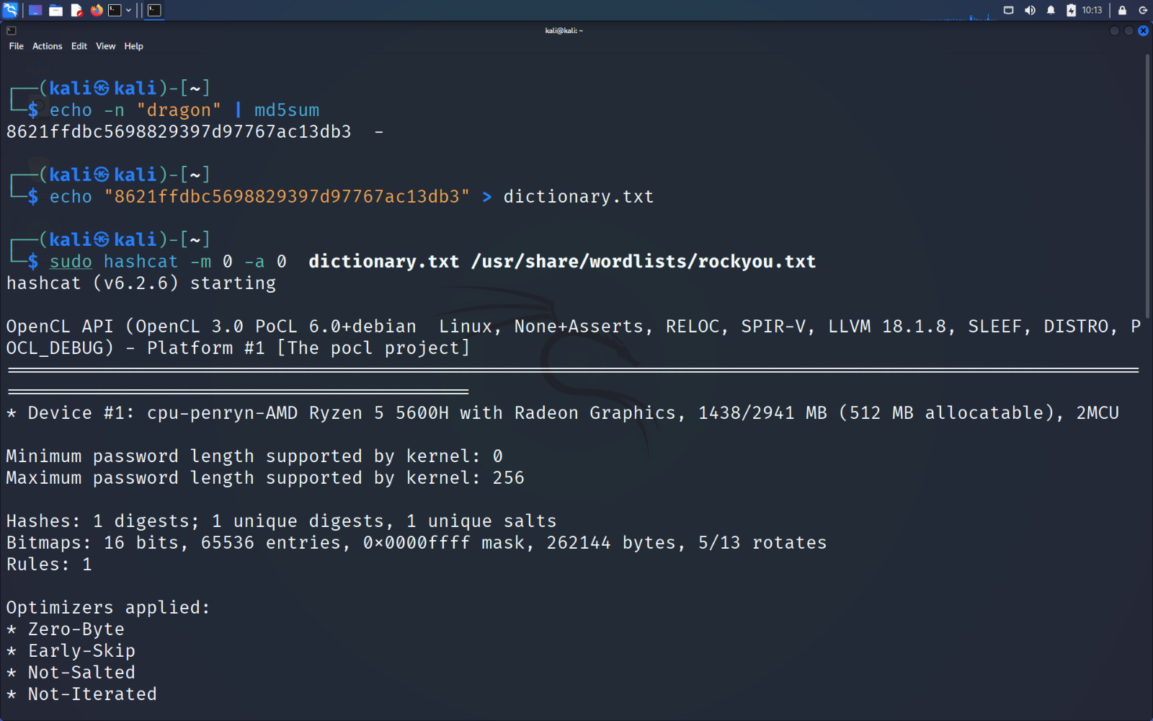

Slide 8
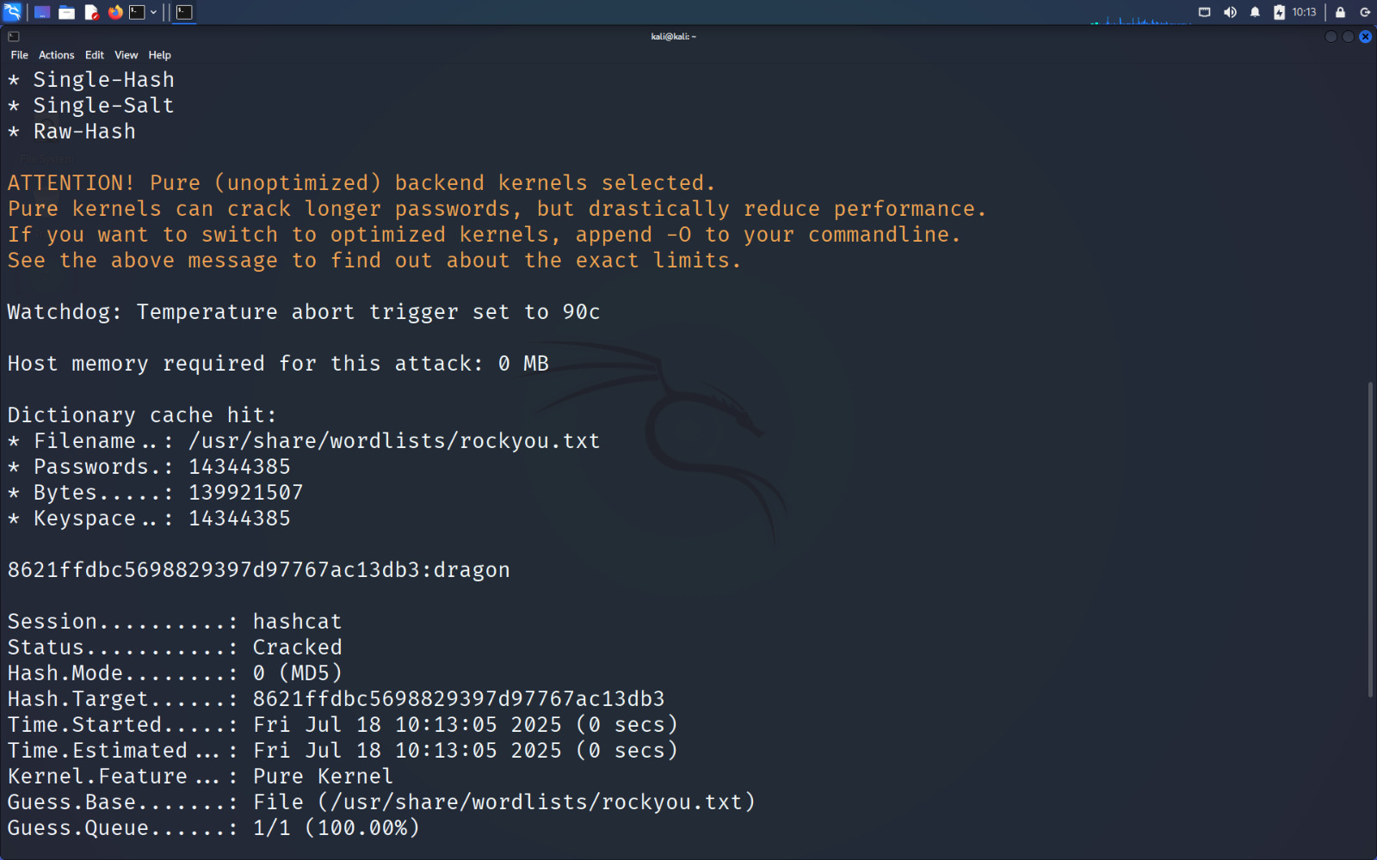

Slide 9
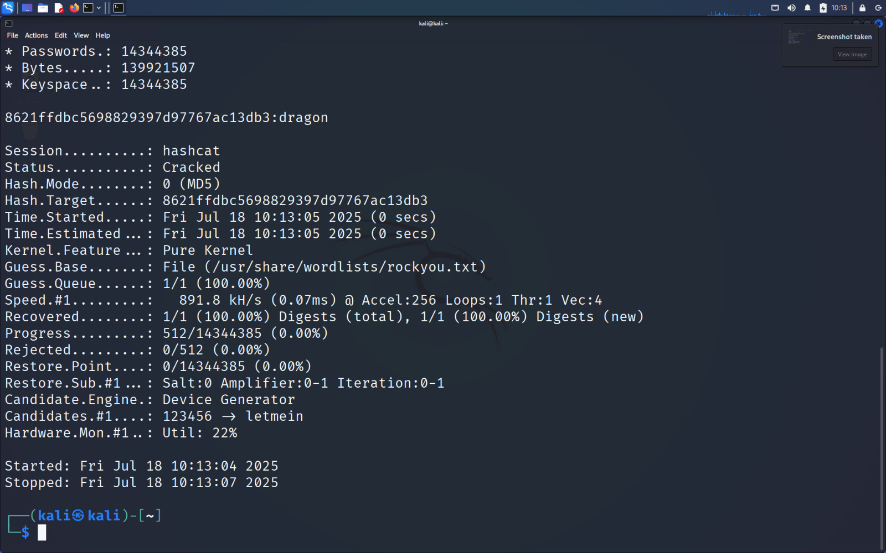

Slide 10
Brute-force Attack Example: '@Eagle1234'
- Password: @Eagle1234
- Hash generated using: echo -n '@Eagle1234' | md5sum
- Saved hash in file: hashes.txt
- Wordlist failed: Not present in rockyou.txt
- Used brute-force pattern: ?s?u?l?l?l?l?d?d?d?d
- Command: hashcat -m 0 -a 3 hashes.txt ?s?u?l?l?l?l?d?d?d?d
- Result: Cracked successfully, but took significantly longer

Slide 11
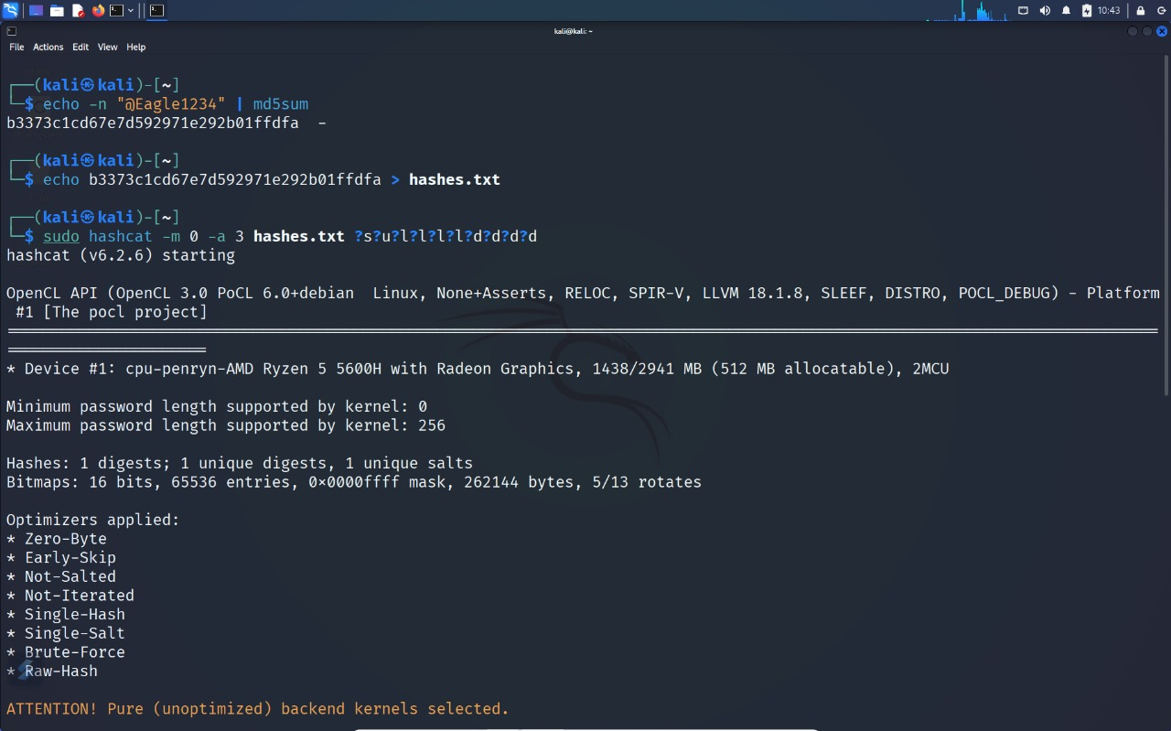

Slide 12
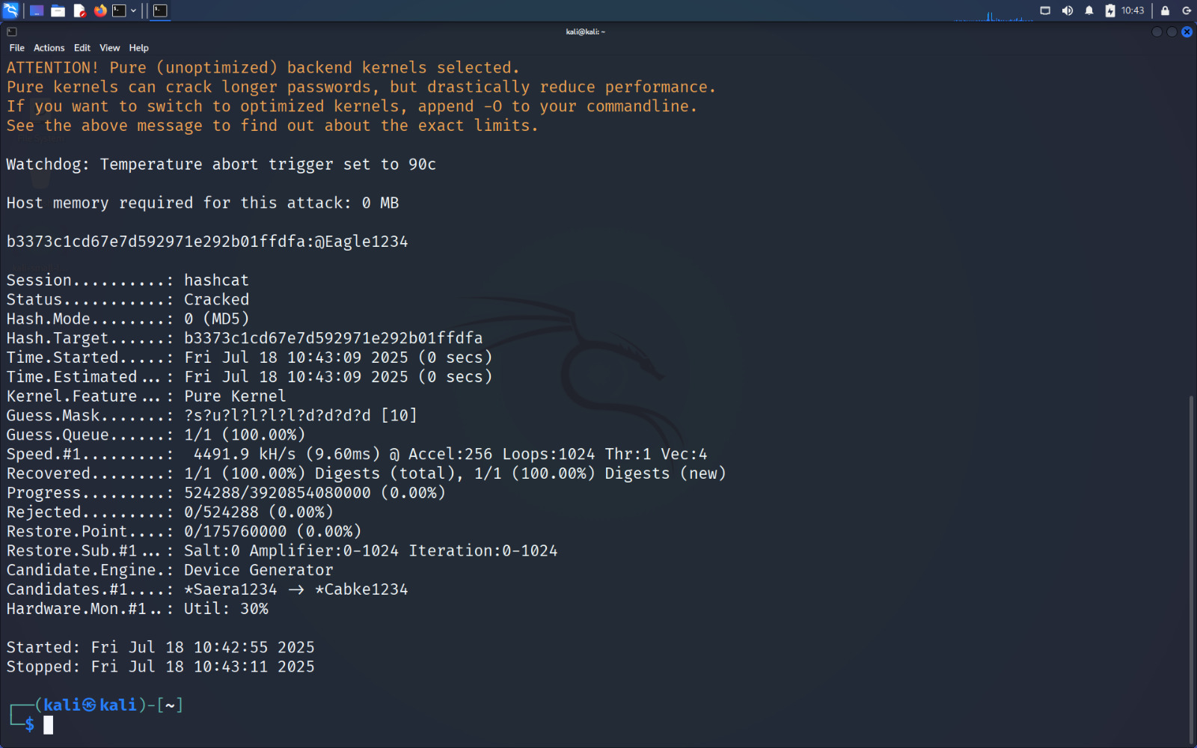

Slide 13
Results & Analysis
- Dictionary attack is faster for common passwords like 'dragon'
- Brute-force is time-intensive but works for complex passwords like '@Eagle1234'
- Cracking time increases exponentially with password length and complexity
- Strong passwords reduce vulnerability

Slide 14
Learnings & Ethics
- Understood how different attack methods operate
- Hands-on experience with ethical password auditing
- Reinforced the importance of unique, strong passwords
- All experiments were conducted in a controlled and legal environment

Slide 15
Conclusion & References
This project successfully demonstrated password cracking using real-world examples.
Hashcat proved effective in simulating both attack types.
References:
- https://hashcat.net/wiki/
- https://www.kali.org/
- /usr/share/wordlists/rockyou.txt
- md5sum command-line tool

