Slide 1
Mini Project Review 2
CIPHER TEXT-ENCRYPTION

Slide 2
MODULE USED :
The code utilizes various cryptography modules to demonstrate secure communication between two users using a combination of asymmetric and symmetric encryption techniques.
The code imports essential libraries, including cryptography for asymmetric encryption, Fernet for symmetric encryption, and base64 for encoding and decoding ciphertext.
Public and private key pairs are generated for each user using the generate_key_pairs function.
Messages from User 1 and User 2 are obtained through user input.
A symmetric key is generated using Fernet.generate_key() for symmetric encryption.
The symmetric key is securely exchanged with both users by encrypting it with their respective public keys and using the OAEP (Optimal Asymmetric Encryption Padding) padding scheme for security.
User messages are encrypted with the symmetric key using the encrypt_message_with_symmetric_key function.
Encrypted messages are decrypted using the symmetric key with the decrypt_message_with_symmetric_key function.
The script displays the original messages sent by each user and the messages received and decrypted by the other user.
The Base64-encoded versions of the encrypted messages are also printed for demonstration purposes.

Slide 3
GUI CODE EXPLANATION:
1. Importing Required Libraries:The script imports several libraries related to cryptography, including cryptography.hazmat.primitives for asymmetric encryption, Fernet for symmetric encryption, and base64 for encoding/decoding.
Generating Public and Private Key Pairs:The generate_key_pairs function generates a pair of public and private keys for each user. It uses the RSA algorithm to create 2048-bit key pairs.
Encrypting and Decrypting Messages with a Symmetric Key:Two functions, encrypt_message_with_symmetric_key and decrypt_message_with_symmetric_key, are defined to encrypt and decrypt messages using symmetric encryption. They employ the Fernet encryption scheme.
Obtaining User Inputs:The script prompts User 1 and User 2 to enter their respective messages.
Generating a Symmetric Key:A symmetric key is generated using Fernet.generate_key(). This key will be used for symmetric encryption and decryption.
Encrypting the Symmetric Key with Asymmetric Encryption:The symmetric key is encrypted with the public key of both User 1 and User 2. This secure key exchange ensures that each user can access the symmetric key to encrypt and decrypt messages.
Encrypting User Messages :The messages entered by User 1 and User 2 are encrypted using the symmetric key with the encrypt_message_with_symmetric_key function.
Decrypting Messages:The encrypted messages are decrypted using the symmetric key and the decrypt_message_with_symmetric_key function, resulting in the original messages.
Displaying Results The script prints the following messages:
User 1's sent message.
User 2's received and decrypted message from User 1.
User 2's sent message.
User 1's received and decrypted message from User 2.
Printing Encrypted Messages:The Base64-encoded versions of the encrypted messages sent by User 1 and User 2 are printed to demonstrate the encryption process.

Slide 4
GUI CODE EXPLANATION: (CONT.)
This code provides a simple graphical interface for generating and reading QR codes. Users can enter data to generate a QR code or select an image containing a QR code to decode. The application uses the pyqrcode library to generate QR codes and the pyzbar library to decode QR codes from images.

Slide 5
GUI CODE EXPLANATION:
It imports necessary cryptography libraries.
Public and private key pairs are generated for each user.
Messages are encrypted and decrypted using a symmetric key.
Users input messages, and a symmetric key is generated.
The symmetric key is securely exchanged between users using asymmetric encryption.
User messages are encrypted with the symmetric key.
Encrypted messages are decrypted, and the original messages are displayed.
Base64-encoded versions of the encrypted messages are printed for demonstration.

Slide 6
OUTPUT

Slide 7
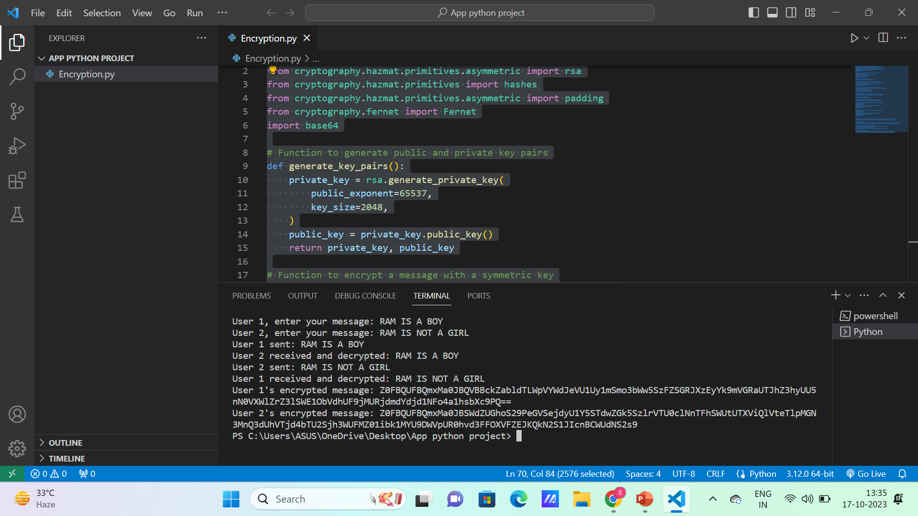

Slide 8


