Slide 1
PGP – Agentic AI
Sessions 1 – 9 | 08:00 – 11:00 AM
Atul Kahate
Notes:
Demo paths on every slide are relative to 16_PGP-Agentic\code (one folder per session; see code\README.md).

Slide 2
Sessions
Session | Date | Topic
Session 1 | Sat 24-Oct | Agentic AI Foundations and Agent Architectures
Session 2 | Sat 25-Oct | LangChain Core: Chains, Memory and RAG
Session 3 | Sun 31-Oct | LangChain Agents and Tool Use
Session 4 | Sat 1-Nov | LangGraph: Stateful Workflows and Routing
Session 5 | Sun 7-Nov | LangGraph: Cycles, Human-in-the-Loop and Persistence
Session 6 | Sat 8-Nov | Multi-Agent Orchestration with CrewAI
Session 7 | Sun 14-Nov | Multi-Agent Systems with Microsoft AutoGen
Session 8 | Sat 15-Nov | Agentic RAG and GraphRAG for Agents
Session 9 | Sun 21-Nov | Deep Agents: Reflection, Planning and Long-Term Memory

Slide 3
Session 1
Agentic AI Foundations and Agent Architectures
Sat 24-Oct | 08:00 – 11:00 AM
Notes:
Start of Session 1

Slide 4
Session 1 Topics
What an AI agent is and why we need one
Chatbots vs workflows vs agents
Agent components and architecture
Setup and API key
OpenAI Agents SDK basics
Giving an agent tools (@function_tool)
Building a multi-tool agent step by step
Sync vs async agents
Agent design patterns: Tool use, Planning, ReAct, Reflection, ReWOO, Multi-agent
Agentic AI framework landscape
Notes:
Session 1 – Sat 24-Oct

Slide 5

AI Agent
AI Agent: It is a system that uses AI models to perform tasks
Can perceive its environment, make decisions, and take actions in order to achieve specific goals
Capability | Definition | Examples
Perception | Takes input from the environment | Camera images, text, audio, sensor data, user queries
Reasoning / Decision-making | Decides what to do using rules, logic, or machine learning | Choosing the best move in chess, planning a route, selecting a response
Action | Performs tasks based on decisions | Moving a robot arm, answering a question, executing a command
Learning (optional) | Improves performance over time using feedback | Updating chatbot responses, refining recommendations, improving accuracy
DEMO: session_1/1_1_my_first_agent.py (teaser)
Notes:
Session 1 | Topic: 1. What an AI agent is and why we need one
Source: 15_real\Agentic AI - Real.pptx, slide 3
Demo: session_1/1_1_my_first_agent.py (teaser)

Slide 6
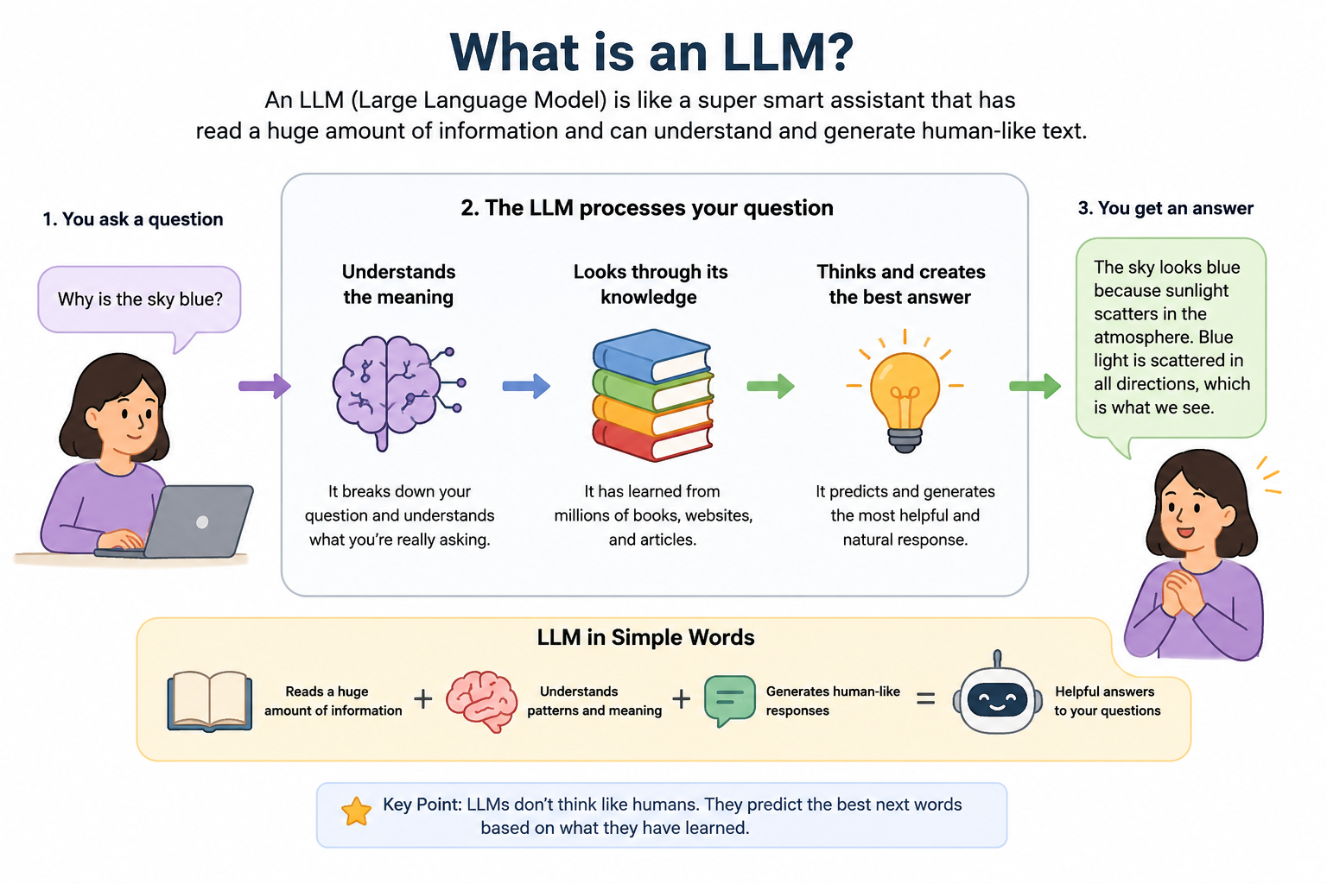
DEMO: Concept slide - no code; discuss
Notes:
Session 1 | Topic: 1. What an AI agent is and why we need one
Source: 0_slides\Agentic AI.pptx, slide 10
Demo: Concept slide - no code; discuss

Slide 7
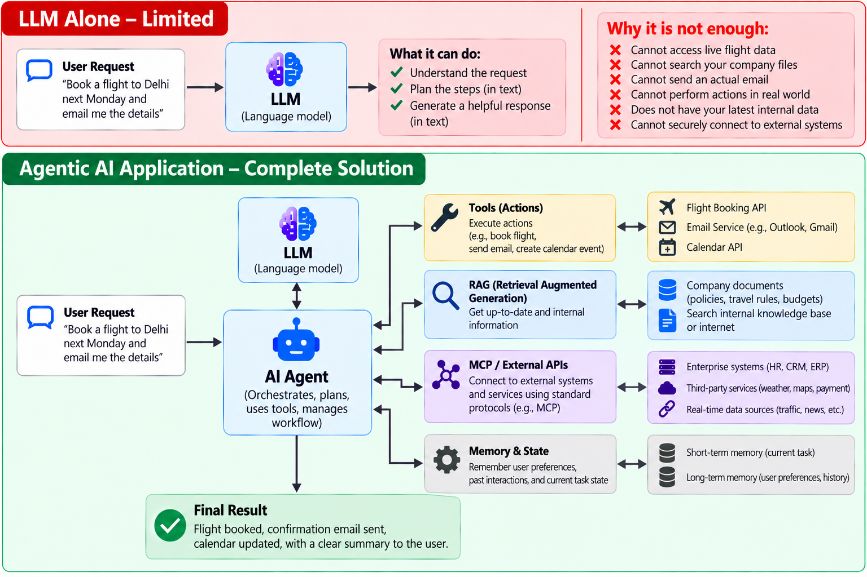

Slide 8
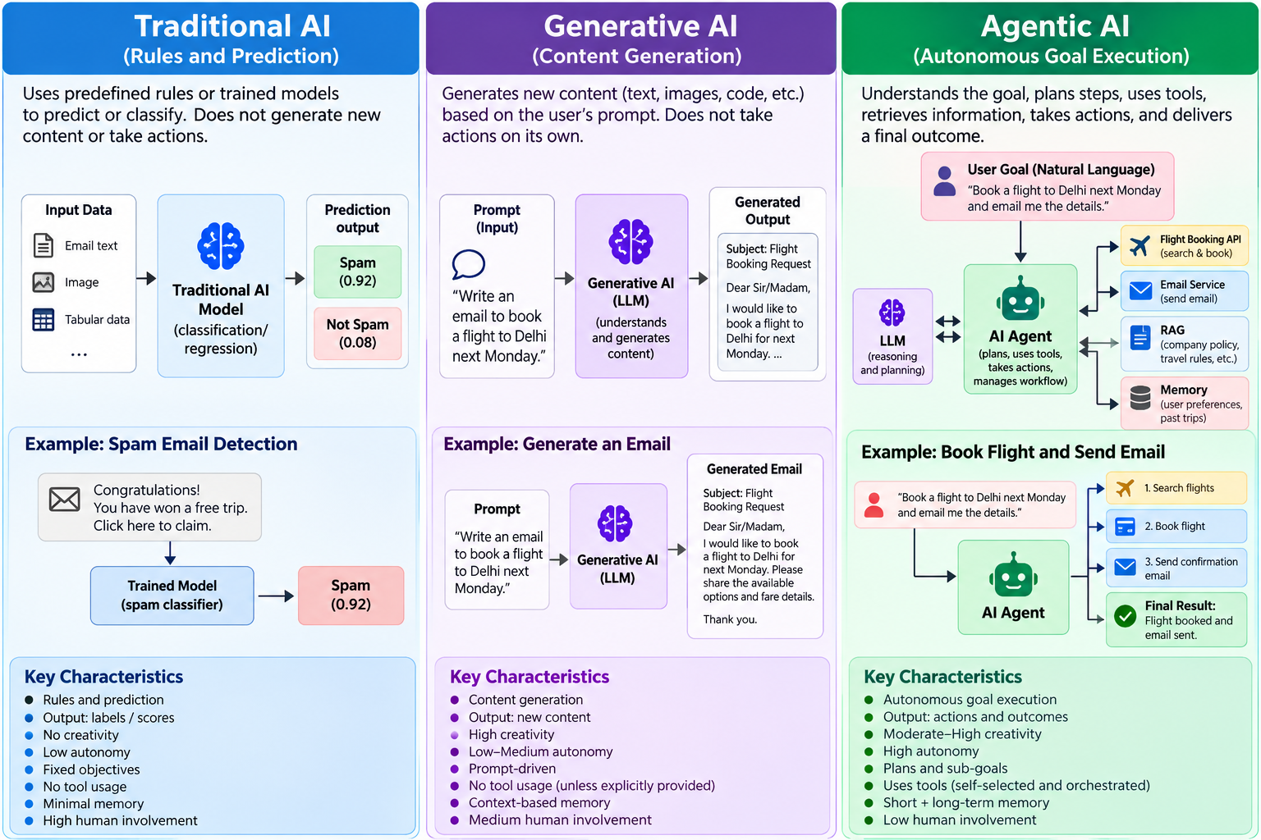
Notes:
Session 1 | Topic: 1. What an AI agent is and why we need one
Source: 15_real\Agentic AI - Real.pptx, slide 5
Demo: Concept slide - no code; discuss

Slide 9
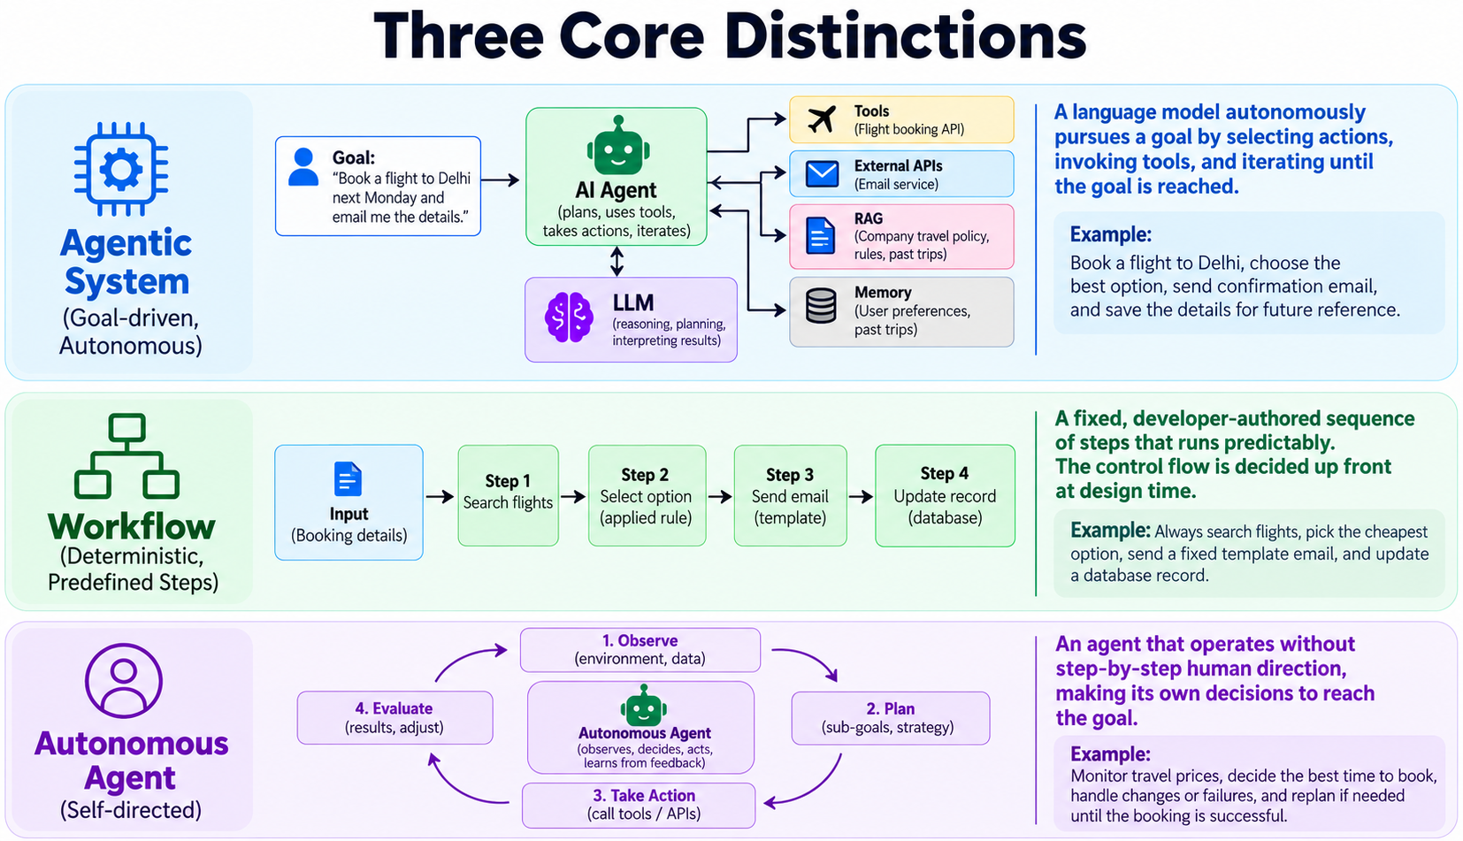
DEMO: Concept slide - no code; discuss
Notes:
Session 1 | Topic: 2. Chatbots vs workflows vs agents
Source: 0_slides\Agentic AI.pptx, slide 13
Demo: Concept slide - no code; discuss

Slide 10


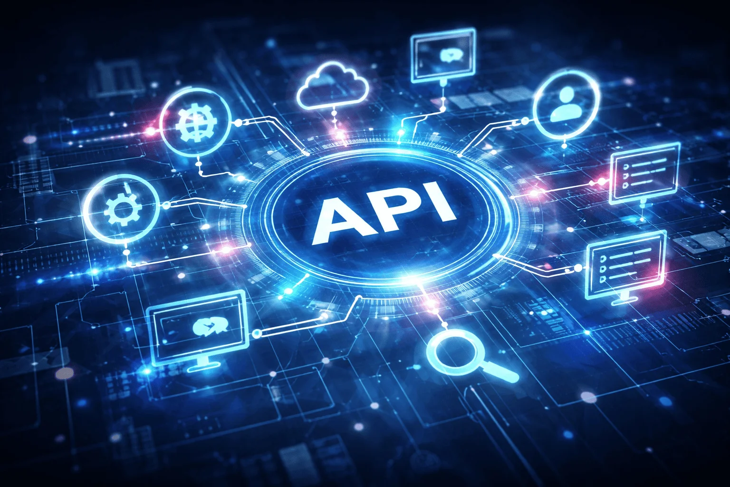







Agentic AI
MCP
Instructions in a Natural Human Language
Think, Act, Review
Tool Calling
RAG
Guardrails
HITL
Memory
DEMO: Concept slide - no code; discuss
This Photo by Unknown Author is licensed under CC BY-ND
Notes:
Session 1 | Topic: 3. Agent components and architecture
Source: 0_slides\Agentic AI.pptx, slide 11
Demo: Concept slide - no code; discuss

Slide 11
Hands-on: Directly Accessing LLMs
Download and install Python Version 3.12 (https://www.python.org/downloads/)
Download and install VS Code (https://code.visualstudio.com/download)
Create a directory (e.g. c:\code\agenticai) on your machine
Set up Python in VS Code: Open VS Code and press Ctrl+Shift+P -> Python: Select interpreter -> Select Python that you have installed on your machine
Create a virtual environment in VS Code
  Terminal -> New Terminal -> cd c:\code\agenticai
  python -m venv myenv
  If you get permission error on Windows, run this command: Set-ExecutionPolicy -Scope Process -ExecutionPolicy Bypass
  myenv\Scripts\activate (On Windows) and source myenv/bin/activate (on Linux)
  pip install openai openai-agents
  Later, if needed, to deactivate: deactivate
DEMO: session_1/1_5_openai_basic.py (raw API call), 1_2_openai_agent_basic.py
Notes:
Session 1 | Topic: 4. Setup and API key
Source: 15_real\Agentic AI - Real.pptx, slide 8
Demo: session_1/1_5_openai_basic.py (raw API call), 1_2_openai_agent_basic.py

Slide 12
Using LLMs: OpenAI
Get an API key: https://platform.openai.com/settings/organization/api-keys
Copy it in .env file
pip install openai dotenv
Run C:\code\agenticai\16_PGP-Agentic\code\session_1\1_5_openai_basic.py
DEMO: session_1/1_5_openai_basic.py (raw API call), 1_2_openai_agent_basic.py
Notes:
Session 1 | Topic: 4. Setup and API key
Source: 15_real\Agentic AI - Real.pptx, slide 9
Demo: session_1/1_5_openai_basic.py (raw API call), 1_2_openai_agent_basic.py

Slide 13

Basic Terms
Component | Full form | Where located?
Agent SDK | Software Development Kit | Runs on our client
API | Application Programming Interface | Runs on the server side (LLM)
Agent
SDK
API
end-point
GPT
(OpenAI LLM)
DEMO: Concept slide - no code; discuss
Notes:
Session 1 | Topic: 5. OpenAI Agents SDK basics
Source: 0_slides\Agentic AI.pptx, slide 33
Demo: Concept slide - no code; discuss

Slide 14
Agents API
Aspect | Description
Official Definition | “Agents represent systems that intelligently accomplish tasks, ranging from executing simple workflows to pursuing complex, open-ended objectives.” — OpenAI
Purpose | Agents combine reasoning, tool use, and memory to autonomously complete tasks — from basic automation to multi-step decision-making
Examples of Tasks | • Run data analysis scripts • Search the web or use APIs • Send messages or emails • Plan and execute multi-step goals
Installation Command | pip install openai-agents
Integration | Works seamlessly with the OpenAI Responses API, enabling dynamic tool-calling and multi-step task completion
Benefit | Turns LLMs from reactive assistants into goal-driven, autonomous systems
Code: C:\code\agenticai\16_PGP-Agentic\code\session_1\1_2_openai_agent_basic.py
DEMO: session_1/1_2_openai_agent_basic.py
Notes:
Session 1 | Topic: 5. OpenAI Agents SDK basics
Source: 0_slides\Agentic AI.pptx, slide 56
Demo: session_1/1_2_openai_agent_basic.py

Slide 15
Agents API Basics
instruction = "You are a helpful customer support analyst.“
message = "Analyze this customer feedback and suggest improvements to the product: 'The packaging is great, but the delivery was delayed by two days.'"
Step 1: Defining an Agent
agent = Agent(
name="Assistant",
instructions=instruction,
model=“gpt-4o-mini” // optional
)
Agent: Object representing our intelligent assistant
instructions: Tell the agent how to behave
Note: This will create but not run the agent
Runner.run_sync executes the agent synchronously
Sends the message to the agent along with instructions
Internally:
1. The agent formats the message for the LLM
2. The LLM generates a response based on the instruction and message
3. Runner wraps this execution and stores the final output in result
Step 2: Running the Agent
result = Runner.run_sync(agent, message)
DEMO: session_1/1_2_openai_agent_basic.py
Notes:
Session 1 | Topic: 5. OpenAI Agents SDK basics
Source: 0_slides\Agentic AI.pptx, slide 57
Demo: session_1/1_2_openai_agent_basic.py

Slide 16
OpenAI Agents SDK
Allows us to build agentic apps with basic primitives:
Primitive | Description | Example Use Case
Agents | LLMs equipped with instructions and tools. | A customer support bot that answers FAQs using a knowledge base and function calling.
Handoffs | Allow agents to delegate to other agents for specific tasks. | A general support agent escalates a billing-related query to a specialized billing agent.
Guardrails | Enable validation of agent inputs and outputs. | Prevent an agent from generating unsafe instructions or validate that output is JSON before returning.
Sessions | Automatically maintain conversation history across agent runs. | A tutoring agent remembers what topics a student has already covered across multiple sessions.
DEMO: session_1/1_2_openai_agent_basic.py
Notes:
Session 1 | Topic: 5. OpenAI Agents SDK basics
Source: 0_slides\Agentic AI.pptx, slide 58
Demo: session_1/1_2_openai_agent_basic.py

Slide 17
First Agent SDK Example (Sync Approach)
agent = Agent(name="Assistant", instructions="You are a helpful assistant")
  Create an Agent object, giving it a name and system prompt (to tell it what role to perform)
result = Runner.run_sync(agent, "Write a joke about vibe coding.")
  Runner executes a task for the agent
  Actual task is mentioned in the method call
  _sync part indicates that the program will wait for the LLM to finish its work
  Output is stored in the result variable
Code: 1_2_openai_agent_basic.py
DEMO: session_1/1_2_openai_agent_basic.py
Notes:
Session 1 | Topic: 5. OpenAI Agents SDK basics
Source: 0_slides\Agentic AI.pptx, slide 61
Demo: session_1/1_2_openai_agent_basic.py

Slide 18

DEMO: session_1/1_6_openai_agent_pattern_tool.py
Notes:
Session 1 | Topic: 6. Giving an agent tools
Source: 0_slides\Agentic AI.pptx, slide 18
Demo: session_1/1_6_openai_agent_pattern_tool.py

Slide 19
Function (Tool) Calling Workflow
Tool calling: Allows an LLM to delegate specific tasks to external functions, APIs, or knowledge sources, making them more useful for real-world tasks, beyond just text generation
Components
Component | Role / Purpose
LLM (Agent) | Generates responses and decides when to call a tool. Uses instructions, context, and available tool schemas.
Tool / Function | Encapsulates a task the agent can perform. Has a name, description, and parameter schema. Provides a callback function to execute when called.
Runner / Executor | Middleware that passes the tool call from the agent to our function. Handles asynchronous execution, error handling, and return of results.
DEMO: session_1/1_6_openai_agent_pattern_tool.py
Notes:
Session 1 | Topic: 6. Giving an agent tools
Source: 0_slides\Agentic AI.pptx, slide 69
Demo: session_1/1_6_openai_agent_pattern_tool.py

Slide 20



Tool Workflow
Tool
call
Tool call needed
Runner
Returns output
Step | Description | Example / Notes
1. Agent receives user input | User types a message. Agent receives it along with instructions and context. | "What is the return policy?"
2. Agent decides whether to call a tool | Agent checks available tools. Decides whether to call a tool or answer internally. | Call get_faq_answer tool for known topic or answer directly.
3. Agent generates a tool call | Agent creates a structured function call matching the tool’s schema. Ensures required fields are present and types are correct. | { "name": "get_faq_answer", "parameters": { "topic": "return policy" } }
4. Runner executes the tool | Runner calls the registered callback function. Passes parameters and tool context (metadata). | params = {"topic": "return policy"} tool_context includes agent name, conversation ID, etc.
5. Tool returns results | Callback function fetches the answer from knowledge base or API. Runner passes it back to the agent. | "You can return any product within 30 days of delivery."
6. Agent generates final response | Agent combines tool output with conversational context and formats response for the user. | Bot: You can return any product within 30 days of delivery.
7. Optional – Logging / Analytics | Tool calls, parameters, and results can be logged for auditing, analytics, or improving accuracy. | Useful for monitoring and refining agent behavior.
DEMO: session_1/1_6_openai_agent_pattern_tool.py
Notes:
Session 1 | Topic: 6. Giving an agent tools
Source: 0_slides\Agentic AI.pptx, slide 70
Demo: session_1/1_6_openai_agent_pattern_tool.py

Slide 21
Function (Tool) Calling
Step 1: Write the actual function
@function_tool
async def add_numbers(a: float, b: float) -> float:
"""
Add two numbers and return the result.
"""
return a + b
Provide very clear docstring – the agent uses this to decide whether to make a tool call
Step 2: Define the Agent with the Tool
adder_agent = Agent(
name=“Adder Bot",
instructions=(
"You are a helpful customer support adder assistant. "
“Perform the addition when the user instructs."
),
tools=[add_numbers]
)
DEMO: session_1/1_6_openai_agent_pattern_tool.py
Notes:
Session 1 | Topic: 6. Giving an agent tools
Source: 0_slides\Agentic AI.pptx, slide 71
Demo: session_1/1_6_openai_agent_pattern_tool.py

Slide 22
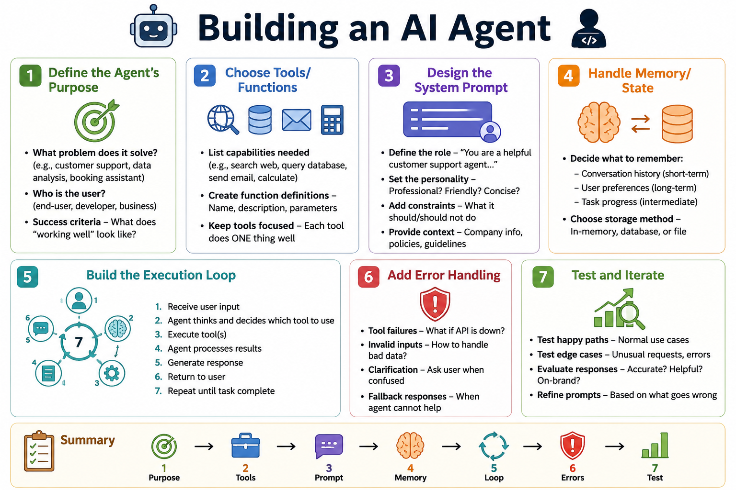
DEMO: session_1/1_1_my_first_agent.py
Notes:
Session 1 | Topic: 7. Building a multi-tool agent step by step
Source: 0_slides\Agentic AI.pptx, slide 22
Demo: session_1/1_1_my_first_agent.py

Slide 23
Building a Multi-Assistant Agent Step-by-Step
Step 1: Setup and Imports
import asyncio
from agents import Agent, Runner, function_tool
from datetime import datetime
from dotenv import load_dotenv
load_dotenv(override=True)
Code | Explanation
agents | OpenAI Agents SDK
asyncio | For running multiple queries concurrently
function_tool | Decorator to convert functions into agent tools
load_dotenv() | Loads API keys from .env file
Installations
pip install openai-agents dotenv
OR
uv add openai-agents dotenv
DEMO: session_1/1_1_my_first_agent.py
Notes:
Session 1 | Topic: 7. Building a multi-tool agent step by step
Source: 0_slides\Agentic AI.pptx, slide 24
Demo: session_1/1_1_my_first_agent.py

Slide 24
Building a Multi-Assistant Agent Step-by-Step
Step 2: Create Tools
@function_tool
def get_temperature(city: str) -> str:
"""Returns mock temperature for a city."""
temps = {
"new york": "72°F",
"london": "65°F",
"tokyo": "78°F",
"sydney": "68°F",
"mumbai": "85°F"
}
return temps.get(city.lower(), "70°F")
Code | Explanation
@function_tool | Decorator tells the agent that it is a callable tool
“”” … ‘’’ | Docstring helps the agent decide if and when to use this tool
DEMO: session_1/1_1_my_first_agent.py
Notes:
Session 1 | Topic: 7. Building a multi-tool agent step by step
Source: 0_slides\Agentic AI.pptx, slide 25
Demo: session_1/1_1_my_first_agent.py

Slide 25
Building a Multi-Assistant Agent Step-by-Step
Step 2: Create Tools
@function_tool
def get_time(timezone: str) -> str:
"""Returns current time for a timezone."""
return datetime.now().strftime("%I:%M %p")
@function_tool
def calculate(expression: str) -> str:
"""Evaluates a simple math expression."""
try:
result = eval(expression)
return f"{expression} = {result}"
except:
return "Invalid expression"
DEMO: session_1/1_1_my_first_agent.py
Notes:
Session 1 | Topic: 7. Building a multi-tool agent step by step
Source: 0_slides\Agentic AI.pptx, slide 26
Demo: session_1/1_1_my_first_agent.py

Slide 26
Building a Multi-Assistant Agent Step-by-Step
Step 3: Create Agent
agent = Agent(
name="QuickAssistant",
model="gpt-4o-mini",
tools=[get_temperature, get_time, calculate],
instructions="You are a helpful assistant. Use tools when needed. Be concise."
)
Code | Explanation
name | Identifies the agent
model | Which LLM to use?
tools | List of available tools
instructions | System prompt
DEMO: session_1/1_1_my_first_agent.py
Notes:
Session 1 | Topic: 7. Building a multi-tool agent step by step
Source: 0_slides\Agentic AI.pptx, slide 27
Demo: session_1/1_1_my_first_agent.py

Slide 27
Building a Multi-Assistant Agent Step-by-Step
Step 4: Prepare Test Queries
async def run_agent():
queries = [
"What's the temperature in Tokyo?",
"Calculate 25 * 4 + 10",
"What time is it in New York timezone?",
]
print("Processing queries in parallel...\n")
Code | Explanation
queries | List of queries to be sent to the agent
async def | Run this concurrently
Queries are in natural (human) language
Agent will figure out if and which tool to call
DEMO: session_1/1_1_my_first_agent.py
Notes:
Session 1 | Topic: 7. Building a multi-tool agent step by step
Source: 0_slides\Agentic AI.pptx, slide 28
Demo: session_1/1_1_my_first_agent.py

Slide 28
Building a Multi-Assistant Agent Step-by-Step
Step 5: Run Queries Concurrently
# Process all queries concurrently
tasks = [Runner.run(agent, query) for query in queries]
results = await asyncio.gather(*tasks)
Code | Explanation
Runner.run(agent, query) | Executes agent with a query, [ ] creates a list comprehension, i.e. multiple tasks
asyncio.gather() | Runs all tasks simultaneously and waits for all to complete
await | Waits for all results before continuing
DEMO: session_1/1_1_my_first_agent.py
Notes:
Session 1 | Topic: 7. Building a multi-tool agent step by step
Source: 0_slides\Agentic AI.pptx, slide 29
Demo: session_1/1_1_my_first_agent.py

Slide 29
Building a Multi-Assistant Agent Step-by-Step
Step 6: Display Results
# Display results
for query, result in zip(queries, results):
print(f"Q: {query}")
print(f"A: {result.final_output}\n")
Code | Explanation
zip() | Pairs each query with its result
result.final_output | Agent’s final answer, after all tool calls
DEMO: session_1/1_1_my_first_agent.py
Notes:
Session 1 | Topic: 7. Building a multi-tool agent step by step
Source: 0_slides\Agentic AI.pptx, slide 30
Demo: session_1/1_1_my_first_agent.py

Slide 30
Building a Mult-Assistant Agent Step-by-Step
Step 7: Run the Program
if __name__ == "__main__":
asyncio.run(run_agent())
Code | Explanation
if __name__ == “__main__”: | Standard Python syntax – Only runs if the file is executing directly
asyncio.run() | Starts the async event loop and runs main()
DEMO: session_1/1_1_my_first_agent.py
Notes:
Session 1 | Topic: 7. Building a multi-tool agent step by step
Source: 0_slides\Agentic AI.pptx, slide 31
Demo: session_1/1_1_my_first_agent.py

Slide 31
Agents API: Sync or Async?
Agents API supports two modes of operation: synchronous and asynchronous
Aspect | Synchronous: Runner.run_sync(...) | Asynchronous: await Runner.run(...)
Programming style | Blocking (runs one task at a time) | Non-blocking (can run multiple tasks concurrently)
Ease of use | Simpler to write, no async/await needed | Requires asyncio and await keywords
Best for | Quick scripts, one-off calls, debugging | Production apps, web servers, handling multiple sessions or tool calls
Concurrency | Cannot overlap calls – each waits for the previous to finish | Can run multiple LLM calls or tool calls in parallel
Performance | Slower if many requests, since they run sequentially | Faster throughput when managing many tasks
Error handling | Traditional try/except | Async exception handling (asyncio.gather, cancellation, timeouts)
DEMO: session_1/1_7_openai_agent_sync.py, 1_8_openai_agent_async.py
Notes:
Session 1 | Topic: 8. Sync vs async agents
Source: 0_slides\Agentic AI.pptx, slide 59
Demo: session_1/1_7_openai_agent_sync.py, 1_8_openai_agent_async.py

Slide 32
Sync versus Async: Sample Code
Sync Approach | Async Approach
from agents import Agent, Runner agent = Agent(name="Assistant", instructions="You are a helpful customer support analyst.") result = Runner.run_sync(agent, "Analyze this customer feedback and suggest improvements to the product: 'The packaging is great, but the delivery was delayed by two days.'" ") print(result.final_output) | import asyncio from agents import Agent, Runner agent = Agent(name="Assistant", instructions="You are a helpful customer support analyst.") async def main(): result = await Runner.run(agent, “Analyze this customer feedback and suggest improvements to the product: 'The packaging is great, but the delivery was delayed by two days.'" ) print(result.final_output) asyncio.run(main())
DEMO: session_1/1_7_openai_agent_sync.py, 1_8_openai_agent_async.py
Notes:
Session 1 | Topic: 8. Sync vs async agents
Source: 0_slides\Agentic AI.pptx, slide 60
Demo: session_1/1_7_openai_agent_sync.py, 1_8_openai_agent_async.py

Slide 33
Sync Versus Async Processing in Agents
Run two agents one after the other, i.e. in sync mode, wait for their work to complete, and then output the final combined result
  1_7_openai_agent_sync.py
Run the same two agents at the same time, i.e. in async mode, wait for their work to complete, and then output the final combined result
  1_8_openai_agent_async.py
DEMO: session_1/1_7_openai_agent_sync.py, 1_8_openai_agent_async.py
Notes:
Session 1 | Topic: 8. Sync vs async agents
Source: 0_slides\Agentic AI.pptx, slide 64
Demo: session_1/1_7_openai_agent_sync.py, 1_8_openai_agent_async.py

Slide 34


Tool Use Pattern
Need to call a Tool
Our Agentic AI Code Containing Tools
Definition
  The agent decides when and how to invoke external tools or APIs to complete a task
  Instead of doing everything internally, the agent delegates tasks to specialized modules
Workflow
  Agent analyzes the task
  Determines which tool is suitable
  Sends structured input to the tool
  Receives output / result
  Integrates result into final reasoning / answer
Advantages
  Modularity: Each tool is specialized; agent remains flexible
  Scalability: Add new tools without changing core agent logic
  Auditability: Clear trace of which tool produced what output
  Efficiency: Offloads complex computations to optimized tools
DEMO: session_1/1_6_openai_agent_pattern_tool.py
Notes:
Session 1 | Topic: 9. Agent design patterns
Source: 0_slides\Agentic AI.pptx, slide 65
Demo: session_1/1_6_openai_agent_pattern_tool.py

Slide 35
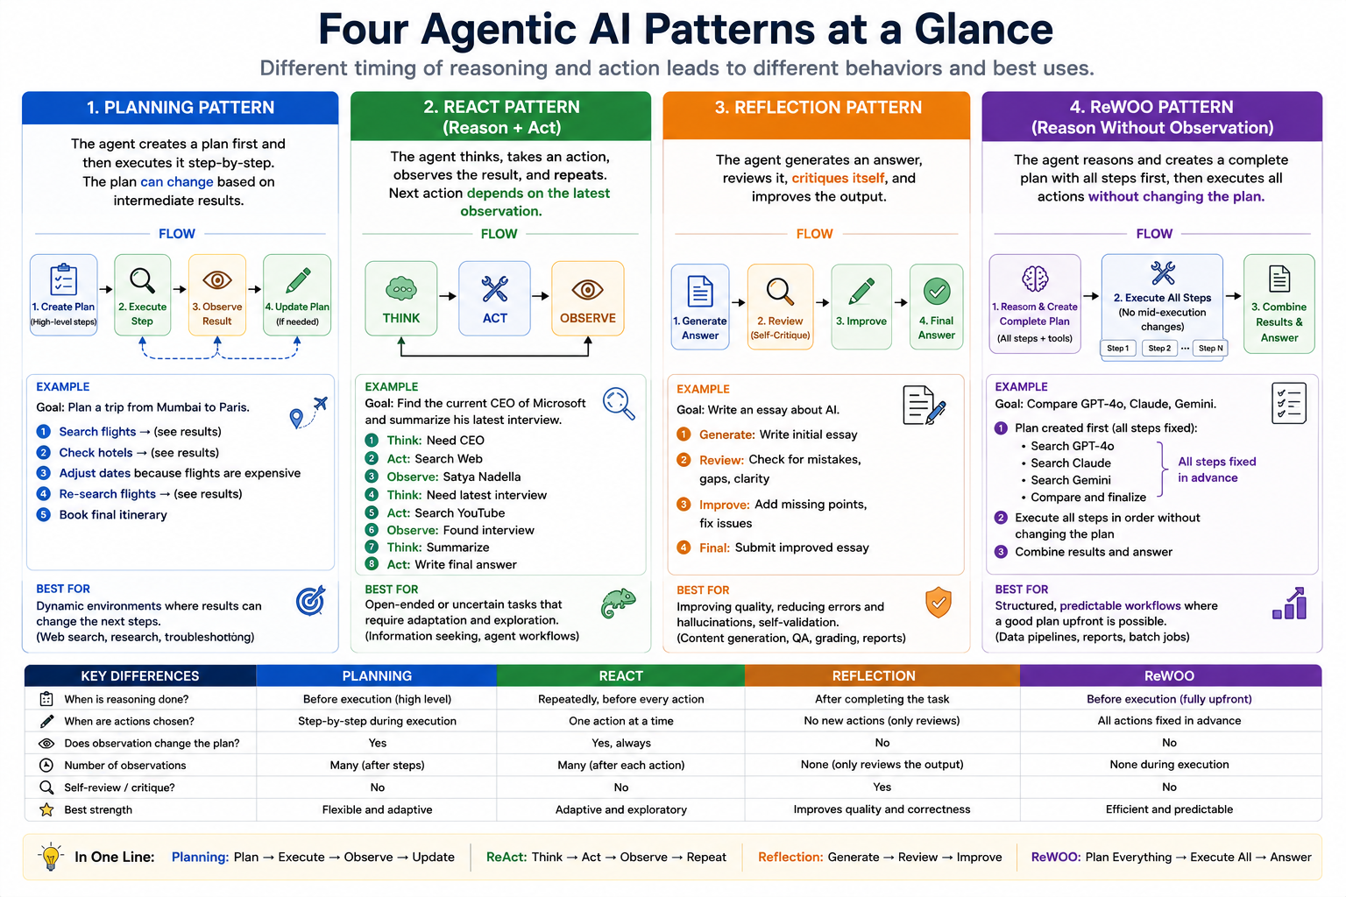
DEMO: session_1/1_9_openai_agent_pattern_plan.py, 1_4_openai_agent_pattern_react.py, 1_10_openai_agent_pattern_reflection.py, 1_3_openai_agent_pattern_rewoo.py
Notes:
Session 1 | Topic: 9. Agent design patterns
Source: 0_slides\Agentic AI.pptx, slide 66
Demo: session_1/1_9_openai_agent_pattern_plan.py, 1_4_openai_agent_pattern_react.py, 1_10_openai_agent_pattern_reflection.py, 1_3_openai_agent_pattern_rewoo.py

Slide 36
ReAct Pattern
ReAct -> Re = Reasoning, Act = Acting
Instead of immediately answering a question, the AI agent:
  Thinks about the problem
  Decides which tool to use
  Executes the tool
  Observes the result
  Thinks again
  Repeats until the goal is achieved
The ReAct Loop: Thought → Action → Observation → Thought → Action → Observation → Answer
C:\code\agenticai\16_PGP-Agentic\code\session_3\3_5_react_agent_web_search_python_repl.py
DEMO: session_1/1_4_openai_agent_pattern_react.py
Notes:
Session 1 | Topic: 9. Agent design patterns
Source: 14_advanced\Agentic AI - Advanced Engineering.pptx, slide 149
Demo: session_1/1_4_openai_agent_pattern_react.py

Slide 37
Plan-and-Execute Pattern
Plan-and-Execute: Separates an AI agent's work into two distinct phases
  Planning – Create a complete plan to achieve the goal
  Execution – Carry out each step in the plan
Instead of deciding the next action after every observation (as in ReAct), the agent first develops an overall strategy
Goal → Planner → Execution Plan → Executor → Step 1 → Step 2 → Step 3 → Final Answer
Each step itself is a ReAct loop internally
session_3\3_6_plan_and_execute_agent.py
DEMO: session_1/1_9_openai_agent_pattern_plan.py
Notes:
Session 1 | Topic: 9. Agent design patterns
Source: 14_advanced\Agentic AI - Advanced Engineering.pptx, slide 150
Demo: session_1/1_9_openai_agent_pattern_plan.py

Slide 38
Multi-agent
Pattern
Our Agentic AI Code
Definition
  Multiple specialized agents collaborate to solve a single problem
  Each agent has a clear role, responsibility, and scope
  Complex tasks are decomposed across agents instead of a single monolithic agent
Workflow
  User request is received by an orchestrator (or coordinator agent)
  Task is decomposed into sub-tasks
  Sub-tasks are assigned to specialized agents
  Agents execute independently or sequentially
  Outputs are aggregated and validated
  Final result is produced
Advantages
  Specialization: Each agent focuses on what it does best
  Scalability: Add or replace agents without redesigning the system
  Parallelism: Agents can work concurrently for faster results
  Robustness: Failure of one agent does not collapse the entire system
DEMO: session_1/1_11_openai_agent_pattern_multi_agent.py
Notes:
Session 1 | Topic: 9. Agent design patterns
Source: 0_slides\Agentic AI.pptx, slide 67
Demo: session_1/1_11_openai_agent_pattern_multi_agent.py

Slide 39
# | Task | Design Pattern | Features | Improvements still to be done | Code
1 | A customer support bot that answers FAQs using a knowledge base and function calling | Information Retrieval Pattern: Pull an answer directly from a predefined source | Function (Tool) calling* | Knowledgebase is hardcoded, Customer queries are searched on keywords, UI is not good | 1_12_openai_agent_tool_hardcoded_knowledge.py
2 | Do not search the customer query based on keywords, but perform semantic search | Semantic Search Pattern: Understand meaning behind the user’s query, not just keywords | Compute embeddings for knowledge base and compare with embeddings for customer query* | Knowledgebase is hardcoded, UI is not good | 1_13_openai_agent_hardcoded_semantic.py
3 | Use OpenAI’s Embeddings | RAG without we coding for it | Use OpenAI embeddings instead of Hugging Face/Chroma Embeddings | NA | 1_14_openai_agent_openai_vectorstore.py
4 | Store our FAQs in Sqllite DB and then vectorize them and use them | RAG – Basic | We create our own vectorized database, but limited in size | Use real data | First run 1_15_openai_agent_create_faq_db.py and then 1_16_openai_agent_faq_db_vectorized.py
4 | Make it like a chatbot | Not a pattern, but separating the UI | Added Gradio | Make it RAG | 1_17_openai_agent_flask.py
5 | Add RAG Functionality | RAG (Insurance document) | Added RAG* | None | 1_18_openai_agent_insurance_flask.py
6 | Guardrails* | Guardrails | Different example | NA | 1_19_openai_agent_guardrails.py
7 | Agents as Tools* | None | Convert agents into tools, which a high-level agent can use | NA | 1_22_openai_agent_agent_as_tool.py
8 | Short Term Memory | Memory pattern | Default: Agents are stateless, Each call: New Agent, Change it | Add long term memory | 1_23_openai_agent_short_term_memory.py
DEMO: session_1/1_12_* … 1_23_*
Notes:
Session 1 | Topic: 9. Agent design patterns
Source: 0_slides\Agentic AI.pptx, slide 68
Demo: session_1/1_12_* … 1_23_*

Slide 40
Agentic AI Frameworks/Technologies
Level | Tool / Framework | Role | Why it fits here
1 | OpenAI SDK | Base API/SDK | Lowest level – just an SDK to call LLMs, embeddings, etc. We build everything else on top
2 | OpenAI Agents SDK | Structured agent building | More structured agents – adds abstractions for tools, memory, structured responses, making agent creation easier
3 | LangGraph | Workflow + Agent graphs | Lets us compose agents/workflows as state machines/graphs. Good for predictable flows or multi-agent orchestration
4 | CrewAI | Multi-agent orchestration | Specializes in multi-agent “crew” collaboration, roles, and task distribution, built for autonomy
5 | AutoGen | Multi-agent conversation framework | Similar to CrewAI, but focuses heavily on conversational agent-to-agent loops (like negotiation, reasoning)
6 | MCP (Model Context Protocol) | Standard protocol for agent ↔ tool ↔ client communication | Sits at the top as infrastructure – not an agent framework itself, but a protocol that makes all the above interoperable
7 | No Code-Low Code | Create agentic AI applications without writing code | Uses drag-and-drop features with a rich set of connectors to create powerful applications (Examples: n8n, OpenAI Agent Builder)
DEMO: Concept slide - no code; discuss
Notes:
Session 1 | Topic: 10. Agentic AI framework landscape
Source: 0_slides\Agentic AI.pptx, slide 21
Demo: Concept slide - no code; discuss

Slide 41
Session 2
LangChain Core: Chains, Memory and RAG
Sat 25-Oct | 08:00 – 11:00 AM
Notes:
Start of Session 2

Slide 42
Session 2 Topics
LangChain overview and architecture
LCEL and Runnables
Prompt templates and output parsers
Conversation memory (session and persistent)
Embeddings and vector databases (Chroma, FAISS)
Document loaders, text splitters and chunking
Building a RAG pipeline with retrievers
Hands-on: Q&A bot over PDFs
Notes:
Session 2 – Sat 25-Oct

Slide 43
LangChain Architecture
Core packages
  langchain
  langchain-core
  langchain-community
  langchain-openai
Models
Prompts: String, Chat, Message
Output parsers: String, JSON, Pydantic, CSV
LangChain Expression Language (LCEL)
Runnables: RunnableLambda, RunnableParallel, RunnablePassthrough
Example: prompt | llm | parser
DEMO: session_2/2_1_langchain_lcel.py
Notes:
Session 2 | Topic: 1. LangChain overview and architecture
Source: 0_slides\Agentic AI.pptx, slide 145
Demo: session_2/2_1_langchain_lcel.py

Slide 44
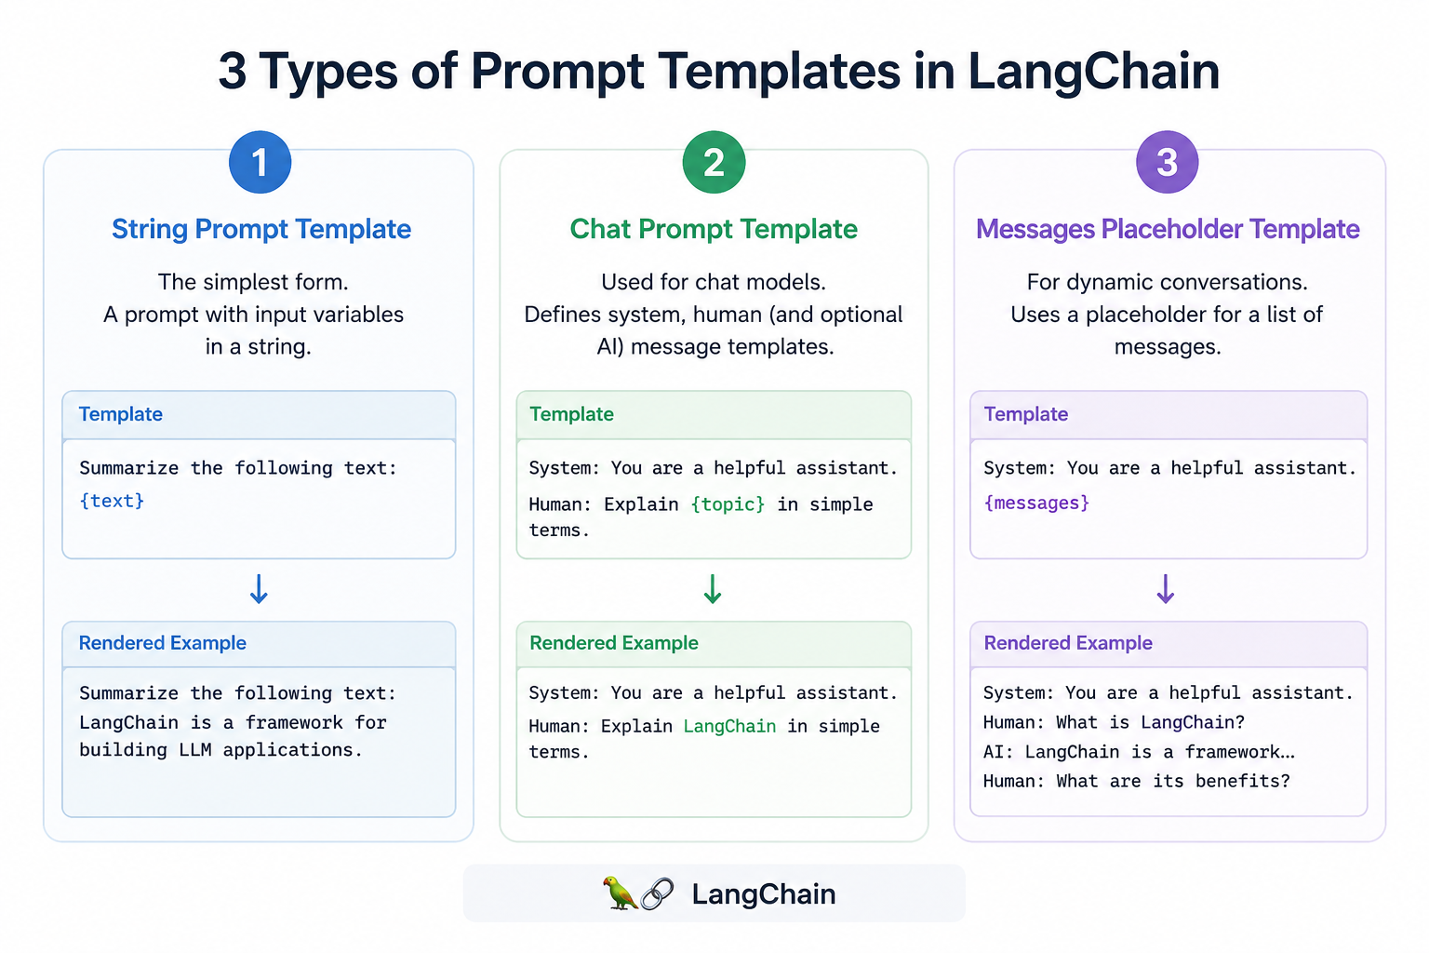
DEMO: session_2/2_1_langchain_lcel.py
Notes:
Session 2 | Topic: 1. LangChain overview and architecture
Source: 0_slides\Agentic AI.pptx, slide 146
Demo: session_2/2_1_langchain_lcel.py

Slide 45
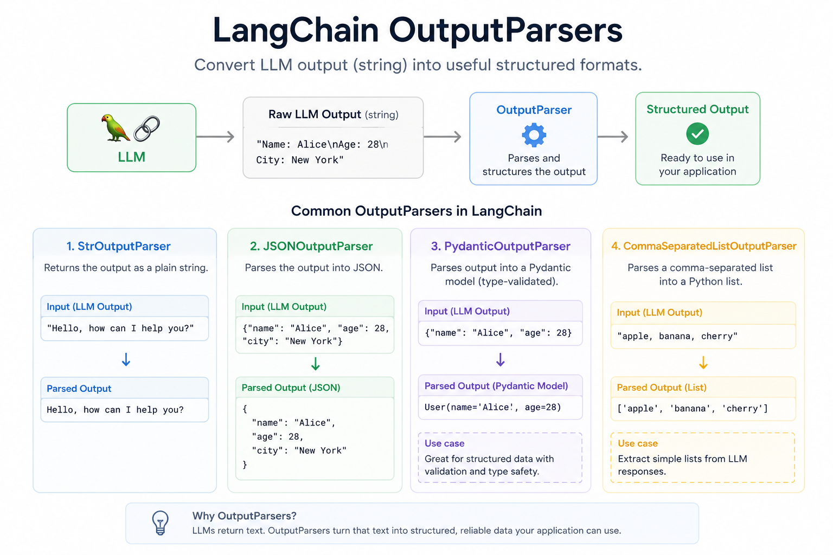
DEMO: session_2/2_1_langchain_lcel.py
Notes:
Session 2 | Topic: 1. LangChain overview and architecture
Source: 0_slides\Agentic AI.pptx, slide 147
Demo: session_2/2_1_langchain_lcel.py

Slide 46
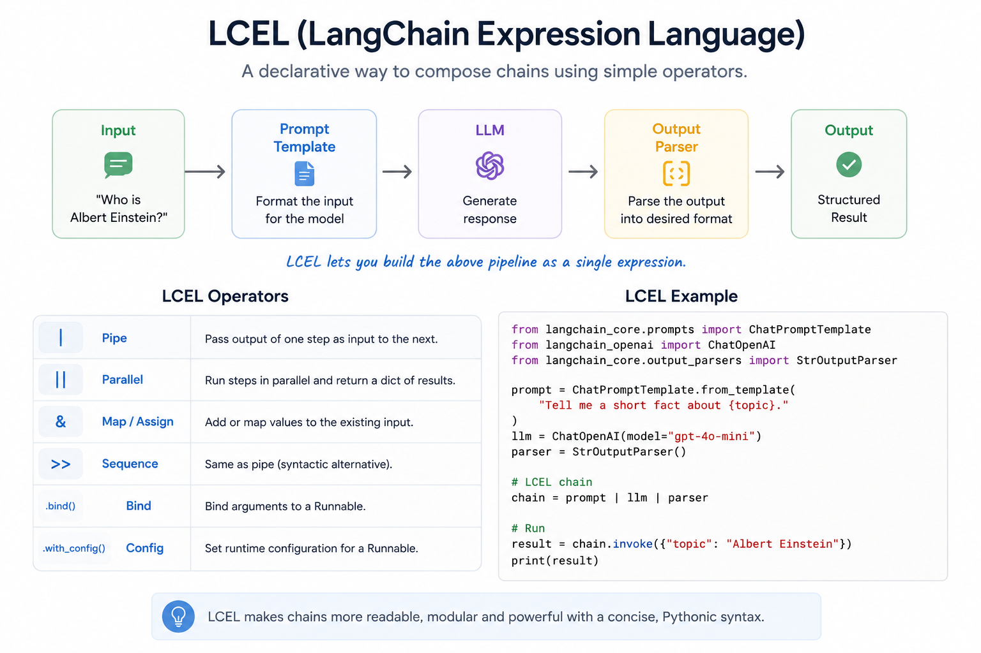
DEMO: session_2/2_1_langchain_lcel.py
Notes:
Session 2 | Topic: 1. LangChain overview and architecture
Source: 0_slides\Agentic AI.pptx, slide 148
Demo: session_2/2_1_langchain_lcel.py

Slide 47
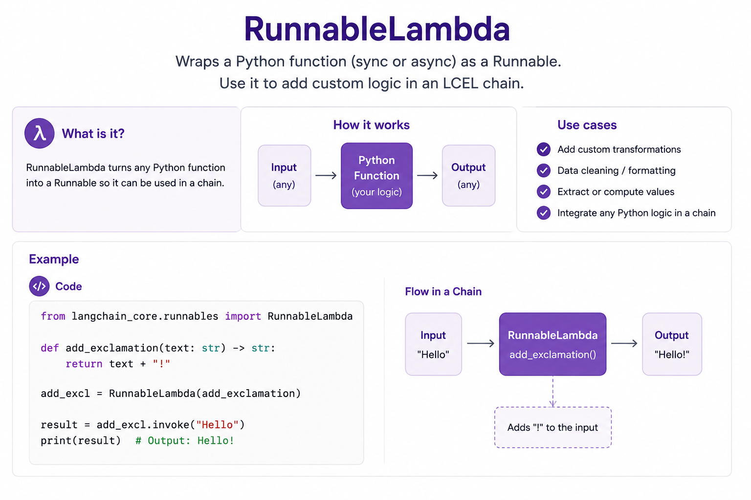
DEMO: session_2/2_1_langchain_lcel.py
Notes:
Session 2 | Topic: 1. LangChain overview and architecture
Source: 0_slides\Agentic AI.pptx, slide 149
Demo: session_2/2_1_langchain_lcel.py

Slide 48
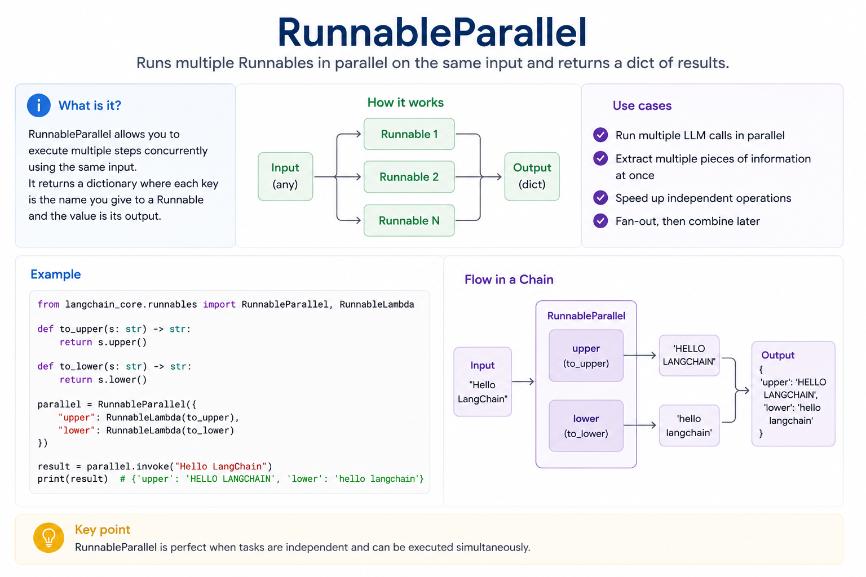
DEMO: session_2/2_1_langchain_lcel.py
Notes:
Session 2 | Topic: 1. LangChain overview and architecture
Source: 0_slides\Agentic AI.pptx, slide 150
Demo: session_2/2_1_langchain_lcel.py

Slide 49
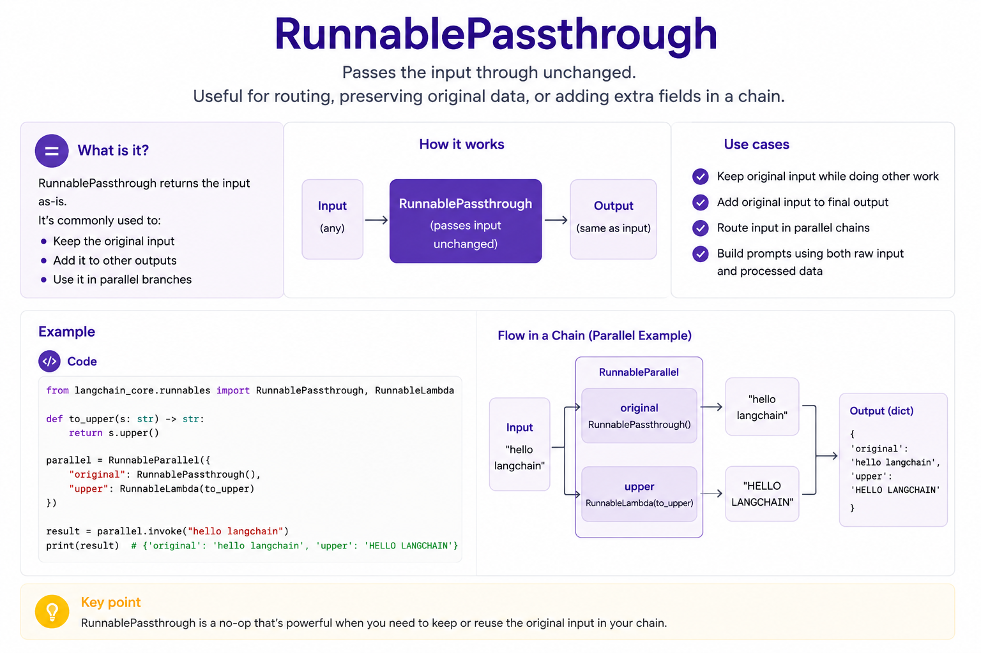
DEMO: session_2/2_1_langchain_lcel.py
Notes:
Session 2 | Topic: 1. LangChain overview and architecture
Source: 0_slides\Agentic AI.pptx, slide 151
Demo: session_2/2_1_langchain_lcel.py

Slide 50
LangChain
An open-source framework designed to help developers build applications using large language models (LLMs)
LangChain evolution
Version | Architecture | Status
Early LangChain | LLMChain | Legacy
Intermediate | SequentialChain | Legacy
Modern LangChain | LCEL (Runnable Architecture) | Recommended
Agentic AI | LangGraph | Current for complex workflows
DEMO: session_2/2_1_langchain_lcel.py
Notes:
Session 2 | Topic: 1. LangChain overview and architecture
Source: 14_advanced\Agentic AI - Advanced Engineering.pptx, slide 131
Demo: session_2/2_1_langchain_lcel.py

Slide 51
LCEL, Runnable
LCEL (LangChain Expression Language): A declarative way to compose AI applications
Instead of creating many chain objects, you connect Runnables together
Everything in modern LangChain is a Runnable
  Prompt
  LLM Output
  Parser
  Retriever
  Lambda Function
  …
Pipe operator (|) connects Runnables
  chain = prompt | llm | parser
DEMO: session_2/2_1_langchain_lcel.py, 2_2_langchain_lcel_ollama.py
Notes:
Session 2 | Topic: 2. LCEL and Runnables
Source: 14_advanced\Agentic AI - Advanced Engineering.pptx, slide 132
Demo: session_2/2_1_langchain_lcel.py, 2_2_langchain_lcel_ollama.py

Slide 52
Example: Prompt | LLM
from langchain_core.prompts import ChatPromptTemplate
from langchain_ollama import ChatOllama
prompt = ChatPromptTemplate.from_template(
"Explain {topic} in simple terms."
)
llm = ChatOllama(model="llama3.2")
chain = prompt | llm
response = chain.invoke(
{"topic":"embeddings"}
)
print(response.content)
DEMO: session_2/2_1_langchain_lcel.py, 2_2_langchain_lcel_ollama.py
Notes:
Session 2 | Topic: 2. LCEL and Runnables
Source: 14_advanced\Agentic AI - Advanced Engineering.pptx, slide 133
Demo: session_2/2_1_langchain_lcel.py, 2_2_langchain_lcel_ollama.py

Slide 53
Output Parsers
Without a parser: Prompt -> LLM -> AIMessage
Many applications want plain text, JSON, or structured output
  Prompt -> LLM -> AIMessage -> Parser
Code: C:\code\agenticai\16_PGP-Agentic\code\session_2\2_3_output_parsers.py
DEMO: session_2/2_3_output_parsers.py, 2_4_output_parsers_openai.py
Notes:
Session 2 | Topic: 3. Prompt templates and output parsers
Source: 14_advanced\Agentic AI - Advanced Engineering.pptx, slide 134
Demo: session_2/2_3_output_parsers.py, 2_4_output_parsers_openai.py

Slide 54
Prompt Templates
Prompt template: Reusable prompt with placeholders (variables) that are filled at runtime
Example: Instead of
  Explain Artificial Intelligence
  Explain {topic}
C:\code\agenticai\16_PGP-Agentic\code\session_2\2_5_prompt_templates.py
DEMO: session_2/2_5_prompt_templates.py, 2_6_prompt_templates_openai.py
Notes:
Session 2 | Topic: 3. Prompt templates and output parsers
Source: 14_advanced\Agentic AI - Advanced Engineering.pptx, slide 135
Demo: session_2/2_5_prompt_templates.py, 2_6_prompt_templates_openai.py

Slide 55
Session Memory Types
Buffer Memory
  Stores everything and sends the entire conversation to the LLM
    Turn 1
    Turn 2
    Turn 3
    Turn 4
    Turn 5
    Turn 6
Conversation Summary Memory
  Instead of keeping every turn, keeps a summary of the conversation
    Customer purchased a laptop and is experiencing a battery problem. They have asked about the return policy and delivery charges and now want to replace the laptop and contact support.
Vector Store Memory
  Stores the individual turns as embeddings and retrieves the turns most relevant to the current question
    Example: Suppose the customer asks: “I want to replace my laptop. What is the process?“
    It might retrieve
      Turn 5: Customer wants to replace the laptop.
      Turn 2: Customer asks about the return policy.
      Turn 3: Laptop battery is not working.
    Does not necessarily retrieve the most recent turns. It retrieves the turns that are semantically most relevant
Memory Type | Stores
BufferMemory | Entire conversation
ConversationSummaryMemory | Conversation summary
VectorStoreMemory | Semantic memory
Sample conversation
  Turn 1: Customer says they bought a laptop
  Turn 2: Customer asks about the return policy
  Turn 3: Customer says the laptop battery is not working
  Turn 4: Customer asks about delivery charges
  Turn 5: Customer says they want to replace the laptop
  Turn 6: Customer asks how to contact customer support
DEMO: session_2/2_7_memory_types.py
Notes:
Session 2 | Topic: 4. Conversation memory
Source: 14_advanced\Agentic AI - Advanced Engineering.pptx, slide 136
Demo: session_2/2_7_memory_types.py

Slide 56
Persistent Memory
Multi-turn conversation: Consists of multiple exchanges between a user and an AI assistant
Session-based memory exists only till the time the application is running - Persistent memory survives application restarts
C:\code\agenticai\16_PGP-Agentic\code\session_2\2_8_persistent_chatbot.py
We send to LLM, 3 things: System instruction + Previous conversation + Current user question
DEMO: session_2/2_8_persistent_chatbot.py
Notes:
Session 2 | Topic: 4. Conversation memory
Source: 14_advanced\Agentic AI - Advanced Engineering.pptx, slide 137
Demo: session_2/2_8_persistent_chatbot.py

Slide 57

DEMO: session_2/2_9_chroma_db_basic.py, 2_10_vector_embedding_cosine_similarity.py
Notes:
Session 2 | Topic: 5. Embeddings and vector databases
Source: 14_advanced\Agentic AI - Advanced Engineering.pptx, slide 99
Demo: session_2/2_9_chroma_db_basic.py, 2_10_vector_embedding_cosine_similarity.py

Slide 58

DEMO: session_2/2_9_chroma_db_basic.py, 2_10_vector_embedding_cosine_similarity.py
Notes:
Session 2 | Topic: 5. Embeddings and vector databases
Source: 14_advanced\Agentic AI - Advanced Engineering.pptx, slide 100
Demo: session_2/2_9_chroma_db_basic.py, 2_10_vector_embedding_cosine_similarity.py

Slide 59

DEMO: session_2/2_9_chroma_db_basic.py, 2_10_vector_embedding_cosine_similarity.py
Notes:
Session 2 | Topic: 5. Embeddings and vector databases
Source: 14_advanced\Agentic AI - Advanced Engineering.pptx, slide 101
Demo: session_2/2_9_chroma_db_basic.py, 2_10_vector_embedding_cosine_similarity.py

Slide 60

DEMO: session_2/2_9_chroma_db_basic.py, 2_10_vector_embedding_cosine_similarity.py
Notes:
Session 2 | Topic: 5. Embeddings and vector databases
Source: 14_advanced\Agentic AI - Advanced Engineering.pptx, slide 102
Demo: session_2/2_9_chroma_db_basic.py, 2_10_vector_embedding_cosine_similarity.py

Slide 61

DEMO: session_2/2_9_chroma_db_basic.py, 2_10_vector_embedding_cosine_similarity.py
Notes:
Session 2 | Topic: 5. Embeddings and vector databases
Source: 14_advanced\Agentic AI - Advanced Engineering.pptx, slide 103
Demo: session_2/2_9_chroma_db_basic.py, 2_10_vector_embedding_cosine_similarity.py

Slide 62

DEMO: session_2/2_9_chroma_db_basic.py, 2_10_vector_embedding_cosine_similarity.py
Notes:
Session 2 | Topic: 5. Embeddings and vector databases
Source: 14_advanced\Agentic AI - Advanced Engineering.pptx, slide 104
Demo: session_2/2_9_chroma_db_basic.py, 2_10_vector_embedding_cosine_similarity.py

Slide 63

DEMO: session_2/2_9_chroma_db_basic.py, 2_10_vector_embedding_cosine_similarity.py
Notes:
Session 2 | Topic: 5. Embeddings and vector databases
Source: 14_advanced\Agentic AI - Advanced Engineering.pptx, slide 105
Demo: session_2/2_9_chroma_db_basic.py, 2_10_vector_embedding_cosine_similarity.py

Slide 64

DEMO: session_2/2_9_chroma_db_basic.py, 2_10_vector_embedding_cosine_similarity.py
Notes:
Session 2 | Topic: 5. Embeddings and vector databases
Source: 14_advanced\Agentic AI - Advanced Engineering.pptx, slide 106
Demo: session_2/2_9_chroma_db_basic.py, 2_10_vector_embedding_cosine_similarity.py

Slide 65

DEMO: session_2/2_9_chroma_db_basic.py, 2_10_vector_embedding_cosine_similarity.py
Notes:
Session 2 | Topic: 5. Embeddings and vector databases
Source: 14_advanced\Agentic AI - Advanced Engineering.pptx, slide 107
Demo: session_2/2_9_chroma_db_basic.py, 2_10_vector_embedding_cosine_similarity.py

Slide 66

DEMO: session_2/2_9_chroma_db_basic.py, 2_10_vector_embedding_cosine_similarity.py
Notes:
Session 2 | Topic: 5. Embeddings and vector databases
Source: 14_advanced\Agentic AI - Advanced Engineering.pptx, slide 108
Demo: session_2/2_9_chroma_db_basic.py, 2_10_vector_embedding_cosine_similarity.py

Slide 67
CRUD operations and metadata filtering in ChromaDB
Creating documents
  import chromadb
  client = chromadb.PersistentClient(path="./chroma_db")
  collection = client.get_or_create_collection("employees")
  collection.add(
  ids=["1", "2"],
  documents=[
  "Alice works in Finance.",
  "Bob works in HR."
  ],
  metadatas=[
  {"department": "Finance"},
  {"department": "HR"}
  ]
  )
DEMO: session_2/2_11_chromadb_crud.py, 2_12_chromadb_search.py, 2_13_chroma_db_adding_metadata.py
Notes:
Session 2 | Topic: 5. Embeddings and vector databases
Source: 14_advanced\Agentic AI - Advanced Engineering.pptx, slide 109
Demo: session_2/2_11_chromadb_crud.py, 2_12_chromadb_search.py, 2_13_chroma_db_adding_metadata.py

Slide 68
CRUD operations and metadata filtering in ChromaDB
Reading documents
  result = collection.get(ids=["1"])
  print(result["documents"])
Updating documents
  collection.update(
  ids=["1"],
  documents=["Alice is now the Finance Manager."],
  metadatas=[{"department": "Finance"}]
  )
Deleting documents
  collection.delete(ids=["2"])
DEMO: session_2/2_11_chromadb_crud.py, 2_12_chromadb_search.py, 2_13_chroma_db_adding_metadata.py
Notes:
Session 2 | Topic: 5. Embeddings and vector databases
Source: 14_advanced\Agentic AI - Advanced Engineering.pptx, slide 110
Demo: session_2/2_11_chromadb_crud.py, 2_12_chromadb_search.py, 2_13_chroma_db_adding_metadata.py

Slide 69
ChromaDB - Filtering
results = collection.query(
query_texts=["budget"],
n_results=5,
where={"department": "Finance"}
)
Code: C:\code\agenticai\16_PGP-Agentic\code\session_2\2_12_chromadb_search.py and 2_11_chromadb_crud.py
DEMO: session_2/2_11_chromadb_crud.py, 2_12_chromadb_search.py, 2_13_chroma_db_adding_metadata.py
Notes:
Session 2 | Topic: 5. Embeddings and vector databases
Source: 14_advanced\Agentic AI - Advanced Engineering.pptx, slide 111
Demo: session_2/2_11_chromadb_crud.py, 2_12_chromadb_search.py, 2_13_chroma_db_adding_metadata.py

Slide 70
FAISS
FAISS (Facebook AI Similarity Search): An open-source library developed by Meta for efficient similarity search and clustering of dense vectors (embeddings)
Uses index for very fast search
Why needed?
  Suppose we have 1 million documents and user asks What is machine learning?
  Without FAISS: Query embedding -> Compare with document 1 -> Compare with document 2 -> … -> Compare with document 1000000 (Linear search)
  With FAISS: Query embedding -> FAISS index -> Top 5 results
DEMO: session_2/2_14_faiss_search.py, 2_15_faiss_search_ollama.py
Notes:
Session 2 | Topic: 5. Embeddings and vector databases
Source: 14_advanced\Agentic AI - Advanced Engineering.pptx, slide 112
Demo: session_2/2_14_faiss_search.py, 2_15_faiss_search_ollama.py

Slide 71
Nearest-neighbour retrieval: understanding similarity metrics (cosine, L2, dot product)
Common similarity metrics
Metric | Measures | Best Value
Cosine Similarity | Angle between vectors | Larger
L2 Distance (Euclidean) | Straight-line distance | Smaller
Dot Product | Alignment and magnitude | Larger
DEMO: session_2/2_16_rag_cosine_euclidean_1.py
Notes:
Session 2 | Topic: 5. Embeddings and vector databases
Source: 14_advanced\Agentic AI - Advanced Engineering.pptx, slide 117
Demo: session_2/2_16_rag_cosine_euclidean_1.py

Slide 72
Document Loaders
Document Loader: Responsible for reading data from a source and converting it into LangChain Document objects
Every RAG application has this
  Data Source -> Document Loader -> Document Objects -> Text Splitter -> Embeddings -> Vector Database -> Retriever -> LLM
Real world applications use PDF, MS-Word, HTML, CSV, Excel, etc
One format = One loader
Example
  from langchain_community.document_loaders import PyPDFLoader
  loader = PyPDFLoader("banking.pdf")
  documents = loader.load()
Each page = One document
DEMO: session_2/2_17_document_loaders.py
Notes:
Session 2 | Topic: 6. Document loaders, text splitters and chunking
Source: 14_advanced\Agentic AI - Advanced Engineering.pptx, slide 138
Demo: session_2/2_17_document_loaders.py

Slide 73
Text Splitters
Splitting documents before embedding them into a vector database for RAG
RecursiveCharacterTextSplitter: Instead of cutting every N characters, it tries to split intelligently in this order
  Paragraph -> New line -> Sentence -> Space -> Character
  Example text
    Artificial Intelligence is changing the world.
    Machine Learning is one branch of AI.
    Deep Learning is a subset of Machine Learning.
    Neural Networks are inspired by the human brain.
  Suppose chunk size = 80
  First attempt: Paragraph separator – Too large
  Second attempt: New line separator – Result: 4 chunks – Preserves complete sentences
SemanticChunker: Uses meaning
  Instead of How many characters, asks Does the topic change here?
  Computes embeddings and decides
C:\code\agenticai\16_PGP-Agentic\code\session_2\2_18_text_splitters.py
DEMO: session_2/2_18_text_splitters.py
Notes:
Session 2 | Topic: 6. Document loaders, text splitters and chunking
Source: 14_advanced\Agentic AI - Advanced Engineering.pptx, slide 139
Demo: session_2/2_18_text_splitters.py

Slide 74
RAG - Chunking
Why can we not send an entire document to LLM?
  Limited context window
  Faster responses
  Embedding model have lower context windows
  Better retrieval quality
Basic RAG using LangChain: 2_21_langchain_rag.py
DEMO: session_2/2_18_text_splitters.py
Notes:
Session 2 | Topic: 6. Document loaders, text splitters and chunking
Source: 14_advanced\Agentic AI - Advanced Engineering.pptx, slide 120
Demo: session_2/2_18_text_splitters.py

Slide 75
Chunking Strategies
Fixed-size chunking
  Split text into chunks of a fixed number of characters or tokens
  Simple, but may split sentences or ideas
  Solution: Use overlapping chunks
Sentence / Paragraph chunking
  Split at natural boundaries such as sentences or paragraphs
  Preserves readability and context
Recursive chunking
  Split using progressively smaller units: Paragraph → Sentence → Clause
  Maintains structure while meeting the desired chunk size.
Document-structure chunking
  Use document structure such as headings, sections, or Markdown (#, ##, ###)
  Keeps related content together
Semantic chunking
  Group text based on meaning or topic instead of size
  Produces the most meaningful chunks but is computationally more expensive
Strategy | Best For
Fixed-size | Simple text, quick prototyping
Sentence / Paragraph | Articles, reports
Recursive | General-purpose RAG (most common)
Document Structure | Markdown, manuals, documentation
Semantic | High-quality enterprise RAG
DEMO: session_2/2_18_text_splitters.py
Notes:
Session 2 | Topic: 6. Document loaders, text splitters and chunking
Source: 14_advanced\Agentic AI - Advanced Engineering.pptx, slide 121
Demo: session_2/2_18_text_splitters.py

Slide 76
Building a RAG pipeline
Documents (PDF, Word, Web, CSV, Database) → Document Loader → Raw Document Objects → Text Splitter → Small Text Chunks → Embedding Model → Embeddings (Vector Representations) → Vector Database (Chroma / FAISS / Pinecone) ← User Question → Question Embedding → Retriever (Similarity Search) → Top-K Relevant Chunks → Prompt (Context + User Question) → LLM / Generator → Final Answer
C:\code\agenticai\16_PGP-Agentic\code\session_2\2_19_rag_pipeline.py
DEMO: session_2/2_19_rag_pipeline.py, 2_20_rag_pipeline_ollama.py, 2_21_langchain_rag.py
Notes:
Session 2 | Topic: 7. Building a RAG pipeline with retrievers
Source: 14_advanced\Agentic AI - Advanced Engineering.pptx, slide 140
Demo: session_2/2_19_rag_pipeline.py, 2_20_rag_pipeline_ollama.py, 2_21_langchain_rag.py

Slide 77
Retrievers
Retriever: Responsible for finding the most relevant documents for a user's query
Instead of sending every document to the LLM, the retriever selects only the most relevant ones
Knowledge Base → Document Loader → Text Splitter → Embedding Model → Vector Database ← User Question → Question Embedding → Retriever → Relevant Chunks → Prompt (Context + Question) → LLM → Final Answer
Bridge between the vector database and the LLM
Instead of sending all documents, the retriever selects only the relevant chunks
DEMO: session_2/2_22_retrievers.py
Notes:
Session 2 | Topic: 7. Building a RAG pipeline with retrievers
Source: 14_advanced\Agentic AI - Advanced Engineering.pptx, slide 141
Demo: session_2/2_22_retrievers.py

Slide 78
Retriever Types (C:\code\agenticai\16_PGP-Agentic\code\session_2\2_22_retrievers.py)
Retriever | What it actually does internally
VectorStoreRetriever | Converts the query into an embedding, compares it with stored document embeddings, and returns the most similar chunks
MultiQueryRetriever | Uses an LLM to generate multiple alternative versions of the user’s query, retrieves documents for each version, then combines the results
ContextualCompressionRetriever | First retrieves candidate documents, then uses a compressor/reranker/LLM to remove irrelevant portions and keep only information relevant to the query
SelfQueryRetriever | Uses an LLM to convert the natural-language query into two parts: a semantic search query and structured metadata filters; then applies both to the vector store
ParentDocumentRetriever | Stores small child chunks for accurate similarity matching, but when a child chunk matches, returns its larger parent document so the LLM gets more context
MultiVectorRetriever | Represents one document using multiple vectors (for example, summaries, chunks, or hypothetical questions); searches those vectors and maps the matches back to the original document
EnsembleRetriever | Runs multiple retrievers independently, combines their results, and uses a ranking method such as Reciprocal Rank Fusion (RRF) to produce a final ranked list
DEMO: session_2/2_22_retrievers.py
Notes:
Session 2 | Topic: 7. Building a RAG pipeline with retrievers
Source: 14_advanced\Agentic AI - Advanced Engineering.pptx, slide 142
Demo: session_2/2_22_retrievers.py

Slide 79
Build a Q&A Bot from PDFs
Chroma DB, Insurance example: C:\code\agenticai\16_PGP-Agentic\code\session_2\2_23_langchain_qand_a_bot_chroma.py
Test: Browser - http://localhost:8000/ask/playground/
FAISS: C:\code\agenticai\16_PGP-Agentic\code\session_2\2_25_langchain_qanda_bot_faiss.py
Test: Browser - http://localhost:8000/ask/playground/
While Chroma manages a directory of files automatically, FAISS typically saves to a single .index file along with a .pkl for the documents
In LangChain, we use save_local and load_local for this
DEMO: session_2/2_23_langchain_qand_a_bot_chroma.py, 2_24_langchain_qand_a_bot_chroma_ollama.py, 2_25_langchain_qanda_bot_faiss.py, 2_26_chroma_db_data_science_pdf_chatbot.py
Notes:
Session 2 | Topic: 8. Hands-on: Q&A bot over PDFs
Source: 15_real\Agentic AI - Real.pptx, slide 67
Demo: session_2/2_23_langchain_qand_a_bot_chroma.py, 2_24_langchain_qand_a_bot_chroma_ollama.py, 2_25_langchain_qanda_bot_faiss.py, 2_26_chroma_db_data_science_pdf_chatbot.py

Slide 80
Session 3
LangChain Agents and Tool Use
Sun 31-Oct | 08:00 – 11:00 AM
Notes:
Start of Session 3

Slide 81
Session 3 Topics
Agent fundamentals (recap)
Prompting techniques that drive agents
Creating custom tools and binding them to an LLM
Tools with Pydantic schemas
AgentExecutor
ReAct agent
Plan-and-Execute agent
SQL database agents
Multi-step reasoning and tool chaining
Tool-augmented research agent
Notes:
Session 3 – Sun 31-Oct

Slide 82
Agent Fundamentals
AI Agent: An AI system that can
  Perceive its environment
  Reason about a problem
  Decide what action to take
  Execute actions using tools
  Observe the results
  Continue until the goal is achieved
Unlike a traditional chatbot, an AI agent can make decisions and perform tasks autonomously
DEMO: Concept slide - no code; discuss
Notes:
Session 3 | Topic: 1. Agent fundamentals (recap)
Source: 14_advanced\Agentic AI - Advanced Engineering.pptx, slide 147
Demo: Concept slide - no code; discuss

Slide 83
Structuring System Prompts for Domain-Expert Personas
System prompt: Defines the AI assistant's role, expertise, behavior, constraints, and response style before any user interaction
Helps produce consistent, domain-specific, and reliable responses
Component | Purpose
Role | Define the assistant's expertise
Goal | Specify the primary objective
Knowledge Scope | State the domain or information sources
Instructions | Describe how responses should be generated
Constraints | Specify what the model should avoid
Output Format | Define the desired response structure
Tone | Formal, friendly, technical, etc.
DEMO: session_3/3_1_prompting_techniques.py
Notes:
Session 3 | Topic: 2. Prompting techniques that drive agents
Source: 14_advanced\Agentic AI - Advanced Engineering.pptx, slide 82
Demo: session_3/3_1_prompting_techniques.py

Slide 84
System Prompt Template and Example
You are an expert <ROLE>.
Your goal is to <OBJECTIVE>.
Use your expertise in <DOMAIN>.
When answering:
- Explain concepts clearly.
- Ask clarifying questions if information is missing.
- Do not make up facts.
- If uncertain, say so.
- Use bullet points where appropriate.
Respond in a professional and concise manner.
You are an experienced physician specializing in internal medicine.
Answer questions using evidence-based medical knowledge.
Always:
- Explain medical terminology simply.
- Recommend consulting a healthcare professional for emergencies.
- Do not diagnose with certainty from limited information.
- Clearly distinguish facts from assumptions.
DEMO: session_3/3_1_prompting_techniques.py
Notes:
Session 3 | Topic: 2. Prompting techniques that drive agents
Source: 14_advanced\Agentic AI - Advanced Engineering.pptx, slide 83
Demo: session_3/3_1_prompting_techniques.py

Slide 85
Zero-shot, one-shot, and few-shot prompting patterns
Prompting Pattern | Number of Examples in Prompt | Structure | Example Prompt | Best Use Cases | Advantages | Limitations
Zero-shot Prompting | 0 | Instruction only | Prompt: "Classify the sentiment of this review: The product arrived on time and works perfectly." | General question answering, summarization, translation, simple classification | Simple, fast, minimal prompt engineering | May produce inconsistent results for complex tasks
One-shot Prompting | 1 | One example followed by the task | Example: Review: This phone is terrible. → Sentiment: Negative Prompt: Review: The product arrived on time and works perfectly. → Sentiment: ? | Teaching the desired format or style | Helps the model understand the expected output | One example may not cover all cases
Few-shot Prompting | 2–10 examples | Multiple examples followed by the task | Examples:Review: Excellent service. → Positive Review: Very slow delivery. → Negative Review: Packaging was damaged. → Negative Prompt: Review: The product arrived on time and works perfectly. → Sentiment: ? | Complex classification, information extraction, structured output generation | Usually improves consistency and accuracy without retraining | Longer prompts consume more tokens and increase latency
DEMO: session_3/3_1_prompting_techniques.py
Notes:
Session 3 | Topic: 2. Prompting techniques that drive agents
Source: 14_advanced\Agentic AI - Advanced Engineering.pptx, slide 84
Demo: session_3/3_1_prompting_techniques.py

Slide 86
Chain-of-Thought (CoT) Prompting
Chain-of-Thought (CoT) prompting: Encourages an LLM to break down a complex problem into a sequence of intermediate reasoning steps before producing the final answer
Particularly useful for tasks that require logical reasoning, planning, multi-step calculations, or decision-making
DEMO: session_3/3_1_prompting_techniques.py
Notes:
Session 3 | Topic: 2. Prompting techniques that drive agents
Source: 14_advanced\Agentic AI - Advanced Engineering.pptx, slide 85
Demo: session_3/3_1_prompting_techniques.py

Slide 87
Chain-of-Thought (CoT) - Example
Using CoT
Prompt
  A customer has a budget of $1,200 and needs a laptop for programming, machine learning, and occasional gaming.
  Reason through the problem step by step before giving the final recommendation.
Response
  1. Budget limit is $1,200.
  2. Programming benefits from a fast CPU and at least 16 GB RAM.
  3. Machine learning benefits from a dedicated GPU.
  4. Occasional gaming also requires a capable GPU.
  5. Compare available laptops within the budget.
  6. Laptop B offers:
    Intel Core i7 processor
    16 GB RAM
    NVIDIA RTX 4060 GPU
    1 TB SSD
    Price: $1,180
  Final Recommendation:
    Laptop B best satisfies the user's performance requirements while staying within budget.
Without CoT
Prompt
  A customer has a budget of $1,200 and needs a laptop for programming, machine learning, and occasional gaming.
  Recommend the best option.
Response
  I recommend Laptop B because it offers the best balance of CPU, GPU, memory, and price for your requirements.
DEMO: session_3/3_1_prompting_techniques.py
Notes:
Session 3 | Topic: 2. Prompting techniques that drive agents
Source: 14_advanced\Agentic AI - Advanced Engineering.pptx, slide 86
Demo: session_3/3_1_prompting_techniques.py

Slide 88
ReAct Prompting
ReAct (Reason + Act): A prompting technique where an AI model alternates between reasoning about the problem and taking actions such as calling tools, searching documents, querying databases, or invoking APIs
Instead of relying only on its internal knowledge, the model thinks, acts, observes the result, and continues reasoning until it reaches an answer
Workflow: User Question -> Thought ("What information do I need?") -> Action (Call a tool / Search / API) -> Observation -> (Receive tool result) -> Thought (Updated) -> Final Answer
DEMO: session_3/3_1_prompting_techniques.py
Notes:
Session 3 | Topic: 2. Prompting techniques that drive agents
Source: 14_advanced\Agentic AI - Advanced Engineering.pptx, slide 89
Demo: session_3/3_1_prompting_techniques.py

Slide 89
ReAct Example
User query: I have ₹10 lakh to invest for the next 10 years. Should I invest in an equity mutual fund, a fixed deposit, or a balanced fund?
ReAct execution
  Thought: To recommend an investment, I need the user's risk profile.
  Action:Call getCustomerProfile(customer_id)
  Observation: Age: 38, Risk Appetite: Moderate, Investment Horizon: 10 years
  Thought: Now I should compare the expected returns and risk of the available investment options.
  Action: Call getInvestmentOptions(["Equity Mutual Fund", "Fixed Deposit", "Balanced Fund"])
  Observation: Equity Mutual Fund: Expected Return: 12% Risk: High; Fixed Deposit: Expected Return: 7% Risk: Low; Balanced Fund: Expected Return: 10% Risk: Medium
  Thought: The customer has a moderate risk appetite and a long investment horizon. A balanced fund provides a good balance between growth and risk.
  Final Answer: Based on your moderate risk profile and 10-year investment horizon, a Balanced Fund is the most suitable option. It offers better growth potential than a Fixed Deposit while exposing you to less risk than an Equity Mutual Fund.
Code example: session_3\3_1_prompting_techniques.py
DEMO: session_3/3_1_prompting_techniques.py
Notes:
Session 3 | Topic: 2. Prompting techniques that drive agents
Source: 14_advanced\Agentic AI - Advanced Engineering.pptx, slide 90
Demo: session_3/3_1_prompting_techniques.py

Slide 90
Creating Custom Tools
Tool calling: Allows an LLM to request the execution of an external function/tool
The LLM does not execute the function itself, it just generates a tool call
The application/agent executes the tool
Example
  User: “Find the most downloaded Project Gutenberg book by Jane Austen”
  The LLM realizes that it needs to search an external book catalog and requests: search_gutenberg_books(query="Jane Austen")
Summary: LLM can generate text but cannot (1) Query an API, (2) Send an email, (3) Read a company’s database, (4) Run local function
DEMO: session_3/3_2_tool_calling.py
Notes:
Session 3 | Topic: 3. Creating custom tools and binding them to an LLM
Source: 14_advanced\Agentic AI - Advanced Engineering.pptx, slide 151
Demo: session_3/3_2_tool_calling.py

Slide 91
Tool in LangChain
Define a tool
  from langchain_core.tools import tool
  @tool
  def search_gutenberg_books(query: str) -> str:
  """Search Project Gutenberg books."""
  ...
Binding a tool to an LLM
  tools = [search_gutenberg_books]
  llm_with_tools = llm.bind_tools(tools)
Code: 3_2_tool_calling.py
DEMO: session_3/3_2_tool_calling.py
Notes:
Session 3 | Topic: 3. Creating custom tools and binding them to an LLM
Source: 14_advanced\Agentic AI - Advanced Engineering.pptx, slide 152
Demo: session_3/3_2_tool_calling.py

Slide 92
Tools and Pydantic
Pydantic ensures that inputs/outputs to or from the LLM are as per some specific schema
TOOL -> Pydantic Schema -> LLM
Code: C:\code\agenticai\16_PGP-Agentic\code\session_3\3_3_tool_calling_pydantic.py
DEMO: session_3/3_3_tool_calling_pydantic.py
Notes:
Session 3 | Topic: 4. Tools with Pydantic schemas
Source: 14_advanced\Agentic AI - Advanced Engineering.pptx, slide 153
Demo: session_3/3_3_tool_calling_pydantic.py

Slide 93
AgentExecutor
Sample run: 3_4_agent_executor_serp_gutenberg.py
Call 1: AgentExecutor sends the question to the model; the model doesn't answer yet, instead it returns a tool call — serp_search(query="who wrote Pride and Prejudice").
Executor runs the tool: Not the model. AgentExecutor looks up serp_search, executes it, and gets back the web search results.
Result feeds back into context: The (tool call, tool result) pair is appended to agent_scratchpad, and the executor loops back to the model.
Call 2: Now seeing the search results, the model spots "Jane Austen" but still is not done — it fires a second tool call, search_gutenberg_books(query="Jane Austen"). Executor runs it, appends results.
Call 3: With both tool results in context, the model finally returns plain text instead of a tool call — this is an AgentFinish, which ends the loop.
Final output: agent_executor.invoke(...) returns that text as result["output"], printed as the final answer.
AgentExecutor: Runtime engine that manages an AI agent
Without it, we have to manually wire together the reasoning loop ourself
An LLM alone can only generate text — it cannot
  Call a tool and get the result back
  Feed that result back into the next reasoning step
  Know when to stop and return an answer instead of looping forever
AgentExecutor automates this cycle so we do not have to hand-code it every time
Think of it as the orchestrator that coordinates all agent activities
DEMO: session_3/3_4_agent_executor_serp_gutenberg.py
Notes:
Session 3 | Topic: 5. AgentExecutor
Source: 14_advanced\Agentic AI - Advanced Engineering.pptx, slide 154
Demo: session_3/3_4_agent_executor_serp_gutenberg.py

Slide 94
ReAct Pattern
ReAct -> Re = Reasoning, Act = Acting
Instead of immediately answering a question, the AI agent:
  Thinks about the problem
  Decides which tool to use
  Executes the tool
  Observes the result
  Thinks again
  Repeats until the goal is achieved
The ReAct Loop: Thought → Action → Observation → Thought → Action → Observation → Answer
C:\code\agenticai\16_PGP-Agentic\code\session_3\3_5_react_agent_web_search_python_repl.py
DEMO: session_3/3_5_react_agent_web_search_python_repl.py
Notes:
Session 3 | Topic: 6. ReAct agent
Source: 14_advanced\Agentic AI - Advanced Engineering.pptx, slide 149
Demo: session_3/3_5_react_agent_web_search_python_repl.py

Slide 95
Plan-and-Execute Pattern
Plan-and-Execute: Separates an AI agent's work into two distinct phases
  Planning – Create a complete plan to achieve the goal
  Execution – Carry out each step in the plan
Instead of deciding the next action after every observation (as in ReAct), the agent first develops an overall strategy
Goal → Planner → Execution Plan → Executor → Step 1 → Step 2 → Step 3 → Final Answer
Each step itself is a ReAct loop internally
session_3\3_6_plan_and_execute_agent.py
DEMO: session_3/3_6_plan_and_execute_agent.py
Notes:
Session 3 | Topic: 7. Plan-and-Execute agent
Source: 14_advanced\Agentic AI - Advanced Engineering.pptx, slide 150
Demo: session_3/3_6_plan_and_execute_agent.py

Slide 96
SQLDatabaseToolkit
SQLDatabaseToolkit: Connects an LLM to a SQL database
Allows an LLM-powered agent to work with relational databases
Can inspect database structure, Generate SQL queries, Execute SQL queries, Analyze query results, Correct SQL when a query fails
Natural Language → Database Query → Answer
Example: “Which department has the highest average salary?”
  Agent can determine the appropriate SQL, execute it, and explain the result
Provides four important tools
  1. sql_db_list_tables: Lists the tables available in the database
  2. sql_db_schema: Provides schema information for selected tables
  3. sql_db_query: Executes a SQL query
  4. sql_db_query_checker: Checks a SQL query for possible problems before execution
C:\code\agenticai\16_PGP-Agentic\code\session_3\3_8_sql_database_toolkit_agent.py
DEMO: session_3/3_8_sql_database_toolkit_agent.py, 3_9_sales_db_agent.py (3_7_create_sales_db.py first)
Notes:
Session 3 | Topic: 8. SQL database agents
Source: 14_advanced\Agentic AI - Advanced Engineering.pptx, slide 155
Demo: session_3/3_8_sql_database_toolkit_agent.py, 3_9_sales_db_agent.py (3_7_create_sales_db.py first)

Slide 97
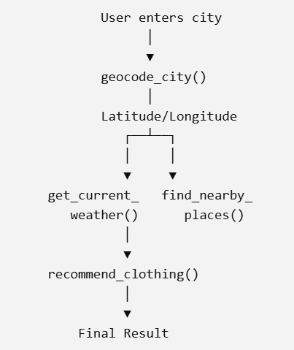
Multi-Step Reasoning
Why needed?
  Book the cheapest flight and email me the ticket
One tool cannot do this
Tool chaining: Tool 1 → Output → Tool 2 → Output → Tool 3 -> Final Output
session_3\3_11_chaining_tool_outputs_flask.py -> Calls session_3\3_10_chaining_tool_outputs.py
DEMO: session_3/3_10_chaining_tool_outputs.py, 3_11_chaining_tool_outputs_flask.py
Notes:
Session 3 | Topic: 9. Multi-step reasoning and tool chaining
Source: 14_advanced\Agentic AI - Advanced Engineering.pptx, slide 156
Demo: session_3/3_10_chaining_tool_outputs.py, 3_11_chaining_tool_outputs_flask.py

Slide 98
Tool-Augmented Research Agent
Use SERP API for researching on the specified topic
If the topic is recent, try date-based search
For specific topics, retrieve more details using Python BeautifulSoup library
C:\code\agenticai\16_PGP-Agentic\code\session_3\3_12_research_agent_tools.py
DEMO: session_3/3_12_research_agent_tools.py, 3_13_research_agent_tools_serp.py
Notes:
Session 3 | Topic: 10. Tool-augmented research agent
Source: 15_real\Agentic AI - Real.pptx, slide 82
Demo: session_3/3_12_research_agent_tools.py, 3_13_research_agent_tools_serp.py

Slide 99
Session 4
LangGraph: Stateful Workflows and Routing
Sat 1-Nov | 08:00 – 11:00 AM
Notes:
Start of Session 4

Slide 100
Session 4 Topics
Why LangGraph (LangChain vs LangGraph)
Core components: State, nodes, edges
Building the first graph
Reducers
Conditional routing
Message graphs
Streaming
Multi-node pipelines and LangGraph Studio
Notes:
Session 4 – Sat 1-Nov

Slide 101
Evolution of Approaches to Work with LLMs
Aspect | OOP-style (Manual) | LangChain (LCEL) | LangGraph
Core idea | Traditional Python classes/functions controlling API calls | Functional and declarative LLM “chains” using the LangChain Expression Language (LCEL) | Graph-based, event-driven system where each node can be an LLM, tool, or function
Level of abstraction | Low — direct API calls and manual flow | Medium — declarative pipeline of components | High — nodes and edges define complex, reactive workflows
State management | Manual; handled in code (variables, memory) | Partly handled via memory components or retrievers | Explicit and persistent graph state (supports branches, loops, conditional edges)
Error handling / control flow | Manual try/except logic | Built-in retry and fallback options | Graph nodes can define error edges or conditional transitions
Reactivity / branching | Linear; must code logic explicitly | Mostly linear (LCEL adds limited conditional logic) | Fully reactive — conditional routing, parallel branches, feedback loops
Use case fit | Simple, one-off LLM calls or prototypes | Standard pipelines (e.g., prompt → LLM → parser → tool) | Complex, multi-agent, or stateful reasoning workflows
Example use case | “Ask LLM to summarize text” | Same, but wrapped in a LangChain chain | Same, but modeled as a small reactive graph
DEMO: session_4/4_1_not_langgraph_langchain_instead.py
Notes:
Session 4 | Topic: 1. Why LangGraph
Source: 0_slides\Agentic AI.pptx, slide 167
Demo: session_4/4_1_not_langgraph_langchain_instead.py

Slide 102
Comparison of the Approaches
Object-Oriented
LangChain
LangGraph
from langchain_openai import ChatOpenAI
from langchain.prompts import PromptTemplate
from langchain.schema.runnable import RunnableMap, RunnablePassthrough
llm = ChatOpenAI(model="gpt-4o-mini")
prompt = PromptTemplate.from_template("Summarize this: {text}")
chain = {"text": RunnablePassthrough()} | prompt | llm
result = chain.invoke({"text": "LangChain and LangGraph simplify how developers use LLMs."})
print(result.content)
from langgraph.graph import Graph, END
from langchain_openai import ChatOpenAI
llm = ChatOpenAI(model="gpt-4o-mini")
# Define the node (a summarization step)
def summarize_node(state):
text = state["text"]
prompt = f"Summarize this: {text}"
result = llm.invoke(prompt)
return {"summary": result.content}
# Build graph
graph = Graph()
graph.add_node("summarize", summarize_node)
graph.set_entry_point("summarize")
graph.add_edge("summarize", END)
# Run
result = graph.invoke({"text": "LangChain and LangGraph simplify how developers use LLMs."})
print(result["summary"])
from openai import OpenAI
client = OpenAI()
text = "LangChain and LangGraph simplify how developers use LLMs."
prompt = f"Summarize this: {text}"
response = client.chat.completions.create(
model="gpt-4o-mini",
messages=[{"role": "user", "content": prompt}]
)
print(response.choices[0].message.content)
DEMO: session_4/4_1_not_langgraph_langchain_instead.py
Notes:
Session 4 | Topic: 1. Why LangGraph
Source: 0_slides\Agentic AI.pptx, slide 168
Demo: session_4/4_1_not_langgraph_langchain_instead.py

Slide 103
LangChain versus LangGraph
Aspect | LangChain | LangGraph
Purpose | Use LLMs as agents with access to external tools (APIs, databases, etc.) | Build complex, stateful, multi-agent applications with LLMs
Workflow type | Simple, single-step or short workflows | Complex, multi-step, long-running workflows
Agents involved | Usually one agent handling requests | Multiple agents collaborating and interacting
State management | Minimal or stateless; memory handled externally | Built-in memory/state tracking across interactions
Dynamic execution | Limited; follows predefined steps | Supports dynamic branching, agent coordination, and runtime decisions
Best for | Chatbots, calculators, document queries | Automation systems, multi-agent orchestration, AI workflows
Learning curve | Easier; basic LLM + tools interface | Steeper; requires understanding of agents, state, and coordination
Relationship | Foundational concepts | Builds on and extends LangChain principles
DEMO: session_4/4_1_not_langgraph_langchain_instead.py
Notes:
Session 4 | Topic: 1. Why LangGraph
Source: 15_real\Agentic AI - Real.pptx, slide 69
Demo: session_4/4_1_not_langgraph_langchain_instead.py

Slide 104
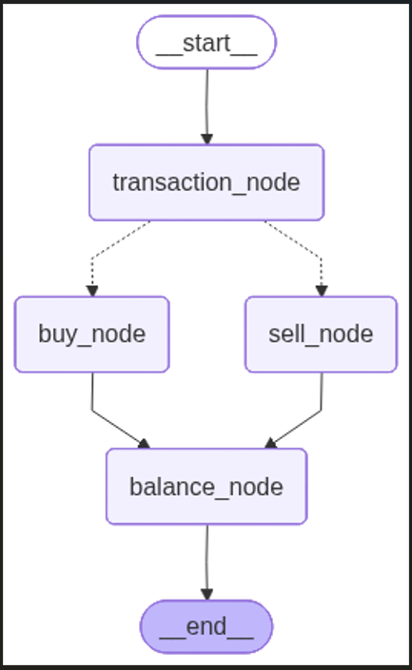
LangGraph:
Key Components
The overall structure that organizes nodes and edges
Graph
Step or operation in the graph – Takes an input state and produces an output state
Node
Edge
Connects two nodes and decides how information flows through them
Data structure that describes the information flowing through the graph at each stage
Final balance
State
DEMO: session_4/4_2_greeter_graph.py
Notes:
Session 4 | Topic: 2. Core components: State, nodes, edges
Source: 0_slides\Agentic AI.pptx, slide 170
Demo: session_4/4_2_greeter_graph.py

Slide 105
State using TypeDict
Unlike traditional function calls, LangGraph nodes need a common place to store information
Instead of passing many variables between nodes, a shared state is passed
TypedDict: A Python type that defines the structure of a dictionary
class BankState(TypedDict):
customer_id: str
balance: float
transfer_amount: float
transaction_id: str
Now every node knows what fields exist
A node does not return the entire state – just what it updated; LangGraph updates it in the whole state object
DEMO: session_4/4_2_greeter_graph.py
Notes:
Session 4 | Topic: 2. Core components: State, nodes, edges
Source: 14_advanced\Agentic AI - Advanced Engineering.pptx, slide 160
Demo: session_4/4_2_greeter_graph.py

Slide 106
TypeDict Versus Pydantic BaseModel
Feature | TypedDict (from typing) | Pydantic BaseModel
Purpose | Type hinting for dictionaries | Data validation and parsing
Runtime behavior | Static type only (checked by linters/myPy) | Enforced at runtime
Validation | None (no type enforcement at runtime) | Automatic type conversion and validation
Default values | Not supported | Supported via field defaults
Field aliasing and renaming | No support | Supported (Field(..., alias="..."))
Nested models | Manual nesting (just dicts) | Fully supported (BaseModel inside BaseModel)
Serialization | Just a dict | .dict(), .json(), .model_dump() methods
Performance | Faster (no runtime checks) | Slower due to validation logic
Use case | When we just need structured typing | When we need validation, coercion, or API inputs
DEMO: Concept slide - no code; discuss
Notes:
Session 4 | Topic: 2. Core components: State, nodes, edges
Source: 0_slides\Agentic AI.pptx, slide 171
Demo: Concept slide - no code; discuss

Slide 107
First LangGraph Application (4_3_langgraph_basic.py)
Class / Constant | Description
StateGraph | The main class for building graphs in LangGraph
START / END | Special constants representing entry and exit points of the graph
ChatOpenAI | The OpenAI integration from LangChain, used for connecting language models
TypedDict | Used to define the structure and types of data that flows through the graph
from langgraph.graph import StateGraph, START, END
from langchain_openai import ChatOpenAI
from typing import TypedDict
LangGraph uses a state-based architecture. Instead of passing data between individual nodes, all data flows through a shared "state" object. Think of it like a shared clipboard that each step can read from and write to.
user_name: Stores the user's name
greeting: Stores the generated greeting message
messages: Keeps a log of the conversation
class GraphState(TypedDict):
user_name: str
greeting: str
messages: list
DEMO: session_4/4_3_langgraph_basic.py
Notes:
Session 4 | Topic: 3. Building the first graph
Source: 15_real\Agentic AI - Real.pptx, slide 71
Demo: session_4/4_3_langgraph_basic.py

Slide 108
First LangGraph Application (4_3_langgraph_basic.py)
def ask_name_node(state: GraphState) -> GraphState:
user_input = input("Bot: What is your name? ")
return {
**state,
"user_name": user_input,
"messages": state.get("messages", []) + [f"User provided name: {user_input}"]
}
Node function 1
Takes the current state as input
Asks user for their name
Returns a new state with updated information
  **state copies all existing state data
  Updates specific fields (user_name, messages)
def greet_user_node(state: GraphState) -> GraphState:
user_name = state.get("user_name", "there")
greeting = f"Hello {user_name}! Nice to meet you."
return {
**state,
"greeting": greeting,
"messages": state.get("messages", []) + [f"Bot: {greeting}"]
}
Node function 2
Reads user_name from the current state
Creates a personalized greeting
Updates state with the greeting and conversation log
DEMO: session_4/4_3_langgraph_basic.py
Notes:
Session 4 | Topic: 3. Building the first graph
Source: 15_real\Agentic AI - Real.pptx, slide 72
Demo: session_4/4_3_langgraph_basic.py

Slide 109
First LangGraph Application (4_3_langgraph_basic.py)
def create_greeting_graph():
workflow = StateGraph(GraphState)
# Add nodes
workflow.add_node("ask_name", ask_name_node)
workflow.add_node("greet_user", greet_user_node)
# Add edges
workflow.add_edge(START, "ask_name")
workflow.add_edge("ask_name", "greet_user")
workflow.add_edge("greet_user", END)
return workflow.compile()
Graph Construction
Structure: START → ask_name → greet_user → END
Nodes represent processing steps (functions)
Edges define the flow between steps
START is where execution begins
END is where execution terminates
.compile() creates the executable graph
DEMO: session_4/4_3_langgraph_basic.py
Notes:
Session 4 | Topic: 3. Building the first graph
Source: 15_real\Agentic AI - Real.pptx, slide 73
Demo: session_4/4_3_langgraph_basic.py

Slide 110
First LangGraph Application (4_3_langgraph_basic.py)
# Create the graph
app = create_greeting_graph()
# Initialize state
initial_state = GraphState(
user_name="",
greeting="",
messages=[]
)
# Run the graph
final_state = app.invoke(initial_state)
Execution
Initialize: Create empty state
Invoke: Start execution at START node
Flow: State passes through: ask_name → greet_user
Result: Get final state with all accumulated data
DEMO: session_4/4_3_langgraph_basic.py
Notes:
Session 4 | Topic: 3. Building the first graph
Source: 15_real\Agentic AI - Real.pptx, slide 74
Demo: session_4/4_3_langgraph_basic.py

Slide 111
Building a Graph
StateGraph: Central object used to build workflows in LangGraph
Defines Shared state, Nodes, Edges, Entry point, Exit point
Think of it as the blueprint of your AI workflow
from langgraph.graph import StateGraph, END
graph = StateGraph(AgentState)
No nodes exist yet – we add them
graph.add_node( "search", search_node)
graph.add_node( “summarize", summarize_node)
Add edges
graph.add_edge("search", "summary")
Define the entry point
graph.set_entry_point("search")
Define the end
graph.add_edge(“sumary", END)
Compile the graph
app = graph.compile()
Execute the graph
result = app.invoke ( {“question”: “What is AI?”})
DEMO: session_4/4_3_langgraph_basic.py
Notes:
Session 4 | Topic: 3. Building the first graph
Source: 14_advanced\Agentic AI - Advanced Engineering.pptx, slide 161
Demo: session_4/4_3_langgraph_basic.py

Slide 112
LangGraph Reducer
(4_4_langgraph_without_reducer.py, 4_5_langgraph_with_reducer.py)
Reducer: Defines how state values are merged when multiple nodes write to the same key
Answers the question: “When many agents update the same state, how do we combine it?”
With reducer
def add_messages(old: List[str], new: List[str]) -> List[str]:
return old + new # This is the reducer function
class State(TypedDict):
messages: Annotated[List[str], add_messages]
def agent_a(state: State):
return {"messages": ["Hello from Agent A"]} # Not lost
def agent_b(state: State):
return {"messages": ["Hello from Agent B"]}
Without reducer
class State(TypedDict):
messages: List[str]
def agent_a(state: State):
return {"messages": ["Hello from Agent A"]}
def agent_b(state: State):
return {"messages": ["Hello from Agent B"]}
DEMO: session_4/4_4_langgraph_without_reducer.py, 4_5_langgraph_with_reducer.py, 4_6_langgraph_reducer_return_policy.py
Notes:
Session 4 | Topic: 4. Reducers
Source: 15_real\Agentic AI - Real.pptx, slide 75
Demo: session_4/4_4_langgraph_without_reducer.py, 4_5_langgraph_with_reducer.py, 4_6_langgraph_reducer_return_policy.py

Slide 113
Using Reducer with LLM
Check the product return policy of two e-commerce websites
Use a reducer to combine the outputs of the two
Create two agents and run them in parallel
Code: 4_6_langgraph_reducer_return_policy.py
DEMO: session_4/4_4_langgraph_without_reducer.py, 4_5_langgraph_with_reducer.py, 4_6_langgraph_reducer_return_policy.py
Notes:
Session 4 | Topic: 4. Reducers
Source: 15_real\Agentic AI - Real.pptx, slide 76
Demo: session_4/4_4_langgraph_without_reducer.py, 4_5_langgraph_with_reducer.py, 4_6_langgraph_reducer_return_policy.py

Slide 114
Conditional Nodes
Conditional edge: Allows the graph to choose the next node based on the current state, instead of following one fixed path
Loan approved or rejected?, Enough account balance?, Customer authenticated?
Unconditional nodes: C:\code\agenticai\16_PGP-Agentic\code\session_4\4_10_stock_price_graph.py
Conditional nodes: C:\code\agenticai\16_PGP-Agentic\code\session_4\4_11_stock_news_sentiment_graph.py
Another example: C:\code\agenticai\16_PGP-Agentic\code\session_4\4_7_conditional_routing_specialists.py
DEMO: session_4/4_7_conditional_routing_specialists.py
Notes:
Session 4 | Topic: 5. Conditional routing
Source: 14_advanced\Agentic AI - Advanced Engineering.pptx, slide 162
Demo: session_4/4_7_conditional_routing_specialists.py

Slide 115
Message Graph
Message graph: A LangGraph workflow where the primary state is the conversation history
Instead of passing separate variables such as: question, answer, context it works with messages
Typical structure
State
└── messages
├── HumanMessage
├── AIMessage
├── HumanMessage
├── SystemMessage
└── AIMessage
Key idea: The conversation itself becomes the state of the graph
C:\code\agenticai\16_PGP-Agentic\code\session_4\4_8_message_graph_bank_faq.py
DEMO: session_4/4_8_message_graph_bank_faq.py
Notes:
Session 4 | Topic: 6. Message graphs
Source: 14_advanced\Agentic AI - Advanced Engineering.pptx, slide 163
Demo: session_4/4_8_message_graph_bank_faq.py

Slide 116
Streaming
Normally, the graph executes all nodes before returning a result
Streaming: each completed node sends its output immediately
User sees progress while the graph is running
C:\code\agenticai\16_PGP-Agentic\code\session_4\4_9_streaming_stock_recommendation.py
DEMO: session_4/4_9_streaming_stock_recommendation.py
Notes:
Session 4 | Topic: 7. Streaming
Source: 14_advanced\Agentic AI - Advanced Engineering.pptx, slide 164
Demo: session_4/4_9_streaming_stock_recommendation.py

Slide 117
Visualizing and Debugging Graphs in LangGraph Studio
LangGraph Studio: A visual development environment (IDE) for LangGraph applications
Allows developers to View graph structure, Execute graphs, Inspect state, Debug nodes, Replay execution, Modify prompts, Test agents interactively
Create langgraph.json to set up Stock market example
Install and run the dev-server CLI
  uv pip install "langgraph-cli[inmem]"
  langgraph dev --tunnel
  This should launch the studio in the browser
  If it gives a ‘domain not allowed’ error
    Look for Advanced setttings after clicking + on right
    Allowed domains: Add *.trycloudflare.com
    Connect
In Studio, pick stock_news graph and give input: stock Name: hdfcbank
To stop, Ctrl+C in terminal
DEMO: session_4/langgraph.json, 4_10_stock_price_graph.py, 4_11_stock_news_sentiment_graph.py
Notes:
Session 4 | Topic: 8. Multi-node pipelines and LangGraph Studio
Source: 14_advanced\Agentic AI - Advanced Engineering.pptx, slide 165
Demo: session_4/langgraph.json, 4_10_stock_price_graph.py, 4_11_stock_news_sentiment_graph.py

Slide 118
LangGraph Examples
Feature | Description | Code
External API Call and LangGraph Conditional Logic | Call News API to get news about a particular topic and summarize according to sentiments in the news | 4_12_langgraph_news_summarizer.py (4_13 is its Ollama version)
Code Security Reviewer Agent | Review code in a GitHub repository for security issues (1) Workflow type (2) Agentic – The Planner agent decides what to do, conditionally | session_5\5_2_langgraph_code_review.py and 4_16_langgraph_code_review_planner_agent.py
Adding Memory | Various memory options | session_5\5_7_langgraph_memory.py
Text Embeddings (Real) | Bank chatbot (Kaggle data) | session_5\5_15_langgraph_bank_chromadb_flask_chatbot.py
DEMO: session_4/4_12_langgraph_news_summarizer.py (+ 4_13/4_14 Ollama/Gemini versions), 4_15_langgraph_company_sector_outlook.py, 4_16_langgraph_code_review_planner_agent.py
Notes:
Session 4 | Topic: 8. Multi-node pipelines and LangGraph Studio
Source: 0_slides\Agentic AI.pptx, slide 174
Demo: session_4/4_12_langgraph_news_summarizer.py (+ 4_13/4_14 Ollama/Gemini versions), 4_15_langgraph_company_sector_outlook.py, 4_16_langgraph_code_review_planner_agent.py

Slide 119
LangGraph Examples
Feature | Description | Code
Add message and email tool | Add notify.sh and gmail tools | session_5\5_16_langgraph_bank_ntfy_email_flask.py
Guardrails | Create Guardrails from a Hugging Face dataset | session_5\5_12_langgraph_create_guardrails.py
Test Guardrails | Test the above Guardrails | session_5\5_13_langgraph_test_guardrails_flask.py
Guardrails for Bank example | Apply Guardrails to the earlier bank example | session_5\5_14_langgraph_guardrails_bank_flask.py
Short Term Memory + RAG | Search in STM, if not, in VectorDB | session_5\5_17_langgraph_STM_RAG_chatbot.py
Looping Agents | Allow agents to review their own actions till a looping condition is satisfied | session_5\5_1_langgraph_looping_agents.py
DEMO: session_4/4_12_langgraph_news_summarizer.py (+ 4_13/4_14 Ollama/Gemini versions), 4_15_langgraph_company_sector_outlook.py, 4_16_langgraph_code_review_planner_agent.py
Notes:
Session 4 | Topic: 8. Multi-node pipelines and LangGraph Studio
Source: 0_slides\Agentic AI.pptx, slide 175
Demo: session_4/4_12_langgraph_news_summarizer.py (+ 4_13/4_14 Ollama/Gemini versions), 4_15_langgraph_company_sector_outlook.py, 4_16_langgraph_code_review_planner_agent.py

Slide 120
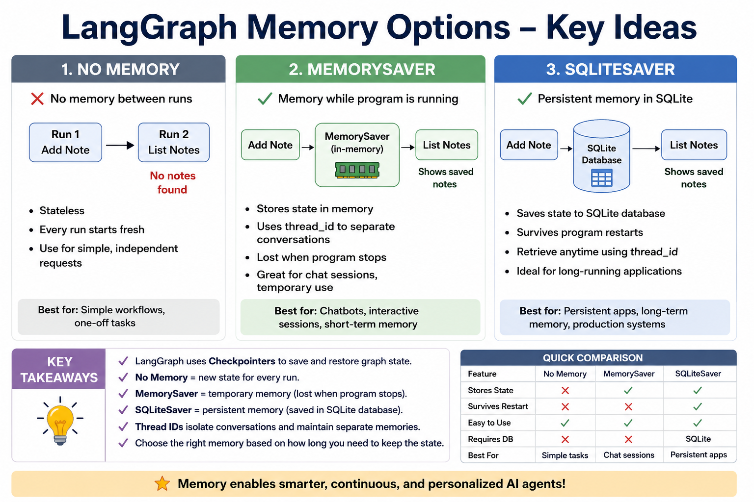
DEMO: session_4/4_12_langgraph_news_summarizer.py (+ 4_13/4_14 Ollama/Gemini versions), 4_15_langgraph_company_sector_outlook.py, 4_16_langgraph_code_review_planner_agent.py
Notes:
Session 4 | Topic: 8. Multi-node pipelines and LangGraph Studio
Source: 0_slides\Agentic AI.pptx, slide 176
Demo: session_4/4_12_langgraph_news_summarizer.py (+ 4_13/4_14 Ollama/Gemini versions), 4_15_langgraph_company_sector_outlook.py, 4_16_langgraph_code_review_planner_agent.py

Slide 121
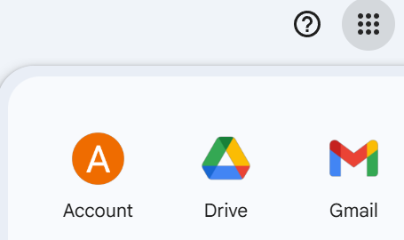
Emails
Your Google Account
Security and sign-in -> 2-step verification -> Enable
If you see “App passwords” option, use it, otherwise click on https://myaccount.google.com/apppasswords and create an app password
Copy the 12-character password without spaces and use in the code
DEMO: session_4/4_12_langgraph_news_summarizer.py (+ 4_13/4_14 Ollama/Gemini versions), 4_15_langgraph_company_sector_outlook.py, 4_16_langgraph_code_review_planner_agent.py
Notes:
Session 4 | Topic: 8. Multi-node pipelines and LangGraph Studio
Source: 0_slides\Agentic AI.pptx, slide 177
Demo: session_4/4_12_langgraph_news_summarizer.py (+ 4_13/4_14 Ollama/Gemini versions), 4_15_langgraph_company_sector_outlook.py, 4_16_langgraph_code_review_planner_agent.py

Slide 122

DEMO: session_4/4_12_langgraph_news_summarizer.py (+ 4_13/4_14 Ollama/Gemini versions), 4_15_langgraph_company_sector_outlook.py, 4_16_langgraph_code_review_planner_agent.py
Notes:
Session 4 | Topic: 8. Multi-node pipelines and LangGraph Studio
Source: 0_slides\Agentic AI.pptx, slide 178
Demo: session_4/4_12_langgraph_news_summarizer.py (+ 4_13/4_14 Ollama/Gemini versions), 4_15_langgraph_company_sector_outlook.py, 4_16_langgraph_code_review_planner_agent.py

Slide 123
Session 5
LangGraph: Cycles, Human-in-the-Loop and Persistence
Sun 7-Nov | 08:00 – 11:00 AM
Notes:
Start of Session 5

Slide 124
Session 5 Topics
Cycles and loops
Human-in-the-loop (HITL)
Checkpointers and persistence
State schema design
Subgraphs
Guardrails in LangGraph
End-to-end: stateful banking chatbot
Notes:
Session 5 – Sun 7-Nov

Slide 125
Looping in LangGraph
Loop: A node can run more than once, based on state
class AgentState(TypedDict):
question: str
answer: str
history: List[str]
iterations: int
decision: str # "continue" or "stop"
Nodes to run in sequence:
answer
evaluate
Then a conditional edge
builder.add_conditional_edges(
"evaluate",
should_continue,
{
"continue": "answer", # LOOP
"stop": END # EXIT
}
)
Node = answer
Send question and previous answer(s) to LLM
Improve answer if needed
Increase iteration count by 1
Node = evaluate
Send question and latest answer to LLM
Ask if continue or stop and return the decision
Conditional logic in function should_continue()
If iteration count >= 3 then stop
Otherwise return the decision as it is
Main logic
Call the “answer” node and get the latest/refined answer for the question from LLM
Using “evaluate” node, pass this on to LLM and ask, more iterations needed? It will return decision as “continue” or “stop”
Take this to the “should_continue()” function and check if iteration count has exceeded 3, in which case decision = “stop”
Return the decision, which will either cause it to loop back to answer or stop
DEMO: session_5/5_1_langgraph_looping_agents.py
Notes:
Session 5 | Topic: 1. Cycles and loops
Source: 0_slides\Agentic AI.pptx, slide 179
Demo: session_5/5_1_langgraph_looping_agents.py

Slide 126
Creating Loops in LangGraph
Conditional edges are used
  graph.add_conditional_edges(
  "process_payment",
  route_after_payment,
  {
  "approved": "ship_order",
  "retry": "process_payment",
  "give_up": "fail_order"
  },
  )
process_payment: Source node
  route_after_payment: Will make a decision (Routing function)
    This function looks at the state and returns one of the following three strings
      approved, retry, give_up
    If approved -> will go to ship_order node
    If retry -> will go back to process_payment node (loop)
    If give_up -> will go to fail_order node
DEMO: session_5/5_2_langgraph_code_review.py, 5_3_order_processing_state_machine.py
Notes:
Session 5 | Topic: 1. Cycles and loops
Source: 14_advanced\Agentic AI - Advanced Engineering.pptx, slide 168
Demo: session_5/5_2_langgraph_code_review.py, 5_3_order_processing_state_machine.py

Slide 127
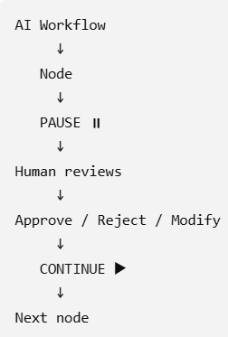
Human In the Loop (HIL)
Human-in-the-Loop (HIL): The graph pauses execution at specific points, allowing a human to inspect, approve, modify, or reject the workflow before it continues
Examples: Loan approvals, Large bank transfers, Medical recommendations, Legal document generation, Contract signing
An interrupt tells LangGraph to pause execution and wait
Types: interrupt_before (Before a node executes), interrupt_after (After a node executes)
C:\code\agenticai\16_PGP-Agentic\code\session_5\5_4_human_approval_gate.py
DEMO: session_5/5_4_human_approval_gate.py
Notes:
Session 5 | Topic: 2. Human-in-the-loop (HITL)
Source: 14_advanced\Agentic AI - Advanced Engineering.pptx, slide 169
Demo: session_5/5_4_human_approval_gate.py

Slide 128
Checkpointers
THREAD_ID = "transfer-1”
  Identifies a workflow/execution -> "Which saved workflow state are we talking about?“
After debit but before credit, the code deliberately crashes
START -> debit_account -> checkpoint saved -> credit_account -> 💥 CRASH
When we resume: result = app.invoke(None, config)
  None means do not give a new starting state, but resume the existing state associated with the thread ID
LangGraph looks for transfer-1 and finds something like this
  {
  "amount": 250.00,
  "completed_steps": [
  "debit_account"
  ]
  }
So it does not run the whole graph, but instead, starts running credit_account node
  It had credit_attempts = 1, to which it adds 1, so it is 2
  Now the code will not crash
Checkpointer: A component that saves the current state of a LangGraph workflow so execution can continue later instead of starting over
Contains current graph state, current node, conversation history, variables, thread identifier, pending interrupts
Without persistence: Graph → State → RAM -> program ends -> LOST
With persistence: Graph → State → SQLite database -> program ends -> RETAINED
C:\code\agenticai\16_PGP-Agentic\code\session_5\5_8_sqlite_checkpointing_crash_recovery.py
DEMO: session_5/5_4_human_approval_gate.py
Notes:
Session 5 | Topic: 2. Human-in-the-loop (HITL)
Source: 14_advanced\Agentic AI - Advanced Engineering.pptx, slide 170
Demo: session_5/5_4_human_approval_gate.py

Slide 129
Human In The Loop (HITL) UX
A good HITL experience should provide
  Clear AI recommendation
  Supporting evidence
  Confidence score
  Retrieved documents
  Reasoning summary
  Action buttons
Code: C:\code\agenticai\16_PGP-Agentic\code\session_5\5_5_support_ticketing_agent_hitl.py
DEMO: session_5/5_5_support_ticketing_agent_hitl.py, 5_6_langchain_long_term_memory_rag.py
Notes:
Session 5 | Topic: 2. Human-in-the-loop (HITL)
Source: 15_real\Agentic AI - Real.pptx, slide 102
Demo: session_5/5_5_support_ticketing_agent_hitl.py, 5_6_langchain_long_term_memory_rag.py

Slide 130
Code Example
Long term memory (in ChromaDB) using LangChain: C:\code\agenticai\16_PGP-Agentic\code\session_5\5_6_langchain_long_term_memory_rag.py
DEMO: session_5/5_5_support_ticketing_agent_hitl.py, 5_6_langchain_long_term_memory_rag.py
Notes:
Session 5 | Topic: 2. Human-in-the-loop (HITL)
Source: 15_real\Agentic AI - Real.pptx, slide 103
Demo: session_5/5_5_support_ticketing_agent_hitl.py, 5_6_langchain_long_term_memory_rag.py

Slide 131
Checkpointers
Checkpointer: A component that saves the current state of a LangGraph workflow so execution can continue later instead of starting over
Contains
  Current graph state
  Current node
  Conversation history
  Variables
  Thread identifier
  Pending interrupts
Checkpointer (Where was the agent?) ≠ Memory (What does the agent know?)
C:\code\agenticai\16_PGP-Agentic\code\session_5\5_8_sqlite_checkpointing_crash_recovery.py
DEMO: session_5/5_7_langgraph_memory.py, 5_8_sqlite_checkpointing_crash_recovery.py
Notes:
Session 5 | Topic: 3. Checkpointers and persistence
Source: 15_real\Agentic AI - Real.pptx, slide 79
Demo: session_5/5_7_langgraph_memory.py, 5_8_sqlite_checkpointing_crash_recovery.py

Slide 132
State Schema Design
State: A structured data object that stores all the information an agent needs while executing a workflow
As the workflow progresses, each node reads the current state and updates it
Initial State -> Agent Node A (Read and Update) -> Updated State -> Agent Node B (Read and Update) -> Updated State -> Final Response
Field | Purpose
messages | Conversation history
user_query | Current user request
retrieved_docs | Retrieved knowledge
tool_results | Results returned by tools
reasoning | Intermediate reasoning
final_answer | Final response
user_profile | User preferences and profile
status | Current workflow status
DEMO: session_5/5_9_langgraph_reducer_return_policy.py
Notes:
Session 5 | Topic: 4. State schema design
Source: 15_real\Agentic AI - Real.pptx, slide 98
Demo: session_5/5_9_langgraph_reducer_return_policy.py

Slide 133
Example of State Schema
User asks: Am I eligible for a ₹50 lakh home loan?
Initial State
messages
user_query
Everything else empty
After retrieval
messages
user_query
retrieved_docs
After tool execution
messages
user_query
retrieved_docs
tool_results
After reasoning
messages
user_query
retrieved_docs
tool_results
reasoning
Final State
messages
user_query
retrieved_docs
tool_results
reasoning
Final_answer
Agent State
  messages
  user_query
  retrieved_docs
  tool_results
  reasoning
  final_answer
DEMO: session_5/5_9_langgraph_reducer_return_policy.py
Notes:
Session 5 | Topic: 4. State schema design
Source: 15_real\Agentic AI - Real.pptx, slide 99
Demo: session_5/5_9_langgraph_reducer_return_policy.py

Slide 134
Subgraphs
Subgraph = A graph inside another graph -> Subgraph composition pattern
Instead of placing every node into one huge graph, you divide the workflow into smaller, reusable graphs
Each subgraph performs one well-defined responsibility
Breaking a large problem into smaller problems
C:\code\agenticai\16_PGP-Agentic\code\session_5\5_10_simple_subgraph_example.py
session_5\5_11_medical_diagnosis_subgraphs.py
DEMO: session_5/5_10_simple_subgraph_example.py, 5_11_medical_diagnosis_subgraphs.py
Notes:
Session 5 | Topic: 5. Subgraphs
Source: 14_advanced\Agentic AI - Advanced Engineering.pptx, slide 172
Demo: session_5/5_10_simple_subgraph_example.py, 5_11_medical_diagnosis_subgraphs.py

Slide 135
Guardrails
A safety control mechanism that ensures the model operates within defined limits by preventing unsafe, harmful, incorrect, off-topic, or policy-violating behavior
Type of Guardrail | Purpose | Examples
Keyword / Phrase Blocking | Stop harmful or restricted words | Block: “bomb”, “hack”, “virus”
Input Validation | Reject malformed, long, or suspicious inputs | Max length, no URLs, no code blocks
Allow-List Topics | Only permit certain categories | Only allow: product queries, reviews
Semantic Safety (Embedding-Based) | Detect harmful intent beyond keywords | Check if query is similar to “harm”, “illegal activity”
Prompt Guardrails | Restrict what the LLM is allowed to answer | “Use context only”, “Don’t produce code”
Output Filtering | Post-process model output before showing it | Remove sensitive data, profanity
Tool-Use Guardrails | Restrict which tools the agent is allowed to call | Don't allow web search for medical queries
Rate and Abuse Control | Prevent spam or automated misuse | Throttling, user authentication
Content Policy Enforcement | Ensure model answers follow rules | Safety, factuality, privacy constraints
Hallucination Reduction | Prevent LLM from making up facts | Use retrieval-only answers; citations required
Business-Logic Guardrails | Enforce domain rules | “Don’t show pricing for unlaunched products”
DEMO: session_5/5_12_langgraph_create_guardrails.py, 5_13_langgraph_test_guardrails_flask.py, 5_14_langgraph_guardrails_bank_flask.py
Notes:
Session 5 | Topic: 6. Guardrails in LangGraph
Source: 15_real\Agentic AI - Real.pptx, slide 80
Demo: session_5/5_12_langgraph_create_guardrails.py, 5_13_langgraph_test_guardrails_flask.py, 5_14_langgraph_guardrails_bank_flask.py

Slide 136
Session 6
Multi-Agent Orchestration with CrewAI
Sat 8-Nov | 08:00 – 11:00 AM
Notes:
Start of Session 6

Slide 137
Session 6 Topics
CrewAI concepts: agents, tasks, crews, process
Building crews for real tasks
Crew vs Flow, and conditional routing
Hierarchical crews and manager agents
Human-in-the-loop and controlled autonomy
Memory and knowledge
Structured outputs and agent-to-agent communication
Guardrails, error handling and reliability
Observability for crews
End-to-end crew application
Notes:
Session 6 – Sat 8-Nov

Slide 138
What is CrewAI?
CrewAI: Python framework for building multi-agent AI systems
Different AI agents collaborate to accomplish complex tasks
Component | Definition | Analogy / Example | Key Properties / Responsibilities | Examples
1. Agents | Individual AI entities with specific roles, goals, and capabilities | Like team members in a software development team (developer, tester, architect) | Role: What they do, Goal: What they aim to achieve, Backstory: Context to improve performance, Tools: Functions they can execute | A summarizer agent, a data extractor, a translator
2. Tasks | Specific assignments given to agents | Work assigned to a team member | Description: What needs to be done- Expected output: Format and content requirements Agent assignment: Who does the work | "Extract customer names from the document", "Translate text to Spanish"
3. Crew | The orchestrator that manages agents and tasks | Project manager or team lead | Task delegation, Agent coordination, Process management, Result aggregation | Assigning tasks, scheduling workflows, combining outputs
4. Tools | Functions that agents can use to perform actions | Software utilities or APIs available to team members | Execute file operations, API calls, web scraping, database queries, Custom tools can be created for domain-specific needs | File readers, calculators, database connectors, REST APIs
DEMO: session_6/6_1_crewai_basics.py
Notes:
Session 6 | Topic: 1. CrewAI concepts
Source: 0_slides\Agentic AI.pptx, slide 181
Demo: session_6/6_1_crewai_basics.py

Slide 139
Sample CrewAI Usage
Agent 1
(Research)
Agent 2
(Analysis)
Agent 3
(Writing)
Crew
(Orchestrator)
DEMO: session_6/6_1_crewai_basics.py
Notes:
Session 6 | Topic: 1. CrewAI concepts
Source: 0_slides\Agentic AI.pptx, slide 182
Demo: session_6/6_1_crewai_basics.py

Slide 140
CrewAI
Basic Crew Advanced Crew
Advanced CrewAI applications need to answer
What should happen next?
Which agent should act?
What information should be carried forward?
What if the result is poor?
Where should a human intervene?
Agent
Agent
Task
Orchestration
Crew
State
Control
C:\code\agenticai\16_PGP-Agentic\code\session_6\6_1_crewai_basics.py
DEMO: session_6/6_1_crewai_basics.py
Notes:
Session 6 | Topic: 1. CrewAI concepts
Source: 14_advanced\Agentic AI - Advanced Engineering.pptx, slide 219
Demo: session_6/6_1_crewai_basics.py

Slide 141
CrewAI Examples
Task | Code
1. Document Generator: Create a crew that researches a technology and writes documentation | 6_2_crewai_document_generator.py
2. Log Analyzer: Build agents that parse, analyze, and summarize system logs | 6_3_crewai_log_analyzer.py
3. Code Reviewer: Design a multi-agent system for code quality assessment, and a second version to add memory to agents (Explanation on separate slide) | 6_11_crewai_Without_Memory.py, 6_10_crewai_With_Memory.py
4. Cloud Bill Analysis (We might need pip install pandas) (See next slide) | 6_4_crewai_cloud_bill.py
5. Add Observability Pattern using LangSmith | 6_14_crewai_observability.py
6. Stock Analysis Agent (Obtain API key from https://www.marketaux.com/) | 6_5_crewai_stock_analysis_flask.py
7. Customer Service Agent Bot (Accept customer query, Search in our Vector database, Decide priority: Low – Just respond back, Medium – Send email to our customer service address for attention, High – Send message to the ntfy.sh topic) | 6_16_crewai_customer_service_flask.py
DEMO: session_6/6_2_crewai_document_generator.py, 6_3_crewai_log_analyzer.py, 6_4_crewai_cloud_bill.py, 6_5_crewai_stock_analysis_flask.py
Notes:
Session 6 | Topic: 2. Building crews for real tasks
Source: 0_slides\Agentic AI.pptx, slide 183
Demo: session_6/6_2_crewai_document_generator.py, 6_3_crewai_log_analyzer.py, 6_4_crewai_cloud_bill.py, 6_5_crewai_stock_analysis_flask.py

Slide 142
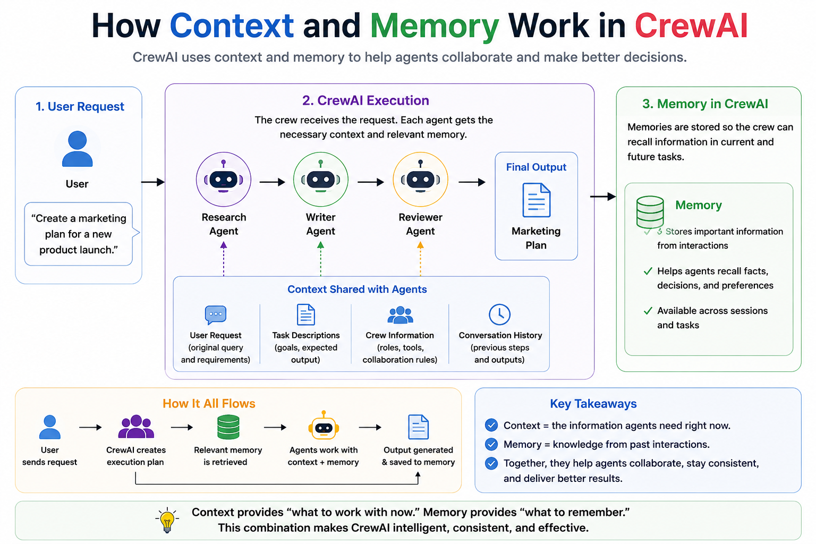
DEMO: session_6/6_2_crewai_document_generator.py, 6_3_crewai_log_analyzer.py, 6_4_crewai_cloud_bill.py, 6_5_crewai_stock_analysis_flask.py
Notes:
Session 6 | Topic: 2. Building crews for real tasks
Source: 0_slides\Agentic AI.pptx, slide 184
Demo: session_6/6_2_crewai_document_generator.py, 6_3_crewai_log_analyzer.py, 6_4_crewai_cloud_bill.py, 6_5_crewai_stock_analysis_flask.py

Slide 143
Crew and Flow
Crew = Who does the work? Flow = How does the application run?
Crew | Flow
Team of agents working together | Controls the overall application
Focuses on collaboration | Focuses on orchestration
Agents perform tasks | Flow controls what happens next
Good for multi-agent work | Good for complex workflows
DEMO: session_6/6_6_crew_vs_flow.py
Notes:
Session 6 | Topic: 3. Crew vs Flow, and conditional routing
Source: 14_advanced\Agentic AI - Advanced Engineering.pptx, slide 220
Demo: session_6/6_6_crew_vs_flow.py

Slide 144
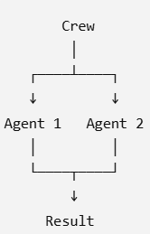
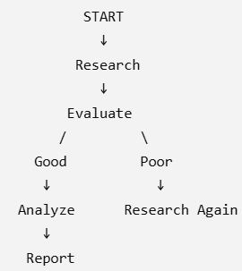
Crew versus Flow
Crew Flow
DEMO: session_6/6_6_crew_vs_flow.py
Notes:
Session 6 | Topic: 3. Crew vs Flow, and conditional routing
Source: 14_advanced\Agentic AI - Advanced Engineering.pptx, slide 221
Demo: session_6/6_6_crew_vs_flow.py

Slide 145
Flow Building Blocks
Four decorators: @start -> @listen -> @router -> @listen
@start → where the Flow begins
@listen → react to another method's output
@router → decide which path to take
State → maintain information across the workflow
Example: @start -> research() -> @listen -> analyze() -> report()
A flow can maintain a shared state
  FLOW STATE = [topic, search_results, confidence, decision]
Different steps can Read -> Update -> Pass forward
DEMO: session_6/6_6_crew_vs_flow.py
Notes:
Session 6 | Topic: 3. Crew vs Flow, and conditional routing
Source: 14_advanced\Agentic AI - Advanced Engineering.pptx, slide 222
Demo: session_6/6_6_crew_vs_flow.py

Slide 146
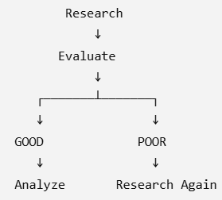
Conditional Routing
Instead of hard coding, the Flow can decide
Example
  @router(evaluate)
  def route(result):
  if result.confidence > 0.8:
  return "good"
  return "retry“
Different listeners can respond to the route
  "good" → analyze()
  "retry" → research_again()
DEMO: session_6/6_6_crew_vs_flow.py
Notes:
Session 6 | Topic: 3. Crew vs Flow, and conditional routing
Source: 14_advanced\Agentic AI - Advanced Engineering.pptx, slide 223
Demo: session_6/6_6_crew_vs_flow.py

Slide 147
How to Develop a Flow C:\code\agenticai\16_PGP-Agentic\code\session_6\6_6_crew_vs_flow.py
Define the State (Information sharing across Flow steps)
class ResearchState(BaseModel):
ticker: str
snapshot: dict = {}
confidence: float = 0
report: str = ""
@start defines where the Flow begins
@start()
def fetch_data(self):
...
For more complex workflows, a Flow can have multiple starting points
@router allows the Flow to make a workflow-level decision
@router(fetch_data)
def check_quality(self):
if self.state.confidence >= 0.8:
return "good"
return "retry"
Convergence: Different branches can eventually come together
@listen(or_(handle_failure, analyze))
def finalize(self):
...
@listen connects one step to another
@listen(fetch_data)
def analyze(self):
...
Meaning: Run analyze() after fetch_data() completes
Conditional branching can trigger different actions
@listen("good")
def analyze(self):
...
@listen("retry")
def handle_failure(self):
...
DEMO: session_6/6_6_crew_vs_flow.py
Notes:
Session 6 | Topic: 3. Crew vs Flow, and conditional routing
Source: 14_advanced\Agentic AI - Advanced Engineering.pptx, slide 224
Demo: session_6/6_6_crew_vs_flow.py

Slide 148
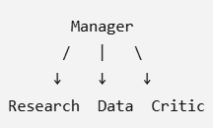
Hierarchical Crews and Manager Agents
Workflow decides who should do what
Traditional: Researcher → Analyst → Writer
Now, manager decides how to distribute the work
Manager agent: Acts as the orchestrator inside a Crew
Understand the overall objective , Delegate work to specialists, Review their results, Decide what needs more work, Coordinate the final output
Important: If the workflow is straightforward and not agentic, we need not use hierarchical crews and manager agents
C:\code\agenticai\16_PGP-Agentic\code\session_6\6_7_hierarchical_crew.py
DEMO: session_6/6_7_hierarchical_crew.py
Notes:
Session 6 | Topic: 4. Hierarchical crews and manager agents
Source: 14_advanced\Agentic AI - Advanced Engineering.pptx, slide 225
Demo: session_6/6_7_hierarchical_crew.py

Slide 149
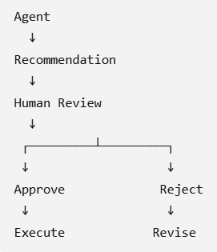
Human In The Loop (HITL) and Controlled Autonomy
Sometimes we need human approval
Levels of autonomy
session_6\6_8_human_in_the_loop.py
Level | Agent behavior | Example
Human-in-the-loop | Human approves action | Approve a refund
Human-on-the-loop | Human supervises | Monitor automated decisions
Human-out-of-the-loop | Fully autonomous | Automated classification
DEMO: session_6/6_8_human_in_the_loop.py
Notes:
Session 6 | Topic: 5. Human-in-the-loop and controlled autonomy
Source: 14_advanced\Agentic AI - Advanced Engineering.pptx, slide 226
Demo: session_6/6_8_human_in_the_loop.py

Slide 150
Memory and Knowledge
Knowledge: Agent thinks -> What information do I need to know?
Memory: Agent thinks -> What do I remember from previous interactions/work?
Flow State ≠ Memory
Flow State: Current workflow -> Temporary execution context
Memory: External information -> Retrieved when needed
C:\code\agenticai\16_PGP-Agentic\code\session_6\6_9_memory_and_knowledge.py
DEMO: session_6/6_9_memory_and_knowledge.py, 6_10_crewai_With_Memory.py vs 6_11_crewai_Without_Memory.py
Notes:
Session 6 | Topic: 6. Memory and knowledge
Source: 14_advanced\Agentic AI - Advanced Engineering.pptx, slide 227
Demo: session_6/6_9_memory_and_knowledge.py, 6_10_crewai_With_Memory.py vs 6_11_crewai_Without_Memory.py

Slide 151
Structured Outputs and Pydantic + Reliable Agent Communication
Many times it is better to structure agent outputs
Agent -> Structured Output -> Validated Schema -> Next Agent
Example
session_6\6_12_structured_outputs.py
class ResearchFinding(BaseModel):
company: str
revenue_growth: float
risk_level: str
confidence: float
evidence: list[str]
{
"company": "ABC Ltd",
"revenue_growth": 18.5,
"risk_level": "medium",
"confidence": 0.87,
"evidence": ["...", "..."]
}
DEMO: session_6/6_12_structured_outputs.py
Notes:
Session 6 | Topic: 7. Structured outputs and agent-to-agent communication
Source: 14_advanced\Agentic AI - Advanced Engineering.pptx, slide 228
Demo: session_6/6_12_structured_outputs.py

Slide 152
Guardrails, Error Handling and Reliability
Agents fail because they might: Hallucinate, Return incomplete information, Call the wrong tool, Produce invalid output, Get stuck in a loop, Fail because an external service is unavailable
Guardrail checks whether an agent’s output satisfies a requirement: Required fields exist, Answer contains evidence, Confidence is above a threshold, Output follows a policy, SQL is read-only, Response is within an allowed range
Validation types
  Format
  Content
  Quality
  Safety / Policy
C:\code\agenticai\16_PGP-Agentic\code\session_6\6_13_guardrails_and_reliability.py
DEMO: session_6/6_13_guardrails_and_reliability.py
Notes:
Session 6 | Topic: 8. Guardrails, error handling and reliability
Source: 14_advanced\Agentic AI - Advanced Engineering.pptx, slide 229
Demo: session_6/6_13_guardrails_and_reliability.py

Slide 153
Adding Observability Using LangSmith
Register on smith.langchain.com
Tracing -> New -> market-research-crew
Add this to .env file
  LANGSMITH_TRACING="true"
  LANGSMITH_ENDPOINT="https://api.smith.langchain.com"
  LANGSMITH_API_KEY=“your api key"
  LANGSMITH_PROJECT="market-research-crew"
DEMO: session_6/6_14_crewai_observability.py
Notes:
Session 6 | Topic: 9. Observability for crews
Source: 0_slides\Agentic AI.pptx, slide 185
Demo: session_6/6_14_crewai_observability.py

Slide 154
Session 7
Multi-Agent Systems with Microsoft AutoGen
Sun 14-Nov | 08:00 – 11:00 AM
Notes:
Start of Session 7

Slide 155
Session 7 Topics
AutoGen overview
AssistantAgent and tools
Synchronous vs asynchronous agents
Structured output
Multimodal messages
Teams / group chats: round-robin, selector, magentic
GraphFlow (including parallel join)
Memory
Notes:
Session 7 – Sun 14-Nov

Slide 156
Autogen
Autogen: Open-source programming framework for building AI agents and facilitating cooperation among multiple agents to solve tasks
Version 0.4: Completely revamped to use asynchronous operations
Approaches
Tool / Component | Purpose | Key Features | When to Use
Autogen Studio | Web-based UI for agent prototyping without writing code | No-code prototyping, drag-and-drop interface, quick experimentation, visualization of agent interactions | When we want to prototype quickly without coding, demo ideas, or validate workflows before implementation
AgentChat | Programming framework for building conversational single and multi-agent apps | Focus on dialogue systems, conversational logic, agent orchestration, extensibility via Python | When building chatbots or multi-agent conversations where dialogue and interaction flow matter most
Core | Event-driven programming framework for building scalable multi-agent apps | Low-level primitives for agents, event/message handling, supports complex workflows, high scalability | When we need scalable, event-driven systems with many agents coordinating beyond simple conversations
DEMO: session_7/7_1_autogen_basic.py
Notes:
Session 7 | Topic: 1. AutoGen overview
Source: 0_slides\Agentic AI.pptx, slide 187
Demo: session_7/7_1_autogen_basic.py

Slide 157
Details | Code
Basic example to illustrate Autogen syntax using AssistantAgent* | 7_1_autogen_basic.py
Same example, but making a call to the Forex API to get actual live rate | 7_2_autogen_forex_api.py
Adding TextMessage* object to send the user message to the agent, instead of passing it as a simple task message | 7_3_autogen_forex_api_text_message.py
Adding MultiModalMessage | 7_7_autogen_multimodal_message.py
Running two agents synchronously* | 7_4_autogen_synchronous_agents.py
Running two agents asynchronously*, use Anthropic Claude LLM, Yahoo Finance to get stock market data | 7_5_autogen_asynchronous_agents.py
Implementing structured output* (Currently only OpenAI supported) | 7_6_autogen_structured_output.py
Round Robin Chat* | 7_8_autogen_round_robin_group_chat.py
Selector Group Chat | 7_9_autogen_selector_group_chat.py
Magentic One Group Chat | 7_10_autogen_magentic_group_chat.py
“India never faced a recession in the last 30 years” claim | 7_11_autogen_recession_claim.py
GraphFlow in Autogen* | 7_12_autogen_graphflow.py
GraphFlow Parallel Flow with Join (Two editors -> Final reviewer) | 7_13_autogen_graphflow_parallel_join.py
Memory* | 7_14_autogen_memory.py
DEMO: session_7/7_1_autogen_basic.py
Notes:
Session 7 | Topic: 1. AutoGen overview
Source: 0_slides\Agentic AI.pptx, slide 188
Demo: session_7/7_1_autogen_basic.py

Slide 158
AssistantAgent
Parameter | What it Does | Why it is Important
name="forex_agent" | Assigns a unique name to the agent | Useful for identifying the agent when we have multiple agents
model_client=model_client | Connects the agent to the OpenAIChatCompletionClient (gpt-4o) | This is the LLM backend that powers the agent’s reasoning and responses
tools=[get_forex_rate] | Gives the agent access to external functions (here: forex lookup) | Lets the agent use functions instead of relying only on text generation (AssistantAgent automatically converts a Python function into a FunctionTool, while also generating the schema)
system_message="You are a helpful assistant." | Sets the agent’s role and behavior | Guides tone, style, and purpose of responses
reflect_on_tool_use=True | Enables the agent to review and improve how it calls tools | Adds a “self-check” step for better accuracy
model_client_stream=True | Streams model output token by token | Allows real-time responses instead of waiting for the full output
DEMO: session_7/7_2_autogen_forex_api.py, 7_3_autogen_forex_api_text_message.py
Notes:
Session 7 | Topic: 2. AssistantAgent and tools
Source: 0_slides\Agentic AI.pptx, slide 189
Demo: session_7/7_2_autogen_forex_api.py, 7_3_autogen_forex_api_text_message.py

Slide 159



TextMessage
Step | Component | What Happens | Code Example
1 | User creates a message | We (the user) or another agent create a TextMessage. It’s an object that holds the message text and metadata (like who sent it). | python text_message = TextMessage(content="What is USD to INR today?", source="User")
2 | Agent receives message | When we call the agent’s method (e.g., run(), run_stream(), or handle_message()), we pass the TextMessage. The agent is designed to accept any TextReference, which includes both plain strings and TextMessage objects. | await agent.run_stream(task=text_message)
3 | Agent converts it internally | Inside the agent’s logic, AutoGen converts the input TextMessage into a model-ready format using message.to_model_message() (from autogen_agentchat.messages). This produces the data structure that the LLM (Gemini, GPT-4, etc.) expects. | (Happens automatically — we don’t need to code it)
4 | Model processes content | The model_client (e.g., Gemini or OpenAI) reads the text from the message and generates a response. | –
5 | Agent wraps model output back into a TextMessage | The agent takes the LLM’s reply, wraps it in a new TextMessage (with source="forex_agent"), and returns it or streams it to the console/UI. | Example return object: TextMessage(content="1 USD = 83.12 INR today!", source="forex_agent")
User
TextMessage
AssistantAgent
Model Client (LLM)
DEMO: session_7/7_2_autogen_forex_api.py, 7_3_autogen_forex_api_text_message.py
Notes:
Session 7 | Topic: 2. AssistantAgent and tools
Source: 0_slides\Agentic AI.pptx, slide 190
Demo: session_7/7_2_autogen_forex_api.py, 7_3_autogen_forex_api_text_message.py

Slide 160
Synchronous Versus Asynchronous Agents
Aspect | Synchronous Execution | Asynchronous Execution (with await)
Definition | Tasks run one after another — the next starts only after the previous one finishes. | Tasks are awaited and can be paused while waiting for I/O (e.g., model response, network call), allowing other tasks to run concurrently.
Execution Flow | Linear — each agent completes fully before the next begins. | Non-blocking — multiple agents or coroutines can run "in parallel" (cooperatively).
When Used | When later tasks depend on earlier outputs (e.g., description before context). | When tasks are independent or can overlap safely.
Performance | Slower if each call waits for external APIs or LLMs to finish. | Faster overall — allows concurrent model calls or background processing.
Example | # Runs one after another desc = await desc_agent.on_messages([...]) context = await context_agent.on_messages([...]) | # Runs together (non-blocking) desc_task = asyncio.create_task(desc_agent.on_messages([...])) context_task = asyncio.create_task(context_agent.on_messages([...])) desc, context = await asyncio.gather(desc_task, context_task)
Typical Use Case | Step-by-step reasoning or pipeline workflows. | Multi-agent systems where agents can think or act independently.
Drawback | Inefficient for I/O-heavy or independent tasks. | Harder to debug and manage shared state or dependencies.
DEMO: session_7/7_4_autogen_synchronous_agents.py, 7_5_autogen_asynchronous_agents.py
Notes:
Session 7 | Topic: 3. Synchronous vs asynchronous agents
Source: 0_slides\Agentic AI.pptx, slide 191
Demo: session_7/7_4_autogen_synchronous_agents.py, 7_5_autogen_asynchronous_agents.py

Slide 161
Structured Output
Concept | Description
Purpose | Ensure the model returns responses in a pre-defined, machine-readable JSON format
Technique Used | Pydantic model schema to define expected fields
Dataset Source | https://www.kaggle.com/datasets/joykimaiyo18/linkedin-data-jobs-dataset
Task | Read 5 job descriptions (description field) and extract company name, role, and location
Agent Role | Extract structured information from unstructured job text
Expected Output | JSON with keys: company_name, role, location
Advantage | Ensures consistent, easily parsed output for downstream automation
DEMO: session_7/7_6_autogen_structured_output.py
Notes:
Session 7 | Topic: 4. Structured output
Source: 0_slides\Agentic AI.pptx, slide 192
Demo: session_7/7_6_autogen_structured_output.py

Slide 162
Teams
Team Type | Description | Example
RoundRobinGroupChat | Agents take turns responding in a round-robin sequence. All share a common conversation context, and each agent’s response is broadcast to everyone for consistent understanding. | Two agents (Writer and Critic) alternately refine a blog post until the Critic replies “APPROVE.”
SelectorGroupChat | Uses an LLM to decide which agent speaks next after each message. Each message is shared with all agents to maintain synchronized context. | A group of agents where a Reviewer, Coder, and Tester interact dynamically — the LLM decides who contributes next.
MagenticOneGroupChat | A general-purpose multi-agent framework for handling open-ended tasks using web or file data across multiple domains. | Upload a PDF report or web link, and the team extracts, summarizes, and analyzes it automatically.
Swarm | A coordinated agent system where one agent can handoff control to another using HandoffMessage, allowing smooth task transitions. Still being developed by Autogen (See Handoffs — AutoGen) | A DataCollector agent fetches API data, then passes results to a DataAnalyzer agent for visualization.
DEMO: session_7/7_8_autogen_round_robin_group_chat.py, 7_9_autogen_selector_group_chat.py, 7_10_autogen_magentic_group_chat.py, 7_11_autogen_recession_claim.py
Notes:
Session 7 | Topic: 6. Teams / group chats
Source: 0_slides\Agentic AI.pptx, slide 193
Demo: session_7/7_8_autogen_round_robin_group_chat.py, 7_9_autogen_selector_group_chat.py, 7_10_autogen_magentic_group_chat.py, 7_11_autogen_recession_claim.py

Slide 163
Autogen GraphFlow (Similar to LangGraph)
Feature / Aspect | Description
Purpose | Orchestrate multi-agent workflows using a directed graph instead of linear chains.
Nodes | Represent agents or tools.
Edges | Define possible transitions between nodes (can include conditional logic).
Flow Control | Supports branching, loops, and conditional transitions for complex workflows.
Start Node | Defines the entry point of the workflow.
Termination | Can define end conditions such as max turns, signals from agents, or workflow completion.
Use Case | Multi-agent collaboration, RAG workflows, NLP/CV pipelines, editing/review tasks, etc.
Integration | Works within Microsoft AutoGen’s teams and agents framework.
Advantages | Structured orchestration, clearer workflow logic, supports parallel and sequential execution.
Limitations / Notes | Experimental, subject to API changes, requires careful debugging and termination design.
DEMO: session_7/7_12_autogen_graphflow.py, 7_13_autogen_graphflow_parallel_join.py
Notes:
Session 7 | Topic: 7. GraphFlow
Source: 0_slides\Agentic AI.pptx, slide 194
Demo: session_7/7_12_autogen_graphflow.py, 7_13_autogen_graphflow_parallel_join.py

Slide 164
Memory
Concept / Memory Type | What it Does (Simple) | When to Use / Example
Memory (general) | Stores info from conversation for later use | Remember facts about user, context, or previous answers
add() | Add info to memory | “User’s name is Alice”
query() | Retrieve relevant info | “What did user ask before?”
update_context() | Add memory info to agent’s current context | Use retrieved facts in current answer
clear() | Delete all stored info | Start fresh conversation
close() | Clean up resources | Close vector DB or file store
ListMemory | Simple chronological memory (like a list) | Demo or small tasks
Vector / External Memory | Stores info in vector DB for semantic search | For RAG workflows, document retrieval
RAG (Retrieval Augmented Generation) | Agent uses retrieved documents to answer better | Answer questions using external knowledge/documents
DEMO: session_7/7_14_autogen_memory.py
Notes:
Session 7 | Topic: 8. Memory
Source: 0_slides\Agentic AI.pptx, slide 195
Demo: session_7/7_14_autogen_memory.py

Slide 165
Session 8
Agentic RAG and GraphRAG for Agents
Sat 15-Nov | 08:00 – 11:00 AM
Notes:
Start of Session 8

Slide 166
Session 8 Topics
RAG failure modes and advanced approaches
Traditional RAG vs agentic RAG
Retrieval + reasoning
Self-RAG
Corrective RAG (CRAG)
Re-ranking retrieved chunks
Hybrid search
GraphRAG
Multi-hop reasoning
Evaluating RAG with RAGAS
Notes:
Session 8 – Sat 15-Nov

Slide 167
RAG Failure Modes
Failure Mode | Definition
Missed Retrieval | Correct information exists in the knowledge base but is not retrieved
Irrelevant Context | Retrieved documents are not sufficiently relevant to the question
Hallucination | LLM generates information not supported by the retrieved context
Context Overflow / Lost-in-the-Middle | Right info is retrieved but buried among too much other content
Chunking Fragmentation | Relevant information is split across multiple chunks
DEMO: session_8/8_1_rag_hallucination_eval.py
Notes:
Session 8 | Topic: 1. RAG failure modes and advanced approaches
Source: 14_advanced\Agentic AI - Advanced Engineering.pptx, slide 231
Demo: session_8/8_1_rag_hallucination_eval.py

Slide 168
Various Approaches for Advanced RAG
Technique | One-line summary
RAGAS | Evaluates RAG quality — accuracy, relevance, usefulness, and completeness of retrieval and answers.
Agentic RAG | Uses an agent to decide what to retrieve, how to retrieve, and what to do next.
Self-RAG | Retrieves, checks the retrieved evidence, and retrieves/generates again when the evidence is insufficient.
Corrective RAG | Corrects poor retrieval by using additional retrieval sources, such as web search, when necessary.
Reranking | Reorders retrieved chunks using a stronger relevance model so the best ones reach the LLM.
HyDE | Generates a hypothetical answer first, embeds it, and uses it to retrieve matching documents.
Query Expansion | Generates multiple reformulations of the query to improve retrieval coverage.
GraphRAG | Represents information as an entity–relationship graph to retrieve connected facts across documents.
Multi-hop Reasoning | Traverses multiple facts or relationships step-by-step to answer questions requiring several pieces of information.
Hybrid RAG | Combines multiple retrieval methods, such as vector search and graph traversal, to improve retrieval.
DEMO: session_8/8_1_rag_hallucination_eval.py
Notes:
Session 8 | Topic: 1. RAG failure modes and advanced approaches
Source: 14_advanced\Agentic AI - Advanced Engineering.pptx, slide 232
Demo: session_8/8_1_rag_hallucination_eval.py

Slide 169
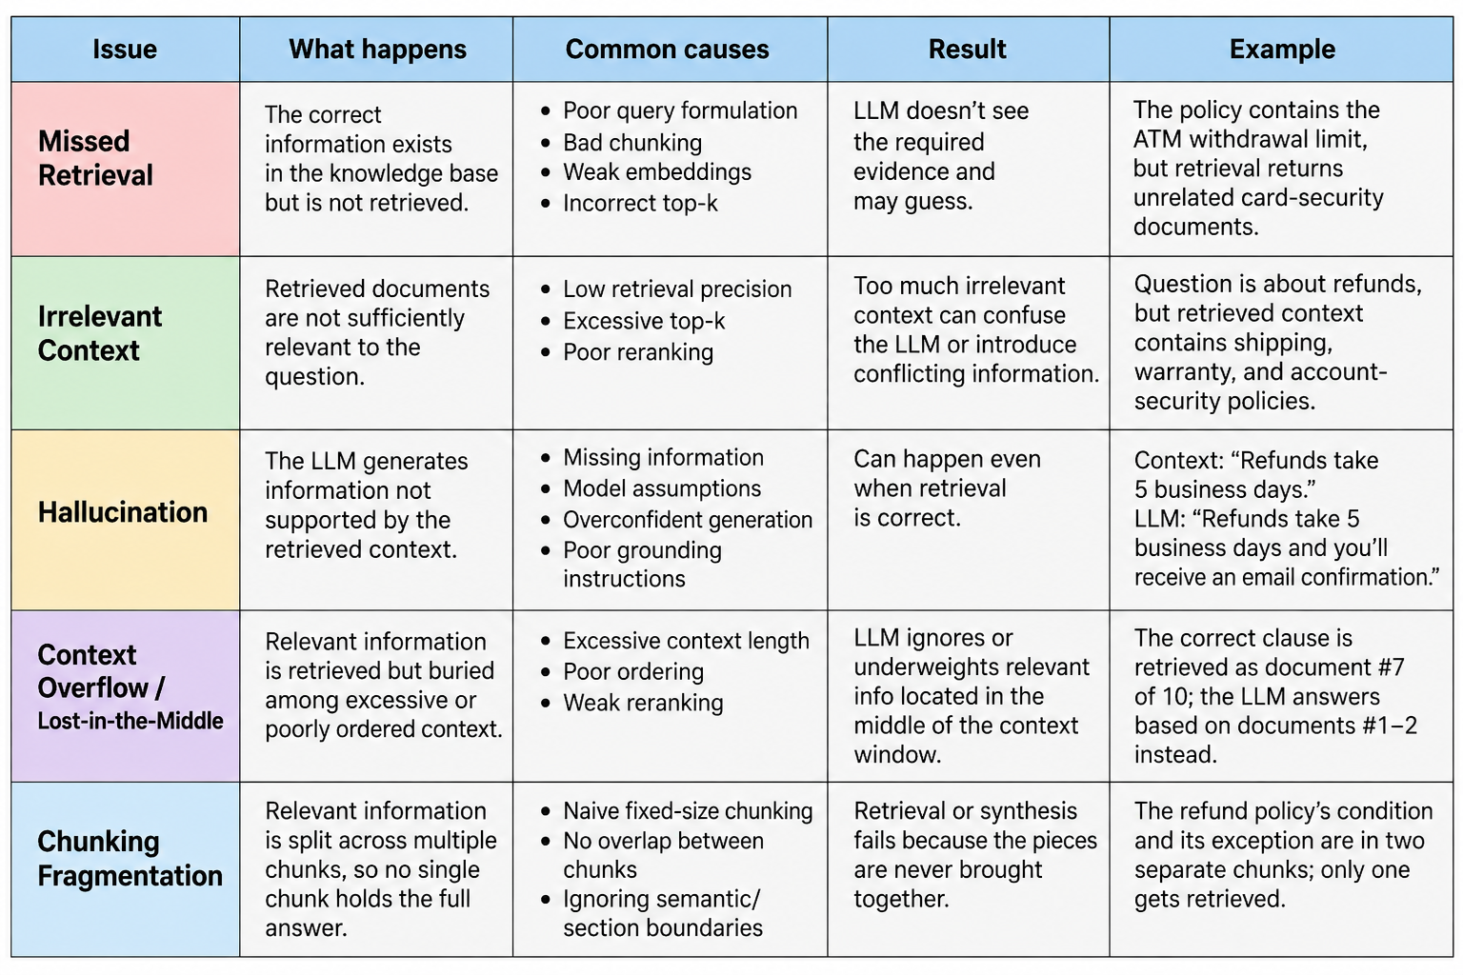
DEMO: session_8/8_1_rag_hallucination_eval.py
Notes:
Session 8 | Topic: 1. RAG failure modes and advanced approaches
Source: 14_advanced\Agentic AI - Advanced Engineering.pptx, slide 233
Demo: session_8/8_1_rag_hallucination_eval.py

Slide 170
Traditional RAG versus Agentic RAG
Traditional RAG | Agentic RAG
Fixed retrieval pipeline | Intelligent, dynamic workflow
Retrieves documents once | Can retrieve multiple times as needed
Single LLM call | Multiple reasoning steps
No planning capability | Plans and decides next actions
Limited decision-making | Autonomous decision-making
Uses a predefined sequence | Chooses the best execution path
Simple architecture | Multi-step agent architecture
Best for straightforward Q&A | Best for complex problem solving
DEMO: session_8/8_3_traditional_vs_agentic_rag.py, 8_4_traditional_vs_agentic_rag_serp.py, 8_5_openai_agent_traditional_rag.py vs 8_6_openai_agent_agentic_rag.py
Notes:
Session 8 | Topic: 2. Traditional RAG vs agentic RAG
Source: 15_real\Agentic AI - Real.pptx, slide 85
Demo: session_8/8_3_traditional_vs_agentic_rag.py, 8_4_traditional_vs_agentic_rag_serp.py, 8_5_openai_agent_traditional_rag.py vs 8_6_openai_agent_agentic_rag.py

Slide 171
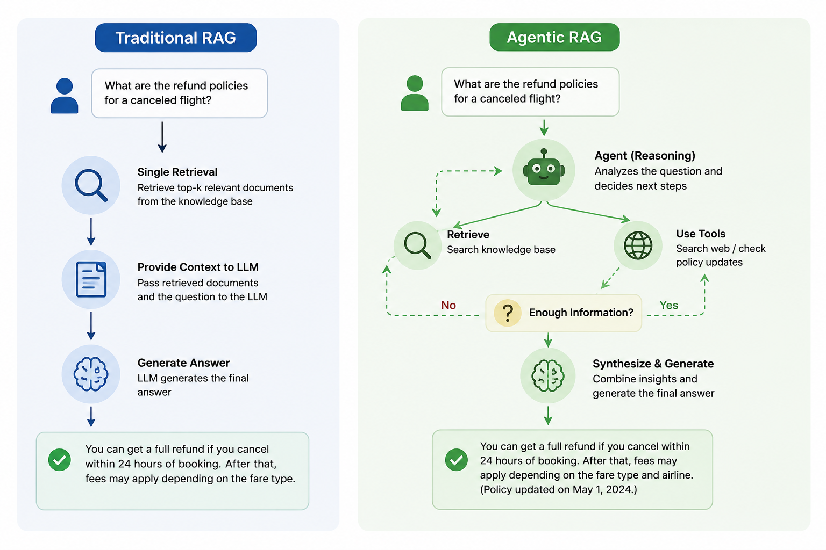
C:\code\agenticai\16_PGP-Agentic\code\session_8\8_3_traditional_vs_agentic_rag.py
DEMO: session_8/8_3_traditional_vs_agentic_rag.py, 8_4_traditional_vs_agentic_rag_serp.py, 8_5_openai_agent_traditional_rag.py vs 8_6_openai_agent_agentic_rag.py
Notes:
Session 8 | Topic: 2. Traditional RAG vs agentic RAG
Source: 15_real\Agentic AI - Real.pptx, slide 86
Demo: session_8/8_3_traditional_vs_agentic_rag.py, 8_4_traditional_vs_agentic_rag_serp.py, 8_5_openai_agent_traditional_rag.py vs 8_6_openai_agent_agentic_rag.py

Slide 172
Common Adaptive Strategies (C:\code\agenticai\16_PGP-Agentic\code\session_8\8_7_adaptive_retrieval_strategies.py)
Strategy | Description
Skip Retrieval | Answer directly if existing knowledge is sufficient
Single Retrieval | Retrieve once for simple factual questions
Iterative Retrieval | Retrieve additional documents if more information is needed
Query Reformulation | Rewrite the query to improve search accuracy
Multi-Source Retrieval | Combine information from vector databases, SQL databases, APIs, and web search
Tool-Based Retrieval | Choose the most appropriate tool based on the user's request
DEMO: session_8/8_7_adaptive_retrieval_strategies.py, 8_8_adaptive_retrieval_strategies_serp.py
Notes:
Session 8 | Topic: 2. Traditional RAG vs agentic RAG
Source: 15_real\Agentic AI - Real.pptx, slide 87
Demo: session_8/8_7_adaptive_retrieval_strategies.py, 8_8_adaptive_retrieval_strategies_serp.py

Slide 173
Retrieval + Reasoning
Modern AI applications combine Retrieval (finding relevant information) with Reasoning (analyzing, interpreting, and making decisions) to produce accurate and context-aware responses
  Retrieval provides factual knowledge
  Reasoning uses that knowledge to solve the user's problem
Example: Can I get a ₹50 lakh home loan? My salary is ₹18 lakh/year, I already have a car loan, and my credit score is 760.
  Retrieval: Loan eligibility policy, Current interest rates, Customer profile, Credit score, Existing loans, RBI lending rules
  Reasoning: Calculates Debt-to-Income (DTI) ratio, Checks credit score eligibility, Verifies policy rules, Determines maximum eligible amount, Suggests suitable loan options
DEMO: session_8/8_9_loan_eligibility_rag_reasoning.py, 8_10_cohere_rag_pipeline.py
Notes:
Session 8 | Topic: 3. Retrieval + reasoning
Source: 15_real\Agentic AI - Real.pptx, slide 89
Demo: session_8/8_9_loan_eligibility_rag_reasoning.py, 8_10_cohere_rag_pipeline.py

Slide 174
Retrieval + Reasoning Example
Code: C:\code\agenticai\16_PGP-Agentic\code\session_8\8_10_cohere_rag_pipeline.py
embed() — turns text into 1536-dim vectors (embed-v4.0)
rerank() — narrows all 324 FAQs down to the top-3 most relevant to the query (rerank-v3.5) — correctly surfaced the 3 refund-related entries for "How do I get my money back for an order?"
chat() — generates the final answer, passing the reranked FAQs straight in via documents= — Cohere's chat endpoint handles the grounding/context-stuffing natively, unlike OpenAI where you build that prompt yourself
DEMO: session_8/8_9_loan_eligibility_rag_reasoning.py, 8_10_cohere_rag_pipeline.py
Notes:
Session 8 | Topic: 3. Retrieval + reasoning
Source: 15_real\Agentic AI - Real.pptx, slide 90
Demo: session_8/8_9_loan_eligibility_rag_reasoning.py, 8_10_cohere_rag_pipeline.py

Slide 175
Self-RAG
RAG
  Question → Retrieve → Generate Answer
  It trusts the retrieved documents
Self-RAG: Does not blindly trust the first retrieval
  Question → Retrieve → Check → Retrieve/Generate Again if needed → Final Answer
Example: Question - What documents are required for a cashless health insurance claim?
  Retrieve: System retrieves 3 chunks from the policy database
  Self-RAG asks: Are these chunks sufficient and relevant to answer the question?
    Suppose one chunk is irrelevant
  Retrieve again: The system searches again for information specifically about cashless claims and required documents
    Finds Claim form + original bills + discharge summary + prescription + diagnostic reports
  Generate/Synthesize: For a cashless claim, submit the claim form, original bills, discharge summary, prescription and diagnostic reports
Code: C:\code\agenticai\16_PGP-Agentic\code\session_8\8_11_self_rag.py
DEMO: session_8/8_11_self_rag.py
Notes:
Session 8 | Topic: 4. Self-RAG
Source: 14_advanced\Agentic AI - Advanced Engineering.pptx, slide 242
Demo: session_8/8_11_self_rag.py

Slide 176
Corrective RAG (CRAG)
Falling back to web search when local knowledge fails
C:\code\agenticai\16_PGP-Agentic\code\session_8\8_12_corrective_rag.py
DEMO: session_8/8_12_corrective_rag.py
Notes:
Session 8 | Topic: 5. Corrective RAG (CRAG)
Source: 14_advanced\Agentic AI - Advanced Engineering.pptx, slide 243
Demo: session_8/8_12_corrective_rag.py

Slide 177
Re-ranking Retrieved Chunks with Cohere and Cross-encoder Models
Why re-ranking?: Vector search finds similar chunks, but the most similar chunk is not always the most relevant to the question
User Query → Vector Search → Top 20 Chunks → Cohere Reranker → Best 3–5 Chunks → LLM
Example: What documents are required for a cashless health insurance claim?
Initial vector search
  Chunk A → “Submit the claim form, original bills and discharge summary.” → 0.82
  Chunk B → “Health insurance premiums must be paid within the grace period.” → 0.79
  Chunk C → “Required claim documents include prescription and diagnostic reports.” → 0.76
  Vector search may rank B highly because it is generally related to health insurance
Cohere Reranker: Examines the query + each chunk together and assigns a new relevance score
  Chunk A → 0.97 ✓
  Chunk B → 0.18 ✗
  Chunk C → 0.94 ✓
Result: A + C → LLM
Code: C:\code\agenticai\16_PGP-Agentic\code\session_8\8_13_cohere_reranking.py
DEMO: session_8/8_13_cohere_reranking.py
Notes:
Session 8 | Topic: 6. Re-ranking retrieved chunks
Source: 14_advanced\Agentic AI - Advanced Engineering.pptx, slide 244
Demo: session_8/8_13_cohere_reranking.py

Slide 178
Hybrid Search
Combine Two Search Methods
Keyword Search
  Finds exact words
  Good for error codes, names, acronyms
Semantic Search
  Finds meaning
  Good for paraphrases and natural language
Hybrid Search = Keyword + Semantic
Best of both worlds
DEMO: session_8/8_14_hybrid_search.py
Notes:
Session 8 | Topic: 7. Hybrid search
Source: 14_advanced\Agentic AI - Advanced Engineering.pptx, slide 124
Demo: session_8/8_14_hybrid_search.py

Slide 179
Hybrid Search
Hybrid RAG: Combines two retrieval strategies so each covers the other's blind spot
  Vector search → finds semantically similar text
  Graph traversal → finds connected entities and relationships across documents
Query: "My Savings Account Plus card was used fraudulently — am I covered, and how long will resolution take?"
  Vector search finds: General fraud protection FAQ, Zero Liability Protection program description, Fraud Resolution team contact page
  Graph traversal finds: Savings Account Plus → enrolled in → Zero Liability Protection → covers → unauthorized transactions (60-day window) → processed by → Fraud Resolution team → turnaround → 5 business days
Why combine both:
  Vector search is good at surfacing topically relevant content, even with loose or informal query wording
  Graph traversal is good at chaining precise, structured facts across documents — but only works when the query maps cleanly to known entities
  Combining = The system does not have to guess in advance whether a question needs semantic matching or precise multi-hop reasoning — it gets both
How? Results from both retrieval paths are merged into one candidate pool, often followed by a reranker to pick the final best chunks for the LLM
Code: C:\code\agenticai\16_PGP-Agentic\code\session_8\8_15_agentic_hybrid_search.py
DEMO: session_8/8_15_agentic_hybrid_search.py
Notes:
Session 8 | Topic: 7. Hybrid search
Source: 14_advanced\Agentic AI - Advanced Engineering.pptx, slide 249
Demo: session_8/8_15_agentic_hybrid_search.py

Slide 180
GraphRAG
Core idea: Instead of treating documents as independent, disconnected chunks, GraphRAG extracts entities and relationships from text and represents them as a knowledge graph — connecting facts that live in different chunks or even different documents
Why: Chunk-based retrieval only works when a single chunk contains the full answer - When an AI agent needs to chain facts across multiple documents to answer a question, vector search alone falls short
Example — Source text (spread across three separate documents in a bank's policy knowledge base)
  Doc 1 (account terms): "Savings Account Plus customers are enrolled in the Zero Liability Protection program."
  Doc 2 (program rules): "Zero Liability Protection covers unauthorized transactions reported within 60 days."
  Doc 3 (claims policy): "Claims under Zero Liability Protection are processed by the Fraud Resolution team, with a standard turnaround of 5 business days."
Represented as a graph
  (Savings Account Plus) --[enrolls customers in]--> (Zero Liability Protection)
  (Zero Liability Protection) --[covers]--> (Unauthorized transactions, 60-day window)
  (Zero Liability Protection) --[processed by]--> (Fraud Resolution team)
  (Fraud Resolution team) --[turnaround]--> (5 business days)
Customer: "My Savings Account Plus card was used fraudulently 3 weeks ago — am I covered, and how long will it take?“
Multi-hop reasoning solves it (next slide)
Code: C:\code\agenticai\16_PGP-Agentic\code\session_8\8_16_graph_rag.py
DEMO: session_8/8_16_graph_rag.py
Notes:
Session 8 | Topic: 8. GraphRAG
Source: 14_advanced\Agentic AI - Advanced Engineering.pptx, slide 247
Demo: session_8/8_16_graph_rag.py

Slide 181
Multi-Hop Reasoning
Multi-hop reasoning: Answering a question by following multiple relationships or pieces of evidence rather than finding the answer in a single document
"Is a Savings Account Plus customer covered for fraud reported 3 weeks ago, and how long will resolution take?"
Traversal: Savings Account Plus → (enrolls in) → Zero Liability Protection → (covers) → unauthorized transactions within 60 days [3 weeks ✓ within window] → (processed by) → Fraud Resolution team → (turnaround) → 5 business days
The agent chains four facts across three documents to construct an answer no single chunk contains — and also applies a condition (60-day window) to the customer's specific situation
Code: C:\code\agenticai\16_PGP-Agentic\code\session_8\8_17_multi_hop_reasoning.py
DEMO: session_8/8_17_multi_hop_reasoning.py
Notes:
Session 8 | Topic: 9. Multi-hop reasoning
Source: 14_advanced\Agentic AI - Advanced Engineering.pptx, slide 248
Demo: session_8/8_17_multi_hop_reasoning.py

Slide 182
RAGAS
Retrieval-Augmented Generation Assessment
Open-source framework to evaluate RAG systems — no manual labeling needed
Scores both retrieval and generation, not just the final answer
Why needed? Traditional eval only checks the final answer, RAGAS asks:
  Was the right info retrieved?
  Was it relevant?
  Is the answer grounded in it?
  Does the answer actually address the question?
DEMO: session_8/8_18_ragas_evaluation.py, 8_19_ragas_evaluation_customer_support.py
Notes:
Session 8 | Topic: 10. Evaluating RAG with RAGAS
Source: 14_advanced\Agentic AI - Advanced Engineering.pptx, slide 234
Demo: session_8/8_18_ragas_evaluation.py, 8_19_ragas_evaluation_customer_support.py

Slide 183
RAGAS Metrics
Metric | What it measures
Faithfulness | Did the LLM make things up? = Accuracy
Answer Relevancy | Did the LLM answer the question? = Relevance
Context Precision | Did we retrieve mostly useful information? = Usefulness
Context Recall | Did we retrieve all the information we needed? = Completeness
DEMO: session_8/8_18_ragas_evaluation.py, 8_19_ragas_evaluation_customer_support.py
Notes:
Session 8 | Topic: 10. Evaluating RAG with RAGAS
Source: 14_advanced\Agentic AI - Advanced Engineering.pptx, slide 235
Demo: session_8/8_18_ragas_evaluation.py, 8_19_ragas_evaluation_customer_support.py

Slide 184
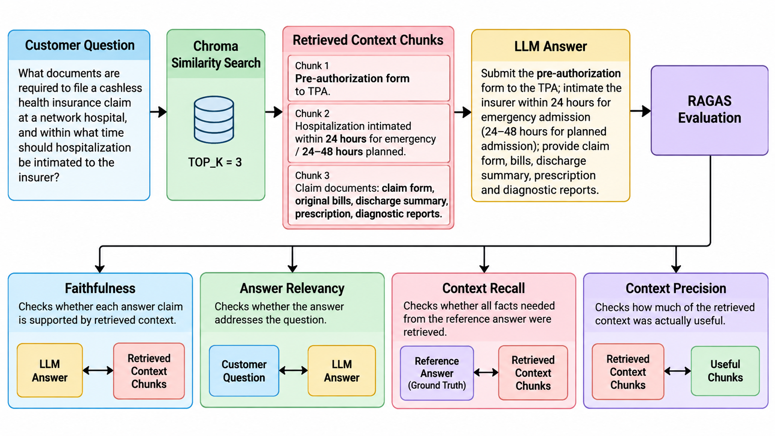
DEMO: session_8/8_18_ragas_evaluation.py, 8_19_ragas_evaluation_customer_support.py
Notes:
Session 8 | Topic: 10. Evaluating RAG with RAGAS
Source: 14_advanced\Agentic AI - Advanced Engineering.pptx, slide 236
Demo: session_8/8_18_ragas_evaluation.py, 8_19_ragas_evaluation_customer_support.py

Slide 185
Metric | Example
Faithfulness | Context says “Hospitalization must be intimated within 24 hours for emergency admissions.” If the LLM says “within 24 hours and a ₹5,000 fee is charged,” faithfulness drops because the fee is not in the context.
Answer Relevancy | Question: “What documents are required for a cashless claim?” Answer: “Submit the pre-authorization form, claim form, bills and discharge summary.” → High relevance.
Context Precision | 3 chunks are retrieved: claim documents, hospitalization timing, policy renewal. The first two are useful for the question; the renewal chunk is irrelevant → lower precision.
Context Recall | Reference requires pre-authorization form + claim documents + 24-hour notification. If retrieval finds the documents and pre-authorization information but misses the 24-hour requirement, recall is low.
DEMO: session_8/8_18_ragas_evaluation.py, 8_19_ragas_evaluation_customer_support.py
Notes:
Session 8 | Topic: 10. Evaluating RAG with RAGAS
Source: 14_advanced\Agentic AI - Advanced Engineering.pptx, slide 237
Demo: session_8/8_18_ragas_evaluation.py, 8_19_ragas_evaluation_customer_support.py

Slide 186
Faithfulness
Are the answer's claims actually backed by the retrieved context?
Answer generated by RAG/LLM:
“Submit the pre-authorization form to the TPA; hospitalization must be intimated within 12 hours for emergency admission; submit the claim form, bills, discharge summary, prescription and diagnostic reports.”
Broken into 3 claims:
  S1: Submit pre-authorization form to TPA
  S2: Intimate insurer within 12 hours for emergency admission
  S3: Submit claim form, bills, discharge summary, prescription and diagnostic reports
Retrieved context:
“For a cashless claim at a network hospital, the policyholder submits a pre-authorization form to the TPA. Hospitalization must be intimated within 24 hours for emergency admissions (24 to 48 hours for planned admissions). Claim documents typically include the claim form, original bills, discharge summary, prescription, and diagnostic test reports.”
  S1 ✅ — confirmed
  S2 ❌ — context says 24 hours, not 12 hours - The “12 hours” detail was made up
  S3 ✅ — confirmed
Score = 2/3 = 0.67 — the answer contains one unsupported claim
DEMO: session_8/8_18_ragas_evaluation.py, 8_19_ragas_evaluation_customer_support.py
Notes:
Session 8 | Topic: 10. Evaluating RAG with RAGAS
Source: 14_advanced\Agentic AI - Advanced Engineering.pptx, slide 238
Demo: session_8/8_18_ragas_evaluation.py, 8_19_ragas_evaluation_customer_support.py

Slide 187
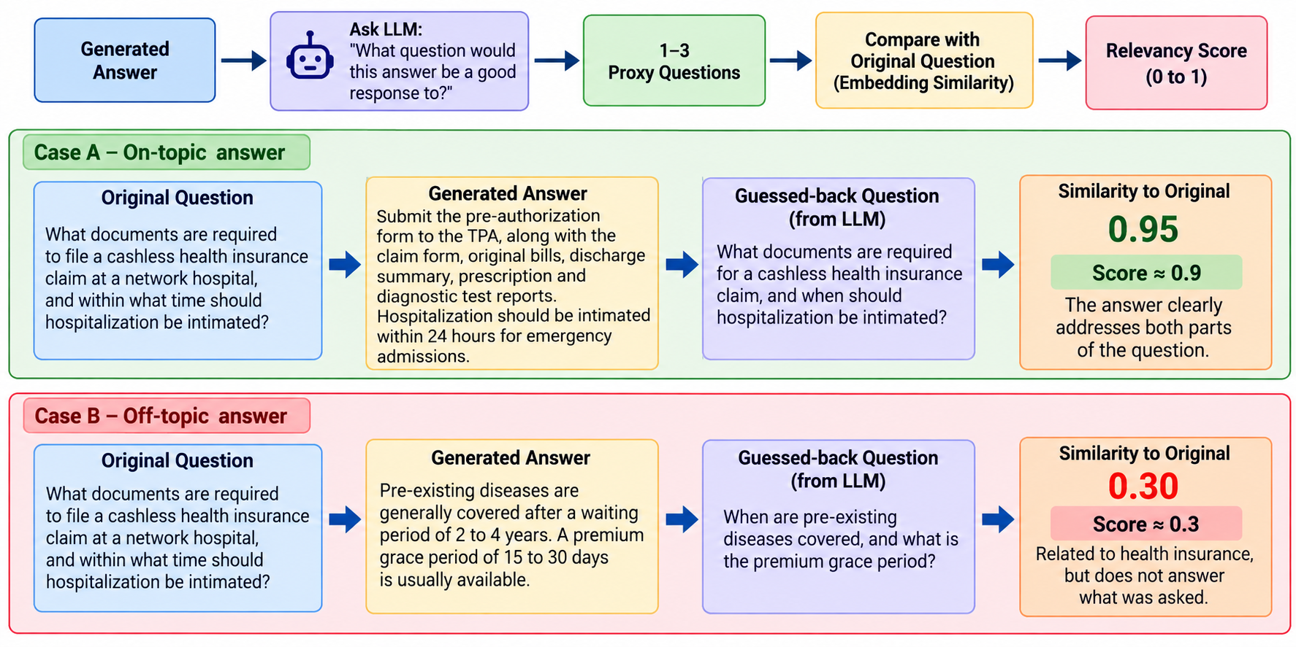
Answer Relevance
DEMO: session_8/8_18_ragas_evaluation.py, 8_19_ragas_evaluation_customer_support.py
Notes:
Session 8 | Topic: 10. Evaluating RAG with RAGAS
Source: 14_advanced\Agentic AI - Advanced Engineering.pptx, slide 239
Demo: session_8/8_18_ragas_evaluation.py, 8_19_ragas_evaluation_customer_support.py

Slide 188
Context Precision
Of what was retrieved, how much was actually useful?
5 chunks retrieved for "What documents are required to file a cashless health insurance claim at a network hospital, and within what time should hospitalization be intimated?”
Score = 3/5 = 0.60 — 2 irrelevant chunks diluted the useful ones
Chunk | Content | Relevant?
1 | Pre-authorization form to TPA | ✅ Yes
2 | Hospitalization intimated within 24 hours for emergency admissions | ✅ Yes
3 | Claim form, original bills, discharge summary, prescription and diagnostic reports | ✅ Yes
4 | Premium grace period of 15–30 days | ❌ No
5 | Pre-existing disease waiting period of 2–4 years | ❌ No
DEMO: session_8/8_18_ragas_evaluation.py, 8_19_ragas_evaluation_customer_support.py
Notes:
Session 8 | Topic: 10. Evaluating RAG with RAGAS
Source: 14_advanced\Agentic AI - Advanced Engineering.pptx, slide 240
Demo: session_8/8_18_ragas_evaluation.py, 8_19_ragas_evaluation_customer_support.py

Slide 189
Context Recall
Was everything needed to fully answer the question actually retrieved?
Ground truth — 4 facts needed for a complete answer
  Submit pre-authorization form to the TPA
  Intimate hospitalization within 24 hours for emergency admissions
  Submit claim form, original bills, discharge summary, prescription and diagnostic reports
  TPA verifies the bills and coordinates settlement between hospital and insurer
Score = 3/4 = 0.75 — the retrieved context contains most of the information needed, but misses the TPA's role in verifying bills and coordinating settlement
RAGAS code: C:\code\agenticai\16_PGP-Agentic\code\session_8\8_18_ragas_evaluation.py
Required Fact | Retrieved?
Pre-authorization form to TPA | ✅ Yes
24-hour emergency intimation | ✅ Yes
Required claim documents | ✅ Yes
TPA verification and settlement coordination | ❌ No
DEMO: session_8/8_18_ragas_evaluation.py, 8_19_ragas_evaluation_customer_support.py
Notes:
Session 8 | Topic: 10. Evaluating RAG with RAGAS
Source: 14_advanced\Agentic AI - Advanced Engineering.pptx, slide 241
Demo: session_8/8_18_ragas_evaluation.py, 8_19_ragas_evaluation_customer_support.py

Slide 190
Session 9
Deep Agents: Reflection, Planning and Long-Term Memory
Sun 21-Nov | 08:00 – 11:00 AM
Notes:
Start of Session 9

Slide 191
Session 9 Topics
What makes an agent "deep"
Self-reflection loops
Multi-turn reflection with a quality threshold
Plan-and-Execute
Replanning
ReAct vs Plan-and-Execute
Long-term memory types
Episodic memory
Memory consolidation
Context propagation and trimming
Self-improvement from failures
Unified architecture: reflection + planning + memory
Notes:
Session 9 – Sun 21-Nov

Slide 192
What Makes an Agent ‘Deep'
A “deep” agent doesn't just produce an answer — it can evaluate its own process and adapt what it does next
Basic agent
  User -> LLM -> Tool -> Answer
Deeper agent
  User -> LLM -> Think about the task -> Plan -> Act -> Observe result -> Evaluate -> Revise strategy -> May Loop -> Answer
Normal reasoning: "How do I solve this?"
Meta-cognition: "Is my way of solving this working?"
DEMO: Concept slide - no code; discuss
Notes:
Session 9 | Topic: 1. What makes an agent "deep"
Source: 14_advanced\Agentic AI - Advanced Engineering.pptx, slide 206
Demo: Concept slide - no code; discuss

Slide 193
Self-reflection Loops
Generate → Critique → Revise -> Loop
Generate step
  Create an initial solution
  Input -> LLM -> Draft
Critique
  Evaluate the draft against explicit criteria
  Draft -> Critic -> Issues + scores + recommendations
Revise
  Use the critique to produce an improved version
  Draft + Critique -> LLM -> Revised answer
Generate: Explain RAG to a beginner in 200 words
  Output: RAG combines an LLM with external information…
Critique: Against a Rubric
  Accuracy: Good
  Completeness: Missing indexing/vector search
  Clarity: Good
  Beginner level: Good
  Word limit: Within limit
  Issues
    1. Explain retrieval more clearly.
    2. Mention why embeddings are used.
    3. Explain how retrieved context reaches the LLM.
Revise: Address the above weaknesses
DEMO: session_9/9_1_openai_agent_pattern_reflection.py
Notes:
Session 9 | Topic: 2. Self-reflection loops
Source: 14_advanced\Agentic AI - Advanced Engineering.pptx, slide 207
Demo: session_9/9_1_openai_agent_pattern_reflection.py

Slide 194
Multi-Turn Reflection
Iterating Until a Quality Threshold Is Met
Instead of one critique and revision, repeat until a quality threshold is met
Generate -> Critique → Score = 6/10 -> Revise -> Critique → Score = 7.5/10 -> Revise -> Critique → Score = 9/10 -> STOP
Critique may score multiple dimensions and calculate their average
  Accuracy, Completeness, Relevance, Clarity, Evidence
May also need to put an upper limit on the number of loops
C:\code\agenticai\16_PGP-Agentic\code\session_9\9_2_meal_plan_reflection.py
DEMO: session_9/9_2_meal_plan_reflection.py
Notes:
Session 9 | Topic: 3. Multi-turn reflection with a quality threshold
Source: 14_advanced\Agentic AI - Advanced Engineering.pptx, slide 208
Demo: session_9/9_2_meal_plan_reflection.py

Slide 195
Plan-and-Execute
Separating Planning from Execution
Two clear steps
  Planning — decide what needs to be done (Strategy)
  Execution — actually do those steps (Action)
Example: User - "Research three competitors, compare their pricing, identify their strengths, and recommend which one we should consider.“
  Planner
    1. Identify three competitors
    2. Research competitor A
    3. Research competitor B
    4. Research competitor C
    5. Collect pricing information
    6. Compare features and pricing
    7. Identify strengths and weaknesses
    8. Make recommendation
  Executor – Perform these steps using appropriate tools
Code: C:\code\agenticai\16_PGP-Agentic\code\session_9\9_3_study_plan_plan_execute.py
DEMO: session_9/9_3_study_plan_plan_execute.py
Notes:
Session 9 | Topic: 4. Plan-and-Execute
Source: 14_advanced\Agentic AI - Advanced Engineering.pptx, slide 209
Demo: session_9/9_3_study_plan_plan_execute.py

Slide 196
Replanning
Updating the Plan When New Information Arrives
Reason: During execution, the agent may discover:
  A required resource is unavailable
  A tool fails
  Retrieved information contradicts an assumption
  New information changes the situation
  A task is already completed
  A dependency is missing
  The original approach is too expensive or slow
Code: C:\code\agenticai\16_PGP-Agentic\code\session_9\9_4_pathology_report_replanning.py
DEMO: session_9/9_4_pathology_report_replanning.py
Notes:
Session 9 | Topic: 5. Replanning
Source: 14_advanced\Agentic AI - Advanced Engineering.pptx, slide 210
Demo: session_9/9_4_pathology_report_replanning.py

Slide 197
ReAct Versus Plan-and-Execute
ReAct: Combines reasoning and action in an iterative loop, decides the next action based on the latest observation
Plan-and-Execute: First creates a higher-level plan
Dimension | ReAct | Plan-and-Execute
Planning | Incremental | Upfront
Decision making | Every step | At plan level
Adaptability | Very high | High with replanning
Structure | Less explicit | Highly structured
Simple tasks | Excellent | Often unnecessary
Long workflows | Can become messy | Better suited
Debugging | More difficult | Easier
Parallelization | Less natural | Easier
Planning overhead | Low | Higher
Transparency | Action-by-action | Explicit plan
DEMO: session_9/9_5_openai_agent_pattern_react.py vs 9_6_openai_agent_pattern_plan.py
Notes:
Session 9 | Topic: 6. ReAct vs Plan-and-Execute
Source: 14_advanced\Agentic AI - Advanced Engineering.pptx, slide 211
Demo: session_9/9_5_openai_agent_pattern_react.py vs 9_6_openai_agent_pattern_plan.py

Slide 198
Memory Types
Memory Type | Purpose | Lifetime | Example
Short-Term Memory (Working Memory) | Current conversation context | Minutes / Session | Previous chat messages
Long-Term Memory | Persistent user knowledge | Days to Years | User preferences, profile
External Memory | Information stored outside the agent | Persistent | ChromaDB, SQL, Redis
Semantic Memory | Facts and knowledge | Persistent | "Python is your preferred language."
Episodic Memory | Past interactions and experiences | Persistent | Previous customer support sessions
Procedural Memory | Learned procedures and workflows | Persistent | Steps to deploy an application
Why memory?
  Maintain conversation context
  Remember user preferences
  Recall previous tasks
  Personalize responses
  Reduce repeated questions
  Support long-running workflows
DEMO: session_9/9_7_agent_memory_short_term_langgraph.py, then 9_8, 9_9, 9_10 (dynamic session ID; short to long term; short to external SQLite)
Notes:
Session 9 | Topic: 7. Long-term memory types
Source: 15_real\Agentic AI - Real.pptx, slide 96
Demo: session_9/9_7_agent_memory_short_term_langgraph.py, then 9_8, 9_9, 9_10 (dynamic session ID; short to long term; short to external SQLite)

Slide 199
Memory Examples
First run session_9\9_7_agent_memory_short_term_langgraph.py
Now run session_9\9_8_agent_memory_dynamic_session_id_langgraph.py -> Change is, we accept user id from user and that is our session ID
Now run session_9\9_9_agent_memory_short_to_long_term_langgraph.py and session_9\9_10_agent_memory_short_to_external_sqlite_langgraph.py -> Saving short term memory into local/external long term memory
Now run session_9\9_14_agent_memory_episodic_langgraph.py, session_9\9_12_agent_memory_procedural_langgraph.py, session_9\9_11_agent_memory_semantic_langgraph.py
DEMO: session_9/9_7_agent_memory_short_term_langgraph.py, then 9_8, 9_9, 9_10 (dynamic session ID; short to long term; short to external SQLite)
Notes:
Session 9 | Topic: 7. Long-term memory types
Source: 15_real\Agentic AI - Real.pptx, slide 97
Demo: session_9/9_7_agent_memory_short_term_langgraph.py, then 9_8, 9_9, 9_10 (dynamic session ID; short to long term; short to external SQLite)

Slide 200
Long Term Memory Types
Episodic = Experiences
Semantic = Knowledge
Procedural = Skills
Memory | Core question | Example
Episodic | What happened? | "We discussed Project X last Tuesday."
Semantic | What do I know? | "Project X uses PostgreSQL."
Procedural | How do I do it? | "Deploy Project X using this procedure."
DEMO: session_9/9_11_agent_memory_semantic_langgraph.py, 9_12_agent_memory_procedural_langgraph.py
Notes:
Session 9 | Topic: 7. Long-term memory types
Source: 14_advanced\Agentic AI - Advanced Engineering.pptx, slide 212
Demo: session_9/9_11_agent_memory_semantic_langgraph.py, 9_12_agent_memory_procedural_langgraph.py

Slide 201
Episodic Memory
Episodic memory: An agent's ability to store and recall specific past interactions or experiences — as opposed to just relying on general/static knowledge
Typical meaning for an agent
  Records of specific episodes — A particular conversation, a task the agent completed, a decision it made, an error it encountered and how it was resolved
  Retrievable and reusable — The agent can look back at these episodes later to inform future behavior
  Distinct from parametric knowledge — Stored externally (a database, vector store, log) and pulled in at inference time
Code: C:\code\agenticai\16_PGP-Agentic\code\session_9\9_13_episodic_memory_store.py
  Instead of a fixed knowledge base, use a vector DB that starts with a batch of past cases and keeps growing as the agent handles new ones
  Loads 324 real past support tickets and stores each one as a single text blob in this shape:
    "Customer asked: Why was my payment declined? | Resolution: ..."
  This is the agent's starting memory — like giving it a transcript of everything support agents have handled before
  When a query comes, recall() finds 2 best matches, adds in the prompt telling the LLM how the previous questions were answered so as to answer this new question
  The remember() function writes this as a new query and response in the text blob format, as above
DEMO: session_9/9_13_episodic_memory_store.py, 9_14_agent_memory_episodic_langgraph.py
Notes:
Session 9 | Topic: 8. Episodic memory
Source: 14_advanced\Agentic AI - Advanced Engineering.pptx, slide 213
Demo: session_9/9_13_episodic_memory_store.py, 9_14_agent_memory_episodic_langgraph.py

Slide 202
Memory Consolidation
Summarising and Compressing Old Episodic Memories
Normal: Day 1 → Episode 1, Day 2 → Episode 2, Day 3 → Episode 3, ... Day 100 → Episode 100
Problems: Large, Redundant, Expensive to retrieve, Difficult to reason over
Solution: Many episodes -> Identify common patterns -> Summarize -> Store compact memory
Code: C:\code\agenticai\16_PGP-Agentic\code\session_9\9_15_memory_consolidation.py
  Previous example creates many duplicates for similar issues
  As a sample, take 8 episodes identifying 3 clear patterns (2FA issue, card declined, subscription cancellation), feed to LLM, and replace each group with one dense summary
  Swap it in the vector store in place of the original entries, so 8 episodes -> 3 summaries
DEMO: session_9/9_15_memory_consolidation.py
Notes:
Session 9 | Topic: 9. Memory consolidation
Source: 14_advanced\Agentic AI - Advanced Engineering.pptx, slide 214
Demo: session_9/9_15_memory_consolidation.py

Slide 203
Context Propagation and Trim Strategies
Context propagation: Passing relevant information from one step (or agent) to the next so that the workflow maintains continuity and makes informed decisions
Example: User asks - Can I get a ₹50 lakh home loan?
  Step 1: Query
  Step 2: Query + Retrieved policies
  Step 3: Query + Retrieved policies + Credit score
  Step 4: Query + Retrieved policies + Credit score + Reasoning -> Final answer
Why trim context?
  LLM has a limited context window
  Techniques: Next slide
DEMO: session_9/9_16_context_management_strategies.py
Notes:
Session 9 | Topic: 10. Context propagation and trimming
Source: 15_real\Agentic AI - Real.pptx, slide 100
Demo: session_9/9_16_context_management_strategies.py

Slide 204
Context Trimming Strategies
Code: C:\code\agenticai\16_PGP-Agentic\code\session_9\9_16_context_management_strategies.py
Strategy | Description | Best For
Sliding Window | Keep only the latest N messages | Chatbots
Summarization | Replace older conversations with a summary | Long conversations
Semantic Retrieval | Retrieve only relevant past memories | Long-term memory
Token-Based Trimming | Remove oldest content when token limit is reached | Production systems
Priority-Based Context | Always keep critical information, discard less important details | Enterprise agents
DEMO: session_9/9_16_context_management_strategies.py
Notes:
Session 9 | Topic: 10. Context propagation and trimming
Source: 15_real\Agentic AI - Real.pptx, slide 101
Demo: session_9/9_16_context_management_strategies.py

Slide 205
Agent Self-Improvement Using Semantic Self-Generation from Failures
Use facts (semantics) and learn from mistakes (self-improving)
Not episodic (Stripping of who asked, when etc)
Code: C:\code\agenticai\16_PGP-Agentic\code\session_9\9_17_self_improving_agent.py
  recall_lessons — Before answering, check if any past lessons are relevant to this query
  respond — Answer the customer, using any recalled lessons as guidance
  evaluate — An LLM judge grades the answer against a real ground-truth policy reference: Score 7+ only if the answer states the specific correct fact, not just plausible-sounding generic advice
  maybe_store_lesson - Only when the agent failed (score < 7) does it write anything to memory — and what it writes is not the failed answer, it is the corrected fact the judge supplies (Good answers leave no trace - Mistakes leave a permanent lesson)
DEMO: session_9/9_17_self_improving_agent.py
Notes:
Session 9 | Topic: 11. Self-improvement from failures
Source: 14_advanced\Agentic AI - Advanced Engineering.pptx, slide 216
Demo: session_9/9_17_self_improving_agent.py

Slide 206
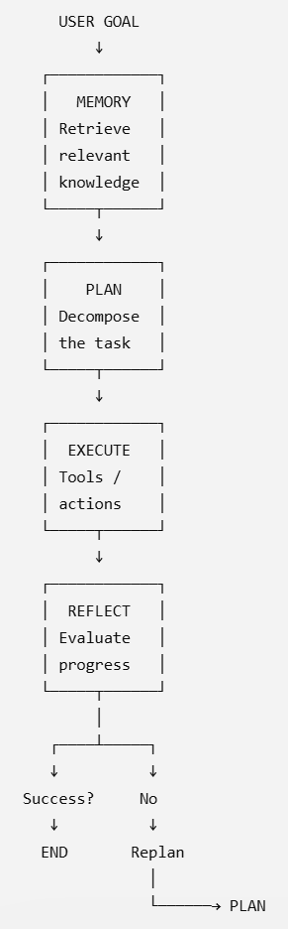
Combining Reflection, Planning, and Memory into One Unified Agent Architecture
Combine various concepts
Memory informs planning → planning guides execution → reflection evaluates execution → replanning adapts future actions
Component | Main question | Purpose
Memory | What do I know? | Retrieve past experience
Planning | What should I do? | Create strategy
Execution | How do I act? | Use tools / perform tasks
Reflection | Is it working? | Evaluate progress
Replanning | What should change? | Adapt strategy
DEMO: session_9/9_18_personal_memory_assistant.py
Notes:
Session 9 | Topic: 12. Unified architecture: reflection + planning + memory
Source: 14_advanced\Agentic AI - Advanced Engineering.pptx, slide 217
Demo: session_9/9_18_personal_memory_assistant.py

