Slide 1

Gaming News-Site TEITA_A3
St. Francis Institute of Technology
Department of Information Technology
Mini Project –Web Based Business Model (ITM 501)
Ashly Daniel John 38
Rangel Koli 42
Deep Kotian 43
Mentor:
Dr. Prachi Raut
Professor

Slide 2
Overview
Problem Statement
Business model canvas
System Design
Technology used
References
Demonstration

Slide 3
Problem Statement
This project aims to build a news website for the Indian gaming community. In the past few years gaming as a whole has had a huge boost on all platforms and due to the recent pandemic, it has got an even bigger boost. Making it a million dollar industry. To keep these gamers up to date there is no such specific website. So we decided to create a website dedicated to Indian gaming community.

Slide 4
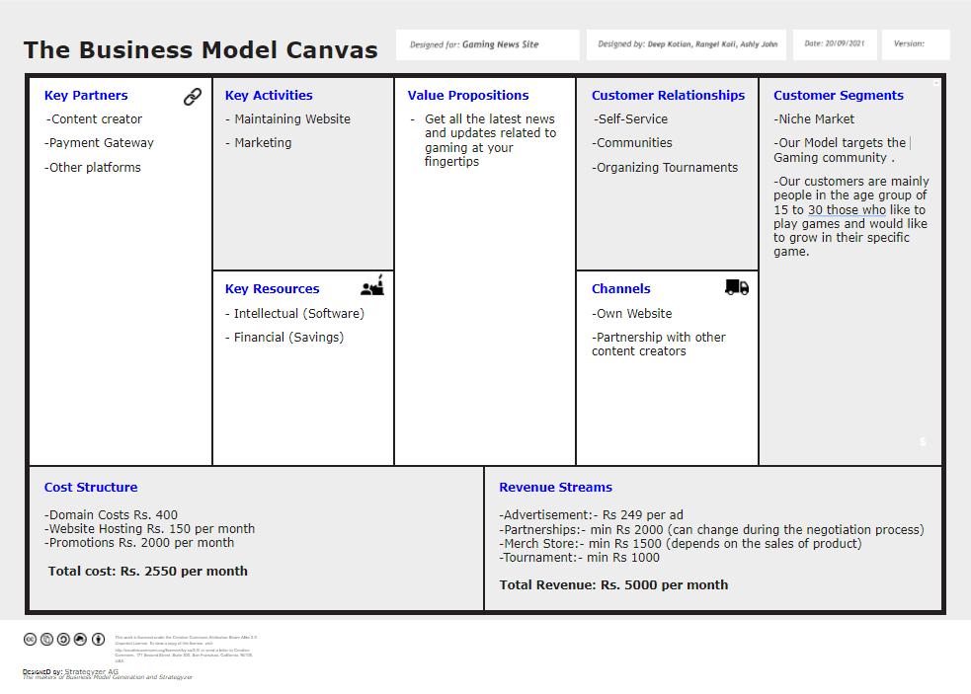
Business Model Canvas

Slide 5
Business Model
Niche Market
Indian Gaming Community
Customer Segments
Self-Service
Community
Organizing Tournaments
Customer Relationships
Own Website
Partnership with other Content Creators
Channels

Slide 6
Business Model contd.
Maintaining Website
Marketing
Key Activities
Content Creators
Payment Gateway
Other platforms
Key Partners
Financial:Savings
Intellectual: Software
Key Resources

Slide 7
Business Model contd.
Cost
Revenue
-Domain Cost: Rs 400
-Website Hosting: Rs 150
-Promotions: Rs 2000
(Promoting our website through other social media platforms as well as ads)
-Total cost: Rs 2250
-Advertisement : Rs 249
(This cost is for one week)
-Partnership: Rs 2000
(can change on dealing with partner)
-Merch store : Rs 2500
(It would depend on the sales of our product)
-Tournaments : Rs 1000
(we would be hosting tournaments for gamers)
-Total Revenue : Rs 5000
(Our total revenue can also change depending on the growth of our website )

Slide 8
Business Model contd.
Value Proposition
Get all the latest news and updates related to gaming at your fingertips.

Slide 9
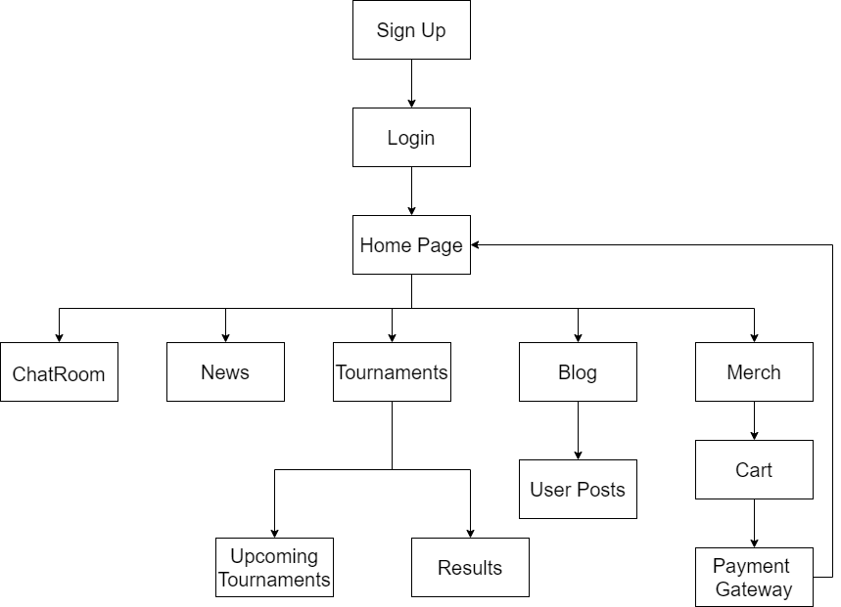
System Design

Slide 10
System Design
News: It will consist of all the latest news related to Gaming.
Tournament: The details of the Ongoing and Upcoming tournaments will be displayed in this page along with the results from the past tournaments
Blog: It will consist of the user blogs given to us by the content creators. The users who have logged in our website are only eligible to view and create the blog page.
Chat Room: A real time chat room to interact with all the other Gamers who are online on the website. Users who have logged in to their accounts will be able to use this feature.
Merch: Store to Buy all our merch as well as other content creator’s merch.

Slide 11
Technology Used
-Hardware :
PC with min. 4 GB RAM and i5/i7 processor
-Software :
OS: Windows 7 or above
Browser: Chrome / Firefox / Edge .
Application: VS Code .
Front-end: HTML, CSS, Javascript, Bootstrap.
Framework: Django.

Slide 12
References
[1] Pawan Kalyani, "An Empirical Study on Gaming Industry in India with Special Reference to the SmartPhone Games & Smart Generation Players of School and College", Journal of Management Engineering and Information Technology, Volume -4, Issue- 3, Jun. 2017, ISSN: 2394 - 8124
[2] Indian gaming industry reached global top 5, Yourstory, [online]. Available:
https://yourstory.com/2016/12/2016-indian-gaming-industry/amp (Accessed: December 23, 2016)
[3] BusinessofApps, "Mobile gaming industry statistics and trends for 2021", 2021,[online].Available:https://www.businessofapps.com/insights/mobile-gaming-industry-statistics-and-trends-for-2021/ (Accessed: March 24, 2021)

Slide 13
THANK YOU

