Slide 1

Outdoor Activity Recommendation System Using IOT
St. Francis Institute of Technology
Information Technology
IoE Mini Project (ITL702)
Himanshu Chaurasiya 37
Vikas Chaurasiya 38
Mukesh Gupta 39
Ashly John 40
Mentor
Dr. Prachi Raut

Slide 2
Overview
Introduction
Literature Review
Problem Statement
System Design and Requirement
Data Analytics Algorithm
Results
Conclusion and Future Scope
References

Slide 3
Introduction
Weather predictions are important forecasts because they are used to protect life and property. Forecasts based on temperature and precipitation are important for tourism, transport, forestry, agriculture, and traders within commodity markets.

Slide 4
Literature Review
Ieee paper | Author name | Methodology
Real Time Weather Monitoring System Using Iot | Puja Sharma and Shiva Prakash | The proposed system will work on the client-server architecture model using IoT. The system is organized in Two-tier Architecture. Their proposed system contains a various sensor which will monitor the temperature of the region, humidity, Rain value and pressure of the system.
Weather Prediction using Machine Learning and IOT | Gopinath N, Vinodh S, Prashanth P, Jayasuriya A, Deasione S | In this project proposes a method for forecasting weather conditions and predicting rainfall by means of machine learning. Here, there are two set ups: one, to measure the weather parameters like temperature, humidity using sensors along with Arduino and another set up, to display the current values(status) and predicted rainfall based on the trained machine learning data sets.

Slide 5
Weather Forecasting Using Machine Learning Algorithm | Nitin Singh, Saurabh Chaturved , ‘Shamim Akhter | They have used data analytics and machine learning algorithms, such as random forest classification, are used to predict weather conditions. In this paper, a low-cost and portable solution for weather prediction is devised.
Real Time Weather Prediction System Using IOT and Machine Learning | Gaurav Verma | In this paper they have build the system which utilizes a temperature and humidity sensor i.e. DHT11 and a light intensity sensor.The data is also displayed on a customized HTML webpage for monitoring the real time values. A logistic regression model is used for setting up the machine learning environment.

Slide 6
Problem Statement
To predict the weather condition based on Atmospheric pressure, Humidity, Temperature and Darkness level (cloudy or sunny weather), information for any specific area and to suggest people whether to go for outdoor activities or not.

Slide 7
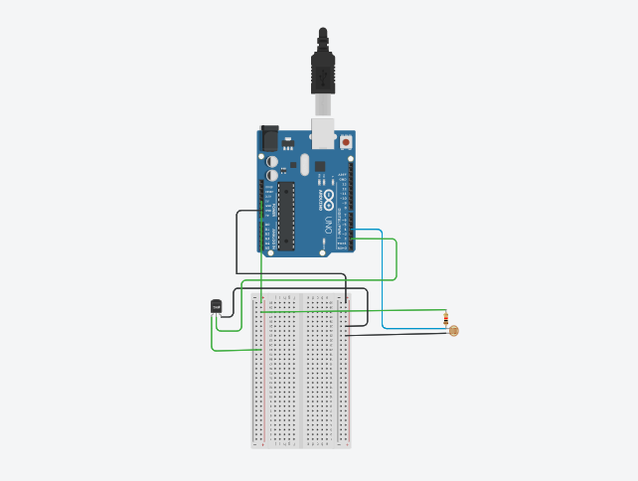
System Design and Requirement

Slide 8
System Requirements
Hardware Requirement:
DHT11(temperature, humidity and Heat Index)
LDR(Light)
R2 100k ohm ,
Arduino UNO
Breadboard
Software requirement:
Arduino Compiler
MC Programming Language

Slide 9
Data Analytics Algorithm
Naive Bayes Algorithm:
A Naive Bayes classifier is a probabilistic machine learning model that’s used for classification task. The crux of the classifier is based on the Bayes theorem.
Formula:
P(A|B) = P(B|A) * P(A) / P(B)
where A and B are events and P(B) ≠ 0.
Basically, we are trying to find the probability of event A, given the event B is true. Event B is also termed as evidence.
P(A) is the priori of A (the prior probability, i.e. Probability of event before evidence is seen). The evidence is an attribute value of an unknown instance(here, it is event B).
P(A|B) is a posteriori probability of B, i.e. probability of event after evidence is seen.

Slide 10
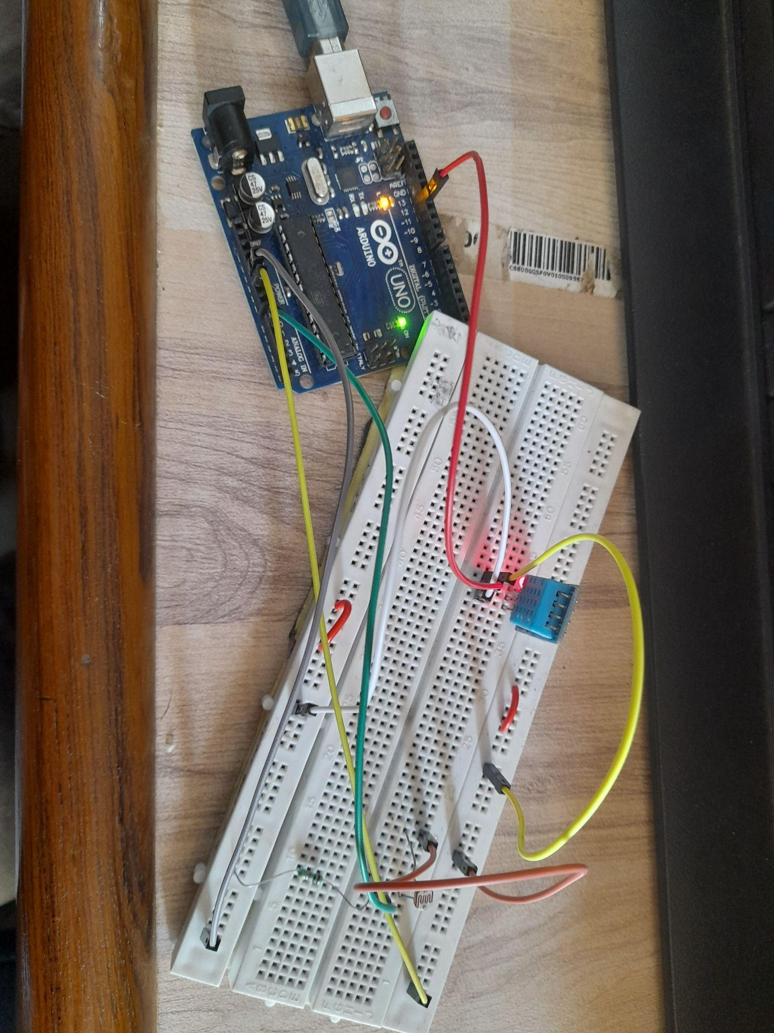

Results

Slide 11
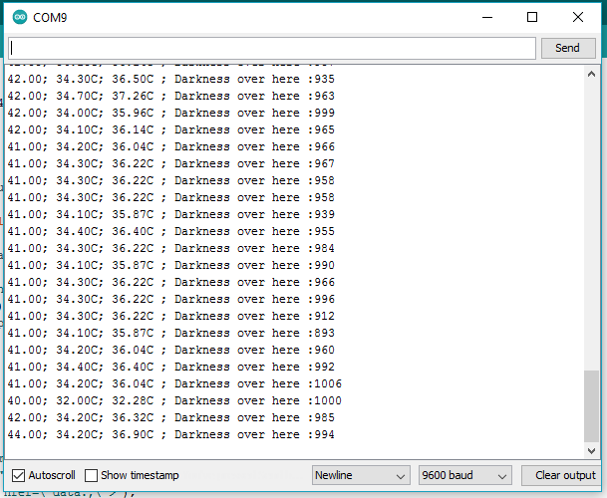


Slide 12
Conclusion and Future Scope
A system was built which could calculate the current temperature, humidity and darkness level of a area and built a prediction model.
Future Scope
More algorithms can be implemented in future to increase the accuracy and check the performance metrics.
Frontend models can be implemented to show recommendations.
Various other weather predictions can be done by increasing the parameter used in the model.

Slide 13
References
[1]Sharma, Puja & Prakash, Shiva. (2021). Real Time Weather Monitoring System Using Iot. ITM Web of Conferences. 40. 01006. 10.1051/itmconf/20214001006.
[2]Gopinath N, Vinodh S, Prashanth P, Jayasuriya A, Deasione S, "Weather Prediction using Machine Learning and IOT" Volume 9 Issue 4, April 2020, International Journal of Engineering and Advanced Technology
[3]N. Singh, S. Chaturvedi and S. Akhter, "Weather Forecasting Using Machine Learning Algorithm," 2019 International Conference on Signal Processing and Communication (ICSC), 2019, pp. 171-174, doi: 10.1109/ICSC45622.2019.8938211.
[4]G. Verma, P. Mittal and S. Farheen, "Real Time Weather Prediction System Using IOT and Machine Learning," 2020 6th International Conference on Signal Processing and Communication (ICSC), 2020, pp. 322-324, doi: 10.1109/ICSC48311.2020.9182766.

