Slide 1
GitHub2 - Library

Slide 2
OUR TEAM
01
Емили Кехайова
Александра Лалева
Our Team
04
02
Vestibulum nec congue tempus
Георги Михов
Борис Милев
03

Slide 3
OUR TEAM
1
2
Break the project into tasks for everyone
Brainstorming
3
Making small parts of the code
4
Combining them into a big program

Slide 4



Microsoft Teams
Used for communication
GitHub
Visual Studio 2019
Used for the code

Slide 5
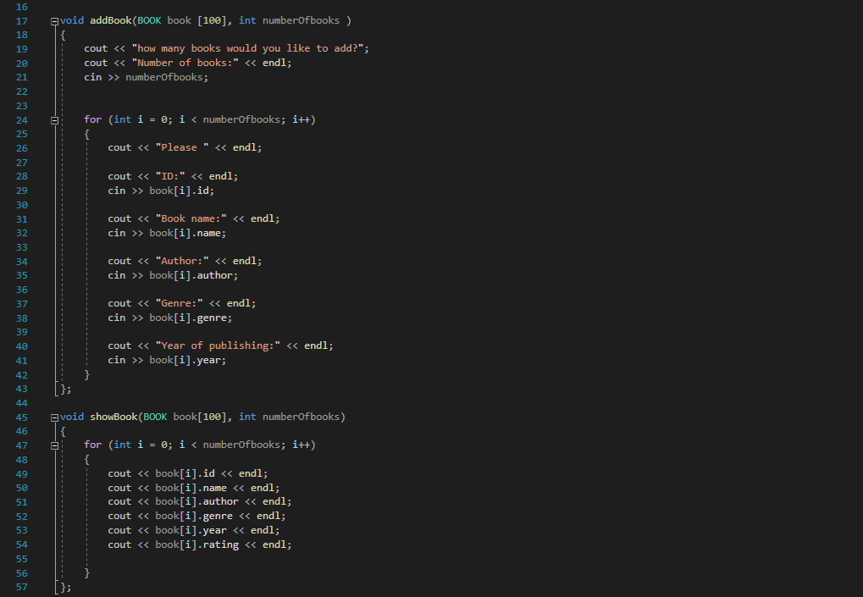
Our code
Place your screenshot here

