Slide 1
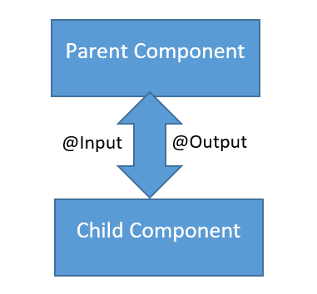
Component Communication in Angular
In Angular, components often need to communicate with each other. Depending on the relationship between components (parent-child, siblings, etc.), there are several patterns to handle communication.

Slide 2
Component Communication in Angular
Scenarios & Communication Techniques
Scenario | Technique
Parent → Child | @Input()
Child → Parent | @Output() + EventEmitter
Sibling → Sibling | Shared Service with RxJS (Subject)
Unrelated Components | Shared Service or Global State Store

Slide 3
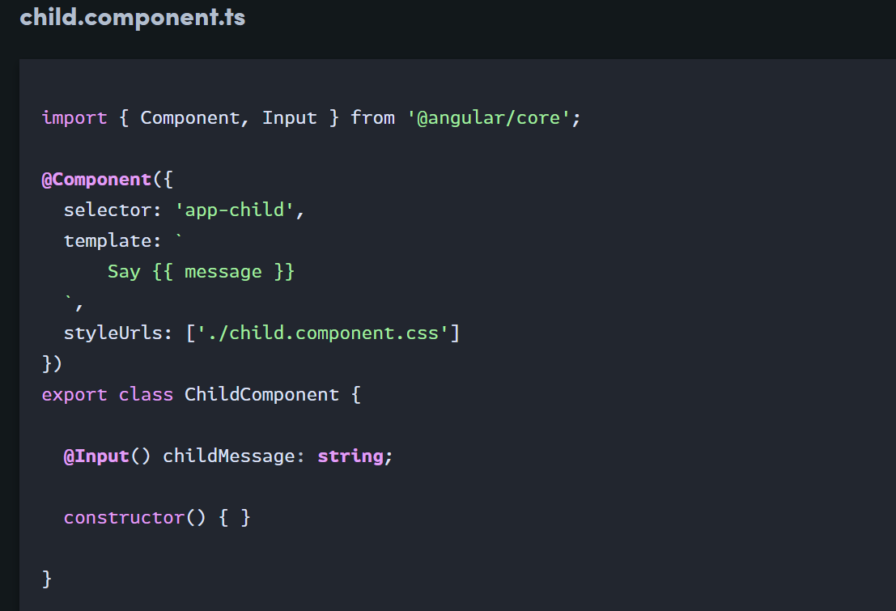
Parent to Child: Sharing Data via Input
This is probably the most common and straightforward method of sharing data. It works by using the @Input() decorator to allow data to be passed via the template.

Slide 4
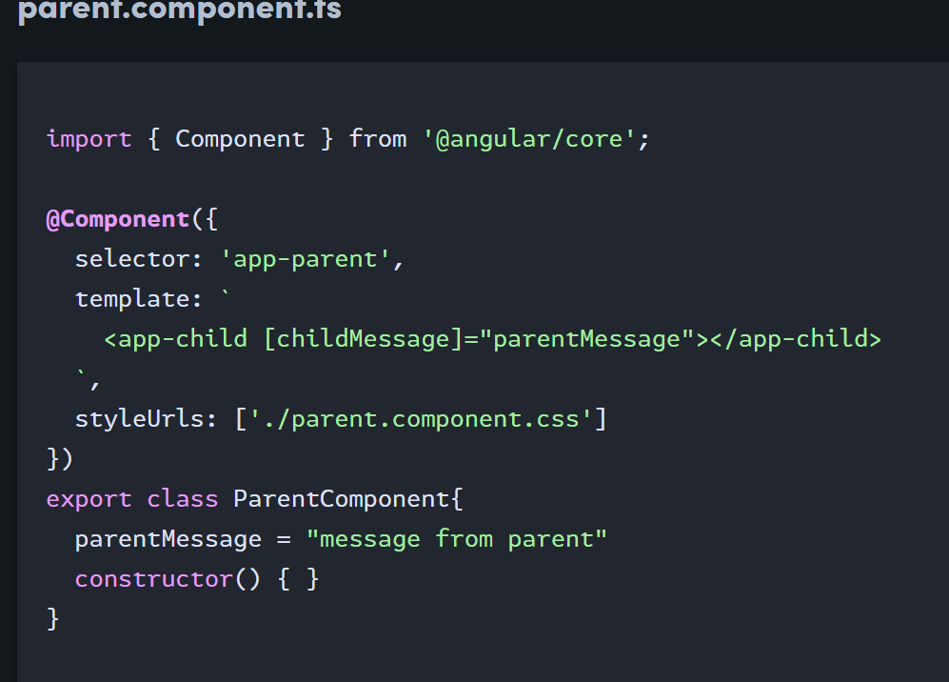
Parent to Child: Sharing Data via Input

Slide 5
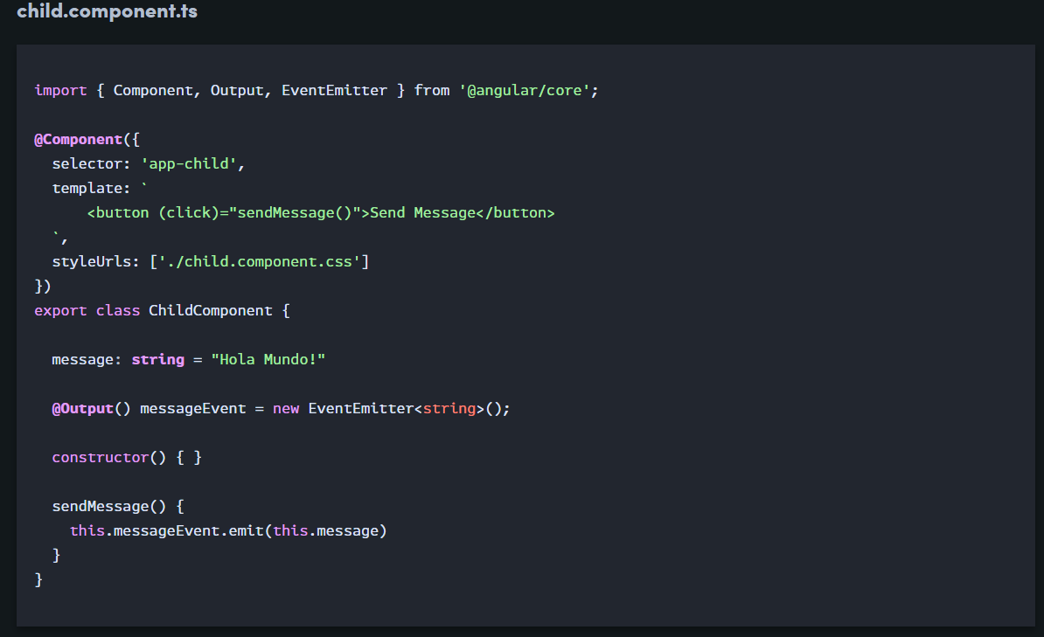
Child to Parent: Sharing Data via Output() and EventEmitter
share data from child to parent is to emit data from the child, which can be listened to by the parent. This approach is ideal when you want to share data changes that occur on things like button clicks, form entires, and other user events.

Slide 6
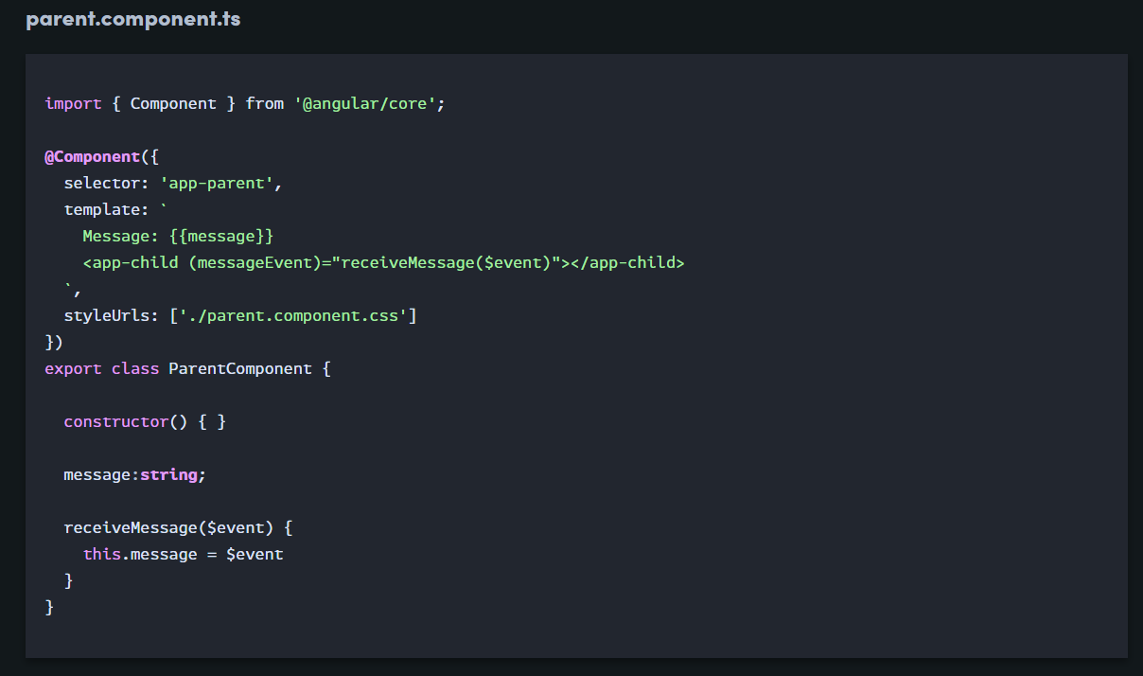
Child to Parent: Sharing Data via Output() and EventEmitter
In the parent, we create a function to receive the message and set it equal to the message variable.
In the child, we declare a messageEvent variable with the Output decorator and set it equal to a new event emitter. Then we create a function named sendMessage that calls emit on this event with the message we want to send. Lastly, we create a button to trigger this function.
The parent can now subscribe to this messageEvent that’s outputted by the child component, then run the receive message function whenever this event occurs.

