Slide 1
Angular Observables
Observables in Angular are a core mechanism for handling asynchronous data streams and event-driven programming.
In Angular, Observables are a key part of how data flows, especially when dealing with asynchronous operations like API calls, user input, and events.
They come from the RxJS (Reactive Extensions for JavaScript) library, which Angular uses heavily under the hood.
What is an Observable?
An Observable is a data stream that you can subscribe to in order to get values over time.
It supports operators to transform, filter, and combine data streams.

Slide 2
Angular Observable Key Concepts
Term | Description
Observable | A producer of values (can be synchronous or asynchronous).
Observer | The consumer — defines what to do when new data arrives, when an error occurs, or when the stream completes.
Subscription | The connection between the Observable and the Observer.
Operators | Functions to transform/filter the data (e.g., map, filter, switchMap).
Subject | An Observable + Observer combined, allowing you to push values manually.

Slide 3
Observable Lifecycle
Creation → Using of(), from(), interval(), fromEvent(), or HTTP calls.
Subscription → observable. Subscribe(...)
Execution → Values are emitted.
Completion/Unsubscribe → Stream ends or you manually unsubscribe.

Slide 4
Benefits of Observables in Angular
Handles multiple values over time (unlike promises).
Works seamlessly with Angular’s HttpClient.
Rich RxJS operators for powerful data transformations.
Good for event streams, WebSockets, and real-time data.

Slide 5
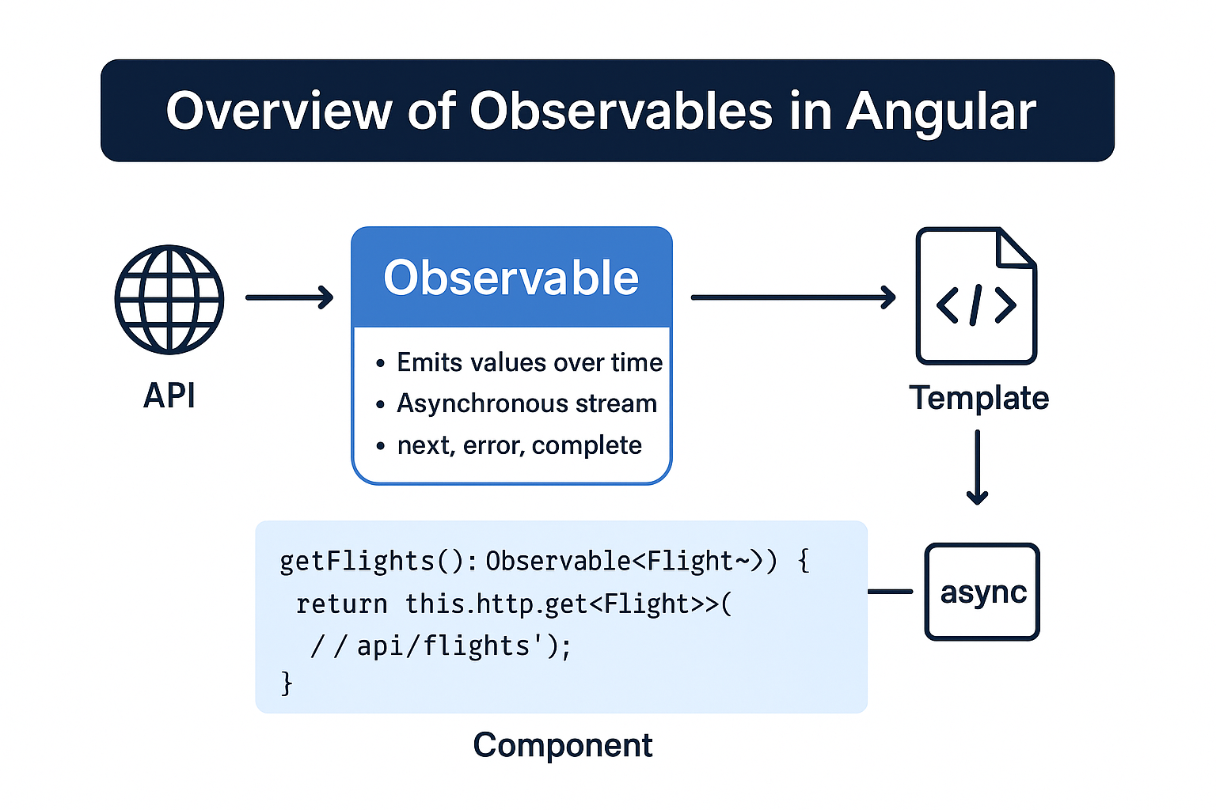
Observable in Angular

