Slide 1
Angular RxJs
RxJS (Reactive Extensions for JavaScript) in Angular is a powerful library used for managing asynchronous data streams through observables.
RxJS (Reactive Xtensions for JavaScript) is a library for reactive programming that makes it easier to work with asynchronous or event-based data streams in JavaScript and TypeScript.
It enabling developers to write reactive and event-driven code.
It is integral to Angular for handling HTTP requests, user events, reactive forms, and component communication with operators like map, filter, merge
RxJS provides Observables, which emit multiple values over time, allowing Angular to manage asynchronous operations smoothly.

Slide 2
Angular RxJs
Observables can be "cold" (start emitting only upon subscription) or "hot" (emit regardless of subscription).
Operators let you manipulate streams declaratively for filtering, mapping, combining, and error handling.
Subscriptions connect observers to observables, listening to emitted values with callbacks for next, error, and completion.
It’s heavily used in Angular because Angular’s HttpClient, forms, and event systems are all built around observables — which come from RxJS.

Slide 3
Angular RxJs Key Concepts
1. Observable
A data source that can emit values over time (think of it like a stream of events).
Can emit 0, 1, or many values asynchronously.
Example: HTTP requests, user input events, WebSocket messages.
2. Observer
An object (or set of callbacks) that subscribes to an observable to receive values.
3. Operators
Functions that let you transform, filter, combine, or handle observable data.
Examples: map, filter, switchMap, mergeMap, catchError, etc.

Slide 4
Angular RxJs Key Concepts
4.Subscription
The act of connecting an observer to an observable.
Needed to start listening to the stream.
5.Subject
A special type of observable that can also emit values manually.
Useful for sharing data between components.

Slide 5
Why RxJS in Angular
Handles async data cleanly (instead of nested callbacks or Promises).
Provides powerful operators for data transformation.
Common operators include map (data transformation), filter (conditional emission), merge (combining streams)
Makes it easier to cancel ongoing requests (important in Angular routing and UI).

Slide 6
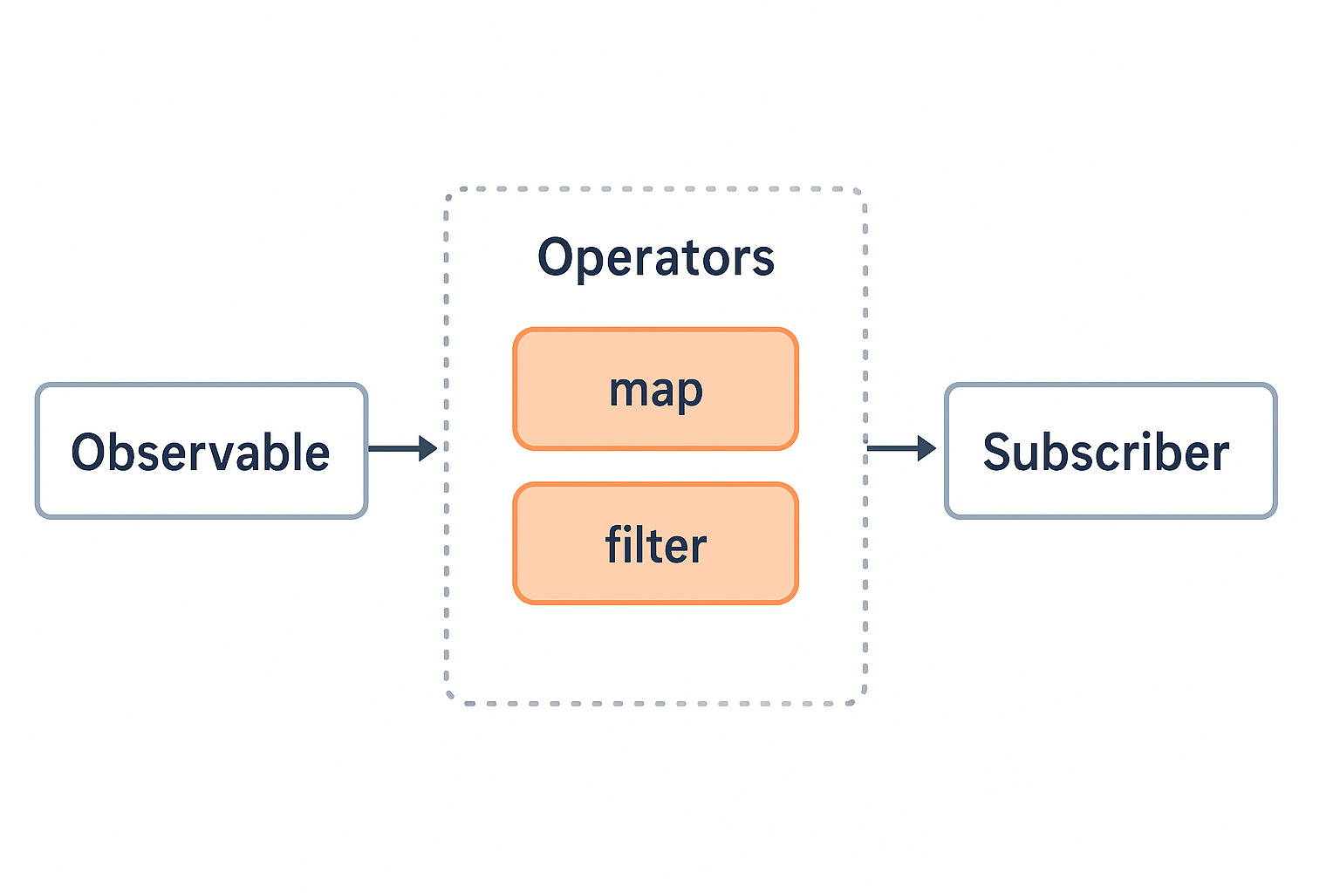
RxJS in Angular
data flows from an Observable → Operators → Subscriber in Angular using RxJS.

Slide 7
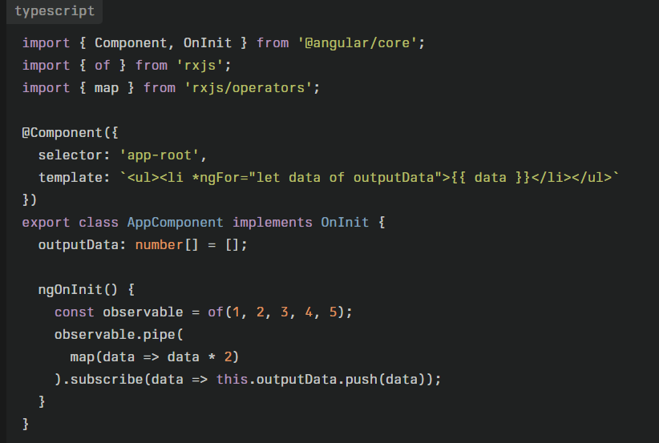
Example RxJS in Angular

Slide 8
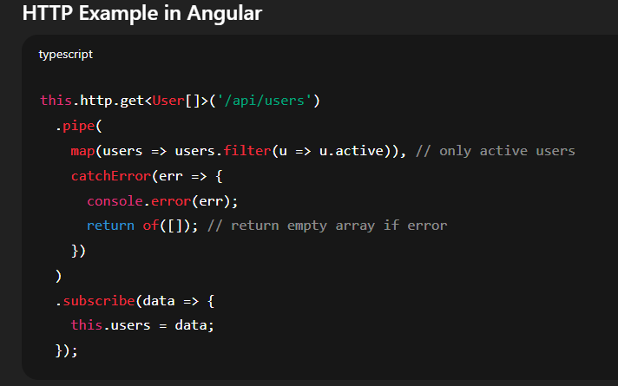
Example RxJS in Angular

