Slide 1

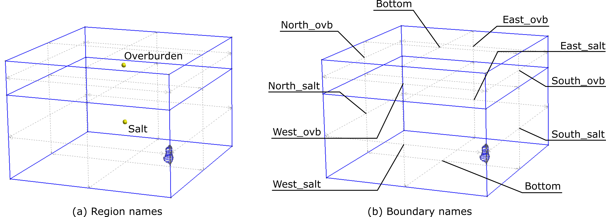
SafeInCave
Open-source 3D finite-element simulator for salt cavern performance assessment
Purpose
Evaluate salt caverns under pressure, temperature, and operational histories.
Core engine
Python package built around FEniCSx finite elements and XDMF outputs.
Why it matters
Transparent, auditable simulations for research and industrial workflows.
Salt cavern geometry and named domains from the documentation examples.
SafeInCave intro - based on README, docs, LICENSE, and pyproject.toml

Slide 2
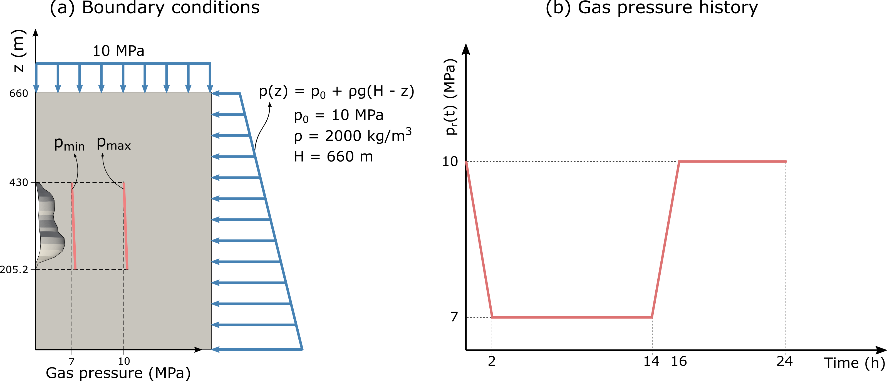
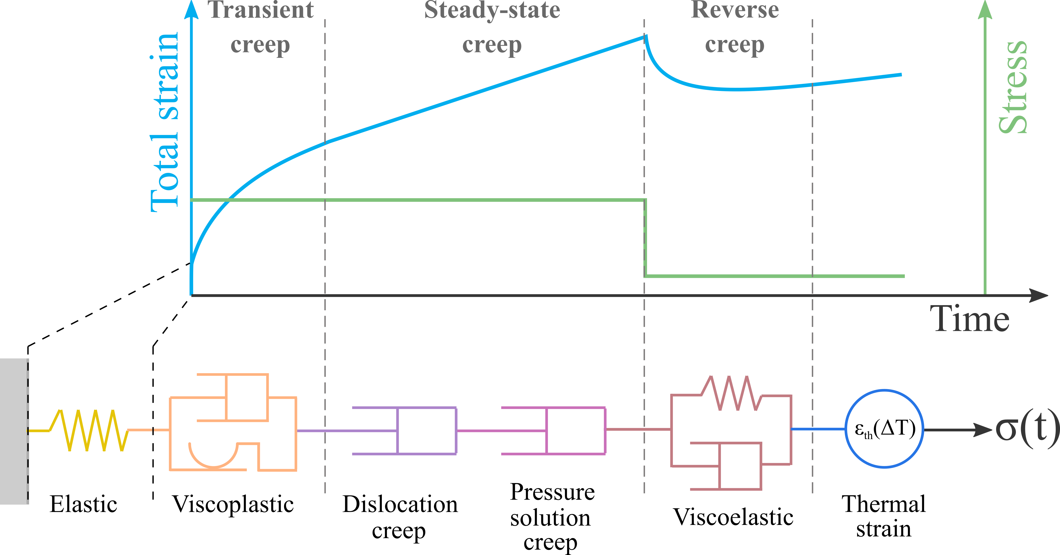
Capabilities at a Glance
Mechanics
Momentum balance, creep, thermal strain, mixed/stabilized FEM.
Heat diffusion
Temperature fields, thermal boundary conditions, heat exchange.
Fluid thermodynamics
Cavern pressure, temperature, density, mass, heat, and volume histories.
Example cavern setup: geometry, regions, and boundary conditions.
Coupled simulators
Mechanical, thermal, and thermo-mechanical workflows for single or multiple caverns.
Examples include triaxial tests, cube and cavern models, hydrogen/methane/water caverns, settlement, and multi-cavern operations.
Constitutive modeling examples support salt-creep behavior.
SafeInCave intro - based on README, docs, LICENSE, and pyproject.toml

Slide 3
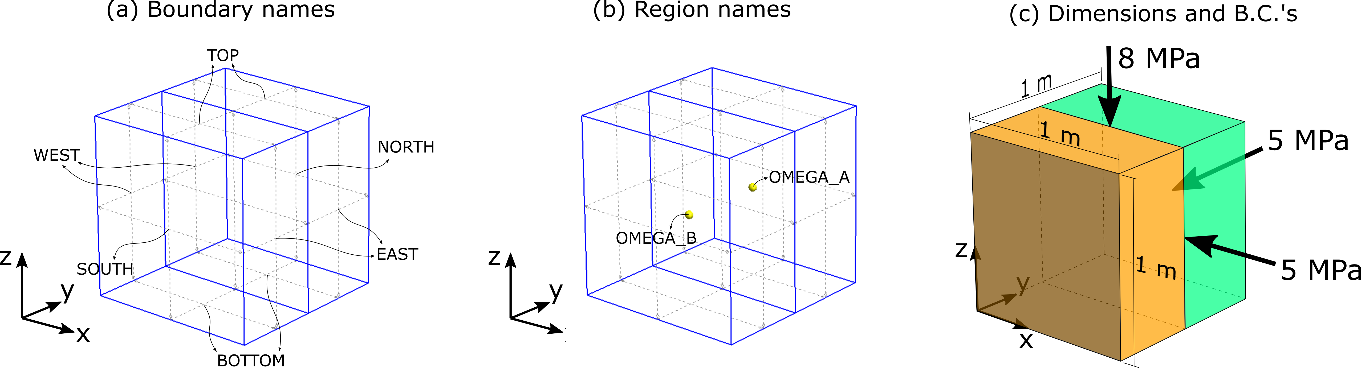
Open Source: BSD 3-Clause
What the license enables
Use and adapt
Permits source and binary use, modification, and redistribution, including proprietary or commercial software.
Low-friction collaboration
Permissive, not copyleft: derivative work does not have to be released as open source solely because it uses SafeInCave.
Attribution and risk
Redistributions must keep copyright, license conditions, and disclaimer; project or contributor names cannot imply endorsement.
Validation remains essential
The software is provided as-is, without warranty or liability. Simulation results still need engineering validation.
Open examples expose complete modeling setups, not just final plots.
Practical implication: transparent simulations with room for academic review, industrial adoption, and community extension.
SafeInCave intro - based on README, docs, LICENSE, and pyproject.toml

