Slide 1

Maya API Introduction
Naiqi Weng
Developer Consultant,
Autodesk Developer Network (ADN)

Slide 2
Bio
Education:
Bachelor of Computer Science, Tsinghua University
Master of Computer Science, University of Toronto
Working Experience
Contact: Naiqi.weng@autodesk.com

Slide 3

Agenda
Maya Architecture Overview
Programming In Maya
Maya API Introduction
Plug-in Development

Slide 4
Maya Architecture Overview
Two vital concepts of Maya architecture
Dependency Graph
Command Architecture

Slide 5
Maya Architecture Overview
Dependency Graph

Slide 6
Dependency Graph
A collection of nodes that transmit data through connected attributes
A.a
A
B
C
B.b

Slide 7
Dependency Graph

Slide 8



DAG(Directed Acyclic Graph)
DAG nodes are special dependency graph nodes that form a scene hierarchy (parenting).
Car
seats
frame
tires

Slide 9
Maya Architecture Overview
Command Architecture

Slide 10
Maya Command Architecture
Maya GUI
MEL Commands
Maya Core
OS

Slide 11
Programming In Maya
Language Options
Maya Embedded Language (MEL)
C++
Python scripting (introduced in 8.5)

Slide 12
Maya Embedded Language
Maya Embedded Language (MEL) is a command based scripting language
Command framework provides a scripting interface to Maya’s internals:
Create and layout UI
Create nodes and connections
Etc.

Slide 13
What do we need API for?
New Custom Node

Slide 14
What do we need API for?
Custom MEL Command
Maya GUI
MEL Commands
Maya API
Maya Core
OS

Slide 15
Maya API Introduction

Slide 16
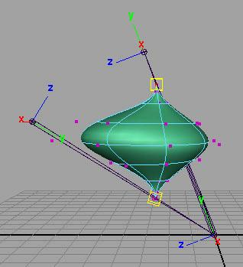

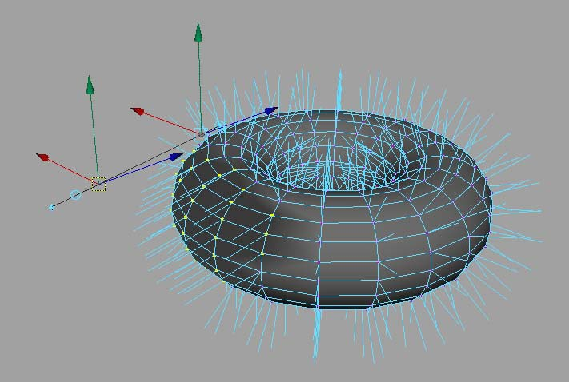
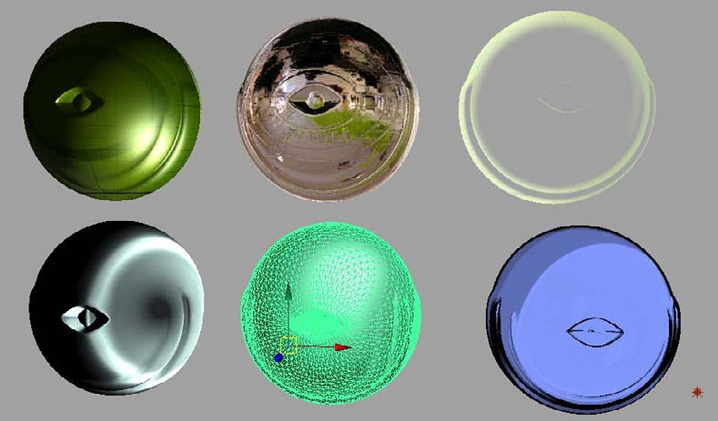
What can you develop using API?
Commands
Dependency Graph Nodes
Deformers
Shaders
Manipulators
Shapes
Etc.
Tools
File Translators

Slide 17
What can you develop using API?
Plug-in
Loads into Maya application
C++ or Python
Full Maya UI
Interact with user and Maya operations
Standalone application
Use Maya libraries to load/save Maya files
C++ or Python
No UI

Slide 18
API Design Overview
A tight wrapper around Maya’s internal architecture
An abstract layer, which separates Maya internal code from external plug-in developers
External
developer
Maya API
Maya core

Slide 19
Maya Libraries
OpenMaya: fundamental classes for defining nodes and commands and for assembling them into a plug-in
OpenMayaUI: classes necessary for creating new user interface elements such as manipulators, contexts, and locators
OpenMayaAnim: classes for animation, including deformers and inverse kinematics.
OpenMayaFX: classes for Autodesk® Dynamics™
OpenMayaRender: classes for performing rendering functions

Slide 20
Class Categories
Naming Convention | Logical Grouping | Examples
MPx*** | Proxy | MPxCommand MPxNode
MFn*** | Function set | MFnAttribute, MFnDependencyNode
MIt*** | Iterator | MItDependencyNodes, MItMeshEdge
M*** | Wrapper et. al | MObject, MPoint, M3dView

Slide 21
Proxy Classes
Proxy Object classes serve as base classes for your custom extensions.
Proxy Classes begin with “MPx”
Proxy Objects allow you to extend the Maya architecture through the creation of new Maya constructs (nodes, commands, etc.).
The most prevalent proxy classes include:
MPxCommand
MPxNode

Slide 22
Function Set Classes & MObject
Separate data with functionality
Classical OOP
VS.
Maya Approach
Class A
Data class A
data
Functions Class B
Functions

Slide 23
Function Set Classes
Function Sets are classes that provide type specific APIs to the corresponding type(s) of MObjects
MFnMesh
Mesh
Node
Functions:
numVertices()
numEdges()
numPolygons()
subdivideFaces()
extrudeFaces()
split()
etc.
Transform
Node

Slide 24
Function Set Classes
MFn::Type enumeration is used throughout the API to indicate item types
MFn::Type MFnBase::type() const
Once a function set is initialized to an MObject, you can call methods to query or set values on the object
MFnBase::setObject ()
MFnMesh myMeshFn( myMeshObj );
myMeshFn.setObject( myMeshObj2 );
Some of the commonly used function sets:
MFnDependencyNode
MFnDagNode
MFnAttribute

Slide 25
Function Set Classes
MFnDependencyNode
Base class providing fundamental operators for all dependency nodes
Contains methods to query the name of a node, locate an attribute and parse connections
MFnDagNode
Derived from MFnDependencyNode
Provides methods to query or modify parent/child relationships in the DAG
MFnAttribute
Base class for Maya DG attributes
Offers methods to create an attribute or query/set properties of an attribute on a node

Slide 26
MObject
MObject is the fundamental data type that represents an object in Maya.
Maya API
MObject
Type Information
Pointer to Object
Maya
Internal
Object

Slide 27
MObject
Objects owned by Maya are accessed via an MObject
MObject = (void *) + (type information)
MObjects are handles to Maya internal objects
Maya objects are created and destroyed by Maya
Use function sets class to operate on MObjects

Slide 28
MObject & MFn::Type
Each MObject carries a type field.
MFn::Type MObject::apiType() const
This type comes from an enumerated list of all node types internal to Maya.
For a comprehensive list of all Maya node types, see MFn.h.

Slide 29
MObject & MFn::Type
MFnMesh
MObject
MFn::kMesh
Mesh
Node
Functions:
numVertices()
numEdges()
numPolygons()
subdivideFaces()
extrudeFaces()
split()
etc.
MObject
MFn::kTransform
Transform
Node

Slide 30
MObject
As a pointer to internal objects...
MObjects are not guaranteed to be valid between calls to your plug-in.
It is strongly recommended that you do not hang onto an MObject between calls to your plug-in.
MObjectHandle can be used to test the validity of an MObject.

Slide 31
Iterator Classes
Used to loop over elements of the same type
Iterators start with “MIt”
Some common iterators are
MItDag
MItDependencyGraph
MItMeshEdge
MItMeshVertex
MItMeshPolygon
MItSurfaceCV

Slide 32
Wrapper Classes
Wrapper class exist for simple classes (such as MPoint, MVector, etc…)
Fully implemented C++ classes

Slide 33
Plug-in Development

Slide 34
Maya Plug-in Architecture
initializePlugin() and uninitializePlugin() as entry point and exit point
Maya API
initializePlugin
uninitializePlugin
Maya
loadPlugin
unloadPlugin

Slide 35
Maya Plug-in Architecture
InitializePlugin()
UninitializePlugin()
MStatus initializePlugin(MObject obj)
{ MFnPlugin plugin(obj, “Autodesk”, “1.0”, “any”); //register command, nodes etc…
return status; }
MStatus uninitializePlugin(MObject obj)
{ MFnPlugin plugin(obj); //deregister command, nodes, etc…
return status; }

Slide 36
Plug-in Development Environment
Operating System | Plug-in Type | Compiler
windows | .mll | Visual Studio 2005 with Service Pack 1 with Template hotfix
Linux | .so | gcc 4.1.2
Mac | .bundle | XCode 2.4.1 with gcc 4.0.1 Universal build binaries: powerPC, IntelMac
All Platforms | .py | Python 2.5.1 kernel

Slide 37
Deployment of plugins
Maya Plug-in Manager
Environment Variable: MAYA_PLUG_IN_PATH
Put your plug-ins into:
C:\My Documents\maya\2009\plug-ins
Add you custom plug-in path
putenv MAYA_PLUG_IN_PATH $destPluginPath;
Maya.env or userSetup.mel
string $currentPluginPath = `getenv MAYA_PLUG_IN_PATH`;
string $destPluginPath = $currentPluginPath + ";C:/My Documents";
putenv MAYA_PLUG_IN_PATH $destPluginPath;

Slide 38
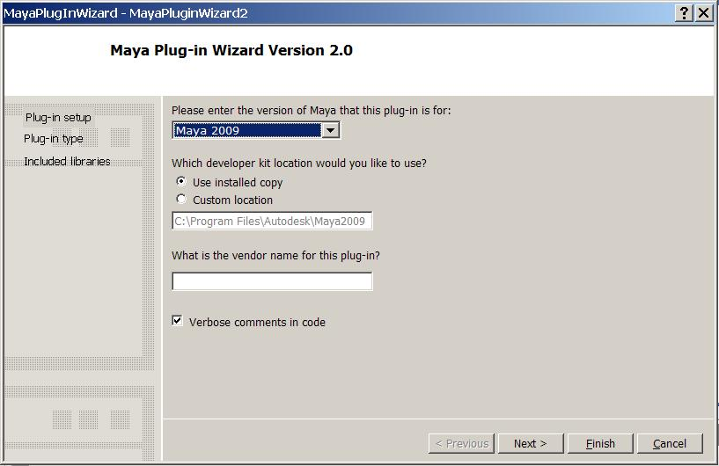
Maya Plug-in wizard
Maya_Installation_directory\devkit\pluginwizard
Manual installation
Appears in the new project section

Slide 39
Maya plug-in wizard installation (windows)
Browse to folder: C:\Program Files\Autodesk\Maya2009\devkit\pluginwizard\
Unzip the MayaPluginWizard2.0.zip file to a temporary directory.
Copy the following files:
MayaPluginWizard.ico
MayaPluginWizard.vsdir
MayaPluginWizard.vsz
to: C:\Program Files\Microsoft Visual Studio 8\VC\vcprojects\
Copy the MayaPluginWizard folder to:
C:\Program Files\Microsoft Visual Studio 8\VC\VCWizards\

Slide 40
How to set up your VS project
Link path: “project”—”XXX properties”—”Configuration Properties”—”C++”—”General”—”Additional Include Directories”
C:\Program Files\Autodesk\Maya2009\include
Library path: “project”—”XXX properties”—”Configuration Properties”—”Linker”—”General”—”Additional Library Directories”
C:\Program Files\Autodesk\Maya2009\library
Library: “project”—”XXX properties”—”Configuration Properties”—”Linker”—”Input”—”Additional Dependencies”
Foundation.lib, OpenMaya.lib…..
Output path: “project”—”XXX properties”—”Configuration Properties”—”Linker”—”General”—”Output File”
C:\My Documents\maya\2009\plug-ins

Slide 41
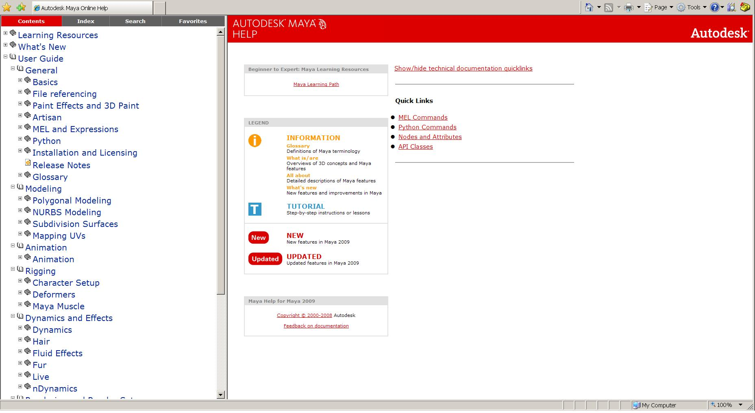
Maya Technical Resources
Including Documents on MEL, Python, Nodes and API Classes
Technical Documents

Slide 42
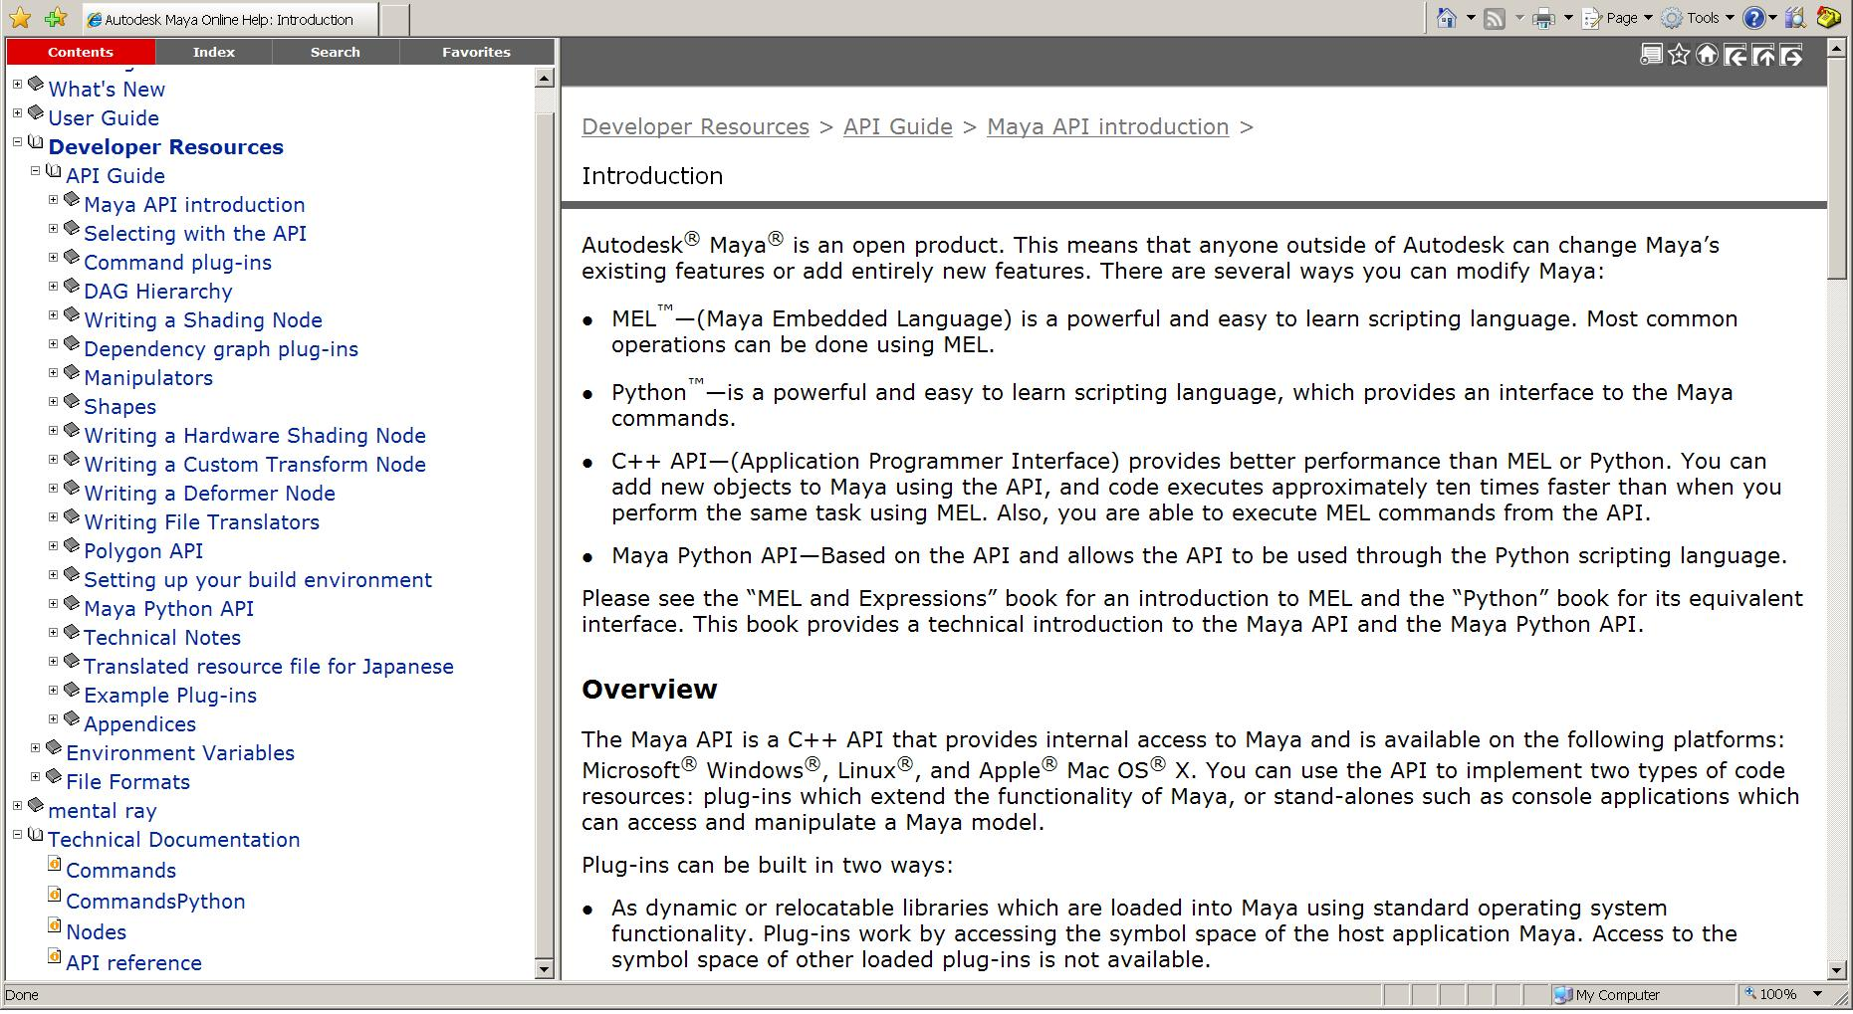
Maya API Resources
The Maya API Documentation contains a wealth of information on all aspects of the API.
API Docs
API Reference

Slide 43
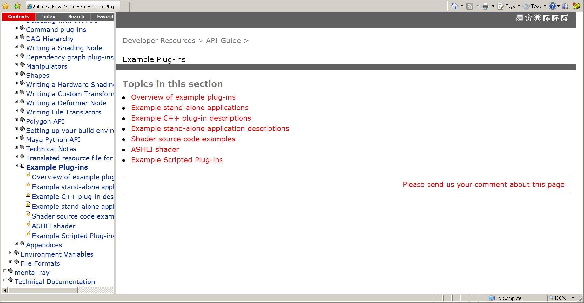
Examples
Example Docs

Slide 44
Examples
C++ Plug-in Examples:
C:\Program Files\Autodesk\Maya2009\devkit\plug-ins
C++ Standalone Application Examples:
C:\Program Files\Autodesk\Maya2009\devkit\applications
Python Examples:
C:\Program Files\Autodesk\Maya2009\devkit\plug-ins\ scripted

Slide 45
Maya API Resources
Maya API White Paper
DevTV
Questions and Problems: ADN
http://www.autodesk.com/adn
Recommended Maya API Programming Books:
David A. D. Gould. Complete Maya Programming, Volume 1. Morgan Kaufmann Publishers, San Francisco, 2003. ISBN:1-55860-835-4

Slide 46
Q & A

Slide 47
Autodesk

