Slide 1

Python in Maya
Naiqi Weng
Developer Consultant, Autodesk Developer Network (ADN)

Slide 2
Agenda
Introduction of Maya Python integration
Different types of Python Application in Maya
Python API Tricky Spots

Slide 3
Python in Maya: Motivation
Scripting language, rapid prototyping
Objective-oriented programming
Flexible and Versatile
Server framework
System programming
Database tools
Large number of shared standard libraries
Cross Platform

Slide 4
Distinguishing features of Python
White space defines scope
Class methods defined within class definition
Python objects are references/pointers
Garbage collection
Namespaces
For Maya 2009,Python version: 2.5.1
Version matching:
import sys
Print sys.version

Slide 5
Usages of Python in Maya
Maya Python scripts:
access standard "Maya commands" from Python
like MEL scripts written in Python
Maya Python API Scripted Plug-ins
define new commands, nodes, etc using Python
like C++ plug-ins written in Python
Maya Python API Scripts
write scripts that access functionality previously available only through the C++ API
Maya Python Standalone Apps
like MLibrary-based C++ apps, but written in Python
Non UI

Slide 6
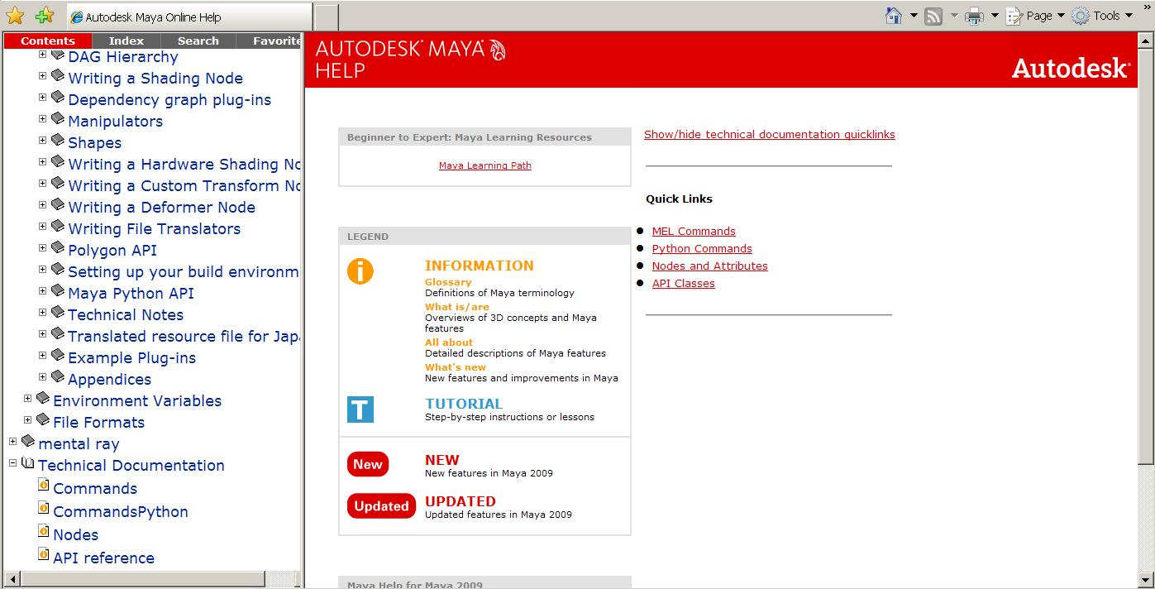
Maya Python Documentation
New “Python command” docs
Python command Docs

Slide 7
Maya Python Scripts
All "Maya Commands" (previously called "MEL Commands") now accessible from Python
Exposed through the maya.cmds module:
MEL:
select pCube1;
ls –sl;
Python:
import maya.cmds
maya.cmds.select( “pCube1“ )
maya.cmds.ls( sl=True )

Slide 8
Python/MEL communication
Invoke MEL from Python:
import maya.mel
maya.mel.eval( "ls -sl" )
# Result: ['pSphere1'] #
Invoke Python from MEL:
“python” command
string $foo[] = python( "['a','b','c']" );
size($foo);
// Result: 3 //

Slide 9
Python/MEL communication
Accessing Python information from MEL
Python:
class MyFile:
_f = "mytestfile.txt"
mf = MyFile()
MEL:
string $f = python("mf._f");
print $f;

Slide 10
Maya API Python
Python API is a thin wrapper around C++ API
Full support of C++ Maya API functionality
SWIG based bindings created from header files
Modules: $MAYA_LOCATION/Python/lib/site-packages/maya
OpenMaya.pyc
OpenMayaAnim.pyc
OpenMayaRender.pyc
OpenMayaFX.pyc
OpenMayaUI.pyc
OpenMayaMPx.pyc
OpenMayaCloth.pyc

Slide 11
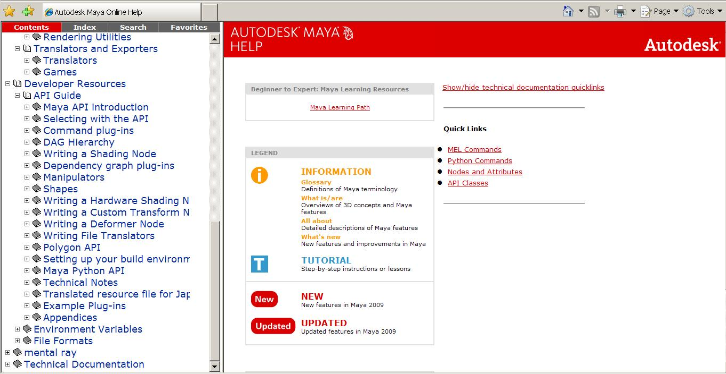
API Documentation
Python API share the same documentation with C++ API
Documentation in API Guide
Python API Introduction
Python API Docs

Slide 12
Python API Documentation
No Python-specific API class documentation
Methods not supported in Python:
Marked by: NO SCRIPT SUPPORT
In most cases, alternate forms are provided
Devkit examples translated from C++ to Python
MAYA_INSTALLATION_PATH/devkit/plug-ins/scripted
MAYA_INSTALLATION_PATH/devkit/applications/scripted

Slide 13
Maya Python API Plug-ins
Define a Python module containing initializePlugin(), uninitializePlugin() functions
import necessary modules
def initializePlugin(mobject): ….
def uninitializePlugin(mobject): ….

Slide 14
Maya Python Plug-ins
Import necessary modules:
import maya.OpenMaya as OpenMaya
import maya.OpenMayaMPx as OpenMayaMPx
import sys

Slide 15
Maya Python Plug-ins
Scripted plug-in initialization
# Initialize the script plug-in
def initializePlugin(mobject):
mplugin = OpenMayaMPx.MFnPlugin(mobject)
try:
mplugin.registerCommand( “foo”, cmdCreator )
except:
sys.stderr.write( "Failed to register command: %s\n" % kPluginCmdName )
raise

Slide 16
Maya Python Plug-ins
Scripted plug-in uninitialization
def uninitializePlugin(mobject):
mplugin = OpenMayaMPx.MFnPlugin(mobject)
try:
mplugin.deregisterCommand( “foo” )
except:
sys.stderr.write( "Failed to unregister command: %s\n" % kPluginCmdName )
raise

Slide 17
Maya Python Plug-ins
Class Implementation: Similar setup to C++ plug-ins
class scriptedCommand(OpenMayaMPx.MPxCommand):
def __init__(self):
OpenMayaMPx.MPxCommand.__init__(self)
def doIt(self,argList):
print "Hello World!"
Parameter: self same as this in C++

Slide 18
Maya Python Plug-ins
Creator Functions:
Similar to C++ plug-ins
Pass Python function to MFnPlugin methods
…
mplugin.registerCommand( “foo”, cmdCreator )
…
Ownership is important

Slide 19
Maya Python Plug-ins
Ownership is important
OpenMayaMPx.asMPxPtr() transfer ownership of newly-created command or node objects to Maya
class scriptedCommand(OpenMayaMPx.MPxCommand):
….
def cmdCreator():
return OpenMayaMPx.asMPxPtr( scriptedCommand() )

Slide 20
Maya Python Plugins
Load from Plug-in Manager or loadPlugin command
maya.cmds.loadPlugin( "foo.py" )
maya.cmds.unloadPlugin("foo.py" )

Slide 21

Differences between C++ and Python API

Slide 22
Python API vs. C++ API
No MStatus class - use exceptions instead
try:
fnPlugin.registerCommand( “spLs", cmdCreator )
except:
sys.stderr.write( "Command registration failed")
raise
Catch error if registerCommand() fails

Slide 23
Python API vs. C++ API
Detect error but allow code to keep running
try:
fnPlugin.registerCommand( “spLs", cmdCreator )
except:
sys.stderr.write( "Command registration failed")
pass
Keyword pass used instead of raise

Slide 24
Python API vs. C++ API
MString and MStringArray classes have been replaced by Python native strings and string lists
import maya.OpenMaya as om
sel = om.MSelectionList();
om.MGlobal.getSelectionListByName( "persp", sel )
path = om.MDagPath()
sel.getDagPath(0, path )
myString = path.fullPathName()
print "Path is %s" % myString
# Path is |persp #
myStrings = []
sel.getSelectionStrings( myStrings )
print myStrings
# [u'persp'] #

Slide 25
Python API vs. C++ API
Python does not have a concept of pointers
Use MScriptUtils for working with pointers and references
Reference treated as a pointer
MScriptUtils
creates objects that can be passed as pointer or reference parameters
convenience methods for transferring values between these objects and native Python datatypes

Slide 26
Python API vs. C++ API
(C++) int MImage::getSize( unsigned int& width, unsigned int& height )
(Python)
img = OpenMaya.MImage()
img.create( 512, 256 )
util = OpenMaya.MScriptUtil()
util2 = OpenMaya.MScriptUtil()
wPtr = util.asUintPtr() # creates a ptr object
hPtr = util2.asUintPtr() # creates another ptr object
OpenMaya.MScriptUtil.setUint( wPtr, 0 )
OpenMaya.MScriptUtil.setUint( hPtr, 0 )
img.getSize( wPtr, hPtr )
width = OpenMaya.MScriptUtil.getUint( wPtr ) # 512
height = OpenMaya.MScriptUtil.getUint( hPtr ) # 256

Slide 27
Python API vs. C++ API
MPxCommand has to use MSyntax
In C++, it is possible to use the argument parameter (MArgList) of MPxCommand::doIt() to parse arguments.
In Python, you must use the MSyntax and MArgParser classes to support arguments within a scripted MPxCommand.

Slide 28
Python API Scripts
With Python, the line between a "script" and a "plug-in" is blurred
Can access maya.OpenMaya* API classes outside of a scripted plug-in

Slide 29
Python API Scripts: Example
Most code translates readily from C++ to Python
# DG modifier to change perspective camera translateX
import maya.OpenMaya as om
sel = om.MSelectionList()
om.MGlobal.getSelectionListByName( "persp“, sel )
dagPath = om.MDagPath()
sel.getDagPath( 0, dagPath )
dagPath.fullPathName()
# Result: |persp #
mod = om.MDGModifier()
mod.commandToExecute( "setAttr persp.tx 5" )
mod.doIt()
maya.cmds.getAttr( "persp.tx" )
# Result: 5 #
mod.undoIt()
# Result: 28 #

Slide 30
Script Modules
Module is used to define closely related functionality
Use Python "import" command to bring in modules
import myModule
myModule.myFunction()
# Result: 1 #
reload" command updates module:
reload( myModule )
Module must be available in path

Slide 31
Scripts Path
PYTHONPATH defines search path for scripts
Includes standard Maya script paths
Update at startup via Maya.env file
Update from Python:
import sys
sys.path.append( "C:/scripts" )

Slide 32
Python API Scripts: Caveats
Careful about undo
API functionality is not automatically undoable in the same way that MEL commands are
With Python API code operating outside of an MPxCommand-derived class, there is no formal interface to allow you to implement your own undo behaviour
Careful with scripted plug-ins
Importing the .py file is not the same as loading it from the Plug-in Manager
Will not register new commands/nodes

Slide 33
Example: sineNode
In this project, we will create a custom node “spSineNode” in python, this node has an input attribute “input” and an output attribute ”output”, the “output” is a sine calculation of “input”.

Slide 34
Q & A

Slide 35
Autodesk

