Slide 1
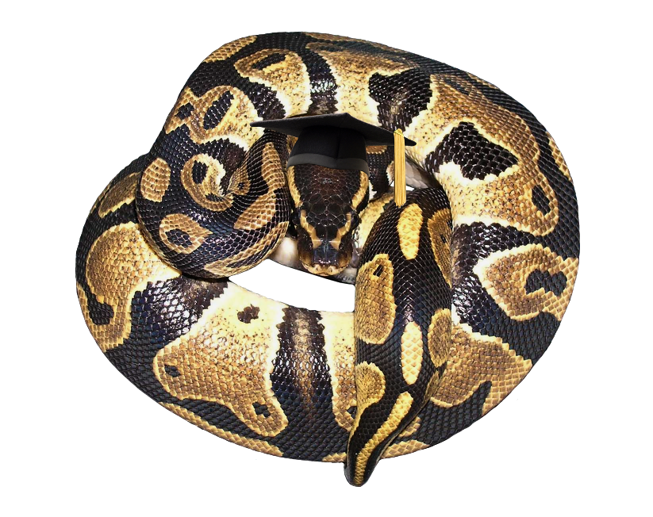

Advanced Autodesk Maya Python
  Kristine Middlemiss, Developer Consultant
  Autodesk Developer Network

Slide 2

Biography
Currently a Developer Consultant in the Autodesk Developer Network
Works with the API’s for Maya, MotionBuilder and FBX
Honours Bachelor of Computing Degree with a major in Computer Science and a minor in Fine Art from the University of Guelph as well as a certificate in Computer Animation.

Slide 3
Topics
Advantages and Disadvantages of Python
Overriding __str__()
Python Object from Proxy Pointer
lambda Functions as Callbacks
Improved Debugger Interface
Data Transfer Using cPickle

Slide 4
Advantages of Python
Fast turnaround (like MEL)‏
API access (like C++)‏
Easier access to MEL than C++ does
Large number of existing modules
Dynamic

Slide 5
Disadvantages of Python
Can be 10+ times slower than C++
Doesn't have access to entire API
Syntactically heavier than MEL

Slide 6
Overriding __str__()‏
Some API types display their values nicely when printed. E.g. MIntArray
Other types are less friendly. E.g. Mvector or Mmatrix
Let's to customize the string representation of our class

Slide 7
ints = om.MIntArray()‏
    ints.append(5)‏
    ints.append(-7)‏
    ints.append(12)‏
    print ints
    [5, -7, 12]

Slide 8
ints = om.MIntArray()‏
    ints.append(5)‏
    ints.append(-7)‏
    ints.append(12)‏
    print ints
    [5, -7, 12]
    v = om.MVector(1, 2, 3)‏
    print v
    <maya.OpenMaya.MVector; proxy of <Swig Object of type 'MVector*' at 0x40c2bf0> >

Slide 9
Overriding __str__()‏
Python uses class' __str__() method to print
Override the class' __str__() with your own method to produce more readable output

Slide 10
def myMVector_str(self):
  return “(%g, %g, %g)” % (self.x, self.y, self.z)‏
om.MVector.__str__ = myMVector_str
print v
(1, 2, 3)‏

Slide 11
Overriding __str__()‏
Note that existing objects are affected because the method is on the class, not the object
To be safe, save and restore the old __str__
    oldMVector_str = om.MVector.__str__
    ...
    om.MVector.__str__ = oldMVector_str
Can also be useful in special situations. E.g. sparse arrays

Slide 12
def myMatrix_str(self):
return "[[%g,%g,%g,%g][%g,%g,%g,%g][%g,%g,%g,%g][%g,%g,%g,%g]]" % (self(0,0), self(0,1), self(0,2), self(0,3), self(1,0), self(1,1), self(1,2), self(1,3), self(2,0), self(2,1), self(2,2), self(2,3), self(3,0), self(3,1), self(3,2), self(3,3))
oldMMatrix_str = OpenMaya.MMatrix.__str__
OpenMaya.MMatrix.__str__ = myMatrix_str
exMatrix = instanceDagPath.exclusiveMatrix()
print exMatrix
OpenMaya.MMatrix.__str__ = oldMMatrix_str

Slide 13
Python Object from Proxy Pointer
Basic Problem: Python doesn’t know how to use a C++ pointer in its methods
API returns proxy object ptr
  MPxContext::_newToolCommand
  MFnDependencyNode::userNode
Need to get corresponding Python object

Slide 14
Python Object from Proxy Pointer
OpenMayaMPx.asHashable()‏
  returns unique key for proxy object when passed the object or its pointer
Have proxy class maintain an object dictionary
  __init__() adds new objects
  __del__() removes destroyed objects

Slide 15
class sineNode(ompx.MPxNode):
  nodeTypeId = om.MTypeId(0x8700)‏
  objDict = {}
  def __init__(self):
    ompx.MPxNode.__init__(self)‏
    nodeKey = ompx.asHashable(self)‏
    sineNode.objDict[nodeKey] = self
  def __del__(self):
    nodeKey = ompx.asHashable(self)‏
    del objDict[nodeKey]

Slide 16
Python Object from Proxy Pointer
Other classes can use the dictionary to get the object from the pointer

Slide 17
nodeFn = om.MFnDependencyNode(nodeObject)‏
nodePtr = nodeFn.userNode()‏
nodeKey = ompx.asHashable(nodePtr)‏
node = sineNode.objDict[nodeKey]
# Now we can call the proxy object's methods
node.myMethod()‏

Slide 18
lambda Functions as Callbacks
lambda functions are shorthand for creating functions consisting of a single expression
Example:
    def lenSquared(a, b):
      return a**2 + b**2
  is equivalent to:
    lenSquared = lambda a, b: a**2 + b**2

Slide 19
lambda Functions as Callbacks
Can be used as replacements for very simple callbacks
Example: using callbacks to maintain a list of all transforms

Slide 20
def transformAdded(node, l):
  l.append(om.MObjectHandle(node))‏
def transformRemoved(node, l):
  l.remove(node)‏
xforms = []
om.MDGMessage.addNodeAddedCallback(
  transformAdded, “transform”, xforms)‏
om.MDGMessage.addNodeRemovedCallback(
  transformRemoved, “transform”, xforms)‏

Slide 21
lambda Functions as Callbacks
We can replace the two functions with inline lambda functions
lambda functions must take same arguments as a regular callback
  In our example that will be a node and clientData

Slide 22
xforms = []
om.MDGMessage.addNodeAddedCallback(
  lambda node, l: l.append(om.MObjectHandle(node)), “transform”, xforms)‏
om.MDGMessage.addNodeRemovedCallback(
  lambda node, l: l.remove(node), “transform”, xforms)‏

Slide 23
lambda Functions as Callbacks
lambdas can access variables from the context in which they are instantiated
In our example that means that they can use 'xforms' directly, they do not need to get it as client data
lambdas still need the client data arg, so of questionable benefit in this example but useful when access to multiple values is required

Slide 24
xforms = []
om.MDGMessage.addNodeAddedCallback(
  lambda node, x: xforms.append(om.MObjectHandle(node)), “transform”)‏
om.MDGMessage.addNodeRemovedCallback(
  lambda node, x: xforms.remove(node), “transform”)‏

Slide 25
lambda Functions as Callbacks
Primary constraint is that lambda function must be an expression.
For example, cannot increment a counter:
numXforms = numXforms + 1
will give syntax error if used in a lambda because assignment is a statement not an expression

Slide 26
Improved Debugger Interface
Python debugger (pdb) is a standard Python module. Not specific to Maya.
Similar to gdb for C/C++ code
To use, import pdb module then call run() with string containing function invocation to debug
Demo
Notes:
DEMO 1

Slide 27
Improved Debugger Interface
Will also work from within Script Editor, but interface is more cumbersome
Script Editor pops up prompt window each time pdb is ready for input
Demo
Notes:
DEMO 2

Slide 28
Improved Debugger Interface
Debugging would be smoother if Step and Next were buttons on the prompt window
pdb gets input from sys.stdin object
Replace sys.stdin with object which provides extra buttons on prompt window
    only requirements are readline() and read() methods

Slide 29
class DebuggerStandardInput:
  def readline(self):
    return self._getUserDebugResponse()‏
  def read(self):
    return self._getUserDebugResponse()‏

Slide 30
def _getUserDebugResponse(self):
    result = cmds.promptDialog(title='Simple Debugger', message='Debugger command:',button=['Step Into', 'Step Over', 'Command'], defaultButton='Command')‏
    if result == 'Command':
      result = cmds.promptDialog(query=True, text=True)‏
    elif result == 'Step Over':
      result = 'n'
    elif result = 'Step Into':
      result = 's'
    return result

Slide 31
Improved Debugger Interface
Create our own run() function to temporarily replace sys.stdin while running the debugger
    def run(command):
      orig_stdin = sys.stdin
      sys.stdin = DebuggerStandardInput()‏
      pdb.run(command)‏
      sys.stdin = orig_stdin
Demo
Notes:
DEMO 3

Slide 32
Improved Debugger Interface
We can also override sys.stdout, for example to eliminate the “(Pdb)” prompts from the output
All that pdb requires of the stdout object are:
  write(self, msg)‏
  writelines(self, msgSeq)‏
  flush(self)‏

Slide 33
class DebuggerStandardOutput:
  def __init__(self, orig_stdout):
    self.orig_stdout = orig_stdout
  def write(self, msg):
    line = msg.strip()‏
    if line[:5] == “(Pdb)”:
      line = '\n'
    self.orig_stdout.write(line)‏

Slide 34
def writelines(self, msgSeq):
    for l in msgSeq:
      self.write(l)‏
  def flush(self):
    return None

Slide 35
Improved Debugger Interface
Modify 'run' function to temporarily replace this as well
Demo
Notes:
DEMO 4

Slide 36
Improved Debugger Interface
Caveat: be careful about debugging code which reads from stdin or writes to stdout

Slide 37
Data Transfer Using cPickle
Use the pickle and cPickle modules for object serialization
  can write most Python objects to a pickle file
  can recreate Python objects from a pickle file
  both have same functionality but cPickle is faster
Example: have a user's Shot data persist across Maya sessions

Slide 38
class Shot:
  def __init__(self):
    self.user = None
    self.production = None
    self.sequence = None
    self.scene = None
    self.shot = None

Slide 39
def saveShotDefaults(shotInfo):
  home = os.environ['HOME']
  fileName = os.path.join(home, 'shotDefaults')‏
  file = open(fileName, 'wb')‏
  pickler = cPickle.Pickler(file, 2)‏
  pickler.dump(shotInfo)‏
  file.close()‏

Slide 40
def loadShotDefaults():
  home = os.environ['HOME']
  fileName = os.path.join(home, 'shotDefaults')‏
  file = open(fileName, 'rb')‏
  unpickler = cPickle.Unpickler(file)‏
  shotInfo = unpickler.load()‏
  file.close()‏
  return shotInfo

Slide 41
Data Transfer Using cPickle
No need to define and maintain file structure: picked up automatically from object
Can also pickle to/from strings
  dumps() and loads() convenience methods
  no need to create a pickler
Example: request shot from server
Demo
Notes:
DEMO 5

Slide 42
Closing Remarks
Many thanks to Tracy Narine and Dean Edmonds for their help in putting this material together.
If you would like to get a hold of today’s examples and white paper outlining more details (including Writing C++ Python Modules for Maya), email me at: kristine.middlemiss@autodesk.com

