Slide 1

Maya Programming Introduction
Kristine Middlemiss, Developer Consultant
Autodesk Developer Network (ADN)

Slide 2


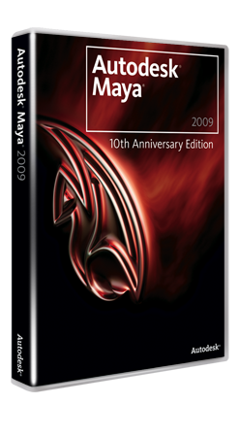
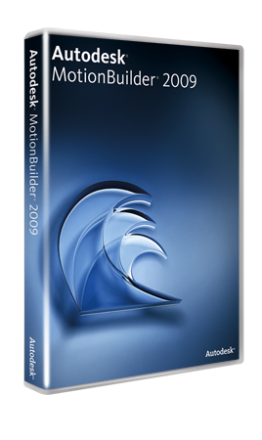




Biography

Slide 3

Day One:
Morning:
Maya API Overview
Maya Nodes Part 1
Afternoon:
Maya Nodes Part 2
Commands

Slide 4
Day Two
Morning:
A Closer Look at the Dependency Graph
Miscellaneous Tools
Afternoon:
Manipulators
Advanced Python Topics
What’s New in the API for 2011
Notes:
Tomorrow’s session is a mix of match of everything.
Internal mechanism, rules, It is a reinforcement, we will also talk about array attribute
Python has become a very popular language and its integration with Maya helps a lot of TDs and artists improving their workflow.

Slide 5
Session Agenda
Why use Programming
Overview of Maya Languages
Uses for Python in Maya
Help Documentation
Navigating the Installation Folder
Looking at how the documentation works
How to execute Python in Maya
Logging Bugs and Suggestion Features
Available Resources

Slide 6
Let’s Get Started

Slide 7
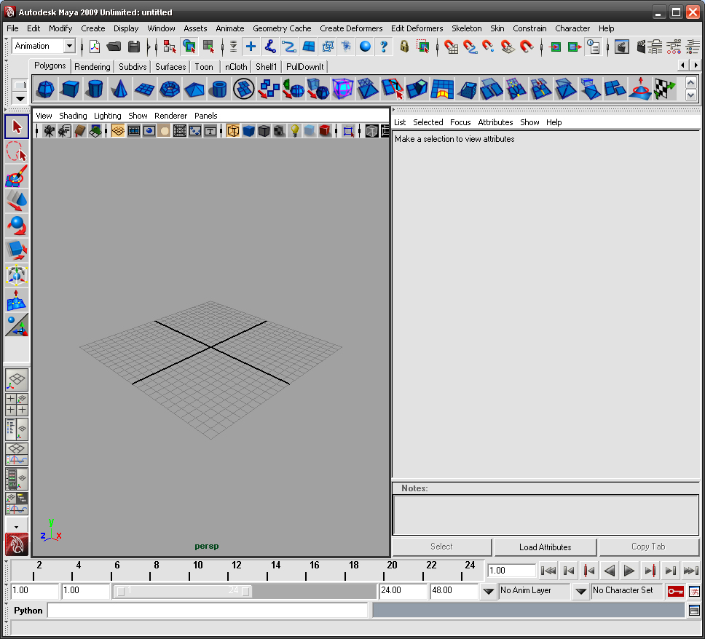
Welcome to Autodesk Maya 2010

Slide 8
Why use Programming in Maya
Automate repetitive, time-consuming tasks and extend features
Uses popular, easy-to-use Python scripting language
The C++ API to create custom tools and features that plug directly into Maya
Create project-specific functionality, for specific workflows and requirements.

Slide 9
Overview of Maya Languages

Slide 10
Programming In Maya Possibilities
Language Options:
Maya Embedded Language (MEL)
C++
Python scripting

Slide 11
MEL Scripting
MEL™ (Maya Embedded Language) is a scripting language at the heart of Maya.
Maya’s user interface is created using MEL, and MEL provides an easy way to extend the functionality of Maya.
Everything you can do using Maya’s graphical interface can be automated and extended using MEL.
Familiarity with MEL can deepen your understanding of and expertise with Maya.

Slide 12
Maya C++ API
The Maya API increases Maya’s power, customizing and extending Maya in many ways that you never thought possible.
It provides functionality for querying and changing the Maya model along with the ability to add new Maya objects to the Maya model.
You can use the Maya API to implement two types of code resources: plug-ins which extends the functionality of Maya, and standalones such as console applications which can access and manipulate a Maya model.

Slide 13
Python Scripting & API
Python™ is a powerful and popular object-oriented scripting language.
With the introduction of Python into Maya 8.5, we now provide Python support for calling the Maya commands.
In addition, we support the Maya Python API which allows developers to write Maya plug-ins and stand-alone applications without having to learn C++.
This integration of Python in Maya empowers production facilities to better integrate Autodesk Maya into your production pipeline.

Slide 14
How they fit into Maya
SCRIPTING CHOICES
Overlapping Functionality
API CHOICES
MEL command docs
1. C++ API
1. MEL Scripting
Same class docs
Python command docs
2. Python API
2. Python Scripting
Maya Application
Notes:
Methods not supported in Python:
Marked by: NO SCRIPT SUPPORT
In most cases, alternate forms are provided
Devkit examples translated from C++ to Python
Demonstrate how to map features to Python (devkit/plug-ins/scripted)
Discussed using maya.cmds in Script Editor and modules and maya.OpenMaya* in Python scripted plug-ins separately
Same usage distinctions as C++/MEL
With Python, the line between a "script" and a "plug-in" is blurred
Can access maya.OpenMaya* API classes outside of a scripted plug-in

Slide 15
Advantages of C++ API
Can be 10+ faster than Python
Slightly more classes and function exposed
Casting objects to a more specialized class to access specific functions
More devkit samples and resources

Slide 16
Advantages of Scripting
No resources needed to start developing, such as Visual Studio
Quick prototyping for tools
No need of hassle with pointers
Easily move between API and Scripting capabilities in Maya all with in the same plug-in or script
Tons of free modules

Slide 17
Why Python?
Customers Requested
Object Oriented
Open Source
Mostly Interpreted no Compiler Needed
Used for Both Standalone programs and Scripting Applications
Advantages
Quicker Development Cycle
Extremely Portable
No need to recompile code every release
Disadvantages
Slower than a fully compiled language like C++
Discloser
Notes:
Modern language with a wide range of easily added features

Slide 18
Python in Maya: Motivation
Scripting language, rapid prototyping
Objective-oriented programming
Flexible and Versatile
Server framework
System programming
Database tools
Large number of shared standard libraries
Cross Platform

Slide 19
Distinguishing features of Python
White space defines scope
Class methods defined within class definition
Python objects are references/pointers
Garbage collection
Namespaces

Slide 20
Uses for Python in Maya
Maya Python scripts:
access standard "Maya commands" from Python
like MEL scripts written in Python
Maya Python API Scripts
write scripts that access functionality previously available only through the C++ API
Maya Python API Scripted Plug-ins
define new commands, nodes, etc using Python
like C++ plug-ins written in Python
Maya Python Standalone Apps
like MLibrary-based C++ applications, but written in Python
Non UI
Notes:
Describe the different types of Python scripts that you can write for Maya, and explain how they correspond to the way you would previously have done things with MEL/C++. The rest of the talk will be going over these areas one at a time.

Slide 21
Documentation Structure
Maya 2009 Installation Guide
Learning Resources
Technical Documentation
Commands
Commands Python
Nodes
API
User Guide
What’s New
Developer Resources
mental ray

Slide 22
Help Documentation
Most Current Version of Documentation located here:
www.autodesk.com/Maya under Documentation Link
www.autodesk.com/developMaya

Slide 23
Navigating the Installation Folder
With Respect to Programming

Slide 24
Navigating Maya Install Folders
Default installation locations:
C:\Program Files\Autodesk\Maya 2010
C:\My Documents\maya\2010
7 Key Programming Related Folders:
devkit
Docs
Include
lib
mentalray
Python
scripts

Slide 25
Examples
C++ Plug-in Examples:
C:\Program Files\Autodesk\Maya2010\devkit\plug-ins
C++ Standalone Application Examples:
C:\Program Files\Autodesk\Maya2010\devkit\applications
Python Examples:
C:\Program Files\Autodesk\Maya2010\devkit\plug-ins\ scripted
C:\Program Files\Autodesk\Maya2010\devkit\applications\scripted

Slide 26
Exploring the Programming Docs

Slide 27
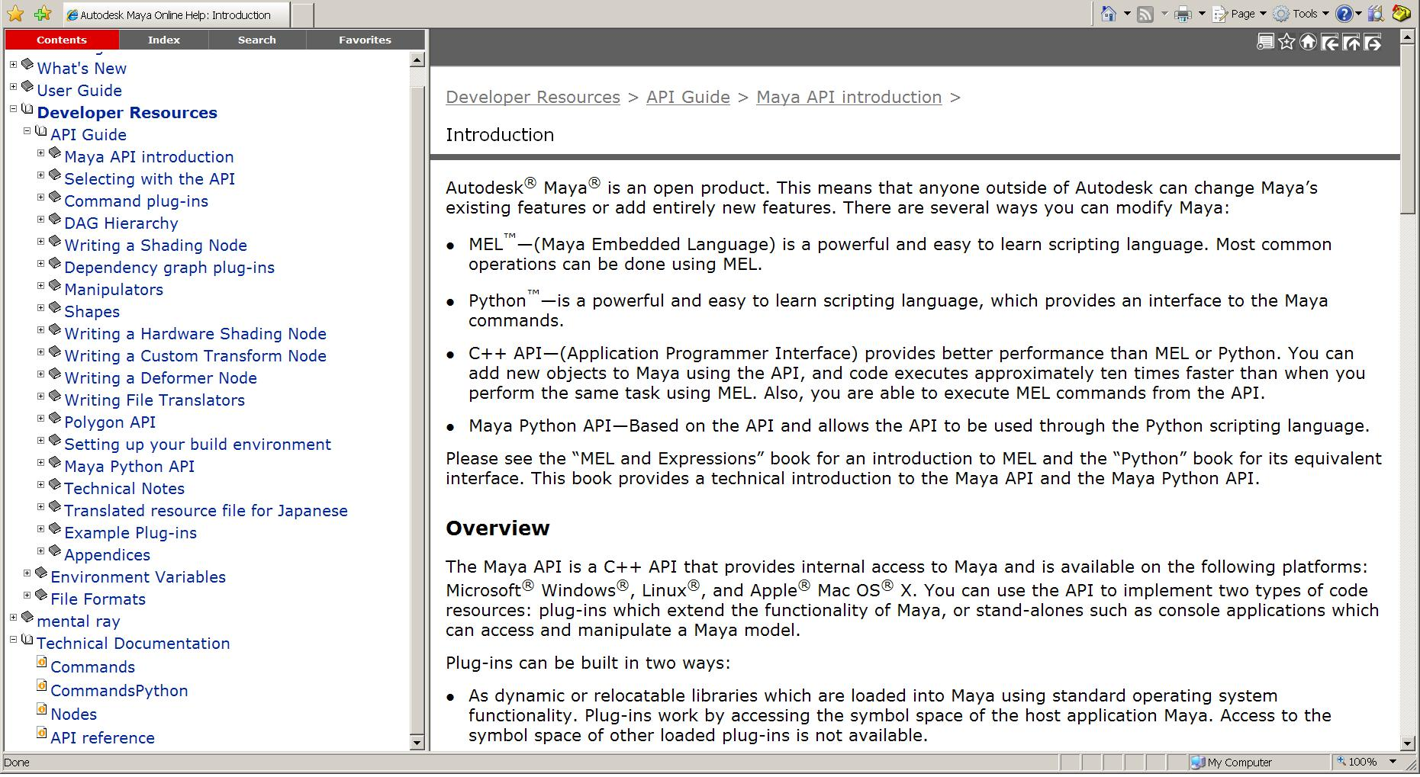
Maya API Resources
The Maya API Documentation contains a wealth of information on all aspects of the API.
API Docs
API Reference

Slide 28
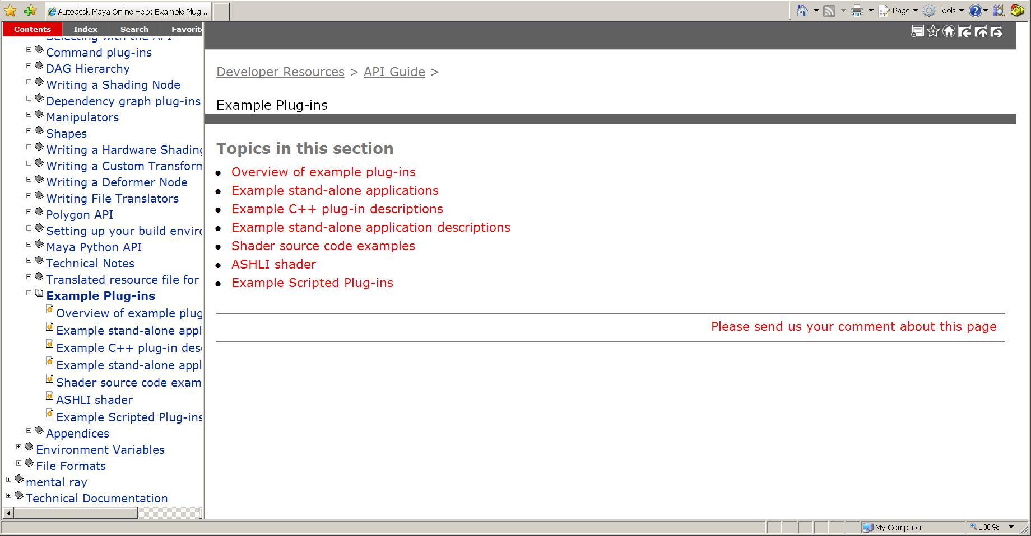
Examples
Example Docs

Slide 29
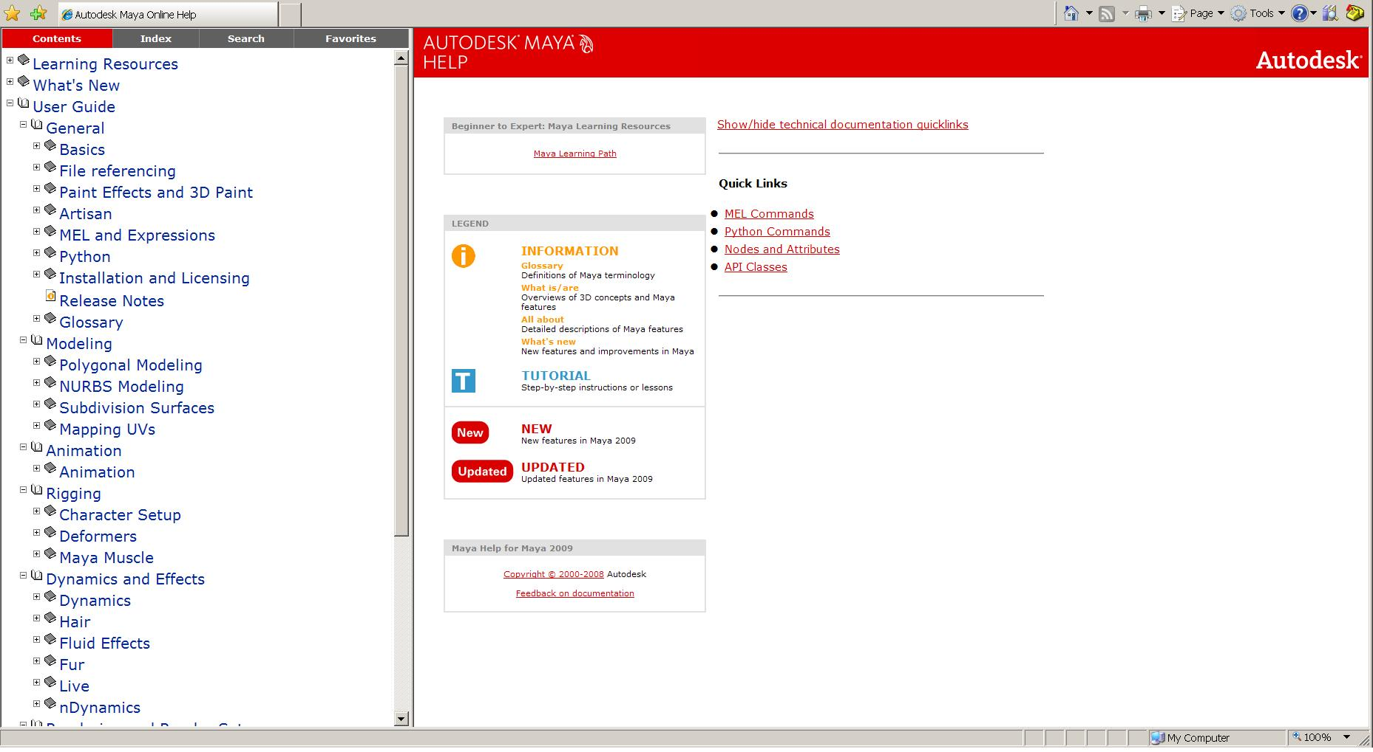
Maya Technical Resources
Including Documents on MEL, Python, Nodes and API Classes
Technical Documents

Slide 30
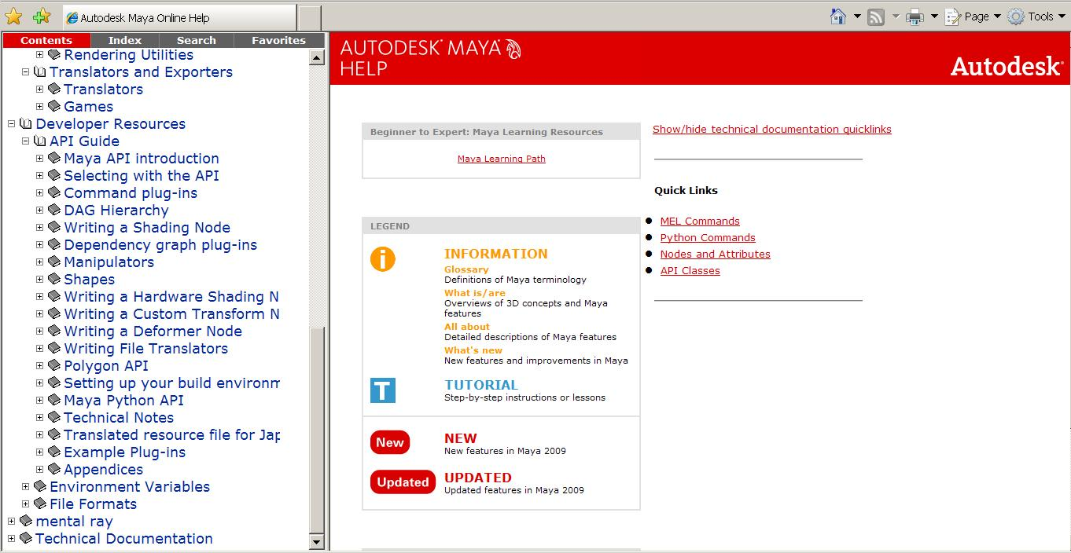
Python API Documentation
Python API share the same documentation with C++ API
Documentation in API Guide
Python API Introduction
Python API Docs

Slide 31
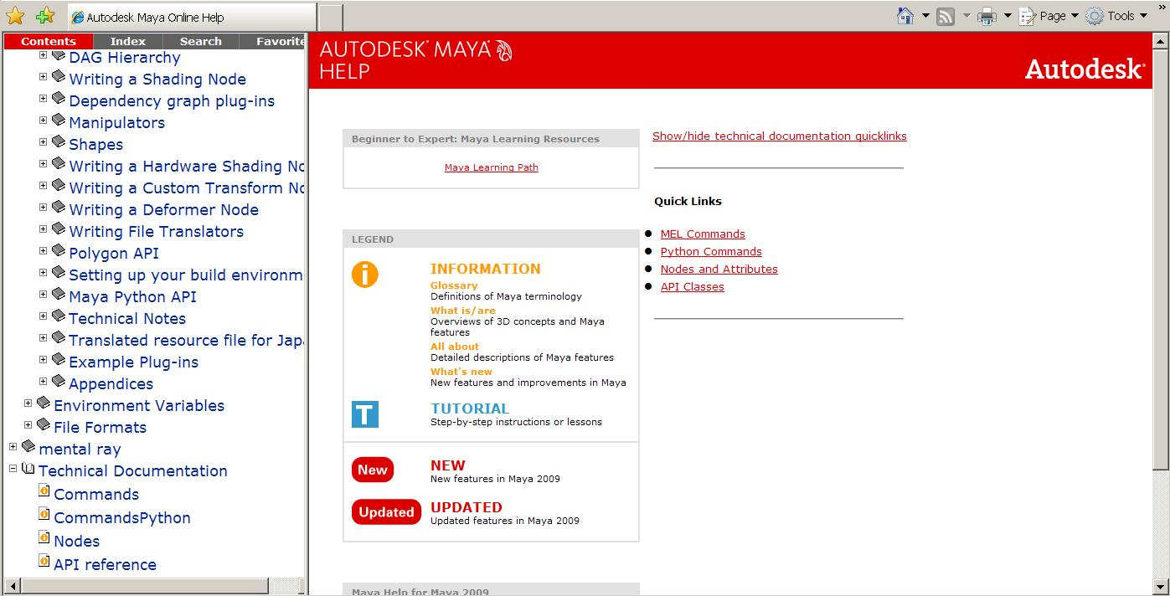
Maya Python Documentation
New “Python command” docs
Python command Docs

Slide 32
Python API Documentation
No Python-specific API class documentation
Methods not supported in Python:
Marked by: NO SCRIPT SUPPORT
In most cases, alternate forms are provided

Slide 33
How to execute Python in Maya

Slide 34
How to Execute Python
Script Editor
Shelf
Command Line
Plug-in Manager
Python modules of Maya from a standalone Python interpreter

Slide 35
Helpful Coding Standards
Comment your code, so that you and others can clearly read it
Put introduction comments at the top of your code, so the code is informative.
Name your variables appropriately, so it is again clear to read.
Use spaces, it makes easier to read

Slide 36
Let us know!
Let us know about Maya defects or Wish list items:
Log software defects here:
www.autodesk.com/maya-bugreport
Log software wish list items here:
www.autodesk.com/maya-sug

Slide 37
Others who use Python
Other Autodesk Products:
MotionBuilder: real-time animation product.
FBX: Autodesk File Format
Wiretap: access to media managed on Autodesk® Stone® file systems without the need to convert files or copy media across the network.
Non-Autodesk:
Youtube, Google, NASA and Air Canada's reservation management system.
Notes:
Simplified Wrapper and Interface Generator
A tool that easily allows a developer to wrap C/C++ functions for use with scripting languages. Currently supports Python, Perl, and Tcl.

Slide 38
Maya API Resources
Maya Developer Center
http://www.autodesk.com/developmaya
Maya API White Paper’s (provided)
DevTV (Webcast)
Questions and Problems: ADN
http://www.autodesk.com/adn
Recommended Maya API Programming Books:
David A. D. Gould. Complete Maya Programming, Volume 1. Morgan Kaufmann Publishers, San Francisco, 2003. ISBN:1-55860-835-4
The AREA || 3D Community Forums

Slide 39
Autodesk

