Slide 1

Maya API Introduction
Kristine Middlemiss, Developer Consultant
Autodesk Developer Network (ADN)
Notes:
There are two purposes/ reasons for this special event:
Introduce Maya Api and promote the usage among developers in production
since our ADN program is relatively new to the our animation and game customers, let more people be aware of our ADN program and its value.

Slide 2

Agenda
Maya Architecture Overview
Maya API Introduction
Plug-in Development

Slide 3
Maya Architecture Overview
Notes:
Dependency Graph is the controlling structure inside of Maya, is the core that makes the whole system work, for example, when I execute animation, build models, or I run particle simulation, the DG is the thing inside Maya that’s doing the work for me. A lot of you are already familiar with that.

Slide 4
Maya Architecture Overview
Two vital concepts of Maya architecture
Dependency Graph
Command Architecture

Slide 5
Maya Architecture Overview
Dependency Graph
Notes:
Dependency Graph is the controlling structure inside of Maya, is the core that makes the whole system work, for example, when I execute animation, build models, or I run particle simulation, the DG is the thing inside Maya that’s doing the work for me. A lot of you are already familiar with that.

Slide 6
Dependency Graph
Control system for Maya
Glue that holds together disparate operations and lets them work together seamlessly
Foundation of the Maya file format

Slide 7
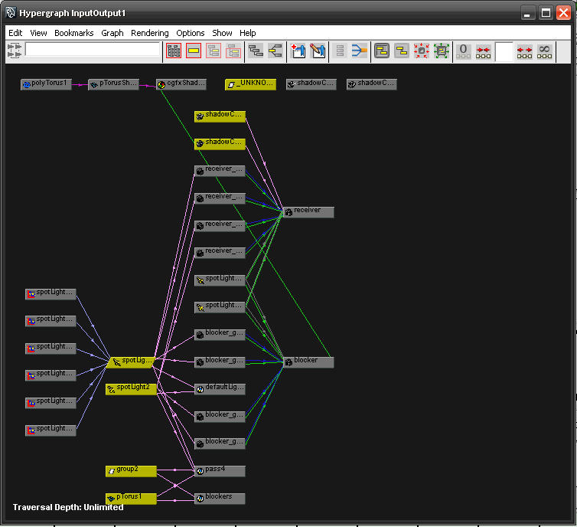
Maya Hypergraph

Slide 8
Dependency Graph
Notes:
In a complex Maya scene, this is More like what you’ll end up with

Slide 9
Dependency Graph
A collection of nodes that transmit data through connected attributes
A
A.a
B
C
B.b

Slide 10
Dependency Graph
Example: revolving surface
Curve
Revolve
Surface
Notes:
Everybody knows where to look at Dependency Graph, right? Hypergraph
It is a graphical representation of the relationship between objects in current Maya scene.

Slide 11
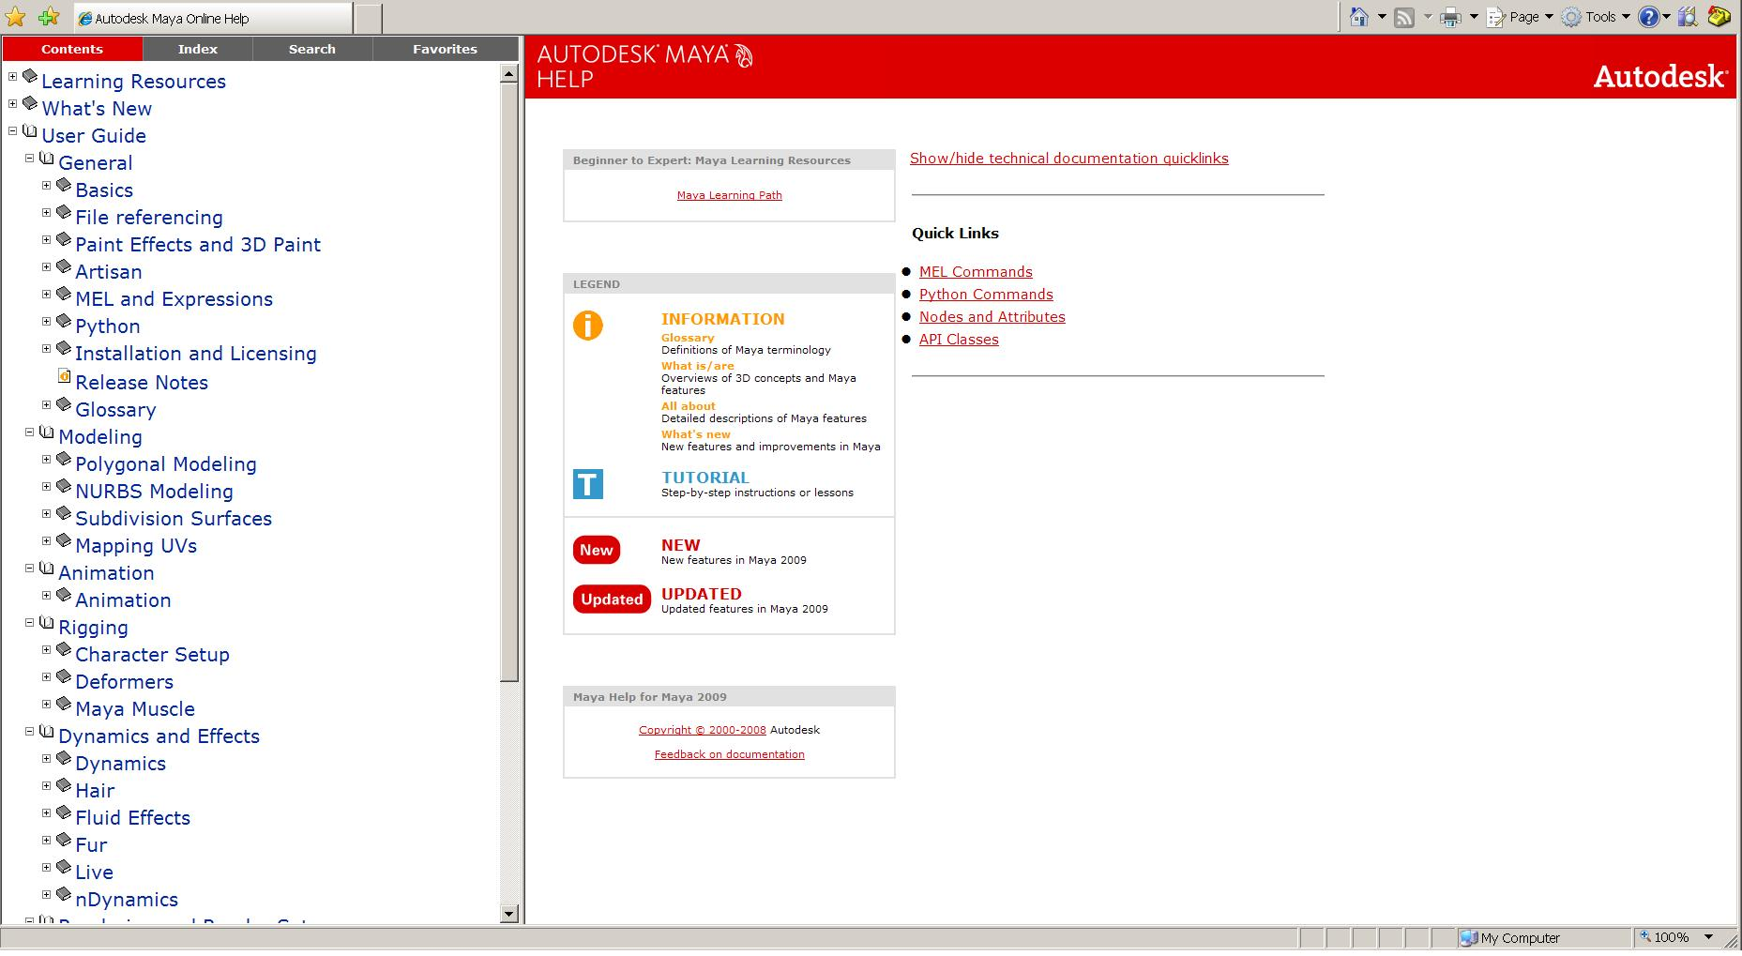
Maya Node Documentation

Slide 12



DAG(Directed Acyclic Graph)
DAG nodes are special dependency graph nodes that form a scene hierarchy (parenting).
Car
seats
frame
tires
Notes:
Where to find DAG node: Hypergraph: - DAG
There is a special type of DG nodes, called “DAG”nodes. Define parent-child relationship

Slide 13
Maya Architecture Overview
Command Architecture

Slide 14
Maya Command Architecture
Maya GUI
Maya Commands
Maya Core
OS
Notes:
On top of that is MEL commands layer, command engine layer. User can send MEL commands to Maya directly through this layer. This layer talk to Maya core to finish user-specified tasks.

Slide 15
Maya Embedded Language
Maya Embedded Language (MEL) is a command based scripting language
Command framework provides a scripting interface to Maya’s internals:
Create and layout UI
Create nodes and connections
Etc.

Slide 16
Maya Command Examples
Some examples:
select –replace myCone; // Replaces selection list with myCone.
connectAttr myCone.ty mySphere.ty; // Connects translateY attributes
headsUpDisplay –s 0 –b 0 –label “myHUD” myHUD;
To view the syntax for a given command use `help`
help headsUpDisplay;
// Result:
//
// Synopsis: headsUpDisplay [flags] String
// Flags:
// -e -edit
// -q -query
// -ac -attributeChange String
// -ad -allDescendants
// … //

Slide 17
Maya Command Documentation

Slide 18
Create, Query and Edit Mode
Create Mode
Query Mode
window -query -widthHeight $window;
Edit Mode
window -edit -widthHeight 100 100 $window;
string $window = `window -title “TestWindow"
-iconName “testWnd" -widthHeight 200 55`;
showWindow $window;

Slide 19
Working with MEL in Maya
Variable declaration and Assignment
Control and looping statements
Global procedures
int $a = 5;
float $b = 3.456;
vector $v = <<1.2, 3.4, 6.5>>;
float $ar[] = {1.2, 3.4, 4.5}; // An array of floats
matrix $mtx[3][2]; // A 3x2 matrix of floats
if else if… else…
switch (…)
while ( …) {…}
for ($i = 10; $i > 0; $i--) { ...}
global proc <return type> <name>(<arg list>)
{
...
return <exp>;
}

Slide 20
Execute MEL commands
Command Line & Script Editor
Record MEL commands
Script Files: *.mel
Script Path: MAYA_SCRIPT_PATH
whatIs: to find a global proc or internal built-in command
source: let Maya know a script has updated
rehash: let Maya rescan the script paths

Slide 21
Customizing Vital Concepts

Slide 22
What do we need API for?
New Custom Node
Notes:
How to take advantage of DG design and extend Maya’s functionality

Slide 23
What do we need API for?
Custom Maya Command
Maya GUI
Maya Commands
Maya API
Maya Core
OS

Slide 24
Maya API Introduction

Slide 25
What is an API?
Application Programming Interface
It is a contract between the server application exposing the API and the client using that API.
Client
API
MyApp.exe
1. Source code 2. Static library
3. DLL 4. EXE

Slide 26
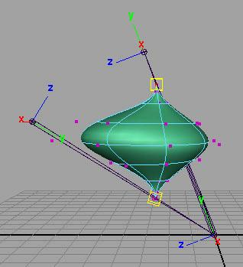
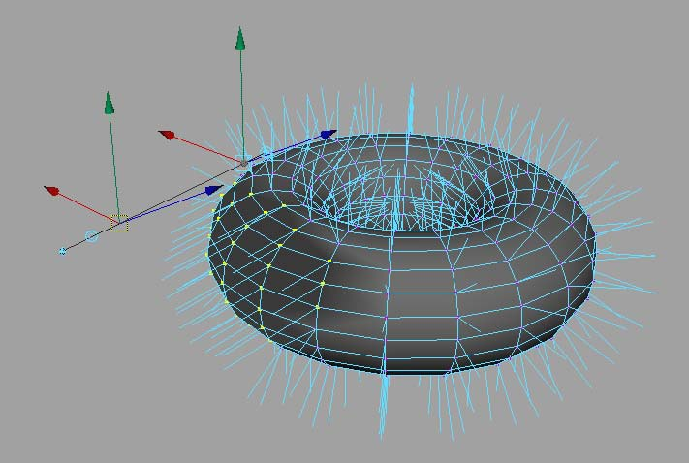
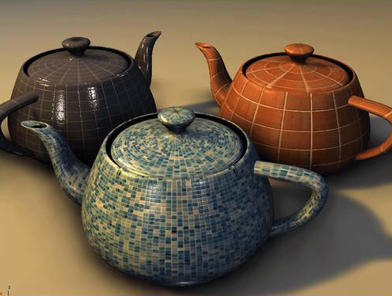

But really, what can you do?
Commands
Dependency Graph Nodes
Deformers
Shaders
Manipulators
Shapes
Etc.
Tools /Contexts
File Translators
Automation

Slide 27
What can you develop using API?
Plug-in
Loads into Maya application
C++ or Python
Full Maya UI
Interact with user and Maya operations
Standalone application
Use Maya libraries to load/save Maya files
C++ or Python
No UI

Slide 28
API Design Overview
A tight wrapper around Maya’s internal architecture
An abstract layer, which separates Maya internal code from external plug-in developers
External
developer
Maya API
Maya core
Notes:
One huge benefit of this is that it makes Maya very flexible and extensible,
Also it protects Maya from possible misuse.

Slide 29
Language of Choice?
Scripting and API
Script languages in Maya
Maya Embedded Language (MEL)
Python scripting
API languages in Maya
C++
Python libraries
2 version of Maya-Python
Converting C++ and MEL types to Python isn’t always easy
Python API wraps C++
Python scripting replicate MEL capabilities

Slide 30
How they fit into Maya
SCRIPTING CHOICES
Overlapping Functionality
API CHOICES
MEL command docs
1. C++ API
1. MEL Scripting
Same class docs
Python command docs
2. Python API
2. Python Scripting
Maya Application
Notes:
Methods not supported in Python:
Marked by: NO SCRIPT SUPPORT
In most cases, alternate forms are provided
Devkit examples translated from C++ to Python
Demonstrate how to map features to Python (devkit/plug-ins/scripted)
Discussed using maya.cmds in Script Editor and modules and maya.OpenMaya* in Python scripted plug-ins separately
Same usage distinctions as C++/MEL
With Python, the line between a "script" and a "plug-in" is blurred
Can access maya.OpenMaya* API classes outside of a scripted plug-in

Slide 31
Plug-in Development

Slide 32
Plug-in Development Environment
Operating System | Plug-in Type | Compiler
windows | .mll | Visual Studio 2008 with Service Pack 1
Linux | .so | gcc 4.1.2
Mac | .bundle | XCode 2.4.1 with gcc 4.0.1 Universal build binaries: powerPC, IntelMac
All Platforms | .py | Python 2.6 kernel

Slide 33
Maya Python API Plug-ins
Load/Unload Plug-in commands extended for Python
Python plug-in read into a dictionary
Searches for entry points
Action runs scripts
Required entry points
initializePlugin
uninitializePlugin

Slide 34
Maya Plug-in Architecture
initializePlugin() and uninitializePlugin() as entry point and exit point
Maya API
initializePlugin
uninitializePlugin
Maya
loadPlugin
unloadPlugin

Slide 35
Maya Python API Plug-ins
Define a Python module containing initializePlugin(), uninitializePlugin() functions
import necessary modules
def initializePlugin()
def uninitializePlugin()
class implementations…
def creator()

Slide 36
1. Import Necessary Modules
Classically we import what we want at the top of the module
import maya.OpenMaya as OpenMaya
import maya.OpenMayaMPx as OpenMayaMPx
import sys

Slide 37
2. initializePlugin()
Scripted plug-in initialization
# Initialize the script plug-in
def initializePlugin(mobject):
mplugin = OpenMayaMPx.MFnPlugin(mobject)
try:
mplugin.registerCommand( “foo”, cmdCreator )
except:
sys.stderr.write( "Failed to register command: %s\n" % kPluginCmdName )
raise

Slide 38
3. uninitializePlugin()
Scripted plug-in uninitialization
def uninitializePlugin(mobject):
mplugin = OpenMayaMPx.MFnPlugin(mobject)
try:
mplugin.deregisterCommand( “foo” )
except:
sys.stderr.write( "Failed to unregister command: %s\n" % kPluginCmdName )
raise

Slide 39
4. Class Implementations
Class Implementation: Similar setup to C++ plug-ins
class scriptedCommand(OpenMayaMPx.MPxCommand):
def __init__(self):
OpenMayaMPx.MPxCommand.__init__(self)
def doIt(self,argList):
print "Hello World!"
Parameter: self same as this in C

Slide 40
5. creator()
Creator Functions:
Similar to C++ plug-ins
Pass Python function to MFnPlugin methods
…
mplugin.registerCommand( “foo”, cmdCreator )
…
Ownership is important

Slide 41
5. creator()
OpenMayaMPx.asMPxPtr() transfer ownership of newly-created command or node objects to Maya
class scriptedCommand(OpenMayaMPx.MPxCommand):
….
def cmdCreator():
return OpenMayaMPx.asMPxPtr( scriptedCommand() )

Slide 42
Deployment of plug-in
Maya Plug-in Manager
Environment Variable: MAYA_PLUG_IN_PATH
Put your plug-ins into:
C:\My Documents\maya\2009\plug-ins
Add your custom plug-in path
putenv MAYA_PLUG_IN_PATH $destPluginPath;
Maya.env or userSetup.mel
string $currentPluginPath = `getenv MAYA_PLUG_IN_PATH`;
string $destPluginPath = $currentPluginPath + ";C:/My Documents";
putenv MAYA_PLUG_IN_PATH $destPluginPath;

Slide 43
Loading the Plug-in
Load from Plug-in Manager or loadPlugin command
maya.cmds.loadPlugin( "foo.py" )
maya.cmds.unloadPlugin("foo.py" )

Slide 44
Re-iterate: Generic Plug-in Algorithm
Define initializePlugin and uninitializePlugin functions
Register and unregister the proxy classes (MPxCommand, MPxNode, etc…) within these functions. ie register the custom commands and custom nodes being defined by the plugin
Implement creator and initialize methods (as required) which Maya calls to build the proxy classes
Implement the required functionality of the proxy classes. This requires importing the necessary modules

Slide 45
Summarize Main Methods
initializePlugin allows Maya to load a plugin.
uninitializePlugin allows Maya to unload a plugin
Both must be defined
Creator functions are used to instantiate a derivative of a proxy class (MPxNode, MPxCommand) and transfer its ownership to Maya
Node initialization functions are used for derivatives of MPxNode in order to define their attributes and initialize their values
Use try … except statements in order to trap errors and avoid crashing Maya. As a rule of thumb use them around API functions that return MStatus object

Slide 46
Autodesk

