Slide 1

Dependency Graph and Nodes
Kristine Middlemiss, Developer Consultant
Autodesk Developer Network (ADN)

Slide 2

Agenda
Dependency Graph
Components of Maya Node and API classes
Building Maya Custom Node with MPxNode

Slide 3
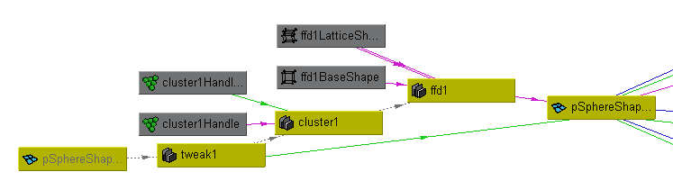
What is the Dependency Graph?

Slide 4
What is the Dependency Graph
Control system for Maya
Glue that holds together disparate operations and lets them work together seamlessly
Foundation of the Maya file format

Slide 5
Foundation of Maya File Format
Example: 02-spaceSaucer_2010.ma
A bunch of MEL commands:
createNode
setAttr
connectAttr

Slide 6
Dependency Graph
Notes:
In a complex Maya scene, this is More like what you’ll end up with

Slide 7
What does a node do?
Know its own attributes
Store data efficiently in “datablocks”
Accept input, compute, generate output
Connect with other nodes through connections

Slide 8
What does a node do?
Accept input data, compute output data
input attributes
output attributes

Slide 9
Maya Node Structure
Maya Node
Attributes
DataBlock DataHandle
Plugs

Slide 10
Attributes
Notes:
Dependency Graph is the controlling structure inside of Maya, is the core that makes the whole system work, for example, when I execute animation, build models, or I run particle simulation, the DG is the thing inside Maya that’s doing the work for me. A lot of you are already familiar with that.

Slide 11
Attributes
Maya Node
Attributes

Slide 12
Attributes
Describe data that belongs to nodes of a given type
Smiley Node Attribute
Float “rotation” Float “diameter”
Int32 “numEyes”

Slide 13
Attributes
Attributes are shared among nodes of the same type and all derived node types
Node A
Smiley Node Attribute
Float “rotation” Float “diameter”
Int32 “numEyes”
Node B

Slide 14
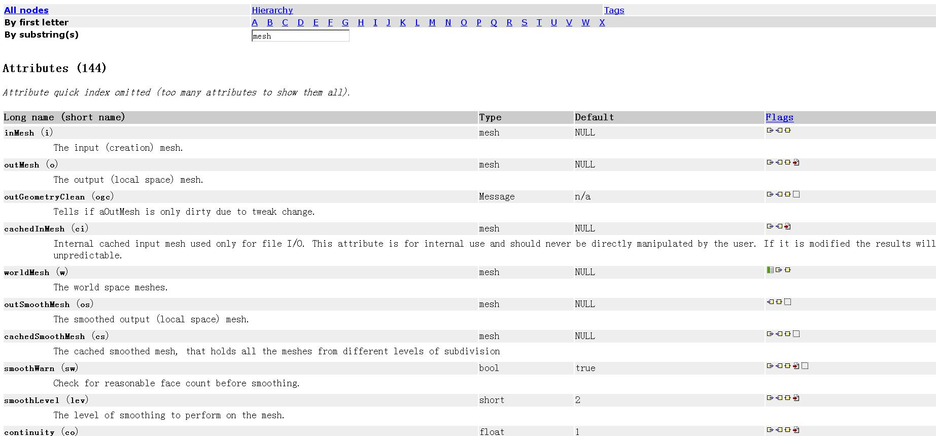
Node and Attributes
Name
Data Type
Structure
Property

Slide 15
Attributes
Define the interface of the node including
Names of the inputs and outputs
Data accepted by the inputs and outputs
Structure of the inputs and outputs
Properties of the inputs and outputs

Slide 16
Attribute Data Types
Basic
Numeric (float, int,etc.)
String
Matrix
Etc.
Complex
Mesh
NurbsSurface
Generic (accepts more than one type)
Etc.

Slide 17
Attribute Structures
Simple
handles a single piece of data
Example: polySphere1.radius
Compound
1 or more attributes grouped under a parent attribute
Example: translate is a compound with children (tx, ty, tz)
t
tx
ty
tz

Slide 18
Attribute Structures
Array (also referred to as a Multi)
An array of simple data
Example: pSphereShape1.face
face
0
1
2
...
n-1
n

Slide 19
Attribute Structures
Compound array
An array of compound data
Example: mesh colors with children (colorR, colorG, colorB, colorA)
And so on...
colors
0
1
2
...
n-1
n
colorR
colorG
colorB
colorA

Slide 20
Attribute Properties – Read/Write
Readable
Attribute can be connected as a source
Example: polyCylinder1.output
Writable
Attribute can be connected as a destination
Example: pCylinderShape1.inMesh
Read/Write
Attribute can be connected as both a source and a destination
Example: pCylinder1.tx

Slide 21
Attribute Properties – Affects
Attributes can affect other attributes
Once created on a node, an “attributeAffects” relationship can be setup to denote a dependency
D
radius
volume
setAttr D.radius 5
attributeAffects(radius,volume)

Slide 22
API Classes for Attributes
Maya Node
Attributes
MFnAttribute

Slide 23
API Classes for Attributes
Base Class: MFnAttribute
Most Common Used Classes
MFnNumericAttribute
MFnCompoundAttribute
MFnTypedAttribute
MFnMatrixAttribute
MFnGenericAttribute

Slide 24
MFnAttribute
Base of attribute function set classes
Take care of all the common aspect of an attribute on node
Readable/writable
Connectable
Storable
Keyable
Dynamic

Slide 25
MFnNumericAttribute
Function set for simple numeric value attribute
import maya.OpenMaya as OpenMaya
nAttr = OpenMaya.MFnNumericAttribute()
simpleNode.input = nAttr.create( "input", "in", OpenMaya.MFnNumericData.kFloat, 0.0 )
nAttr.setWritable(1)
nAttr.setStorable(1)
nAttr.setKeyable(1)
Notes:
Supposing this node class name is simpleNode

Slide 26
MFnNumericAttribute
How to use MFnNumericAttribute to create compound attribute?
nAttr = OpenMaya.MFnNumericAttribute()
transCircleNode.input = nAttr.create( "input", "in", OpenMaya.MFnNumericData.kDouble, 0.0 )
nAttr.setStorable(1)
transCircleNode.inputTranslateX = nAttr.create( "inputTranslateX", "itX", OpenMaya.MFnNumericData.kDouble, 0.0 )
nAttr.setStorable(1)
transCircleNode.inputTranslateY = nAttr.create( "inputTranslateY", "itY", OpenMaya.MFnNumericData.kDouble, 0.0 )
nAttr.setStorable(1)
transCircleNode.inputTranslateZ = nAttr.create( "inputTranslateZ", "itZ", OpenMaya.MFnNumericData.kDouble, 0.0 )
nAttr.setStorable(1)
comAttr = OpenMaya.MFnCompoundAttribute()
transCircleNode.inputTranslate = comAttr.create("inputTranslate","it")
comAttr.addChild(transCircleNode.inputTranslateX)
comAttr.addChild(transCircleNode.inputTranslateY)
comAttr.addChild(transCircleNode.inputTranslateZ)
comAttr.setStorable(1)
Notes:
Kristine says this way of creating compound attribute is not working in python, so we probably just skip this page?

Slide 27
Plugs
Notes:
Dependency Graph is the controlling structure inside of Maya, is the core that makes the whole system work, for example, when I execute animation, build models, or I run particle simulation, the DG is the thing inside Maya that’s doing the work for me. A lot of you are already familiar with that.

Slide 28
Plugs
Maya Node
Attributes
Plugs
MFnAttribute

Slide 29
Plugs
Pointer to an attribute on a specific node (ie. a specific instance of an attribute)
Node type definition
Actual instance of a node
myNode1
myNode2
myNode
myPlug1(myNode1, myAttr)
myAttr
myPlug2(myNode2, myAttr)
Notes:
.

Slide 30
Plugs
Plugs can be used to:
query a value
set a value
create a connection
remove a connection
query connection(s)
Does not store attribute data

Slide 31
API Classes for Plugs
Maya Node
Maya Node
Attributes
Plugs
MFnAttribute
MPlug

Slide 32
API Class for Plug: MPlug
Attribute and Node Operations:
MPlug::MPlug (const MObject &node, const MObject &attribute)
MObject MPlug::attribute ( MStatus * ReturnStatus)
MObject MPlug::node ( MStatus * ReturnStatus)
Operations for Compound Attribute and Connections:
MPlug MPlug::parent ( MStatus * ReturnStatus)
MPlug MPlug::child (unsigned int index, MStatus *ReturnStatus)
bool MPlug::connectedTo ( MPlugArray & array, bool asDst, bool asSrc, MStatus * ReturnStatus = NULL )
Manipulation of Data
MStatus MPlug::getValue ( double & val, MDGContext & ctx )
MStatus MPlug::setValue ( double val )

Slide 33
Datablocks
Notes:
Dependency Graph is the controlling structure inside of Maya, is the core that makes the whole system work, for example, when I execute animation, build models, or I run particle simulation, the DG is the thing inside Maya that’s doing the work for me. A lot of you are already familiar with that.

Slide 34
Datablocks
Maya Node
Attributes
Datablock Datahandle
Plugs
MFnAttribute
MPlug

Slide 35
Datablocks
Node stores data for every attribute (arrays are special, more details later)
Attribute
Node
Datablock

Slide 36
Datablocks & Datahandles
Datablock is the actual storage for the input and output data of a node
For every non-array attribute, datablock stores:
Data
Dirty/clean status
Data handles are lightweight pointers into the data in the datablock

Slide 37
Datablocks
Nodes hold an array of datablocks
One datablock for a normal evaluation (using current time)
More datablocks for timed contexts (specified times)
Normal
t=4
t=12

Slide 38
Maya Node Structure: API Classes
Maya Node
Attributes
Datablock Datahandle
Plugs
MFnAttribute
MDataBlock
MDataHandle
MPlug

Slide 39
API Classes for Datablock
MDatablock
only valid during compute()
Pointers to data block should not be retained after compute()
MDataHandle
a smart pointer for information contained in data block
double & MDataHandle::asDouble ( )
void MDataHandle::setDouble ( double )
MStatus MPxNode::compute(const MPlug& plug, MDataBlock& dataBlock)
MDataHandle MDataBlock::inputValue(const MPlug & plug, MStatus * ReturnStatus)
MDataHandle MDataBlock::outputValue ( const MPlug & plug, MStatus * ReturnStatus)
MDGContext MDataBlock::setContext (const MDGContext & ctx )

Slide 40
Maya Node Structure: API Classes
MPxNode
Maya Node
Attributes
Datablock Datahandle
Plugs
MFnAttribute
MDataBlock
MDataHandle
MPlug

Slide 41
Custom Node Implementation
Notes:
Dependency Graph is the controlling structure inside of Maya, is the core that makes the whole system work, for example, when I execute animation, build models, or I run particle simulation, the DG is the thing inside Maya that’s doing the work for me. A lot of you are already familiar with that.

Slide 42
Custom DG Nodes in Maya
Entirely new operations
MPxNode
Extend existing Maya nodes
MPxDeformerNode
MPxFieldNode
MPxEmitterNode
MPxSpringNode
MPxIkSolverNode
MPxHwShaderNode

Slide 43
MPxNode Registration
Every node requires a unique identifier.
MTypeId myNode::id( 0x80000 );
For plug-ins that you intend to share between sites
Will require a globally unique ID issued to you by Autodesk.
IDs are allocated in blocks of 64/128/256/512.
Contact ADN M&E for unique global IDs.
0 – 0x7ffff (524288 ids)
0x80000 – 0xfffff
0x100fff – 0xffffff
Internal Use
DevKit Examples
Global IDs

Slide 44
MPxNode Registration
To register your node in Maya:
To deregister your node
kPluginNodeTypeName = "simpleNode"
simpleNodeId = OpenMaya.MTypeId(0x80001)
def initializePlugin(mobject):
mplugin = OpenMayaMPx.MFnPlugin(mobject)
try:
mplugin.registerNode( kPluginNodeTypeName, simpleNodeId, nodeCreator, nodeInitializer )
except:
sys.stderr.write( "Failed to register node: %s" % kPluginNodeTypeName )
raise
def uninitializePlugin(mobject):
mplugin = OpenMayaMPx.MFnPlugin(mobject)
try:
mplugin.deregisterNode( simpleNodeId )
except:
sys.stderr.write( "Failed to deregister node: %s" % kPluginNodeTypeName )
raise

Slide 45
MPxNode
MPxNode::creator()
The creator method is called to return a new instance of the node
def nodeCreator():
return OpenMayaMPx.asMPxPtr( simpleNode() )

Slide 46
MPxNode
MPxNode::initialize()
Override this method to define the attribute interface for your node.
create the attribute
set the attribute’s flags
add the attribute to the node
define attribute relationships
Inherit attributes if necessary

Slide 47
Attribute Operations
MStatus MPxNode::addAttribute ( const MObject & attr )
MStatus MPxNode::attributeAffects ( const MObject & whenChanges, const MObject & isAffected )
MStatus MPxNode::inheritAttributesFrom ( const MString & parentClassName)
MPxNode
Custom Node A
Custom Node B

Slide 48
MPxNode
myNode
myOutput
myInput
MPxNode::initialize()
myOutputTwo
def nodeInitializer():
nAttr = OpenMaya.MFnNumericAttribute()
simpleNode.myInputAttr = nAttr.create( "myInput", “mi", OpenMaya.MFnNumericData.kFloat, 1.0 )
nAttr.setStorable(1)
simpleNode.myOutputAttr = nAttr.create(“myOutput”, “mo”, OpenMaya.MFnNumericData.kFloat, 1.0)
nAttr.setStorable(1)
simpleNode.myOutputAttrTwo = nAttr.create(“myOutputTwo”, “motwo”, OpenMaya.MFnNumericData.kFloat, 1.0)
nAttr.setStorable(1)
simpleNode.addAttribute( simpleNode.input )
simpleNode.addAttribute( simpleNode.myOutputAttr)
simpleNode.addAttribute( simpleNode.myOutputAttrTwo)
simpleNode.attributeAffects(simpleNode.myInputAttr, simpleNode.myOutputAttr);
MPxNode::addAttribute()
MPxNode::attributeAffects()

Slide 49
MPxNode
MPxNode::compute()
called when the node is asked to evaluate an output
def compute( self, plug, dataBlock):
if ( plug == simpleNode.myOutputAttr):
# your compute algorithm for output1
if (plug = = simpleNode.myOutputAttrTwo):
# your compute algorithm for output2
getAttr myNode1.myOutput;
myNode
myOutput
myInput
myOutputTwo

Slide 50
MPxNode
MPxNode::compute()
def compute(self,plug,dataBlock):
# …
if( plug == simpleNode.myOutputAttr ):
inputData = dataBlock.inputValue( simpleNode.myInputAttr )
inputValue = inputData.asFloat()
outputHandle = dataBlock.outputValue( simpleNode.myOutputAttr )
outputHandle.setFloat(inputValue * 2 );
dataBlock.setClean( plug )
return OpenMaya.MStatus.kSuccess
if (plug = = simpleNode.myOutputAttrTwo):
#…
return OpenMaya.MStatus.kUnknownParameter
myOutput = myInput * 2;
myNode
myOutput
myInput
myOutputTwo

Slide 51
Example: simpleNode
In this example, we implement a custom node with two attributes: “input”, ”output”. Whenever the “input” attribute value changes, the “output” attribute will always be the input value multiplied by 2.

Slide 52
Autodesk

