Slide 1
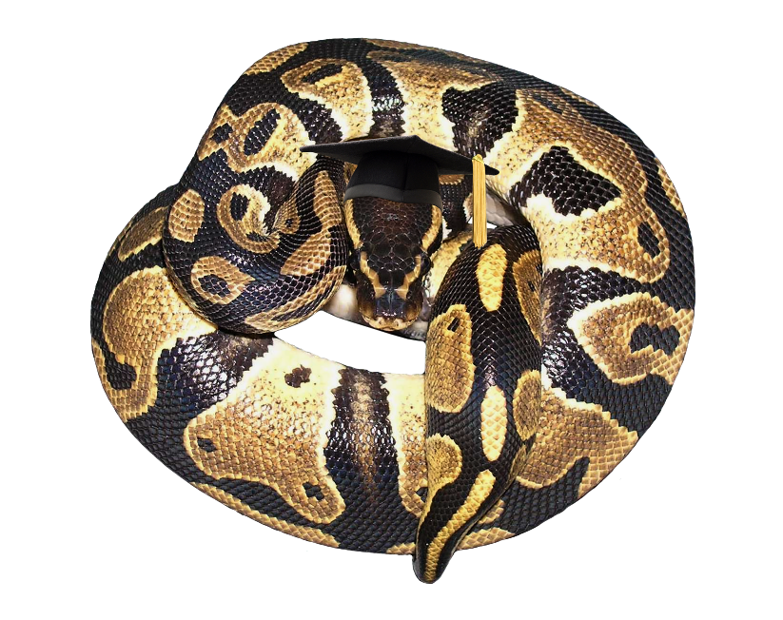

Advanced Autodesk Maya Python
  Kristine Middlemiss, Developer Consultant
  Autodesk Developer Network

Slide 2

Topics
Overriding __str__()
Python Object from Proxy Pointer
lambda Functions as Callbacks
Improved Debugger Interface
Data Transfer Using cPickle
Notes:
Show you how to build faster, more sophisticated tools for binding together the contrasting elements of the typical
production pipeline.
We'll discuss how the dynamic nature of Python's runtime environment
allows us customize standard tools and datatypes to meet special needs.
We'll take a look at some standard Python modules and really cool ways in which they can be used.

Slide 3
Overriding __str__()‏
Some API types display their values nicely when printed. E.g. MIntArray
Other types are less friendly. E.g. Mvector or Mmatrix
Let's to customize the string representation of our class

Slide 4
ints = om.MIntArray()‏
    ints.append(5)‏
    ints.append(-7)‏
    ints.append(12)‏
    print ints
    [5, -7, 12]

Slide 5
ints = om.MIntArray()‏
    ints.append(5)‏
    ints.append(-7)‏
    ints.append(12)‏
    print ints
    [5, -7, 12]
    v = om.MVector(1, 2, 3)‏
    print v
    <maya.OpenMaya.MVector; proxy of <Swig Object of type 'MVector*' at 0x40c2bf0> >

Slide 6
Overriding __str__()‏
Python uses class' __str__() method to print
Override the class' __str__() with your own method to produce more readable output

Slide 7
def myMVector_str(self):
  return “(%g, %g, %g)” % (self.x, self.y, self.z)‏
om.MVector.__str__ = myMVector_str
print v
(1, 2, 3)‏
Notes:
When defining your class methods, you must explicitly list self as the first argument for each method
When you call a method of an ancestor class from within your class, you must include the self argument. But when you call your class method from outside, you do not specify anything for the self argument; you skip it entirely, and Python automatically adds the instance reference for you

Slide 8
Overriding __str__()‏
Note that existing objects are affected because the method is on the class, not the object
To be safe, save and restore the old __str__
    oldMVector_str = om.MVector.__str__
    ...
    om.MVector.__str__ = oldMVector_str
Can also be useful in special situations. E.g. sparse arrays

Slide 9
def myMatrix_str(self):
return "[[%g,%g,%g,%g][%g,%g,%g,%g][%g,%g,%g,%g][%g,%g,%g,%g]]" % (self(0,0), self(0,1), self(0,2), self(0,3), self(1,0), self(1,1), self(1,2), self(1,3), self(2,0), self(2,1), self(2,2), self(2,3), self(3,0), self(3,1), self(3,2), self(3,3))
oldMMatrix_str = OpenMaya.MMatrix.__str__
OpenMaya.MMatrix.__str__ = myMatrix_str
exMatrix = instanceDagPath.exclusiveMatrix()
print exMatrix
OpenMaya.MMatrix.__str__ = oldMMatrix_str

Slide 10
Python Object from Proxy Pointer
Basic Problem: Python doesn’t know how to use a C++ pointer in its methods
API returns proxy object ptr
  MPxContext::_newToolCommand
  MFnDependencyNode::userNode
Need to get corresponding Python object
Notes:
There are times where the Maya API will return a pointer to a Maya object, two examples
In C++ you can pass that to the type of your proxy class, and you can call all your methods on it,
however in Python it doesn't know what a C++ pointers are, so you need a way to translate that pointer
in to an actual python object as a method you can call.
MPxContext::_newToolCommand returns MPxToolCommand
MFnDependencyNode::userNode returns MPxNode
Other examples are:
MPxTransformationMatrix * transformationMatrixPtr () const
MIkHandleGroup * handleGroup () const
const MMatrix * toWorldSpace () const
const MMatrix * toSolverSpace () const

Slide 11
Python Object from Proxy Pointer
OpenMayaMPx.asHashable()‏
  returns unique key for proxy object when passed the object or its pointer
Have proxy class maintain an object dictionary
  __init__() adds new objects
  __del__() removes destroyed objects
Notes:
There is nothing built in to the Python API to do it automatically, but we did put some hooks called the asHashable function in the OpenMayaMPX module.
So what is this asHashable() Function? if you pass it a proxy object or a pointer to a proxy object, it will return a unique id, for every proxy object that you pass into it you will get back a different unique id, and it doesn't matter if you pass it the object it self or the pointer to the object it will still give you back the same key.
So what you can do is have your Proxy class maintain a dictionary, that associates the python object with that key value, you can have your proxy classes init method add an object to the dictionary every time one is created and use your classes del method to remove it from the dictionary each time an object is removed.

Slide 12
class sineNode(ompx.MPxNode):
  nodeTypeId = om.MTypeId(0x8700)‏
  objDict = {}
  def __init__(self):
    ompx.MPxNode.__init__(self)‏
    nodeKey = ompx.asHashable(self)‏
    sineNode.objDict[nodeKey] = self
  def __del__(self):
    nodeKey = ompx.asHashable(self)‏
    del objDict[nodeKey]
Notes:
__init__ methods are optional, but when you define one, you must remember to explicitly call the ancestor's __init__ method (if it defines one)

Slide 13
Python Object from Proxy Pointer
Other classes can use the dictionary to get the object from the pointer

Slide 14
nodeFn = om.MFnDependencyNode(nodeObject)‏
nodePtr = nodeFn.userNode()‏
nodeKey = ompx.asHashable(nodePtr)‏
node = sineNode.objDict[nodeKey]
# Now we can call the proxy object's methods
node.myMethod()‏

Slide 15
lambda Functions as Callbacks
lambda functions are shorthand for creating functions consisting of a single expression
Example:
    def lenSquared(a, b):
      return a**2 + b**2
  is equivalent to:
    lenSquared = lambda a, b: a**2 + b**2

Slide 16
lambda Functions as Callbacks
Can be used as replacements for very simple callbacks
Example: using callbacks to maintain a list of all transforms

Slide 17
def transformAdded(node, l):
  l.append(om.MObjectHandle(node))‏
def transformRemoved(node, l):
  l.remove(node)‏
xforms = []
om.MDGMessage.addNodeAddedCallback(
  transformAdded, “transform”, xforms)‏
om.MDGMessage.addNodeRemovedCallback(
  transformRemoved, “transform”, xforms)‏

Slide 18
lambda Functions as Callbacks
We can replace the two functions with inline lambda functions
lambda functions must take same arguments as a regular callback
  In our example that will be a node and clientData

Slide 19
xforms = []
om.MDGMessage.addNodeAddedCallback(
  lambda node, l: l.append(om.MObjectHandle(node)), “transform”, xforms)‏
om.MDGMessage.addNodeRemovedCallback(
  lambda node, l: l.remove(node), “transform”, xforms)‏

Slide 20
lambda Functions as Callbacks
lambdas can access variables from the context in which they are instantiated
In our example that means that they can use 'xforms' directly, they do not need to get it as client data
lambdas still need the client data arg, so of questionable benefit in this example but useful when access to multiple values is required

Slide 21
xforms = []
om.MDGMessage.addNodeAddedCallback(
  lambda node, x: xforms.append(om.MObjectHandle(node)), “transform”)‏
om.MDGMessage.addNodeRemovedCallback(
  lambda node, x: xforms.remove(node), “transform”)‏

Slide 22
lambda Functions as Callbacks
Primary constraint is that lambda function must be an expression.
For example, cannot increment a counter:
numXforms = numXforms + 1
will give syntax error if used in a lambda because assignment is a statement not an expression

Slide 23
Improved Debugger Interface
Python debugger (pdb) is a standard Python module. Not specific to Maya.
Similar to gdb for C/C++ code
To use, import pdb module then call run() with string containing function invocation to debug
Demo
Notes:
DEMO 1

Slide 24
Improved Debugger Interface
Will also work from within Script Editor, but interface is more cumbersome
Script Editor pops up prompt window each time pdb is ready for input
Demo
Notes:
DEMO 2

Slide 25
Improved Debugger Interface
Debugging would be smoother if Step and Next were buttons on the prompt window
pdb gets input from sys.stdin object
Replace sys.stdin with object which provides extra buttons on prompt window
    only requirements are readline() and read() methods

Slide 26
class DebuggerStandardInput:
  def readline(self):
    return self._getUserDebugResponse()‏
  def read(self):
    return self._getUserDebugResponse()‏

Slide 27
def _getUserDebugResponse(self):
    result = cmds.promptDialog(title='Simple Debugger', message='Debugger command:',button=['Step Into', 'Step Over', 'Command'], defaultButton='Command')‏
    if result == 'Command':
      result = cmds.promptDialog(query=True, text=True)‏
    elif result == 'Step Over':
      result = 'n'
    elif result = 'Step Into':
      result = 's'
    return result

Slide 28
Improved Debugger Interface
Create our own run() function to temporarily replace sys.stdin while running the debugger
    def run(command):
      orig_stdin = sys.stdin
      sys.stdin = DebuggerStandardInput()‏
      pdb.run(command)‏
      sys.stdin = orig_stdin
Demo
Notes:
DEMO 3

Slide 29
Improved Debugger Interface
We can also override sys.stdout, for example to eliminate the “(Pdb)” prompts from the output
All that pdb requires of the stdout object are:
  write(self, msg)‏
  writelines(self, msgSeq)‏
  flush(self)‏

Slide 30
class DebuggerStandardOutput:
  def __init__(self, orig_stdout):
    self.orig_stdout = orig_stdout
  def write(self, msg):
    line = msg.strip()‏
    if line[:5] == “(Pdb)”:
      line = '\n'
    self.orig_stdout.write(line)‏

Slide 31
def writelines(self, msgSeq):
    for l in msgSeq:
      self.write(l)‏
  def flush(self):
    return None

Slide 32
Improved Debugger Interface
Modify 'run' function to temporarily replace this as well
Demo
Notes:
DEMO 4

Slide 33
Improved Debugger Interface
Caveat: be careful about debugging code which reads from stdin or writes to stdout

Slide 34
Data Transfer Using cPickle
Use the pickle and cPickle modules for object serialization
  can write most Python objects to a pickle file
  can recreate Python objects from a pickle file
  both have same functionality but cPickle is faster
Example: have a user's Shot data persist across Maya sessions

Slide 35
class Shot:
  def __init__(self):
    self.user = None
    self.production = None
    self.sequence = None
    self.scene = None
    self.shot = None

Slide 36
def saveShotDefaults(shotInfo):
  home = os.environ['HOME']
  fileName = os.path.join(home, 'shotDefaults')‏
  file = open(fileName, 'wb')‏
  pickler = cPickle.Pickler(file, 2)‏
  pickler.dump(shotInfo)‏
  file.close()‏

Slide 37
def loadShotDefaults():
  home = os.environ['HOME']
  fileName = os.path.join(home, 'shotDefaults')‏
  file = open(fileName, 'rb')‏
  unpickler = cPickle.Unpickler(file)‏
  shotInfo = unpickler.load()‏
  file.close()‏
  return shotInfo

Slide 38
Data Transfer Using cPickle
No need to define and maintain file structure: picked up automatically from object
Can also pickle to/from strings
  dumps() and loads() convenience methods
  no need to create a pickler
Example: request shot from server
Demo
Notes:
DEMO 5

Slide 39
Closing Remarks
Many thanks to Naiqi Weng for preparing this Maya API Training, and Cyrille Fauvel for assisting in putting it together.
Feel free to email me any questions related to this Python API Training at kristine.middlemiss@autodesk.com

