Slide 1

Maya Programming Introduction
Kristine Middlemiss, Senior Developer Consultant
Autodesk Developer Network (ADN)

Slide 2
Session Agenda
Why use Programming
Overview of Maya Languages
Uses for Python in Maya
Help Documentation
Navigating the Installation Folder
Looking at how the documentation works
How to execute Python in Maya
Logging Bugs and Suggestion Features
Available Resources

Slide 3

Let’s Get Started

Slide 4
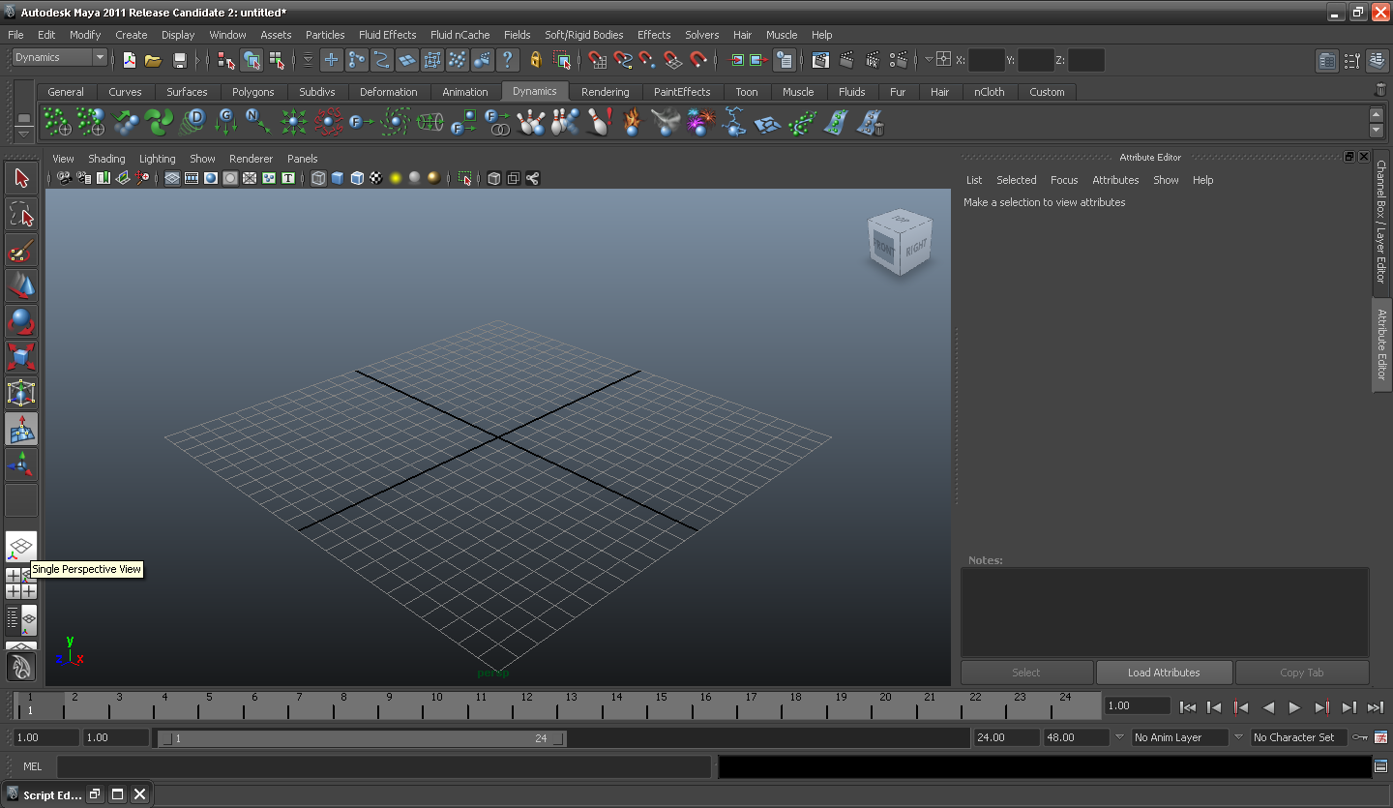
Welcome to Autodesk Maya 2012

Slide 5
Why use Programming in Maya
Automate repetitive, time-consuming tasks and extend features
Uses popular, easy-to-use Python scripting language
The C++ and Python API to create custom tools and features that plug directly into Maya
Create project-specific functionality, for specific workflows and requirements.

Slide 6
Overview of Maya Languages

Slide 7
Programming In Maya Possibilities
Available programming language options in Maya:
Maya Embedded Language (MEL)
C++
Python scripting

Slide 8
MEL Scripting
MEL (Maya Embedded Language) is a scripting language at the heart of Maya.
Maya’s user interface is created using MEL, and MEL provides an easy way to extend the functionality of Maya.
Everything you can do using Maya’s graphical interface can be automated and extended using MEL.
Familiarity with MEL can deepen your understanding of and expertise with Maya.

Slide 9
Python Scripting & API
Python is a powerful and popular object-oriented scripting language.
With the introduction of Python into Maya 8.5, we now provide Python support for calling the Maya commands.
In addition, we support the Maya Python API which allows developers to write Maya plug-ins and stand-alone applications without having to learn C++.
This integration of Python in Maya empowers production facilities to better integrate Autodesk Maya into your production pipeline.

Slide 10
Maya C++ API
The Maya API increases Maya’s power, customizing and extending Maya in many ways that you never thought possible.
It provides functionality for querying and changing the Maya model along with the ability to add new Maya objects to the Maya model.
You can use the Maya API to implement two types of code resources: plug-ins which extends the functionality of Maya, and standalones such as console applications which can access and manipulate a Maya model.

Slide 11
How they fit in Maya
SCRIPTING CHOICES
Overlapping Functionality
API CHOICES
Maya Command Docs
1. C++ API
1. MEL Scripting
API Class Docs*
Python Command Docs
2. Python API
2. Python Scripting
Maya Application
*This is changing soon
Notes:
Methods not supported in Python:
Marked by: NO SCRIPT SUPPORT
In most cases, alternate forms are provided
Devkit examples translated from C++ to Python
Demonstrate how to map features to Python (devkit/plug-ins/scripted)
Discussed using maya.cmds in Script Editor and modules and maya.OpenMaya* in Python scripted plug-ins separately
Same usage distinctions as C++/MEL
With Python, the line between a "script" and a "plug-in" is blurred
Can access maya.OpenMaya* API classes outside of a scripted plug-in

Slide 12
Advantages of Scripting
Easier learning curve
No resources needed to start developing, such as Visual Studio
Quick prototyping for tools
Platform Independent
Tons of free modules (Python)
Easily move between API and Scripting capabilities in Maya all with in the same plug-in or script (Python)

Slide 13
Advantages of C++ API
Compiled, no source code discloser
Can be 10+ faster than Python
More classes and function exposed
More detailed manipulation of lower level core
More devkit samples and resources

Slide 14
Why Python?
Customers Requested
Object Oriented
Open Source
Mostly Interpreted no Compiler Needed
Used for Both Standalone programs and Scripting Applications
Advantages
Quicker Development Cycle
Extremely Portable
No need to recompile code every release
Disadvantages
Slower than a fully compiled language like C++
Discloser
Notes:
Modern language with a wide range of easily added features

Slide 15
Others who use Python
Other Autodesk Products:
MotionBuilder: real-time animation product.
Showcase: Real-time viz product.
FBX: Autodesk File Format
Wiretap: access to media managed on Autodesk® Stone® file systems without the need to convert files or copy media across the network
Non-Autodesk:
Youtube, Google, NASA and Air Canada's reservation management system.

Slide 16
Distinguishing features of Python
White space defines scope
Class methods defined within class definition
Python objects are references/pointers
Garbage collection
Namespaces

Slide 17
Usages for Python in Maya
Maya Python scripts:
access standard "Maya commands" from Python
like MEL scripts written in Python
Maya Python API Scripts
write scripts that access functionality previously available only through the C++ API
Maya Python API Scripted Plug-ins
define new commands, nodes, etc using Python
like C++ plug-ins written in Python
Maya Python Standalone Apps
like MLibrary-based C++ applications, but written in Python
Non UI
Notes:
Describe the different types of Python scripts that you can write for Maya, and explain how they correspond to the way you would previously have done things with MEL/C++. The rest of the talk will be going over these areas one at a time.

Slide 18
Documentation Structure
Maya 2012 Installation Guide
Learning Resources
Technical Documentation
Maya Commands
Python Commands
Nodes and Attributes
API Reference
User Guide
What’s New
Developer Resources
mental ray

Slide 19
Help Documentation
API Docs are only available on the web (starting 2012):
www.autodesk.com/maya
under ‘Documentation’ link, download or view
www.autodesk.com/developMaya

Slide 20
Navigating the Installation Folder
with respect to programming

Slide 21
Navigating Maya Install Folders
Default installation locations:
C:\Program Files\Autodesk\Maya 2012
C:\My Documents\maya\2012
6 Key Programming Related Folders:
bin (mayapy.exe)
devkit
Include
lib
mentalray
Python
scripts

Slide 22
Specific Example Locations
C++ Plug-in Examples:
C:\Program Files\Autodesk\Maya2012\devkit\plug-ins
C++ Standalone Application Examples:
C:\Program Files\Autodesk\Maya2012\devkit\applications
Python Examples:
C:\Program Files\Autodesk\Maya2012\devkit\plug-ins\scripted
C:\Program Files\Autodesk\Maya2012\devkit\applications\scripted

Slide 23
How to Execute Python in Maya

Slide 24
How to Execute Python
Script Editor
Shelf
Command Line
Plug-in Manager
Python modules of Maya from a standalone Python interpreter

Slide 25
Helpful Coding Standards
Comment your code, so that you and others can clearly read it
Put introduction comments at the top of your code, so the code is informative.
Name your variables appropriately, so it is again clear to read.
Use spaces, it makes easier to read

Slide 26
Let us know!
Let us know about Maya defects or Wish list items:
Log software defects here:
www.autodesk.com/maya-bugreport
Log software wish list items here:
www.autodesk.com/maya-sug

Slide 27
Additional Maya API Resources
Maya Developer Center
http://www.autodesk.com/developmaya
Maya API White Paper’s
DevTV (video)
Questions and Problems: ADN
http://www.autodesk.com/adn
The AREA || 3D Community Forums (API & MEL)
Recommended Maya API Programming Books:
David A. D. Gould. Complete Maya Programming, Volume 1. Morgan Kaufmann Publishers, San Francisco, 2003. ISBN:1-55860-835-4

Slide 28
Autodesk

