Slide 1

Maya API Introduction
Kristine Middlemiss, Senior Developer Consultant
Autodesk Developer Network (ADN)

Slide 2

Agenda
Maya Architecture Overview
Maya API Introduction
Plug-in Development

Slide 3
Maya Architecture Overview
Notes:
Dependency Graph is the controlling structure inside of Maya, is the core that makes the whole system work, for example, when I execute animation, build models, or I run particle simulation, the DG is the thing inside Maya that’s doing the work for me. A lot of you are already familiar with that.

Slide 4
Maya Architecture Overview
Two vital concepts of Maya architecture
Dependency Graph
Command Architecture

Slide 5
Dependency Graph
Notes:
Dependency Graph is the controlling structure inside of Maya, is the core that makes the whole system work, for example, when I execute animation, build models, or I run particle simulation, the DG is the thing inside Maya that’s doing the work for me. A lot of you are already familiar with that.

Slide 6
Dependency Graph
Control system for Maya
Glue that holds together disparate operations and lets them work together seamlessly
Foundation of the Maya file format

Slide 7
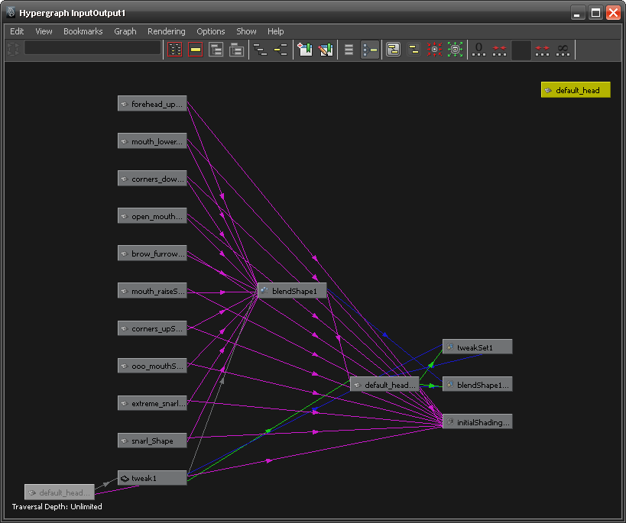
Maya Hypergraph

Slide 8
Dependency Graph
Notes:
In a complex Maya scene, this is more like what you’ll end up with

Slide 9
Dependency Graph
A collection of nodes that transmit data through connected attributes
A
A.a
B
C
B.b

Slide 10
Dependency Graph
Example: revolving surface
Curve
Revolve
Surface
Notes:
Everybody knows where to look at Dependency Graph, right? Hypergraph
It is a graphical representation of the relationship between objects in current Maya scene.

Slide 11
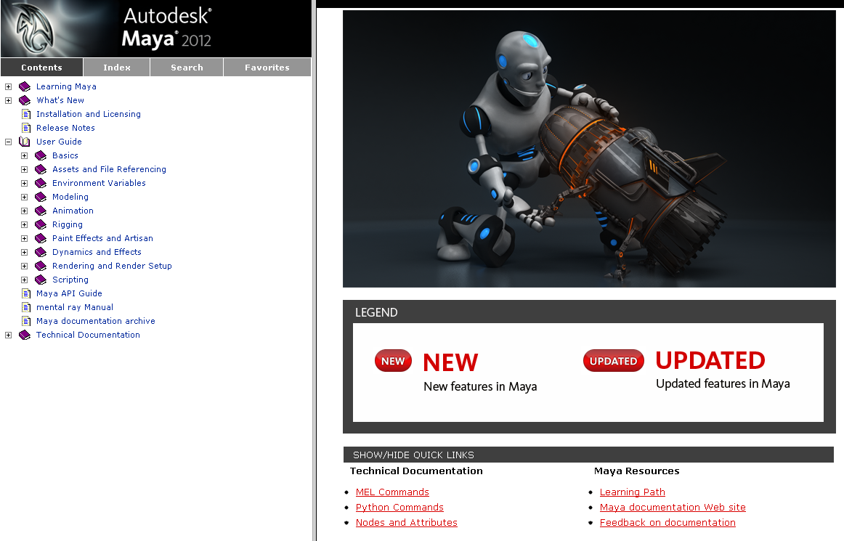
Maya Node Documentation

Slide 12



DAG (Directed Acyclic Graph)
DAG nodes are special dependency graph nodes that form a scene hierarchy (parenting).
Car
seats
frame
tires
Notes:
Where to find DAG node: Hypergraph: - DAG
There is a special type of DG nodes, called “DAG”nodes. Define parent-child relationship

Slide 13
Command Architecture

Slide 14
Maya Command Architecture
Maya GUI
Maya Commands
Maya Core
OS
Notes:
On top of that is MEL commands layer, command engine layer. User can send MEL commands to Maya directly through this layer. This layer talk to Maya core to finish user-specified tasks.

Slide 15
Maya Embedded Language
MEL is the language of the Command Architecture
MEL is deeply embedded in the Maya Architecture
Maya Command Examples
select –replace myCone; // Replaces selection list with myCone.
connectAttr myCone.ty mySphere.ty; // Connects translateY attributes
headsUpDisplay –s 0 –b 0 –label “myHUD” myHUD;
To view the syntax for a given command use `help`
help headsUpDisplay;
// Result:
// Synopsis: headsUpDisplay [flags] String
// Flags:
// -e -edit
// -q -query
…

Slide 16
Maya Command Documentation

Slide 17
Create, Query and Edit Mode
Create Mode
Query Mode
window -query -widthHeight $window;
Edit Mode
window -edit -widthHeight 100 100 $window;
string $window = `window -title “TestWindow"
-iconName “testWnd" -widthHeight 200 55`;
showWindow $window;

Slide 18
Execute MEL commands
Command Line & Script Editor
Record MEL commands
Script Files: *.mel
Script Path: MAYA_SCRIPT_PATH
whatIs: to find a global proc or internal built-in command
source: let Maya know a script has updated
rehash: let Maya rescan the script paths

Slide 19
Customizing Vital Concepts

Slide 20
What do we need API for?
New Custom Node
Notes:
How to take advantage of DG design and extend Maya’s functionality

Slide 21
What do we need API for?
Custom Maya Command
Maya GUI
Maya Commands
Maya API
Maya Core
OS

Slide 22
Maya API Introduction

Slide 23
What is an API?
Application Programming Interface
It is a contract between the server application exposing the API and the client using that API.
Client
API
MyApp.exe
1. Source code 2. Static library
3. DLL 4. EXE

Slide 24
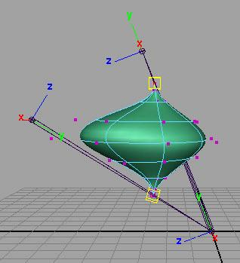
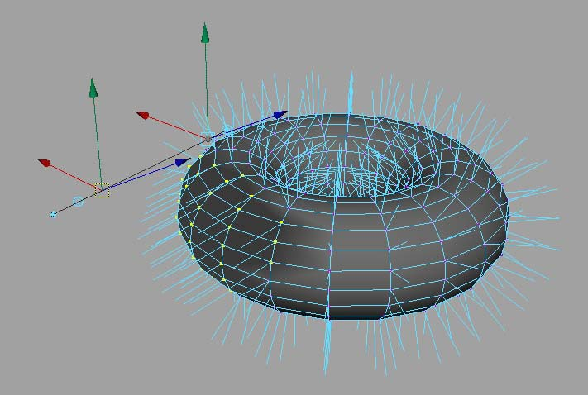


But really, what can you do?
Commands
Dependency Graph Nodes
Deformers
Shaders
Manipulators
Shapes
Etc.
Tools /Contexts
File Translators
Automation

Slide 25
API Design Overview
A tight wrapper around Maya’s internal architecture
An abstract layer, which separates Maya internal code from external plug-in developers
External Developer
Maya API
Maya Core
Notes:
One huge benefit of this is that it makes Maya very flexible and extensible,
Also it protects Maya from possible misuse.

Slide 26
Plug-in Development

Slide 27
Plug-in Development Environment
Operating System | Plug-in Type | Compiler
Windows | .mll | Visual Studio 2008 with Service Pack 1
Linux | .so | gcc 4.1.2
Mac | .bundle | XCode 2.4.1 with gcc 4.0.1 Universal build binaries: powerPC, IntelMac
all platforms | .py | Python 2.6 kernel

Slide 28
Maya Python API Plug-ins
Load/Unload Plug-in commands extended for Python
Python plug-in read into a dictionary
Searches for entry points
Action runs scripts
Required entry points
initializePlugin
uninitializePlugin

Slide 29
Maya Plug-in Architecture
initializePlugin() and uninitializePlugin() as entry point and exit point
Maya API
initializePlugin
uninitializePlugin
Maya
loadPlugin
unloadPlugin

Slide 30
Maya Python API Plug-ins
Define a Python module containing initializePlugin(), uninitializePlugin() functions
import necessary modules
def initializePlugin()
def uninitializePlugin()
class implementations…
def creator()

Slide 31
1. Import Necessary Modules
Classically, we import what we want at the top of the module
import maya.OpenMaya as OpenMaya
import maya.OpenMayaMPx as OpenMayaMPx
import sys

Slide 32
2. initializePlugin()
Scripted plug-in initialization
# Initialize the script plug-in
def initializePlugin(mobject):
mplugin = OpenMayaMPx.MFnPlugin(mobject)
try:
mplugin.registerCommand( “foo”, cmdCreator )
except:
sys.stderr.write( "Failed to register command: %s\n" % kPluginCmdName )
raise

Slide 33
3. uninitializePlugin()
Scripted plug-in uninitialization
def uninitializePlugin(mobject):
mplugin = OpenMayaMPx.MFnPlugin(mobject)
try:
mplugin.deregisterCommand( “foo” )
except:
sys.stderr.write( "Failed to unregister command: %s\n" % kPluginCmdName )
raise

Slide 34
4. Class Implementations
Class Implementation: Similar setup to C++ plug-ins
class scriptedCommand(OpenMayaMPx.MPxCommand):
def __init__(self):
OpenMayaMPx.MPxCommand.__init__(self)
def doIt(self,argList):
print "Hello World!"
Parameter: self same as this in C

Slide 35
5. creator()
Creator Functions is similar to C++ plug-ins
Pass Python function to MFnPlugin methods
…
mplugin.registerCommand( “foo”, cmdCreator )
…
Ownership is important

Slide 36
5. creator()
OpenMayaMPx.asMPxPtr() transfer ownership of newly-created command or node objects to Maya
class scriptedCommand(OpenMayaMPx.MPxCommand):
….
def cmdCreator():
return OpenMayaMPx.asMPxPtr( scriptedCommand() )

Slide 37
Deployment of a Plug-in
Maya Plug-in Manager
Environment Variable: MAYA_PLUG_IN_PATH
Put your plug-ins into:
C:\My Documents\maya\2012\plug-ins
Add your custom plug-in path
putenv MAYA_PLUG_IN_PATH $destPluginPath;
Maya.env or userSetup.mel
string $currentPluginPath = `getenv MAYA_PLUG_IN_PATH`;
string $destPluginPath = $currentPluginPath + ";C:/My Documents";
putenv MAYA_PLUG_IN_PATH $destPluginPath;

Slide 38
How to Load a Plug-in
Load from Plug-in Manager or Maya commands:
maya.cmds.loadPlugin( "foo.py" )
maya.cmds.unloadPlugin("foo.py" )

Slide 39
Re-iterate: Generic Plug-in Algorithm
Define initializePlugin and uninitializePlugin functions
Register and unregister the proxy classes (MPxCommand, MPxNode, etc…) within these functions. ie register the custom commands and custom nodes being defined by the plugin
Implement creator and initialize methods (as required) which Maya calls to build the proxy classes
Implement the required functionality of the proxy classes. This requires importing the necessary modules

Slide 40
Summarize Main Methods
initializePlugin allows Maya to load a plugin.
uninitializePlugin allows Maya to unload a plugin
Both must be defined
Creator functions are used to instantiate a derivative of a proxy class (MPxNode, MPxCommand) and transfer its ownership to Maya
Node initialization functions are used for derivatives of MPxNode in order to define their attributes and initialize their values
Use try … except statements in order to trap errors and avoid crashing Maya. As a rule of thumb use them around API functions that return MStatus object

Slide 41
Autodesk

