Slide 1

Dependency Graph and Nodes
Kristine Middlemiss, Senior Developer Consultant
Autodesk Developer Network (ADN)

Slide 2

Agenda
Components of Maya Node and API classes
Building Maya Custom Node with MPxNode

Slide 3
Dependency Graph
Notes:
In a complex Maya scene, this is More like what you’ll end up with

Slide 4
What does a node do?
Know its own attributes
Store data efficiently in “datablocks”
Accept input, compute, generate output
Connect with other nodes through connections

Slide 5
What does a node do?
Accept input data, compute output data
input attributes
output attributes

Slide 6
Maya Node Structure
Maya Node
Attributes
DataBlock DataHandle
Plugs

Slide 7
Attributes

Slide 8
Attributes
Maya Node
Attributes

Slide 9
Attributes
Describe data that belongs to nodes of a given type
Smiley Node Attribute
Float “rotation” Float “diameter”
Int32 “numEyes”

Slide 10
Attributes
Attributes are shared among nodes of the same type and all derived node types
Node A
Smiley Node Attribute
Float “rotation” Float “diameter”
Int32 “numEyes”
Node B

Slide 11
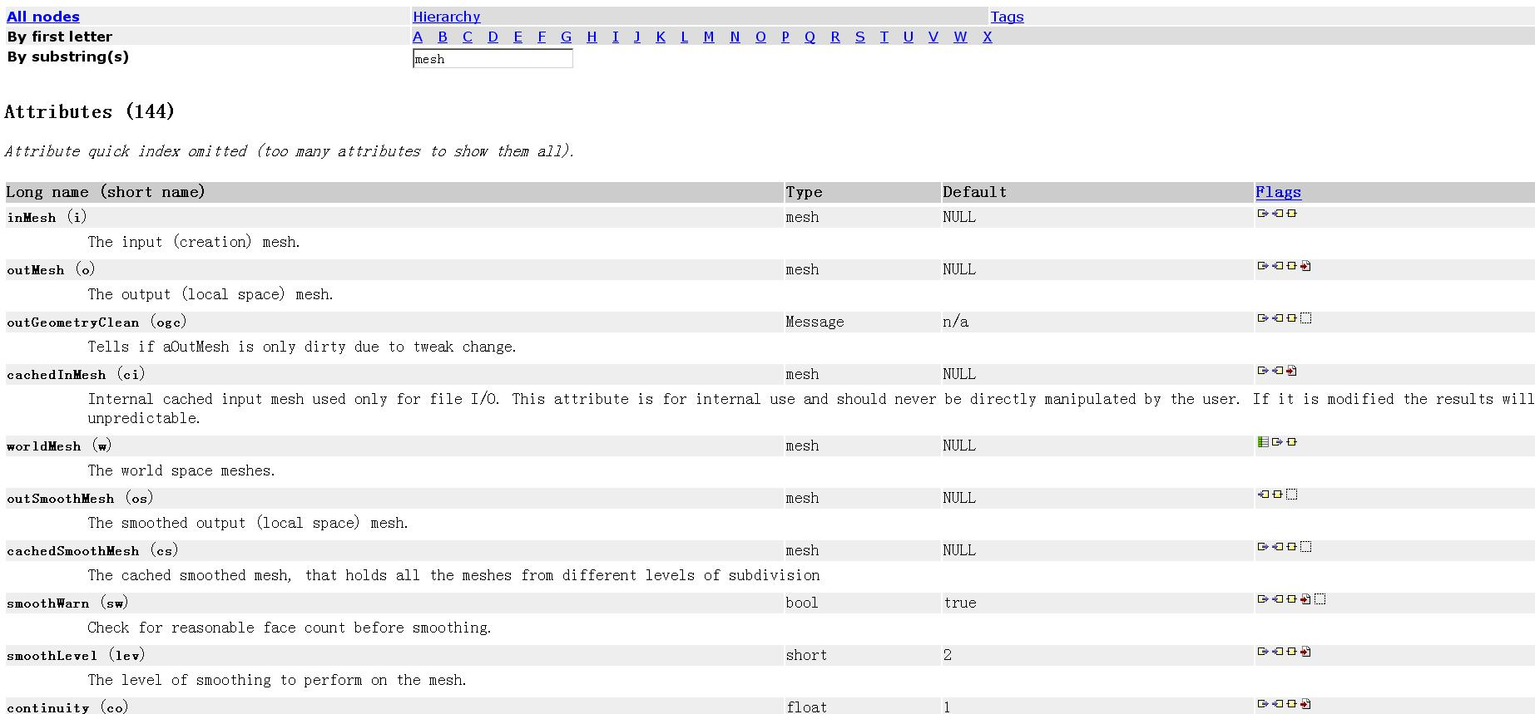
Node and their Attributes
Name
Data Type
Structure
Property

Slide 12
Attributes
Define the interface of the node including
Names of the inputs and outputs
Data accepted by the inputs and outputs
Structure of the inputs and outputs
Properties of the inputs and outputs

Slide 13
Attribute Data Types
Basic
Numeric (float, int,etc.)
String
Matrix
Etc.
Complex
Mesh
NurbsSurface
Generic (accepts more than one type)
Etc.

Slide 14
Attribute Structures
Attribute Data Types will fit into one of these four:
Simple
Compound
Array
Compound Array

Slide 15
Attribute Structures
Simple
handles a single piece of data
Example: polySphere1.radius
Compound
1 or more attributes grouped under a parent attribute
Example: translate is a compound with children (tx, ty, tz)
t
tx
ty
tz

Slide 16
Attribute Structures
3. Array (also referred to as a Multi)
An array of simple data
Example: pSphereShape1.face
face
0
1
2
...
n-1
n

Slide 17
Attribute Structures
4. Compound array
An array of compound data
Example: mesh colors with children (colorR, colorG, colorB, colorA)
colors
0
1
2
...
n-1
n
colorR
colorG
colorB
colorA

Slide 18
Each Attribute has Properties
By default, attributes are:
Readable.
Writable.
Connectable.
Storable.
Cached.
Not arrays.
Have indices that matter.
Do not use an array builder.
Not keyable.
Not hidden.
Not used as colors.
Not indeterminant.
Set to disconnect behavior kNothing.

Slide 19
Attribute Properties
Readable
Attribute can be connected as a source
Example: polyCylinder1.output
Writable
Attribute can be connected as a destination
Example: pCylinderShape1.inMesh
Read/Write
Attribute can be connected as both a source and a destination
Example: pCylinder1.tx

Slide 20
Attribute Affects
Maya has no concept of input and output attribute
Once attributes are created on a node, an “attributeAffects” relationship needs to be setup to denote a dependency (indicating input and outputs)
D
radius
volume
setAttr D.radius 5
attributeAffects(radius,volume)

Slide 21
API Classes for Attributes
Maya Node
Attributes
MFnAttribute

Slide 22
API Classes for Attributes
Base Class: MFnAttribute
Most Common Used Child Classes
MFnNumericAttribute
MFnCompoundAttribute
MFnTypedAttribute
MFnMatrixAttribute
MFnGenericAttribute

Slide 23
Steps to Create an Attribute
Define a Python function containing these steps:
create attribute using MFnAttribute*
set the attribute properties
add to the node
setup any attribute affects relationships

Slide 24
MFnNumericAttribute
Function set for simple numeric value attribute
import maya.OpenMaya as OpenMaya
….
nAttr = OpenMaya.MFnNumericAttribute()
simpleNode.input = nAttr.create( "input", "in", OpenMaya.MFnNumericData.kFloat, 0.0 )
nAttr.setWritable(1)
nAttr.setStorable(1)
nAttr.setKeyable(1)
simpleNode.addAttribute(simpleNode.input)
simpleNode.attributeAffects(simpleNode.input, <output> )
Notes:
Supposing this node class name is simpleNode

Slide 25
Plugs

Slide 26
Plugs
Maya Node
Attributes
Plugs
MFnAttribute

Slide 27
Plugs
Pointer to an attribute on a specific node (ie. a specific instance of an attribute)
Node type definition
Actual instance of a node
myNode1
myNode2
myNode
myPlug1(myNode1, myAttr)
myAttr
myPlug2(myNode2, myAttr)
Notes:
.

Slide 28
Plugs
Plugs can be used to:
query a value
set a value
create a connection
remove a connection
query connection(s)
Does not store attribute data

Slide 29
API Classes for Plugs
Maya Node
Maya Node
Attributes
Plugs
MFnAttribute
MPlug

Slide 30
API Class for Plug: MPlug
Attribute and Node Operations:
MPlug::MPlug (const MObject &node, const MObject &attribute)
MObject MPlug::attribute ( MStatus * ReturnStatus)
MObject MPlug::node ( MStatus * ReturnStatus)
Operations for Compound Attribute and Connections:
MPlug MPlug::parent ( MStatus * ReturnStatus)
MPlug MPlug::child (unsigned int index, MStatus *ReturnStatus)
bool MPlug::connectedTo ( MPlugArray & array, bool asDst, bool asSrc, MStatus * ReturnStatus = NULL )
Manipulation of Data
MStatus MPlug::getValue ( double & val, MDGContext & ctx )
MStatus MPlug::setValue ( double val )

Slide 31
Datablocks

Slide 32
Datablocks
Maya Node
Attributes
Datablock Datahandle
Plugs
MFnAttribute
MPlug

Slide 33
Datablocks
Node stores data for every attribute (arrays are special, more details later)
Attribute
Node
Datablock

Slide 34
Datablocks & Datahandles
Datablock is the actual storage for the input and output data of a node
For every non-array attribute, datablock stores:
Data
Dirty/clean status
Data handles are lightweight pointers into the data in the datablock

Slide 35
Datablocks
Nodes hold an array of datablocks
One datablock for a normal evaluation (using current time)
More datablocks for timed contexts (specified times)
Normal
t=4
t=12

Slide 36
Maya Node Structure: API Classes
Maya Node
Attributes
Datablock Datahandle
Plugs
MFnAttribute
MDataBlock
MDataHandle
MPlug

Slide 37
API Classes for Datablock
MDatablock
only valid during compute()
Pointers to data block should not be retained after compute()
MDataHandle
a smart pointer for information contained in data block
double & MDataHandle::asDouble ( )
void MDataHandle::setDouble ( double )
MStatus MPxNode::compute(const MPlug& plug, MDataBlock& dataBlock)
MDataHandle MDataBlock::inputValue(const MPlug & plug, MStatus * ReturnStatus)
MDataHandle MDataBlock::outputValue ( const MPlug & plug, MStatus * ReturnStatus)
MDGContext MDataBlock::setContext (const MDGContext & ctx )

Slide 38
Maya Node Structure: API Classes
MPxNode
Maya Node
Attributes
Datablock Datahandle
Plugs
MFnAttribute
MDataBlock
MDataHandle
MPlug

Slide 39
Custom Node Implementation

Slide 40
Custom DG Nodes in Maya
Entirely new operations
MPxNode
Extend existing Maya nodes
MPxDeformerNode
MPxFieldNode
MPxEmitterNode
MPxSpringNode
MPxIkSolverNode
MPxHwShaderNode

Slide 41
MPxNode Registration
Every node requires a unique identifier.
MTypeId myNode::id( 0x80000 );
For plug-ins that you intend to share between sites
Will require a globally unique ID issued to you by Autodesk.
IDs are allocated in blocks of 64/128/256/512.
Contact ADN M&E for unique global IDs.
0 – 0x7ffff (524288 ids)
0x80000 – 0xfffff
0x100fff – 0xffffff
Internal Use
DevKit Examples
Global IDs

Slide 42
MPxNode Registration
To register your node in Maya:
To deregister your node
kPluginNodeTypeName = "simpleNode"
simpleNodeId = OpenMaya.MTypeId(0x80001)
def initializePlugin(mobject):
mplugin = OpenMayaMPx.MFnPlugin(mobject)
try:
mplugin.registerNode( kPluginNodeTypeName, simpleNodeId, nodeCreator, nodeInitializer )
except:
sys.stderr.write( "Failed to register node: %s" % kPluginNodeTypeName )
raise
def uninitializePlugin(mobject):
mplugin = OpenMayaMPx.MFnPlugin(mobject)
try:
mplugin.deregisterNode( simpleNodeId )
except:
sys.stderr.write( "Failed to deregister node: %s" % kPluginNodeTypeName )
raise

Slide 43
MPxNode Creator Function
The creator method is called to return a new instance of the node
def nodeCreator():
return OpenMayaMPx.asMPxPtr( simpleNode() )

Slide 44
MPxNode initialize Function
Reminder || Override this method to define the attribute interface for your node:
create the attribute
set the attribute’s flags
add the attribute to the node
define attribute relationships
Inherit attributes if necessary

Slide 45
Attribute Operations
MStatus MPxNode::addAttribute ( const MObject & attr )
MStatus MPxNode::attributeAffects ( const MObject & whenChanges, const MObject & isAffected )
MStatus MPxNode::inheritAttributesFrom ( const MString & parentClassName)
MPxNode
Custom Node A
Custom Node B

Slide 46
MPxNode
myNode
myOutput
myInput
MPxNode::initialize()
myOutputTwo
def nodeInitializer():
nAttr = OpenMaya.MFnNumericAttribute()
simpleNode.myInputAttr = nAttr.create( "myInput", “mi", OpenMaya.MFnNumericData.kFloat, 1.0 )
nAttr.setStorable(1)
simpleNode.myOutputAttr = nAttr.create(“myOutput”, “mo”, OpenMaya.MFnNumericData.kFloat, 1.0)
nAttr.setStorable(1)
simpleNode.myOutputAttrTwo = nAttr.create(“myOutputTwo”, “motwo”, OpenMaya.MFnNumericData.kFloat, 1.0)
nAttr.setStorable(1)
simpleNode.addAttribute( simpleNode.input )
simpleNode.addAttribute( simpleNode.myOutputAttr)
simpleNode.addAttribute( simpleNode.myOutputAttrTwo)
simpleNode.attributeAffects(simpleNode.myInputAttr, simpleNode.myOutputAttr);
MPxNode::addAttribute()
MPxNode::attributeAffects()

Slide 47
MPxNode
MPxNode::compute()
called when the node is asked to evaluate an output
def compute( self, plug, dataBlock):
if ( plug == simpleNode.myOutputAttr):
# your compute algorithm for output1
if (plug = = simpleNode.myOutputAttrTwo):
# your compute algorithm for output2
getAttr myNode1.myOutput;
myNode
myOutput
myInput
myOutputTwo

Slide 48
MPxNode
MPxNode::compute()
def compute(self,plug,dataBlock):
# …
if( plug == simpleNode.myOutputAttr ):
inputData = dataBlock.inputValue( simpleNode.myInputAttr )
inputValue = inputData.asFloat()
outputHandle = dataBlock.outputValue( simpleNode.myOutputAttr )
outputHandle.setFloat(inputValue * 2 );
dataBlock.setClean( plug )
return OpenMaya.MStatus.kSuccess
if (plug = = simpleNode.myOutputAttrTwo):
#…
return OpenMaya.MStatus.kUnknownParameter
myOutput = myInput * 2;
myNode
myOutput
myInput
myOutputTwo

Slide 49
OpenMaya.kUnknownParameter
One gotcha with MStatus codes as exceptions
Some DG routines return MStatus::kUnknownParameter
(e.g. compute)
In Python, this DOES NOT map to an exception
MStatus::kUnknownParameter maps to the Python constant maya.OpenMaya.kUnknownParameter

Slide 50
Workshop Session

Slide 51
Example: simpleNode
In this example, we implement a custom node with two attributes: “input”, ”output”. Whenever the “input” attribute value changes, the “output” attribute will always be the input value multiplied by 2.

Slide 52
Example: sinNode
In this example, we implement a custom node with two attributes: “input”, ”output”. Whenever the “input” attribute value changes, the “output” attribute will calculate the sin of the number.
Don’t forget to import the math module

Slide 53
Example: transCircleNode
In this example, we implement a custom node transCircleNode, it takes in a compound input translate attribute “inputTranslate”, and output a compound translate attribute “outputTranslate”, the value of outputTranslate is the value of inputTranslate plus the value of a circular movement based on current time frame.
Use the MEL script provided “transCircleNode.mel” to set and test your new node

Slide 54
Autodesk

