Slide 1

Miscellaneous Classes and Tools
Kristine Middlemiss, Developer Consultant
Autodesk Developer Network (ADN)

Slide 2
Agenda
DG / DAG Operations
Maya Callback System
Software Shader
Custom Translator
Notes:
Easy to learn and you can use them right away
This session is a “quick start” to write some tools that may be useful
We are not going to show full versions of code here, but just to give you an idea if you want to implement any of these, what functions you should be using.

Slide 3

DG/ DAG Operations

Slide 4
MDGModifier
Used to create remove, and edit nodes in the DG.
This class automatically provides undo and redo for all it’s operations, opposed to implementing all the undo your self.
When each of the functions for editing the DG is called, a record of it is stored from this class.
Important functions in this class:
doIt()
undoIt()

Slide 5
DG/DAG Operations
MDGModifier / MDagModifier:
Facilitate the creation or deletion of nodes and connections
Provides undo/redo support
MDagModifier: dag node creation/parenting
Holds a list of operations. Operations are queued as they are called.
Does not perform these operations until MDGModifier::doIt() call is issued.

Slide 6
MDGModifier code structure
All these operations won’t get executed until dgMod.doIt()
To undo all these operations, dgMod.undoIt()
import maya.OpenMaya as OpenMaya
dgMod = OpenMaya.MDGModifier()
dgMod.createNode ( “transform”)
dgMod.commandToExecute(“sphere -n sphere1 -r 1;”)
dgMod.connect(.....)
.....
dgMod.doIt()
Notes:
DAG Modifier works the same way

Slide 7
Example: setUpTransCircle
transCircle node
setUpTransCircle: In this example, we create a custom command, and simulate the same functionality of the MEL operations we used in “transCircleNode” project, which set up the transCircle node.
Here are the commands you need to simluate:
createNode transCircle -n circleNode1;
sphere -n sphere1 -r 1;
sphere -n sphere2 -r 2;
connectAttr sphere2.translate circleNode1.inputTranslate;
connectAttr circleNode1.outputTranslate sphere1.translate;
connectAttr time1.outTime circleNode1.input;

Slide 8
Maya Callback System
Maya callbacks allow the user to register functions against specific Maya events.
Maya callback classes:
MMessage: base class, remove callback, query callbacks
MDGMessage - node added, removed, connected
MNodeMessage - attribute callbacks
MSceneMessage - before/after: file open, import, export, etc.
MUiMessage - UI objects
MEventMessage - idle, timeChanged, undo, redo, etc.
MConditionMessage - specific conditions
MModelMessage - model related messages

Slide 9
MMessage and Callback Functions
OpenMaya.MSceneMessage.addCallback (OpenMaya.MSceneMessage,
, clientData)
def MMessage_MBasicFunction (args)
MMessage_MBasicFunction
OpenMaya.MSceneMessage.kAfterOpen
OpenMaya.MSceneMessage.addCallback ( OpenMaya.MSceneMessage.kAfterOpen, afterFileOpenCallback)

Slide 10
MMessage and Callback Functions
OpenMaya.MSceneMessage.addCallback ( OpenMaya.MSceneMessage, Mmessage_MBasicFunction , clientData )
Id = OpenMaya.MCallbackId()
def afterFileOpenCallback(clientData):
print “Come to this afterFileOpenCallback function\n”
def MyCmd_addCallback():
OpenMaya.MSceneMessage.addCallback(OpenMaya.MSceneMessage.kAfterOpen, afterFileOpenCallback)
id =
def MyCmd_removeCallback():
OpenMaya.MMessage.removeCallback( id )
Notes:
All callbacks that are registered by a plug-in must be removed by that plug-in when it is unloaded. Failure to do so will result in a fatal error.

Slide 11
Abort operations
OpenMaya.MCallbackId OpenMaya.MSceneMessage.addCheckCallback ( OpenMaya.MSceneMessage, MMessage_MCheckFunction, clientData )
retCode: Result of the function. Provide programmer with options to abort current operations by return false through this variable.
In Python use OpenMaya.MScriptUtil.setBool(retCode, True) since python can’t handle pointer or reference.
OpenMaya.MSceneMessage.kBeforeOpenCheck
def MMessage_MCheckFunction (retCode, clientData)

Slide 12
Abort Operations
def beforeOpenCheckCallback(retCode, clientData):
#Do custom operations, for example, check file versions...
print “Error: file version is not correct, abort opening operations\n”
OpenMaya.MScriptUtil.setBool(retCode, False)
def MyCmd_addCallback():
OpenMaya.MSceneMessage.addCheckCallback(OpenMaya.MSceneMessage.kBeforeOpenCheck, beforeOpenCheckCallback)

Slide 13
Example: sceneMsgCmd
sceneMsgCmd: this example register several callbacks for scene messages such as MSceneMessage::kBeforeOpen and MSceneMessage::kAfterNew, it also shows how to abort the operation by setting retCode.
Notes:
sceneMsgCmd: checked three msgs:
MSceneMessage::kBeforeOpen
MSceneMessage::kAfterNew
MSceneMessage::kBeforeSaveCheck
Use two MSceneMessage::addCallback, MSceneMessage::addCheckCallback
Where callback for kBeforeSaveCheck abort the save operations

Slide 14
Shading Network and Software Shader
Different types of software shaders
Shading group
Custom Software Shader

Slide 15
Software Shading Node
DG Nodes to form Shading Networks
Different Types of Software Shading Nodes:
Type | Frame
Textures | 2D Textures, 3D Textures Environment Textures
Materials | Surface Materials, Volumetric Materials Displacement Materials
Lights | Lights
Utilities | General Utilities Color Utilities Particle Utilities Image Planes Glow

Slide 16
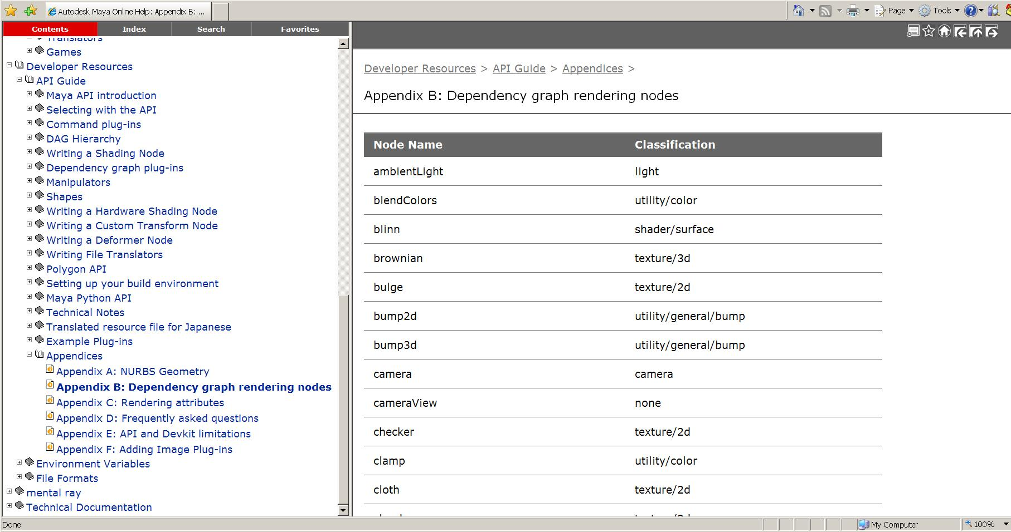
Shading Nodes List
Developer Resources -- API Guide -- Appendices – Appendix B: Dependency Graph rendering Nodes

Slide 17
Shading Group
An Object Set
A logical grouping of an arbitrary collection of objects, attributes or component of objects
Membership is defined by connections:
whole object is in set:
node.instObjGroups → objectSet.dagSetMembers
A part of components are in set:
node.objectGroups → objectSet.dagSetMembers
MEL command for “objectSet” node
sets -e -add blinn1SG pCubeShape2;
sets –q -size blinn1SG;
Notes:
Basically anything that can be selected using the 'select' command can be added to an objectSet.

Slide 18
Shading Group (Renderable Sets)
Only renderable elements can be added into Shading Group
sets –q –renderable blinn1SG; //always return true
Every shader has to be connected with a shading group
Connection point between geometry and shader
shadingNode -asShader blinn;
// Result: blinn1 //
sets -renderable true -noSurfaceShader true -empty -name blinn1SG;
// Result: blinn1SG //
connectAttr -f blinn1.outColor blinn1SG.surfaceShader;
// Result: Connected blinn1.outColor to blinn1SG.surfaceShader. //
Notes:
during the rendering process, renderer just walk around and work with these different groups
Those input attribute values have already pre-computed per sample, if you need its value, you just request it from the datablock.

Slide 19
Rendering Network
Pre-computed Input attribute
renderer
Shader
Output attribute requested by shading group
Shading Group
geometry
Geometry information

Slide 20
Custom Shading Node
Registration:
MFnPlugin::registerNode ( const MString & typeName, const MTypeId & typeId, MCreatorFunction creatorFunction, MInitializeFunction initFunction, MPxNode::Type type = MPxNode::kDependNode, )
const MString * classification
Type | Frame | Classification String
Textures | 2D Textures, 3D Textures Environment Textures | “texture/2d” “texture/3d” “texture/environment”
Materials | Surface Materials, Volumetric Materials Displacement Materials | “shader/surface” “shader/volume” “shader/displacement”
Lights | Lights | “light”
Utilities | General Utilities Color Utilities Particle Utilities Image Planes Glow | “utility/general” “utility/color” “utility/particle” “imageplane” “postprocess/opticalFX”

Slide 21
Custom Shading Node
Code Structure:
myShaderId = OpenMaya.MTypeId(0x00001)
class myShader (OpenMayaMPx::MPxNode):
def __init__(self):
OpenMayaMPx.MPxNode.__init__(self)
def compute(self,plug,data):
# code ...
def myShader_creator():
return OpenMayaMPx.asMPxPtr( myShader() )
def myShader_initialize():
#Input attributes
# …….
#Output attributes
# …….

Slide 22
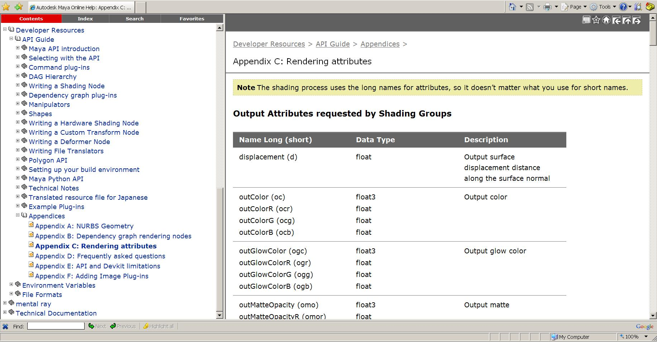
Software Shading Node
Rendering Attributes

Slide 23
Shading node icons for Hypershade
XPM format: 32x32
Icon name: preface "render_".
lambertShader.mll: render_lambertShader.xpm
XBMLANGPATH: Put the icons in one of the directories specified in your XBMLANGPATH.

Slide 24
Custom Translator
Transmitting data in your production pipeline
Define custom file format
Decide what contents you want to export
Plug-in vs. Standalone Application
Notes:
This section is just a brief overview of this class, just to let you aware what functions you need to implement, but wont’ go into details… Because writing a completely working translator is whole lot more code than we can cover today.. Just show your skeleton…./ structure
You need to sit with your animators to talk about what they want to export, otherwise you will end up wasting a lot of time doing a lot of work with them unhappy (grumpy) at what they got when using your translator.
It will cause a lot of frustrations between you and your artists.

Slide 25
Custom Translator Plug-in
Derived from MPxFileTranslator :
Maya consistent UI (File->Export, File->Import)
register your extension with Maya
implement a reader and writer in the same plug-in
Register MSceneMessage callbacks to execute operations before/after import/export
MSceneMessage::kBeforeExport
MSceneMesage::kAfterExport
MSceneMessage::kBeforeImport
MSceneMessage::kAfterImport

Slide 26
Devkit Example: lepTranslator (C++)
Adds the new file format “Lep” to the file manipulation dialogs
An “Lep” file is an ASCII file with a first line of “<LEP>”. The remainder of the file contains MEL commands that create one of the primitives: nurbsSphere, nurbsCone and nurbsCylinder, as well as move commands to position them.

Slide 27
MPxFileTranslator
Custom file format:
static MString myfileExt(“lep”);
MString MPxFileTranslator::defaultExtension()
return custom file format
MPxFileTranslator::identifyFile()
determine whether it is the type supported by the translator

Slide 28
MPxFileTranslator: read & write
MPxFileTranslator::canBeOpened()
decide whether it is an importer or exporter
bool MPxFileTranslator::haveReadMethod()
MStatus MPxFileTranslator::reader ( const MFileObject & file, const MString & optionsString, MPxFileTranslator::FileAccessMode mode )
Mode: the method used to read the file – open or import
bool MPxFileTranslator::haveWriteMethod()
MStatus MPxFileTranslator::writer ( const MFileObject & file, const MString & optionsString, MPxFileTranslator::FileAccessMode mode )
Mode: the method used to write the file - save, export, or export active

Slide 29
Example: lepTranslator
magic =MString (“”)
class LepTranslator (OpenMayaMPx.MPxFileTranslator):
def __init__ (self):
OpenMayaMPx.MPxFileTranslator.__init__(self)
def reader ( mfileobject, optionsString, fileAccessMode):
#code …
def writer ( mfileobject, optionsString, fileAccessMode):
#code …
def haveReadMethod ():
return True
def haveWriteMethod ():
return True
def defaultExtension ():
def canBeOpened():
def identifyFile (fileName, buffer, size):
def getPosition(transform, tx, ty, tz ):

Slide 30
MPxFileTranslator
Register custom file translator:
def initializePlugin( mobject ):
mplugin = OpenMaya.MFnPlugin (mobject)
try:
mplugin.registerFileTranslator( "Lep", "lepTranslator.rgb", LepTranslator_creator,
"lepTranslatorOpts", "showPositions=1", True )
except:
raise

Slide 31
UI for MPxFileTranslator
Export Options: a text string with format:
varName1=value1;varName2=value2;...
In lepTranslator example, the option string is “showPositions = 1” or “showPositions = 0”
lepTranslatorOpts.mel
global proc int lepTranslatorOpts ( )
{
……
}

Slide 32
Autodesk

