Slide 1


Maya Programming Introduction
Kristine Middlemiss, Senior Developer Consultant
Autodesk Developer Network (ADN)
© 2012 Autodesk
1

Slide 2
Session Agenda
• Why use Programming
• Overview of Maya Languages
• Uses for Python in Maya
• Help Documentation
• Navigating the Installation Folder
• Looking at how the documentation works
• How to execute Python in Maya
• Logging Bugs and Suggestion Features
• Available Resources
© 2012 Autodesk
2

Slide 3

Let’s Get Started
© 2012 Autodesk
3

Slide 4
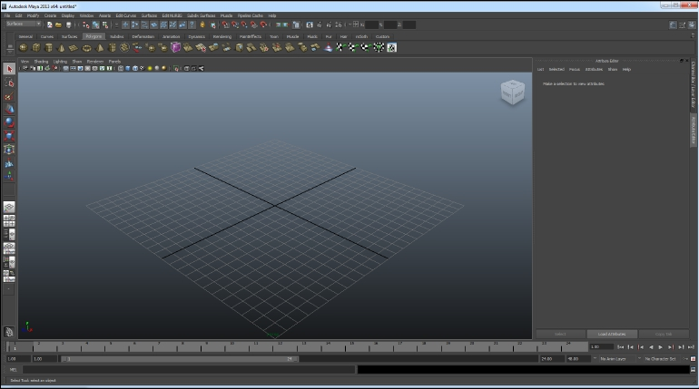
Welcome to Autodesk Maya 2013
© 2012 Autodesk
4

Slide 5
Why use Programming in Maya
• Automate repetitive, time-consuming tasks and
extend features
• Uses popular, easy-to-use Python scripting
language
• The C++ and Python API to create custom tools
and features that plug directly into Maya
• Create project-specific functionality, for specific
workflows and requirements.
© 2012 Autodesk
5

Slide 6
Overview of Maya Languages
© 2012 Autodesk
6

Slide 7
Programming In Maya Possibilities
Available programming language options in Maya:
1.
2.
3.
Maya Embedded Language (MEL)
C++
Python scripting
© 2012 Autodesk
7

Slide 8
MEL Scripting
• MEL (Maya Embedded Language) is a scripting language
at the heart of Maya.
• Maya’s user interface is created using MEL, and MEL
provides an easy way to extend the functionality of Maya.
• Everything you can do using Maya’s graphical interface
can be automated and extended using MEL.
• Familiarity with MEL can deepen your understanding of
and expertise with Maya.
© 2012 Autodesk
8

Slide 9
Python Scripting & API
• Python is a powerful and popular object-oriented scripting
language.
• With the introduction of Python into Maya 8.5, we now
provide Python support for calling the Maya commands.
• In addition, we support the Maya Python API which allows
developers to write Maya plug-ins and stand-alone
applications without having to learn C++.
• This integration of Python in Maya empowers production
facilities to better integrate Autodesk Maya into your
production pipeline.
© 2012 Autodesk
9

Slide 10
Maya C++ API
• The Maya API increases Maya’s power, customizing and
extending Maya in many ways that you never thought
possible.
• It provides functionality for querying and changing the
Maya model along with the ability to add new Maya
objects to the Maya model.
• You can use the Maya API to implement two types of
code resources: plug-ins which extends the functionality
of Maya, and standalones such as console applications
which can access and manipulate a Maya model.
© 2012 Autodesk
10

Slide 11
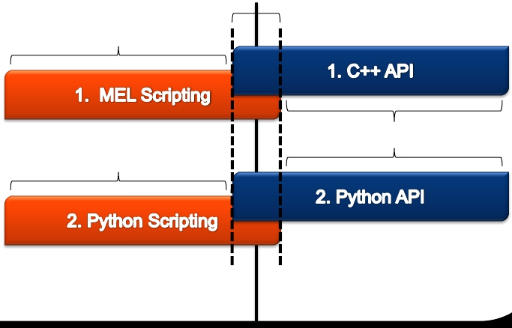
How they fit in Maya
SCRIPTING CHOICES Overlapping
Functionality
Maya Command Docs
API CHOICES
API Class Docs*
Python Command Docs
Maya Application
© 2012 Autodesk
*This is changing soon
11

Slide 12
Advantages of Scripting
• Easier learning curve
• No resources needed to start developing, such as Visual
Studio
• Quick prototyping for tools
• Platform Independent
• Tons of free modules (Python)
• Easily move between API and Scripting capabilities in
Maya all with in the same plug-in or script (Python)
© 2012 Autodesk
12

Slide 13
Advantages of C++ API
• Compiled, no source code discloser
• Can be 10+ faster than Python
• More classes and function exposed
• More detailed manipulation of lower level core
• More devkit samples and resources
© 2012 Autodesk
13

Slide 14
Why Python?
▪
▪
▪
▪
▪
Customers Requested
Object Oriented
Open Source
Mostly Interpreted no Compiler Needed
Used for Both Standalone programs and Scripting Applications
Advantages
▪
▪
▪
Quicker Development Cycle
Extremely Portable
No need to recompile code every release
Disadvantages
▪
▪
© 2012 Autodesk
Slower than a fully compiled language like C++
Discloser
14

Slide 15
Others who use Python
Other Autodesk Products:
• MotionBuilder: real-time animation product.
• Showcase: Real-time viz product.
• FBX: Autodesk File Format
• Wiretap: access to media managed on Autodesk®
Stone® file systems without the need to convert files or
copy media across the network
Non-Autodesk:
• Youtube, Google, NASA and Air Canada's reservation
management system.
© 2012 Autodesk
15

Slide 16
Distinguishing features of Python
• White space defines scope
▪
Class methods defined within class definition
• Python objects are references/pointers
▪
Garbage collection
• Namespaces
© 2012 Autodesk
16

Slide 17
Usages for Python in Maya
1. Maya Python scripts:
▪
▪
access standard "Maya commands" from Python
like MEL scripts written in Python
2. Maya Python API Scripts
▪
write scripts that access functionality previously available only through the
C++ API
3. Maya Python API Scripted Plug-ins
▪
▪
define new commands, nodes, etc using Python
like C++ plug-ins written in Python
4. Maya Python Standalone Apps
▪
▪
like MLibrary-based C++ applications, but written in Python
Non UI
© 2012 Autodesk
17

Slide 18




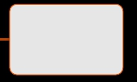



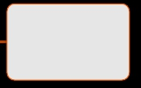


Documentation Structure
Maya 2013
Installation
Guide
Learning
Resources
User Guide
What’s New
Developer
Resources
mental ray
Technical
Documentation
Maya
Commands
Python
Commands
Nodes and
Attributes
API
Reference
© 2012 Autodesk
18

Slide 19
Help Documentation
API Docs are only available on the web:
▪
▪
▪
www.autodesk.com/maya
ounder ‘Documentation’ link, download or view
www.autodesk.com/developMaya
http://usa.autodesk.com/adsk/servlet/item?id=1670776
8&siteID=123112
o2013 SDK Link
© 2012 Autodesk
19

Slide 20
Navigating the Installation Folder
with respect to programming
© 2012 Autodesk
20

Slide 21
Navigating Maya Install Folders
• Default installation locations:
C:\Program Files\Autodesk\Maya2013
C:\My Documents\maya\2013-x64
• 6 Key Programming Related Folders:
▪
▪
▪
▪
▪
▪
▪
bin (mayapy.exe)
devkit
include
lib
mentalray
Python
scripts
© 2012 Autodesk
21

Slide 22
Specific Example Locations
C++ Plug-in Examples:
• C:\Program Files\Autodesk\Maya2013\devkit\plug-ins
C++ Standalone Application Examples:
• C:\Program Files\Autodesk\Maya2013\devkit\applications
Python Examples:
• C:\Program Files\Autodesk\Maya2013\devkit\plug-ins\scripted
• C:\Program Files\Autodesk\Maya2013\devkit\applications\scripted
© 2012 Autodesk
22

Slide 23
How to Execute Python in Maya
© 2012 Autodesk
23

Slide 24
How to Execute Python
1. Script Editor
2. Shelf
3. Command Line
4. Plug-in Manager
5. Python modules of Maya from a standalone Python
interpreter
© 2012 Autodesk
24

Slide 25
Helpful Coding Standards
1. Comment your code, so that you and others can clearly
read it
2. Put introduction comments at the top of your code, so
the code is informative.
3. Name your variables appropriately, so it is again clear to
read.
4. Use spaces, it makes easier to read
© 2012 Autodesk
25

Slide 26
Let us know!
Let us know about Maya defects or Wish list items:
• Log software defects here:
▪
www.autodesk.com/maya-bugreport
• Log software wish list items here:
▪
www.autodesk.com/maya-sug
© 2012 Autodesk
26

Slide 27
Book Resources
•Python
•
Learning Python (O’Reilly) by Mark Lutz and David Ascher
•C++
•
Thinking in C++ Volume One: Introduction to Standard C++ by
Bruce Eckel
•Python
Scripting and Python API
•
Maya Python for Games and Film: A Complete Reference for Maya
Python and the Maya Python API by Adam Mechtley and Ryan
Trowbridge
•MEL
Scripting and C++ API
•
Complete Maya Programming, Volume 1 by David A. D. Gould
© 2012 Autodesk
27

Slide 28
Additional Maya API Resources
•Maya
Developer Center
•
http://www.autodesk.com/developmaya
• Maya
API White Paper’s
• DevTV (video)
•Questions and Problems: ADN
•
http://www.autodesk.com/adn
•The
AREA || 3D Community Forums (API & MEL)
© 2012 Autodesk
28

Slide 29
Autodesk
© 2012 Autodesk
29

