Slide 1


Maya API Overview – Day 2
Try Autodesk Maya 2013 FREE for 30 Days
http://usa.autodesk.com/maya/trial/
© 2012 Autodesk
1

Slide 2
Autodesk Maya Python API Training
Kristine Middlemiss, Senior Developer Consultant
Autodesk Developer Network (ADN)
© 2012 Autodesk
2

Slide 3
Day 1 Questions:
1. Where does PyMEL a true OOP version of Mel and Python fit in all
as we go forward?
2. Can you provide us with PyQt for compiled for Maya 2013 x64?
3. Can you tell us if these classes will be available for download or for
staggered viewing (for those of us in a troublesome time zone)?
4. Is there a way to set up default imports for the script editor? Every
time I open a new python tab I have to do a series of imports.
5. Also does userConfig.py do the same thing as userSetup.py?
6. where can I get tutorials on how to start using Maya API with c++
7. Is it ok to use the 2012 educational version since the Autodesk
education site does not have version 2013 yet?
© 2012 Autodesk
3

Slide 4

userConfig.py or userSetup.py File
• Create a userConfig.py or userSetup.py file and add it to
somewhere on your path (PYTHONPATH)
• You can add imports and Python code you would like
• Changes will show up in top level context
import maya.cmds as cmds
© 2012 Autodesk
4

Slide 5
Scripts Path
• PYTHONPATH defines search path for scripts
• Includes standard Maya script paths
• Update at startup via Maya.env file
• Update from Python:
import sys
sys.path.append("C:/scripts" )
© 2012 Autodesk
5

Slide 6
Maya Environment Variable
• Text file: Maya.env
• Recommended approach of setting environment variable
• Syntax:
▪
PYTHONPATH = C:\Users\wengn\Documents\test
• Save it to
▪
C:\Users\wengn\Documents\maya\2012\Maya.env
•
© 2012 Autodesk
6

Slide 7
Other Useful Modules (externally)
os | processmanagement, environmentvariables, etc
os.path | filepathroutines:join,split, etc.
sys | shellarguments(argv), pythonglobals
re | regularexpressions
urllib2 | URLaccess
pickle | objectarchiving
getopt | commandlineargument parsing
math | assortedmathroutinesand constants
© 2012 Autodesk
7

Slide 8

Agenda
• Maya Architecture Overview
• Maya API Introduction
• Plug-in Development
© 2012 Autodesk
8

Slide 9
Maya Architecture Overview
© 2012 Autodesk
9

Slide 10
Maya Architecture Overview
Two vital concepts of Maya architecture
1. Dependency Graph
2. Command Architecture
© 2012 Autodesk
10

Slide 11
Dependency Graph
© 2012 Autodesk
11

Slide 12
Dependency Graph
•
•
•
Control system for Maya
Glue that holds together disparate
operations and lets them work together
seamlessly
Foundation of the Maya file format
© 2012 Autodesk
12

Slide 13
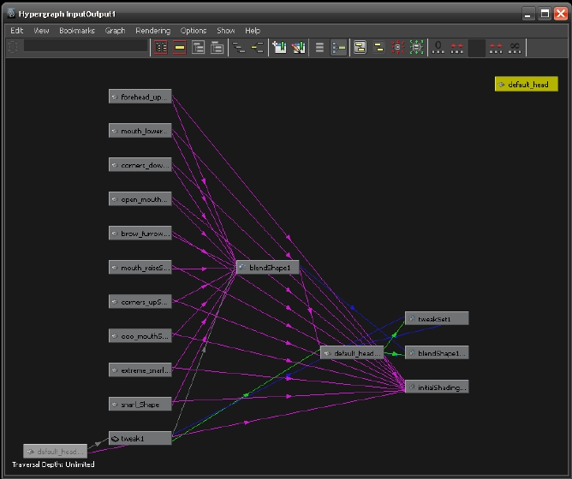
Maya Hypergraph
© 2012 Autodesk
13

Slide 14
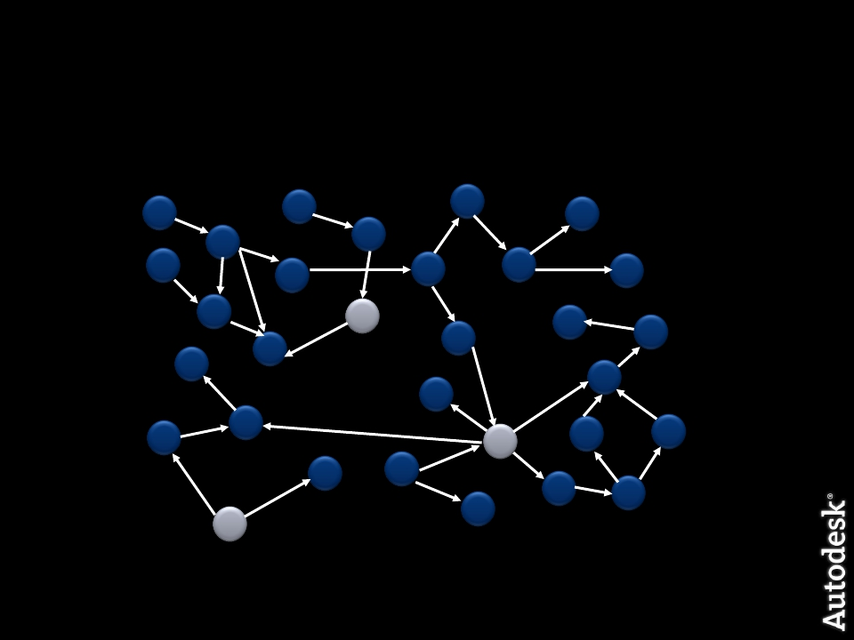
Dependency Graph
© 2012 Autodesk
14

Slide 15
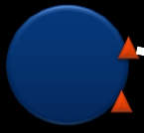
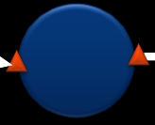
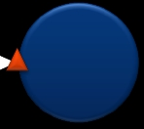
Dependency Graph
• A collection of nodes that transmit data through connected
attributes
A.a
A
B
C
B.b
© 2012 Autodesk
15

Slide 16

Dependency Graph
• Example: revolving surface
Curve
Revolve
Surface
© 2012 Autodesk
16

Slide 17
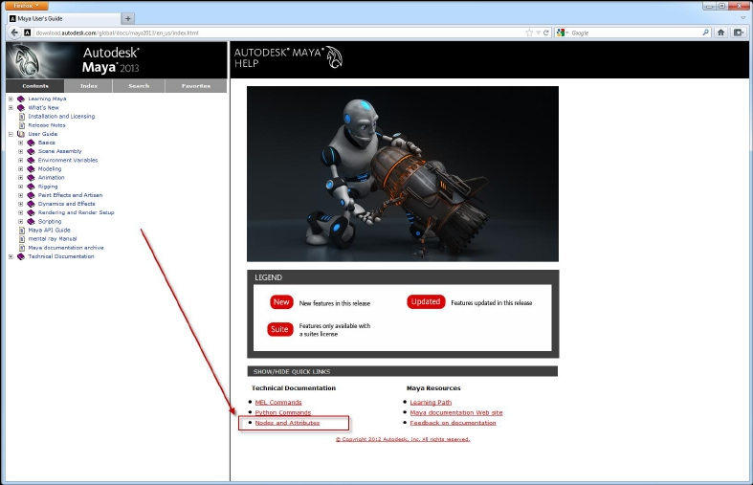
Maya Node Documentation
© 2012 Autodesk
17

Slide 18












DAG (Directed Acyclic Graph)
• DAG nodes are special dependency graph nodes that
form a scene hierarchy (parenting).
Car
frame
seats
tires
© 2012 Autodesk
18

Slide 19
Command Architecture
© 2012 Autodesk
19

Slide 20
Maya Command Architecture
Maya GUI
Maya Commands
Maya Core
OS
© 2012 Autodesk
20

Slide 21
Maya Embedded Language
• MEL is the language of the Command Architecture
• MEL is deeply embedded in the Maya Architecture
• Maya Command Examples
select –replace myCone; // Replaces selection list with myCone.
connectAttr myCone.ty mySphere.ty; // Connects translateY attributes
headsUpDisplay –s 0 –b 0 –label “myHUD” myHUD;
•
To view the syntax for a given command use `help`
help headsUpDisplay;
// Result:
// Synopsis: headsUpDisplay [flags] String
// Flags:
// -e -edit
// -q -query
…
© 2012 Autodesk
21

Slide 22

Maya Command Documentation
© 2012 Autodesk
22

Slide 23
Create, Query and Edit Mode
• Create Mode
string $window = `window -title “TestWindow"
-iconName “testWnd" -widthHeight 200 55`;
showWindow $window;
• Query Mode
window -query -widthHeight $window;
• Edit Mode
window -edit -widthHeight 100 100 $window;
© 2012 Autodesk
23

Slide 24
Execute MEL commands
• Command Line & Script Editor
• Record MEL commands
• Script Files: *.mel
• Script Path: MAYA_SCRIPT_PATH
• whatIs: to find a global proc or internal built-in command
• source: let Maya know a script has updated
• rehash: let Maya rescan the script paths
© 2012 Autodesk
24

Slide 25
Customizing Vital Concepts
© 2012 Autodesk
25

Slide 26
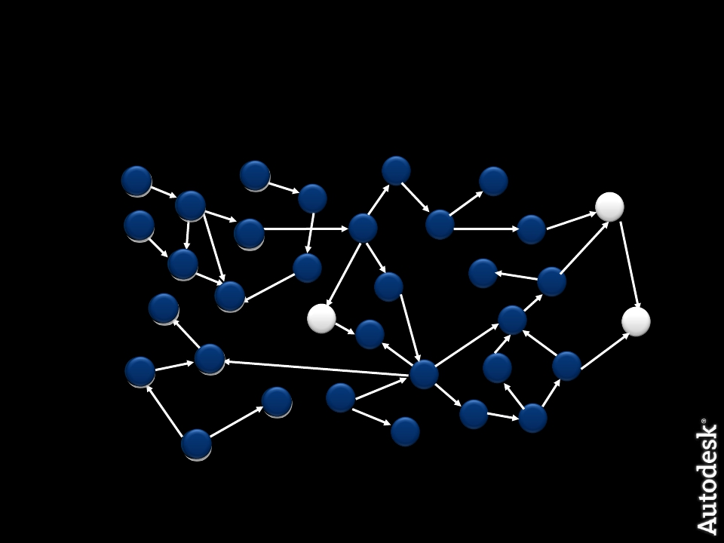
What do we need API for?
New Custom Node
© 2012 Autodesk
26

Slide 27
What do we need API for?
Maya GUI
Maya Commands
Maya API
Maya Core
OS
Custom Maya Command
© 2012 Autodesk
27

Slide 28
Maya API Introduction
© 2012 Autodesk
28

Slide 29
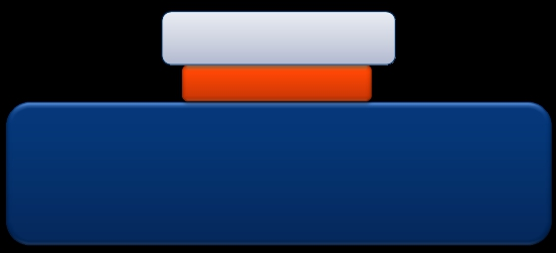
What is an API?
•
•
Application Programming Interface
It is a contract between the server application
exposing the API and the client using that API.
Client
API
MyApp.exe
© 2012 Autodesk
29

Slide 30
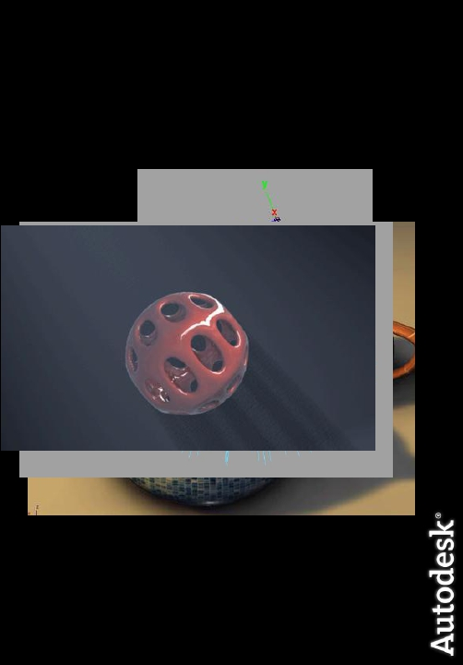
But really, what can you do?
• Commands
• Dependency Graph Nodes
• Deformers
• Shaders
• Manipulators
• Shapes
• Etc.
•
•
•
Tools /Contexts
File Translators
Automation
© 2012 Autodesk
30

Slide 31

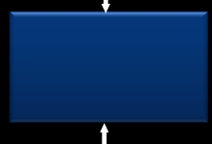
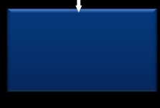
API Design Overview
• A tight wrapper around Maya’s internal architecture
• An abstract layer, which separates Maya internal code
from external plug-in developers
External
Developer
Maya API
Maya Core
31
© 2012 Autodesk

Slide 32
Plug-in Development
© 2012 Autodesk
32

Slide 33
Plug-in Development Environment
Operating
System
Windows
Linux
Mac
all platforms
Plug-in
Type
.mll
.so
.bundle
.py
Compiler
Visual Studio 2010 with
Service Pack 1
gcc 4.1.2
XCode 3.2.1 with gcc
4.0.1
Universal build binaries:
powerPC, IntelMac
Python 2.6 kernel
© 2012 Autodesk
33

Slide 34
Maya Python API Plug-ins
• Load/Unload Plug-in commands extended for Python
▪
▪
▪
Python plug-in read into a dictionary
Searches for entry points
Action runs scripts
• Required entry points
▪
▪
initializePlugin
uninitializePlugin
© 2012 Autodesk
34

Slide 35
Maya Plug-in Architecture
• initializePlugin() and uninitializePlugin() as entry point and
exit point
Maya API
initializePlugin
uninitializePlugin
loadPlugin
Maya
unloadPlugin
© 2012 Autodesk
35

Slide 36
Maya Python API Plug-ins
Define a Python module containing initializePlugin(),
uninitializePlugin() functions
1.
2.
3.
4.
5.
import necessary modules
def initializePlugin()
def uninitializePlugin()
class implementations…
def creator()
© 2012 Autodesk
36

Slide 37
1. Import Necessary Modules
Classically, we import what we want at the top of the module
import maya.OpenMaya as OpenMaya
import maya.OpenMayaMPx as OpenMayaMPx
import sys
© 2012 Autodesk
37

Slide 38
2. initializePlugin()
Scripted plug-in initialization
# Initialize the script plug-in
def initializePlugin(mobject):
mplugin = OpenMayaMPx.MFnPlugin(mobject)
try:
mplugin.registerCommand( “foo”, cmdCreator )
except:
sys.stderr.write( "Failed to register command: %s\n" %
kPluginCmdName )
raise
© 2012 Autodesk
38

Slide 39
3. uninitializePlugin()
Scripted plug-in uninitialization
def uninitializePlugin(mobject):
mplugin = OpenMayaMPx.MFnPlugin(mobject)
try:
mplugin.deregisterCommand( “foo” )
except:
sys.stderr.write( "Failed to unregister command: %s\n"
% kPluginCmdName )
raise
© 2012 Autodesk
39

Slide 40
4. Class Implementations
Class Implementation: Similar setup to C++ plug-ins
class scriptedCommand(OpenMayaMPx.MPxCommand):
def __init__(self):
OpenMayaMPx.MPxCommand.__init__(self)
def doIt(self,argList):
print "Hello World!"
• Parameter: self same as this in C
© 2012 Autodesk
40

Slide 41
5. creator()
Creator Functions is similar to C++ plug-ins
•
•
Pass Python function to MFnPlugin methods
…
mplugin.registerCommand( “foo”, cmdCreator )
…
Ownership is important
© 2012 Autodesk
41

Slide 42
5. creator()
OpenMayaMPx.asMPxPtr() transfer ownership of newly-
created command or node objects to Maya
class scriptedCommand(OpenMayaMPx.MPxCommand):
….
def cmdCreator():
return OpenMayaMPx.asMPxPtr( scriptedCommand() )
© 2012 Autodesk
42

Slide 43
Deployment of a Plug-in
• Maya Plug-in Manager
• Environment Variable: MAYA_PLUG_IN_PATH
• Put your plug-ins into:
C:\My Documents\maya\2012\plug-ins
• Add your custom plug-in path
putenv MAYA_PLUG_IN_PATH $destPluginPath;
string $currentPluginPath = `getenv MAYA_PLUG_IN_PATH`;
string $destPluginPath = $currentPluginPath + ";C:/My Documents";
putenv MAYA_PLUG_IN_PATH $destPluginPath;
• Maya.env or userSetup.mel
© 2012 Autodesk
43

Slide 44
How to Load a Plug-in
• Load from Plug-in Manager or Maya commands:
maya.cmds.loadPlugin( "foo.py" )
maya.cmds.unloadPlugin("foo.py" )
© 2012 Autodesk
44

Slide 45
Re-iterate: Generic Plug-in Algorithm
•Define initializePlugin and uninitializePlugin functions
•Register and unregister the proxy classes (MPxCommand,
MPxNode, etc…) within these functions. ie register the
custom commands and custom nodes being defined by the
plugin
•Implement creator and initialize methods (as required)
which Maya calls to build the proxy classes
•Implement the required functionality of the proxy classes.
This requires importing the necessary modules
© 2012 Autodesk
45

Slide 46
Summarize Main Methods
• initializePlugin allows Maya to load a plugin.
• uninitializePlugin allows Maya to unload a plugin
• Both must be defined
• Creator functions are used to instantiate a derivative of a proxy class
(MPxNode, MPxCommand) and transfer its ownership to Maya
• Node initialization functions are used for derivatives of MPxNode in
order to define their attributes and initialize their values
• Use try … except statements in order to trap errors and avoid crashing
Maya. As a rule of thumb use them around API functions that return
MStatus object
© 2012 Autodesk
46

Slide 47
Autodesk
© 2012 Autodesk
47

