Slide 1


Maya Commands
Kristine Middlemiss, Senior Developer Consultant
Autodesk Developer Network (ADN)
© 2012 Autodesk
1

Slide 2

Agenda
• Adding Undo and Redo Support
• Implementing Edit and Query Flags
© 2012 Autodesk
2

Slide 3
Adding Undo/Redo Support
© 2012 Autodesk
3

Slide 4
Maya Command Undo/Redo
• Maya commands support an undo/redo framework
• The undo/redo queue can be:
• Turned off
• Have a limited size
• Have an infinite size
• Defined in „Settings and Preferences‟
• While a command sits on the undo/redo queue, it retains
all of its parameters, operations and data.
• The lifetime of a command and associated data is
dependent on the settings of the undo queue.
© 2012 Autodesk
4

Slide 5
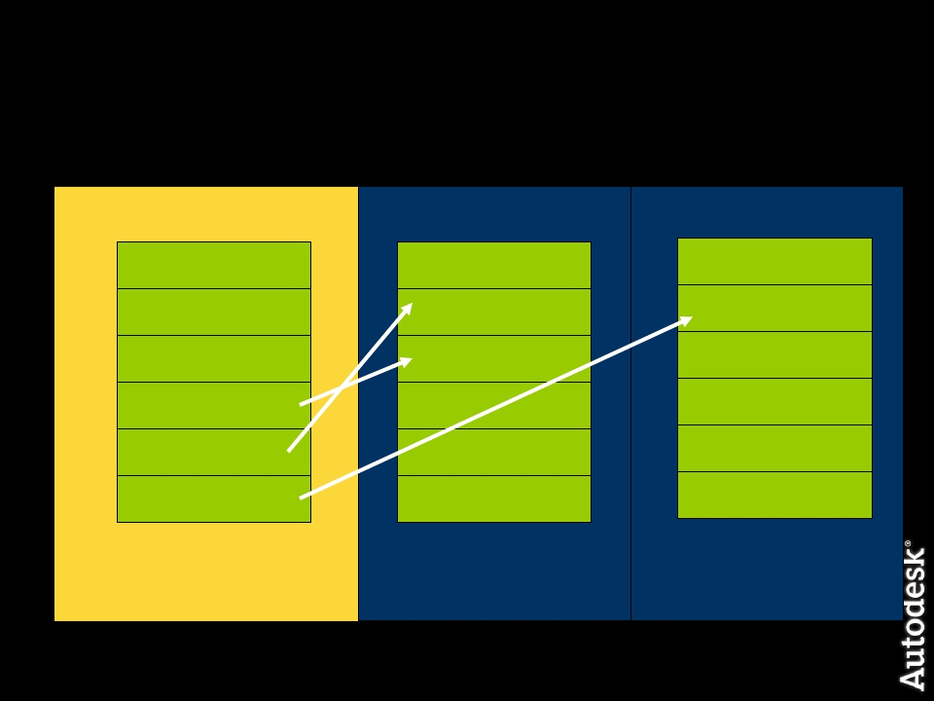
Maya Command Undo/Redo
Maya Command History
create a sphere
scale in z axis
translate in x axis
undo
undo
redo
Undo Queue
create a sphere
scale in z axis
translate in x axis
Redo Queue
translate in x axis
scale in z axis
© 2012 Autodesk
5

Slide 6
Undo/Redo Rules of Commands
• A command that alters the scene in any way MUST have
undo and redo implemented.
• If not it causes Maya state to be in limbo.
• Undo must reverse the changes inflicted to the scene, as
if the command was never executed.
• The Undo queue only exists in the current Maya session,
it is not saved with the scene.
© 2012 Autodesk
6

Slide 7
Undo/Redo Custom Command
• The MPxCommand functions you need to work with when
writing your undo redo are:
• isUndoable
• undoIt
• redoIt
• If isUndoable returns false, which is the default, the
command cannot be undone and undoIt and redoIt are
never called.
© 2012 Autodesk
7

Slide 8
Undo/Redo Functions
• isUndoable()
• Override this method to return true/false to denote if
this command supports undo/redo
• undoIt()
• Called by “undo” command
• redoIt()
• Called by “redo” command
© 2012 Autodesk
8

Slide 9
How Maya works with Commands
1. Custom Command is called, which calls the creator function, and
returns and instance of your command.
2. The commands doIt function is then called.
3. The isUndoable function is called:
• If isUndoable() returns False
• Not placed in undo queue, deleted.
• Command deconstructor is called.
• Command cannot be reversed, no point in keeping it
around
• If isUndoable() returns True
• Placed in undo queue, not deleted.
© 2012 Autodesk
9

Slide 10
Implementing Query and Edit Flags
© 2012 Autodesk
10

Slide 11
Edit and Query Flags
• Adding the built-in ability to query and edit previously set
values in your commands.
• The built-in query and edit flags are:
• -q/query
• -e/edit
• You can edit multiple parameters at the same time.
• You cannot query multiple parameters at the same time.
• In the syntax object you need to specify that it accepts
these flags, enableQuery and enableEdit.
© 2012 Autodesk
11

Slide 12
Workshop Session
© 2012 Autodesk
12

Slide 13
Example: instanceRotate
• manipulates the instances of a selected mesh shape by
rotating them with a quarter angle every time. User can
specify which axis they want the objects to move around
by sending arguments to this command.
• Practice note: how to handle complex plugs such as
compound attribute plug
• how to work with Msyntax, MArgParser and
MArgDatabase and parse arguments
© 2012 Autodesk
13

Slide 14
Autodesk
© 2012 Autodesk
14

