Slide 1


Dependency Graph and Nodes – Day 5
Kristine Middlemiss, Senior Developer Consultant
Autodesk Developer Network (ADN)
© 2012 Autodesk
1

Slide 2

Agenda
• Components of Maya Node and API classes
• Building Maya Custom Node with MPxNode
© 2012 Autodesk
2

Slide 3
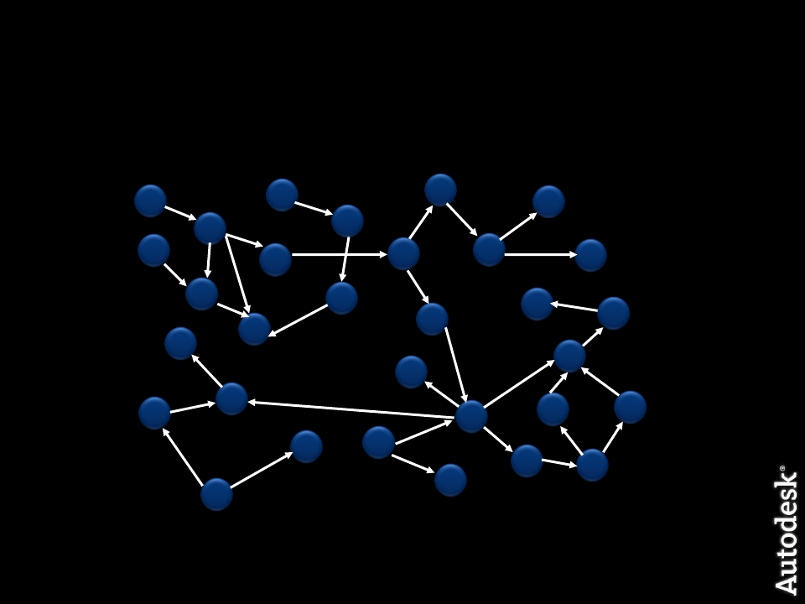
Dependency Graph
© 2012 Autodesk
3

Slide 4
What does a node do?
• Know its own attributes
• Store data efficiently in “datablocks”
• Accept input, compute, generate output
• Connect with other nodes through connections
© 2012 Autodesk
4

Slide 5
What does a node do?
Accept input data, compute output data
input attributes
output attributes
5
© 2012 Autodesk

Slide 6
Maya Node Structure
Maya Node
DataBlock
DataHandle
Attributes
Plugs
© 2012 Autodesk
6

Slide 7
Attributes
© 2012 Autodesk
7

Slide 8
Attributes
Maya Node
Attributes
© 2012 Autodesk
8

Slide 9

Attributes
• Describe data that belongs to nodes of a given type
Smiley Node Attribute
Float
Float
Int32
“rotation”
“diameter”
“numEyes”
© 2012 Autodesk
9

Slide 10
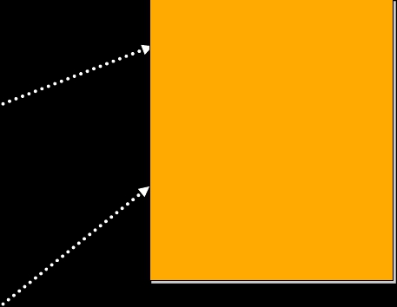

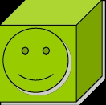
Attributes
• Attributes are shared among nodes of the same type
and all derived node types
Node A
Smiley Node Attribute
Float
Float
Int32
“rotation”
“diameter”
“numEyes”
Node B
© 2012 Autodesk
10

Slide 11
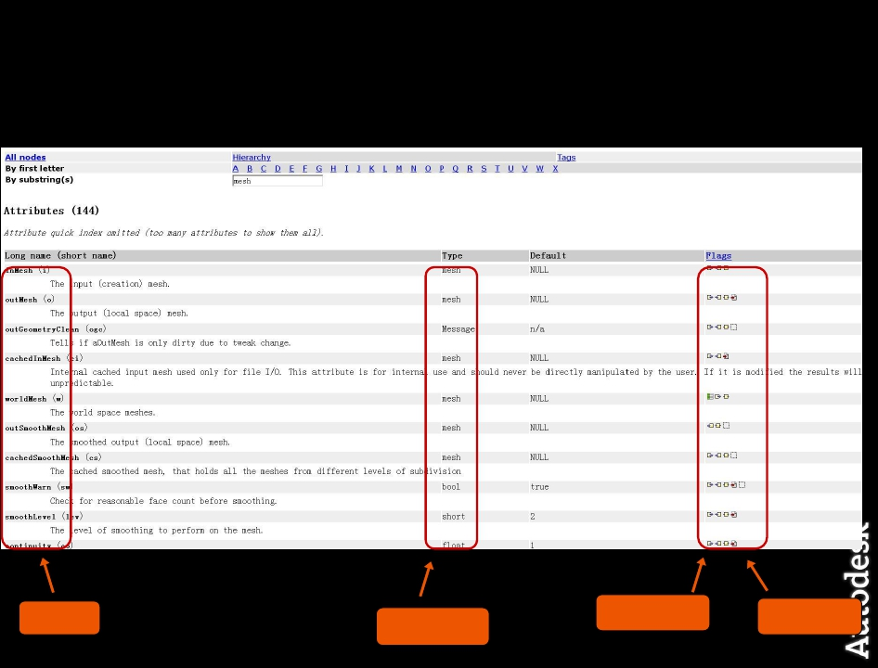
Node and their Attributes
Name
© 2012 Autodesk
Structure
Property
Data Type
11

Slide 12
Attributes
Define the interface of the node including
• Names of the inputs and outputs
• Data accepted by the inputs and outputs
• Structure of the inputs and outputs
• Properties of the inputs and outputs
© 2012 Autodesk
12

Slide 13
Attribute Data Types
• Basic
• Numeric (float, int,etc.)
• String
• Matrix
• Etc.
• Complex
• Mesh
• NurbsSurface
• Generic (accepts more than one type)
• Etc.
© 2012 Autodesk
13

Slide 14
Attribute Structures
Attribute Data Types will fit into one of these four:
1. Simple
2. Compound
3. Array
4. Compound Array
© 2012 Autodesk
14

Slide 15
Attribute Structures
1. Simple
• handles a single piece of data
• Example: polySphere1.radius
2. Compound
• 1 or more attributes grouped under a parent attribute
• Example: translate is a compound with children (tx, ty, tz)
t
tx
ty
tz
© 2012 Autodesk
15

Slide 16
Attribute Structures
3. Array (also referred to as a Multi)
• An array of simple data
• Example: pSphereShape1.face
face
0
1
2
...
n-1
n
© 2012 Autodesk
16

Slide 17
Attribute Structures
4. Compound array
• An array of compound data
• Example: mesh colors with children (colorR, colorG, colorB,
colorA)
colors
0
1
2
...
n-1
n
colorR
colorG
colorB
colorA
© 2012 Autodesk
17

Slide 18
Each Attribute has Properties
By default, attributes are:
▪
▪
▪
▪
▪
▪
▪
▪
▪
▪
▪
▪
▪
Readable.
Writable.
Connectable.
Storable.
Cached.
Not arrays.
Have indices that matter.
Do not use an array builder.
Not keyable.
Not hidden.
Not used as colors.
Not indeterminant.
Set to disconnect behavior kNothing.
© 2012 Autodesk
18

Slide 19
Attribute Properties
• Readable
• Attribute can be connected as a source
• Example: polyCylinder1.output
• Writable
• Attribute can be connected as a destination
• Example: pCylinderShape1.inMesh
•
Read/Write
• Attribute can be connected as both a source and a destination
• Example: pCylinder1.tx
© 2012 Autodesk
19

Slide 20
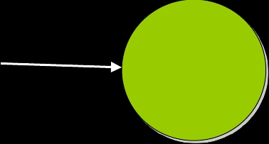
Attribute Affects
• Maya has no concept of input and output attribute
• Once attributes are created on a node, an
“attributeAffects” relationship needs to be setup to denote
a dependency (indicating input and outputs)
radius
setAttr D.radius 5
D
volume
attributeAffects(radius,volume)
© 2012 Autodesk
20

Slide 21
API Classes for Attributes
Maya Node
Attributes
MFnAttribute
© 2012 Autodesk
21

Slide 22
API Classes for Attributes
• Base Class: MFnAttribute
• Most Common Used Child Classes
• MFnNumericAttribute
• MFnCompoundAttribute
• MFnTypedAttribute
• MFnMatrixAttribute
• MFnGenericAttribute
© 2012 Autodesk
22

Slide 23
Steps to Create an Attribute
Define a Python function containing these steps:
1.
2.
3.
4.
create attribute using MFnAttribute*
set the attribute properties
add to the node
setup any attribute affects relationships
© 2012 Autodesk
23

Slide 24
MFnNumericAttribute
• Function set for simple numeric value attribute
import maya.OpenMaya as OpenMaya
….
nAttr = OpenMaya.MFnNumericAttribute()
simpleNode.input = nAttr.create( "input", "in", OpenMaya.MFnNumericData.kFloat, 0.0 )
nAttr.setWritable(1)
nAttr.setStorable(1)
nAttr.setKeyable(1)
simpleNode.addAttribute(simpleNode.input)
simpleNode.attributeAffects(simpleNode.input, <output> )
© 2012 Autodesk
24

Slide 25
Plugs
© 2012 Autodesk
25

Slide 26
Plugs
Maya Node
Attributes
Plugs
MFnAttribute
© 2012 Autodesk
26

Slide 27
Plugs
• Pointer to an attribute on a specific node (ie. a specific
instance of an attribute)
Node type definition
Actual instance of a node
myNode1
myNode2
myNode
myAttr
myPlug1(myNode1, myAttr)
myPlug2(myNode2, myAttr)
© 2012 Autodesk
27

Slide 28
Plugs
•
•
Plugs can be used to:
• query a value
• set a value
• create a connection
• remove a connection
• query connection(s)
Does not store attribute data
© 2012 Autodesk
28

Slide 29
API Classes for Plugs
Maya Node
Attributes
MFnAttribute
© 2012 Autodesk
Plugs
MPlug
29

Slide 30
API Class for Plug: MPlug
Attribute and Node Operations:
•
•
•
MPlug::MPlug (const MObject &node, const MObject &attribute)
MObject MPlug::attribute ( MStatus * ReturnStatus)
MObject MPlug::node ( MStatus * ReturnStatus)
Operations for Compound Attribute and Connections:
•
•
•
MPlug MPlug::parent ( MStatus * ReturnStatus)
MPlug MPlug::child (unsigned int index, MStatus *ReturnStatus)
bool MPlug::connectedTo ( MPlugArray & array, bool asDst, bool asSrc, MStatus * ReturnStatus = NULL )
Manipulation of Data
•
•
MStatus MPlug::getValue ( double & val, MDGContext & ctx )
MStatus MPlug::setValue ( double val )
© 2012 Autodesk
30

Slide 31
Datablocks
© 2012 Autodesk
31

Slide 32
Datablocks
Maya Node
Datablock
Datahandle
Attributes
Plugs
MPlug
32
MFnAttribute
© 2012 Autodesk

Slide 33

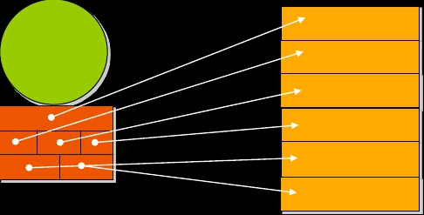

Datablocks
• Node stores data for every attribute (arrays are special,
more details later)
Attribute
Node
Datablock
© 2012 Autodesk
33

Slide 34
Datablocks & Datahandles
• Datablock is the actual storage for the input and output
data of a node
• For every non-array attribute, datablock stores:
• Data
• Dirty/clean status
• Data handles are lightweight pointers into the data in the
datablock
© 2012 Autodesk
34

Slide 35
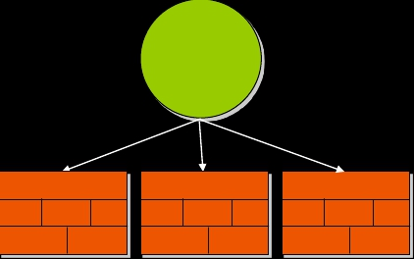
Datablocks
• Nodes hold an array of datablocks
• One datablock for a normal evaluation (using current time)
• More datablocks for timed contexts (specified times)
Normal
t=4
t=12
© 2012 Autodesk
35

Slide 36
Maya Node Structure: API Classes
Maya Node
Datablock
Datahandle
Attributes
Plugs
MFnAttribute
MDataBlock
MPlug
MDataHandle
© 2012 Autodesk
36

Slide 37
API Classes for Datablock
• MDatablock
• only valid during compute()
• Pointers to data block should not be retained after compute()
MStatus MPxNode::compute(const MPlug& plug, MDataBlock& dataBlock)
MDataHandle MDataBlock::inputValue(const MPlug & plug, MStatus * ReturnStatus)
MDataHandle MDataBlock::outputValue ( const MPlug & plug, MStatus * ReturnStatus)
MDGContext MDataBlock::setContext (const MDGContext & ctx )
• MDataHandle
• a smart pointer for information contained in data block
double & MDataHandle::asDouble ( )
void MDataHandle::setDouble ( double )
© 2012 Autodesk
37

Slide 38
Maya Node Structure: API Classes
MPxNode
Maya Node
Datablock
Datahandle
Attributes
Plugs
MFnAttribute
MDataBlock
MPlug
MDataHandle
© 2012 Autodesk
38

Slide 39
Custom Node Implementation
© 2012 Autodesk
39

Slide 40
Custom DG Nodes in Maya
• Entirely new operations
• MPxNode
• Extend existing Maya nodes
• MPxDeformerNode
• MPxFieldNode
• MPxEmitterNode
• MPxSpringNode
• MPxIkSolverNode
• MPxHwShaderNode
© 2012 Autodesk
40

Slide 41

MPxNode Registration
•
Every node requires a unique identifier.
MTypeId myNode::id( 0x80000 );
0 – 0x7ffff (524288 ids)
Internal Use
0x80000 – 0xfffff
DevKit
0x100fff – 0xffffff
Global IDs
Examples
• For plug-ins that you intend to share between sites
• Will require a globally unique ID issued to you by Autodesk.
• IDs are allocated in blocks of 64/128/256/512.
• Contact ADN M&E for unique global IDs.
© 2012 Autodesk
41

Slide 42
MPxNode Registration
• To register your node in Maya:
kPluginNodeTypeName = "simpleNode"
simpleNodeId = OpenMaya.MTypeId(0x80001)
def initializePlugin(mobject):
mplugin = OpenMayaMPx.MFnPlugin(mobject)
try:
mplugin.registerNode( kPluginNodeTypeName, simpleNodeId, nodeCreator, nodeInitializer )
except:
sys.stderr.write( "Failed to register node: %s" % kPluginNodeTypeName )
raise
• To deregister your node
def uninitializePlugin(mobject):
mplugin = OpenMayaMPx.MFnPlugin(mobject)
try:
mplugin.deregisterNode( simpleNodeId )
except:
sys.stderr.write( "Failed to deregister node: %s" % kPluginNodeTypeName )
raise
© 2012 Autodesk
42

Slide 43
MPxNode Creator Function
The creator method is called to return a new instance of the node
def nodeCreator():
return OpenMayaMPx.asMPxPtr( simpleNode() )
© 2012 Autodesk
43

Slide 44
MPxNode initialize Function
Reminder || Override this method to define the attribute interface for
your node:
1. create the attribute
2. set the attribute’s flags
3. add the attribute to the node
4. define attribute relationships
5. Inherit attributes if necessary
© 2012 Autodesk
44

Slide 45
Attribute Operations
• MStatus MPxNode::addAttribute ( const MObject & attr )
• MStatus MPxNode::attributeAffects ( const MObject
& whenChanges, const MObject & isAffected )
• MStatus MPxNode::inheritAttributesFrom ( const MString
& parentClassName)
MPxNode
Custom Node A
Custom Node B
© 2012 Autodesk
45

Slide 46
MPxNode
myOutput
myInput
• MPxNode::initialize()
myNode
myOutputTwo
def nodeInitializer():
nAttr = OpenMaya.MFnNumericAttribute()
simpleNode.myInputAttr = nAttr.create( "myInput", “mi", OpenMaya.MFnNumericData.kFloat, 1.0 )
nAttr.setStorable(1)
simpleNode.myOutputAttr = nAttr.create(“myOutput”, “mo”, OpenMaya.MFnNumericData.kFloat, 1.0)
nAttr.setStorable(1)
simpleNode.myOutputAttrTwo = nAttr.create(“myOutputTwo”, “motwo”,
OpenMaya.MFnNumericData.kFloat, 1.0)
nAttr.setStorable(1)
simpleNode.addAttribute( simpleNode.input )
simpleNode.addAttribute( simpleNode.myOutputAttr)
MPxNode::addAttribute()
MPxNode::attributeAffects()
simpleNode.addAttribute( simpleNode.myOutputAttrTwo)
simpleNode.attributeAffects(simpleNode.myInputAttr, simpleNode.myOutputAttr);
© 2012 Autodesk
46

Slide 47
MPxNode
• MPxNode::compute()
called when the node is asked to evaluate an output
def compute( self, plug, dataBlock):
if ( plug == simpleNode.myOutputAttr):
# your compute algorithm for output1
getAttr myNode1.myOutput;
myOutput
if (plug = = simpleNode.myOutputAttrTwo):
myInput
myNode
# your compute algorithm for output2
myOutputTwo
© 2012 Autodesk
47

Slide 48
MPxNode
• MPxNode::compute()
def compute(self,plug,dataBlock):
# …
if( plug == simpleNode.myOutputAttr ):
inputData = dataBlock.inputValue( simpleNode.myInputAttr )
inputValue = inputData.asFloat()
outputHandle = dataBlock.outputValue( simpleNode.myOutputAttr )
outputHandle.setFloat(inputValue * 2 );
dataBlock.setClean( plug )
return OpenMaya.MStatus.kSuccess
myOutput = myInput * 2;
myOutput
myInput
myNode
myOutputTwo
if (plug = = simpleNode.myOutputAttrTwo):
#…
return OpenMaya.MStatus.kUnknownParameter
© 2012 Autodesk
48

Slide 49
OpenMaya.kUnknownParameter
• One gotcha with MStatus codes as exceptions
• Some DG routines return MStatus::kUnknownParameter
(e.g. compute)
• In Python, this DOES NOT map to an exception
• MStatus::kUnknownParameter maps to the Python
constant maya.OpenMaya.kUnknownParameter
© 2012 Autodesk
49

Slide 50
Workshop Session
© 2012 Autodesk
50

Slide 51
Example: simpleNode
In this example, we implement a custom node with two
attributes: “input”, ”output”. Whenever the “input” attribute
value changes, the “output” attribute will always be the
input value multiplied by 2.
© 2012 Autodesk
51

Slide 52
Example: sinNode
In this example, we implement a custom node with two
attributes: “input”, ”output”. Whenever the “input” attribute
value changes, the “output” attribute will calculate the sin
of the number.
▪
Don’t forget to import the math module
© 2012 Autodesk
52

Slide 53
Example: transCircleNode
In this example, we implement a custom node
transCircleNode, it takes in a compound input translate
attribute “inputTranslate”, and output a compound
translate attribute “outputTranslate”, the value of
outputTranslate is the value of inputTranslate plus the
value of a circular movement based on current time
frame.
▪
Use the MEL script provided “transCircleNode.mel” to set and test your new node
© 2012 Autodesk
53

Slide 54
Autodesk
© 2012 Autodesk
54

