Slide 1


Node Attributes
Module 6
© 2009 Autodesk
1

Slide 2
Autodesk Maya Python API Training
Kristine Middlemiss, Senior Developer Consultant
Autodesk Developer Network (ADN)
© 2009 Autodesk
2

Slide 3
Questions Day 5:
1. Where do the .py files go so they show up in the plugin
Manager?
2. Is there a way to query in Maya what
MAYA_PLUG_IN_PATH will return?
3. In lay man term Plug is a portal to Connect attribute.
Whereas attribute are actual data flowing??
4. In the samples, there is a check in the compute()
methods to see if the plugs are input attributes. Should
we do this? or only check if the plug corresponds to an
output attribute?
© 2009 Autodesk
3

Slide 4
Homework Review
© 2009 Autodesk
4

Slide 5
Agenda
• Exploring MFnAttribute in Depth
• Looking at Static, Dynamic and Extension Attributes
• Setting up Customer User Interfaces for MPxNode
© 2009 Autodesk
5

Slide 6

Types of Attributes
© 2009 Autodesk
6

Slide 7
API Classes for Attributes
• Base Class: MFnAttribute
• Most Common Used Classes
• MFnNumericAttribute
• MFnCompoundAttribute
• MFnTypedAttribute
• MFnMatrixAttribute
• MFnGenericAttribute
© 2009 Autodesk
7

Slide 8
MFnCompoundAttribute
nAttr= OpenMaya.MFnNumericAttribute()
transCircleNode.inputTranslateX = nAttr.create( "inputTranslateX", "itX",
OpenMaya.MFnNumericData.kDouble, 0.0 )
nAttr.setStorable(True)
transCircleNode.inputTranslateY = nAttr.create( "inputTranslateY", "itY",
OpenMaya.MFnNumericData.kDouble, 0.0 )
nAttr.setStorable(True)
transCircleNode.inputTranslateZ = nAttr.create( "inputTranslateZ", "itZ",
OpenMaya.MFnNumericData.kDouble, 0.0 )
nAttr.setStorable(True)
comAttr = OpenMaya.MFnCompoundAttribute()
transCircleNode.inputTranslate = comAttr.create("inputTranslate","it")
comAttr.addChild(transCircleNode.inputTranslateX)
comAttr.addChild(transCircleNode.inputTranslateY)
comAttr.addChild(transCircleNode.inputTranslateZ)
comAttr.setStorable(True)
© 2009 Autodesk
8

Slide 9
Attribute Data Types
• Basic
• Numeric (float, int32,etc.)
• String
• Matrix
• Etc.
• Complex
• Mesh
• NurbsSurface
• Generic (accepts more than one type)
• Etc.
© 2009 Autodesk
9

Slide 10
MFnTypedAttribute
• Function set for typed attributes, a typed attribute accepts
exactly one type of data ( vs. MFnGenericAttribute)
MFnTypedAttribute::create (const MString &full, const MString &brief, MFnData::Type type,
MObject defaultData, MStatus * ReturnStatus)
• MFnData::Type
kNumeric
kString
kMatrix
kIntArry, kDoubleArray, kPointArray…
kMesh, kNurbsSurface….
Etc.
© 2009 Autodesk
10

Slide 11
MFnTypedAttribute
Create a string Attribute:
typedAttr = OpenMaya.MFnTypedAttribute()
defaultString = "description string for current node"
fnStringData = OpenMaya.MFnStringData()
defaultStringObj = fnStringData.create(defaultString)
descString = typedAttr.create("descString", "dStr", OpenMaya.MFnData.kString, defaultStringObj)
typedAttr.setStorable(1)
© 2009 Autodesk
11

Slide 12
Data Creation: MFnData
• MFnData: parent class for all DG data function sets
MFnData::Type
kNumeric
kString
kMatrix
MFnNumericData,
MFnStringData,
MFnMatrixData,
kIntArry, kDoubleArray,
MFnIntArrayData, MFnDoubleArrayData
kPointArray…
MFnPointArrayData,….
kMesh, kNurbsSurface….
MFnMeshData, MFnNurbsSurfaceData…
Etc.
Etc.
© 2009 Autodesk
12

Slide 13
MFnTypedAttribute
• MFnTypeAttribute with MFnData::kNumeric
typedAttr = OpenMaya.MFnTypedAttribute()
fnNumericData = OpenMaya.MFnNumericData();
defaultDataObj = fnNumericData.create(OpenMaya.MFnNumericData.k3Float)
fnNumericData.setData3Float(1.5, 2.5, 3.5)
typedNumeric = typedAttr.create(“typedNumeric", “tNum", OpenMaya.MFnData.kNumeric,
defaultDataObj )
MEL: addAttr -longName numAttr –dataType float3;
• MFnNumericAttribute
nAttr = OpenMaya.MFnNumericAttribute();
input = nAttr.create( "input", "in", OpenMaya.MFnNumericData.kFloat, 0.0 );
MEL: addAttr –longName singleNum –attributeType float;
© 2009 Autodesk
13

Slide 14
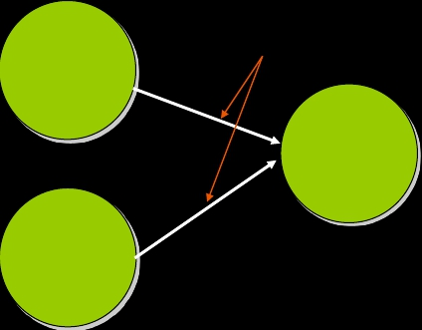
Message Attribute
• Some connections indicate relationships rather than
propagate data flow (eg. sets)
message attributes
pSphere1
set1
pCone1
© 2009 Autodesk
14

Slide 15
Message Attribute
• Some connections indicate relationships rather than propagate
data flow (eg. sets)
• Indicate membership in a grouping
• No data is actually stored
© 2009 Autodesk
15

Slide 16
•
Array Attribute (Multi)
© 2009 Autodesk
16

Slide 17
Array Attribute (Multi)
• An array of simple data
• The data type of each element is defined to be the type
specified by the attribute
• Each element plug can contains its own value
• Each element plug can have its own connection
•
weight
0
1
2
...
n-1
n
•
•
© 2009 Autodesk
getAttr blendShape1.weight[0]
17

Slide 18
Array Attribute
• Array can be sparse
• Logical index v.s. Physical index
•
•
Logical indexes are sparse and used by MEL
MPlug:: elementByLogicalIndex()
When try to retrieve element plug value, element plug will be
created if does not exist already
Physical indexes are not sparse, it is guaranteed that the physical
indexes will range from 0 to numElements() – 1
MPlug:: elementByPhysicalIndex()
© 2009 Autodesk
18

Slide 19

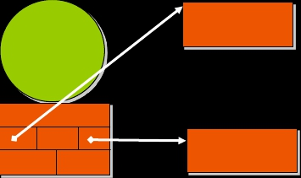

Multi Attribute & DataBlock
• Arrays are stored separately in sub-datablocks, and
accessed through array data handles
Node
Sub-datablock
for arrays
Datablock
© 2009 Autodesk
19

Slide 20
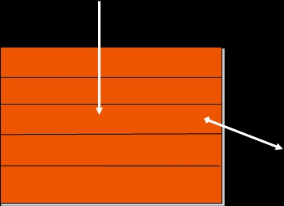
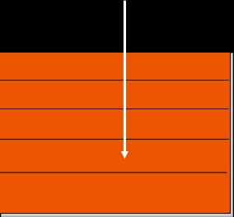
MultiAttribute & DataBlock
MArrayDataHandle
MDataHandle
Datablock
Array Data
© 2009 Autodesk
20

Slide 21
Initialization of Multi Attribute
def nodeInitializer():
nAttr = OpenMaya.MFnNumericAttribute()
myNode. arrayInputAttr = nAttr.create(“arrayInput”, “ai”, OpenMaya.MFnNumericData.kFloat, 1.0)
nAttr.setStorable(1)
nAttr.setArray(1)
myNode.addAttribute(myNode.arrayInputAttr)
myNode.arrayOutputAttr = nAttr.create(“arrayOutput”, “ao”, OpenMaya.MFnNumericData.kFloat, 1.0)
nAttr.setStorable(1)
nAttr.setArray(1)
nAttr.setWritable(0)
myNode.addAttribute(myNode.arrayOutputAttr)
return OpenMaya.MStatus.kSuccess
© 2009 Autodesk
21

Slide 22
Attribute Relationship
•
•
•
•
•
•
•
•
•
•
•
•
def setDependentsDirty(self, inPlug, affectedPlugs ):
if inPlug == myNode.arrayInputAttr :
outArrayPlug = OpenMaya.MPlug (self.thisMObject(), myNode.arrayOutputAttr)
if inPlug.isElement() == true:
logicalIndex = inPlug.LogicalIndex()
outputElem =
OpenMaya.Mplug(outArrayPlug.elementByLogicalIndex(logicalIndex))
affectedPlugs.append(outputElem)
else
affectedPlugs.append(outArrayPlug);
return OpenMaya.Mstatus.kSuccess
© 2009 Autodesk
22

Slide 23
Compute Array Attribute
•
•
•
•
•
•
•
•
•
•
•
•
def compute(self, plug, dataBlock):
if plug == myNode.arrayOutputAttr :
if plug.isElement() == True:
indexToCompute = plug.logicalIndex()
inputArrayHandle = dataBlock.inputArrayValue(myNode.arrayInputAttr)
inputArrayHandle.jumpToElement(indexToCompute)
inputElementHandle = inputArrayHandle.inputValue()
inputElementData = inputElementHandle.asFloat()
© 2009 Autodesk
23

Slide 24
Compute Array Attribute
•
•
•
•
•
•
•
•
•
•
outputArrayHandle = dataBlock.outputArrayValue(arrayOutputAttr)
outputArrayHandle.jumpToElement(indexToCompute)
outputElementHandle = outputArrayHandle.outputValue()
outputElementHandle.setFloat( inputElementData )
return OpenMaya.Mstatus.kSuccess
return OpenMaya.Mstatus.kUnknownParameter
© 2009 Autodesk
24

Slide 25
Array Attributes vs. Array Data
•
Array Attributes
• using MFnAttribute::setArray(true)
• the elements of the array are accessible through MEL by
using:
getAttr node.attribute[element];
(also available in the attribute editor)
• not very effective for large arrays in terms of memory usage
and speed
• no array elements defined at creation time
• allows access to individual element
© 2009 Autodesk
25

Slide 26
Array Attributes vs. Array Data
• Array Data
• using MFnTypedAttribute to create a kDoubleArray
•
•
•
•
the array elements are not accessible through MEL
effective for large arrays
can be constructed with a default value
Easier to handle as data “chunk”
© 2009 Autodesk
26

Slide 27
Ways to add Attributes
1. Static Attributes
▪
Built into the Maya code or are members of plug-in nodes, and
cannot be modified or removed.
2. Dynamic Attributes
▪
Allow you to add or delete attributes on a particular node.
Dynamic attributes are different from static attributes in that they
are only married to a specific instance of a node type.
3. Extension Attributes
▪
▪
Allow you to add or delete attributes, at run time, on all nodes of a
given type.
For example, you can add an attribute to a transform type instead
of an instance of a transform.
© 2009 Autodesk
27

Slide 28
Dynamic Attributes
How to create a dynamic attribute in Maya:
1. Attribute Editor
2. MEL Command: addAttr
addAttr -longName oneAttr -at double;
3.
Any code outside of MPxNode::initialize() to create an attribute
© 2009 Autodesk
28

Slide 29
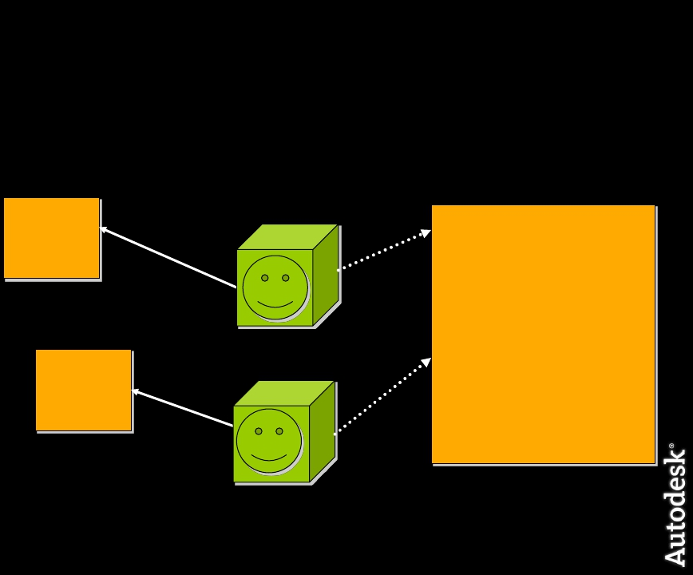
Dynamic Attributes
• Dynamic attributes belong to the node
Node A
Node A
Dynamic
Attributes
Smiley Node Attribute
Float
Float
Int32
“rotation”
“diameter”
“numEyes”
Node B
Node B
Dynamic
Attributes
© 2009 Autodesk
29

Slide 30
Dynamic Attribute
• MPxNode::postConstructor()
def postConstructor(self):
nAttr = OpenMaya.MFnNumericAttribute()
dynAttr = nAttr.create( "dynAttr", "da", OpenMaya.MFnNumericData.kFloat, 0.0 )
nAttr.setStorable(1)
nAttr.setKeyable(1)
thisNode = self.thisMObject()
depNode = OpenMaya.MFnDependencyNode(thisNode)
depNode.addAttribute(dynAttr)
© 2009 Autodesk
30

Slide 31
Attribute Relationship
MPxNode::setDependentsDirty()
• Handle dynamic attribute as well as non-dynamic
attribute
• More flexible relationship
• Do not perform any DG computation
© 2009 Autodesk
31

Slide 32
MPxNode::setDependentsDirty()
dynNode.aOutput # Non-dynamic attribute “aOutput"
def setDependentsDirty(self, dirtyPlug, plugArray):
if dirtyPlug == self.dynAttr:
thisNode = self.thisMObject()
try:
plug = OpenMaya.MPlug(thisNode, dynNode.aOutput)
plugArray.append(plug)
except:
pass
return OpenMayaMPx.MPxNode.setDependentsDirty(self, dirtyPlug, plugArray)
© 2009 Autodesk
32

Slide 33
Extension Attributes
How to create a extension attribute in Maya:
1. Attribute Editor
2. MEL Command: addExtension
addExtension -nt "mesh" -shortName ms -longName mass -
defaultValue 1.0 -minValue 0.001 -maxValue 10000;
3.
Using MDGModifier::addExtensionAttribute
© 2009 Autodesk
33

Slide 34
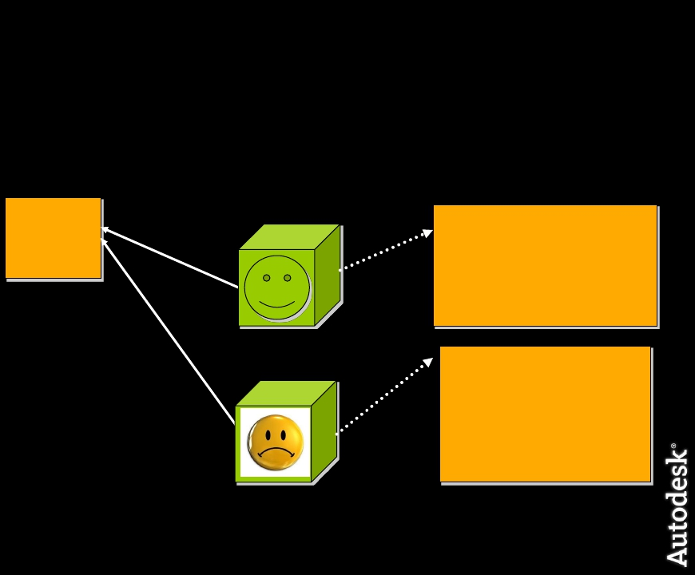
Extension Attributes
• Extension attributes belong to the Type of Node
Node A Type
Transform
Extension
Smiley Node Attribute
Attributes
Float
Float
Int32
“rotation”
“diameter”
“numEyes”
Node B Type
Transform
Sad Node Attribute
Float
“rotation”
© 2009 Autodesk
34

Slide 35
Creating Custom Attribute Editor UI
© 2009 Autodesk
35

Slide 36
MPxNode -- UI
• Once you’ve created a new node type, you can create
your node via:
MEL: `createNode myNode`
Python:
import maya.cmds as cmds
cmds.createNode(“myNode")
•
More typically, create a command to setup the node
(connections, attribute values) and insert it into the scene.
© 2009 Autodesk
36

Slide 37
MPxNode -- UI
• MPxNode in Attribute Editor and Channel Box
• Attributes in Attribute editor
• AENodeNameTemplate.mel defines how the attributes from the plugin MPxNode,
with the name NodeName, are to display in the attribute editor.
Node Name: transCircle
AE template name: AEtransCircleTemplate.mel
• Attributes in Channel Box
• The channel box only shows certain simple data types and they need to be either
setKeyable(true) or setChannelBox(true).
© 2009 Autodesk
37

Slide 38
Attribute Editor
• In AENodeNameTemplate.mel:
• The global procedure name should be the same as file name
global proc AEtransCircleTemplate( string $nodeName ) { …. }
• editorTemplate
• editorTemplate -addControl “attributeName”;
• editorTemplate -suppress “attributeName”;
• editorTemplate -beginLayout;
• editorTemplate -endLayout;
• editorTemplate -callCustom “proc_for_new_created_node“
“proc_for_replace_node” “attributeName";
© 2009 Autodesk
38

Slide 39
Attribute Editor
editorTemplate -callCustom "transCircleScaleNew“ "transCircleScaleReplace“ "scale";
global proc transCircleScaleNew( string $attrName )
{
// build the "quick set" control for the scale attribute
radioButtonGrp -label "Quick Scale“ -numberOfRadioButtons 3
-label1 "Five“ -data1 5
-label2 "Ten“ -data2 10
-label3 "Fifteen“ -data3 15
scaleGrp;
connectControl scaleGrp $attrName;
}
global proc transCircleScaleReplace( string $attrName )
{
// Install the connection between the radioButtonGrp and the actual scale attribute
connectControl scaleGrp $attrName;
}
© 2009 Autodesk
39

Slide 40
Workshop Session
© 2009 Autodesk
40

Slide 41
Example: simpleNode - with Typed
Attr
In this exercise, we add a special type of attribute: string
attribute onto simpleNode from the previous workshop.
© 2009 Autodesk
41

Slide 42
Autodesk
© 2009 Autodesk
42

