Slide 1


Miscellaneous Classes and Tools
Module 8
© 2012 Autodesk
1

Slide 2
Autodesk Maya Python API Training
Kristine Middlemiss, Senior Developer Consultant
Autodesk Developer Network (ADN)
© 2012 Autodesk
2

Slide 3
Homework Review:
© 2012 Autodesk
3

Slide 4
Agenda
• DG / DAG Operations
• Maya Callback System
• Software Shader
• Custom Translator
© 2012 Autodesk
4

Slide 5

DG/ DAG Operations
© 2012 Autodesk
5

Slide 6
MDGModifier
Used to create remove, and edit nodes in the DG.
This class automatically provides undo and redo for all it’s
operations, opposed to implementing all the undo your self.
When each of the functions for editing the DG is called, a
record of it is stored from this class.
Important functions in this class:
▪
▪
doIt()
undoIt()
© 2012 Autodesk
6

Slide 7
DG/DAG Operations
MDGModifier / MDagModifier:
•
•
•
•
•
Facilitate the creation or deletion of nodes and connections
Provides undo/redo support
MDagModifier: dag node creation/parenting
Holds a list of operations. Operations are queued as they are called.
Does not perform these operations until MDGModifier::doIt() call is
issued.
© 2012 Autodesk
7

Slide 8
MDGModifier code structure
import maya.OpenMaya as OpenMaya
dgMod = OpenMaya.MDGModifier()
dgMod.createNode ( “transform”)
dgMod.commandToExecute(“sphere -n sphere1 -r 1;”)
dgMod.connect(.....)
.....
dgMod.doIt()
All these operations won’t get executed until dgMod.doIt()
To undo all these operations, dgMod.undoIt()
© 2012 Autodesk
8

Slide 9
Maya Callback System
Maya callbacks allow the user to register functions against specific Maya
events.
Maya callback classes:
MMessage: base class, remove callback, query callbacks
MDGMessage
MNodeMessage
MSceneMessage
MUiMessage
MEventMessage
MConditionMessage
MModelMessage
- node added, removed, connected
- attribute callbacks
- before/after: file open, import, export, etc.
- UI objects
- idle, timeChanged, undo, redo, etc.
- specific conditions
- model related messages
© 2012 Autodesk
9

Slide 10

MMessage and Callback Functions
OpenMaya.MSceneMessage.addCallback (OpenMaya.MSceneMessage,
MMessage_MBasicFunction , clientData)
OpenMaya.MSceneMessage.kAfterOpen
def MMessage_MBasicFunction (args)
OpenMaya.MSceneMessage.addCallback ( OpenMaya.MSceneMessage.kAfterOpen,
afterFileOpenCallback)
© 2012 Autodesk
10

Slide 11
MMessage and Callback Functions
OpenMaya.MSceneMessage.addCallback ( OpenMaya.MSceneMessage,
Mmessage_MBasicFunction , clientData )
Id = OpenMaya.MCallbackId()
def afterFileOpenCallback(clientData):
print “Come to this afterFileOpenCallback function\n”
def MyCmd_addCallback():
id = OpenMaya.MSceneMessage.addCallback(OpenMaya.MSceneMessage.kAfterOpen, afterFileOpenCallback)
def MyCmd_removeCallback():
OpenMaya.MMessage.removeCallback( id )
© 2012 Autodesk
11

Slide 12

Abort operations
OpenMaya.MCallbackId OpenMaya.MSceneMessage.addCheckCallback (
OpenMaya.MSceneMessage, MMessage_MCheckFunction, clientData )
OpenMaya.MSceneMessage.kBeforeOpenCheck
def MMessage_MCheckFunction (retCode, clientData)
retCode: Result of the function. Provide programmer with options to abort
current operations by return false through this variable.
In Python use OpenMaya.MScriptUtil.setBool(retCode, True) since python can’t
handle pointer or reference.
© 2012 Autodesk
12

Slide 13
Abort Operations
def beforeOpenCheckCallback(retCode, clientData):
#Do custom operations, for example, check file versions...
print “Error: file version is not correct, abort opening operations\n”
OpenMaya.MScriptUtil.setBool(retCode, False)
def MyCmd_addCallback():
OpenMaya.MSceneMessage.addCheckCallback(OpenMaya.MSceneMessage.kBeforeOpenCheck,
beforeOpenCheckCallback)
© 2012 Autodesk
13

Slide 14
Shading Network and Software Shader
• Different types of software shaders
• Shading group
• Custom Software Shader
© 2012 Autodesk
14

Slide 15
Software Shading Node
DG Nodes to form Shading Networks
Different Types of Software Shading Nodes:
Type | Frame
Textures | 2DTextures, 3DTextures EnvironmentTextures
Materials | SurfaceMaterials, VolumetricMaterials DisplacementMaterials
Lights | Lights
Utilities | GeneralUtilities ColorUtilities ParticleUtilities ImagePlanes Glow
© 2012 Autodesk
15

Slide 16
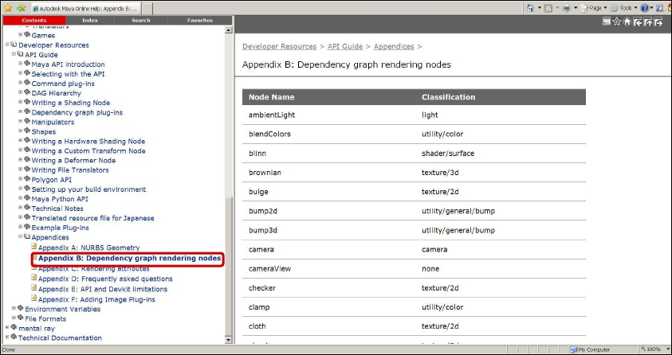
Shading Nodes List
Developer Resources -- API Guide -- Appendices –
Appendix B: Dependency Graph rendering Nodes
© 2012 Autodesk
16

Slide 17
Shading Group
• An Object Set
• A logical grouping of an arbitrary collection of objects, attributes or
component of objects
• Membership is defined by connections:
whole object is in set:
node.instObjGroups → objectSet.dagSetMembers
A part of components are in set:
node.objectGroups → objectSet.dagSetMembers
• MEL command for “objectSet” node
sets -e -add blinn1SG pCubeShape2;
sets –q -size blinn1SG;
© 2012 Autodesk
17

Slide 18
Shading Group (Renderable Sets)
• Only renderable elements can be added into Shading Group
sets –q –renderable blinn1SG; //always return true
• Every shader has to be connected with a shading group
shadingNode -asShader blinn;
// Result: blinn1 //
sets -renderable true -noSurfaceShader true -empty -name blinn1SG;
// Result: blinn1SG //
connectAttr -f blinn1.outColor blinn1SG.surfaceShader;
// Result: Connected blinn1.outColor to blinn1SG.surfaceShader. //
• Connection point between geometry and shader
© 2012 Autodesk
18

Slide 19

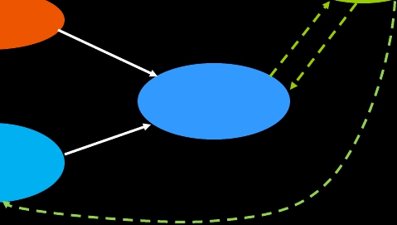
Rendering Network
Pre-computed Input attribute
renderer
Shader
geometry
Output attribute requested
by shading group
Shading
Group
Geometry information
© 2012 Autodesk
19

Slide 20

Custom Shading Node
Registration:
MFnPlugin::registerNode ( const MString & typeName, const MTypeId & typeId, MCreatorFunction creatorFunction,
MInitializeFunction initFunction, MPxNode::Type type = MPxNode::kDependNode, const MString * classification )
Type | Frame | ClassificationString
Textures | 2DTextures, 3DTextures EnvironmentTextures | “texture/2d” “texture/3d” “texture/environment”
Materials | SurfaceMaterials, VolumetricMaterials DisplacementMaterials | “shader/surface” “shader/volume” “shader/displacement”
Lights | Lights | “light”
Utilities | GeneralUtilities ColorUtilities ParticleUtilities ImagePlanes Glow | “utility/general” “utility/color” “utility/particle” “imageplane” “postprocess/opticalFX”
© 2012 Autodesk
20

Slide 21
Custom Shading Node
Code Structure:
myShaderId = OpenMaya.MTypeId(0x00001)
class myShader (OpenMayaMPx::MPxNode):
def __init__(self):
OpenMayaMPx.MPxNode.__init__(self)
def compute(self,plug,data):
# code ...
def myShader_creator():
return OpenMayaMPx.asMPxPtr( myShader() )
def myShader_initialize():
#Input attributes
# …….
#Output attributes
# …….
© 2012 Autodesk
21

Slide 22
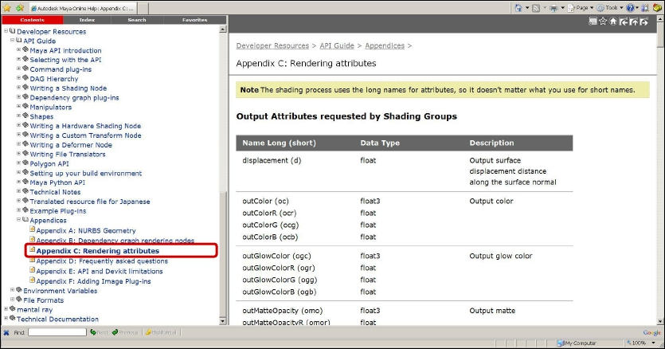
Software Shading Node
Rendering Attributes
© 2012 Autodesk
22

Slide 23
Shading node icons for Hypershade
XPM format: 32x32
Icon name: preface "render_".
lambertShader.mll: render_lambertShader.xpm
XBMLANGPATH: Put the icons in one of the directories
specified in your XBMLANGPATH.
© 2012 Autodesk
23

Slide 24
Custom Translator
• Transmitting data in your production pipeline
• Define custom file format
• Decide what contents you want to export
• Plug-in vs. Standalone Application
© 2012 Autodesk
24

Slide 25
Custom Translator Plug-in
Derived from MPxFileTranslator :
•
•
•
Maya consistent UI (File->Export, File->Import)
register your extension with Maya
implement a reader and writer in the same plug-in
Register MSceneMessage callbacks to execute operations
before/after import/export
•
•
•
•
MSceneMessage::kBeforeExport
MSceneMesage::kAfterExport
MSceneMessage::kBeforeImport
MSceneMessage::kAfterImport
© 2012 Autodesk
25

Slide 26
Devkit Example: lepTranslator
(C++)
Adds the new file format “Lep” to the file manipulation
dialogs
An “Lep” file is an ASCII file with a first line of “<LEP>”. The
remainder of the file contains MEL commands that create
one of the primitives: nurbsSphere, nurbsCone and
nurbsCylinder, as well as move commands to position them.
© 2012 Autodesk
26

Slide 27
MPxFileTranslator
• Custom file format:
static MString myfileExt(“lep”);
MString MPxFileTranslator::defaultExtension()
return custom file format
MPxFileTranslator::identifyFile()
determine whether it is the type supported by the translator
© 2012 Autodesk
27

Slide 28
MPxFileTranslator: read & write
MPxFileTranslator::canBeOpened()
decide whether it is an importer or exporter
bool MPxFileTranslator::haveReadMethod()
MStatus MPxFileTranslator::reader ( const MFileObject & file, const
MString & optionsString, MPxFileTranslator::FileAccessMode mode )
Mode: the method used to read the file – open or import
bool MPxFileTranslator::haveWriteMethod()
MStatus MPxFileTranslator::writer ( const MFileObject & file, const
MString & optionsString, MPxFileTranslator::FileAccessMode mode )
Mode: the method used to write the file - save, export, or export active
© 2012 Autodesk
28

Slide 29
Example: lepTranslator
magic =MString (“”)
class LepTranslator (OpenMayaMPx.MPxFileTranslator):
def __init__ (self):
OpenMayaMPx.MPxFileTranslator.__init__(self)
def reader ( mfileobject, optionsString, fileAccessMode):
#code …
def writer ( mfileobject, optionsString, fileAccessMode):
#code …
def haveReadMethod ():
return True
def haveWriteMethod ():
return True
def defaultExtension ():
def canBeOpened():
def identifyFile (fileName, buffer, size):
def getPosition(transform, tx, ty, tz ):
© 2012 Autodesk
29

Slide 30
MPxFileTranslator
Register custom file translator:
def initializePlugin( mobject ):
mplugin = OpenMaya.MFnPlugin (mobject)
try:
mplugin.registerFileTranslator( "Lep", "lepTranslator.rgb", LepTranslator_creator,
"lepTranslatorOpts", "showPositions=1", True )
except:
raise
© 2012 Autodesk
30

Slide 31
UI for MPxFileTranslator
Export Options: a text string with format:
varName1=value1;varName2=value2;...
lepTranslatorOpts.mel
global proc int lepTranslatorOpts ( )
{
……
}
In lepTranslator example, the option string is “showPositions = 1” or
“showPositions = 0”
© 2012 Autodesk
31

Slide 32
Workshop Session
© 2012 Autodesk
32

Slide 33
Example: setUpTransCircle
transCircle node
setUpTransCircle: In this example, we create a custom
command, and simulate the same functionality of the MEL
operations we used in “transCircleNode” project, which set
up the transCircle node.
Here are the commands you need to simluate:
createNode transCircle -n circleNode1;
sphere -n sphere1 -r 1;
sphere -n sphere2 -r 2;
connectAttr sphere2.translate circleNode1.inputTranslate;
connectAttr circleNode1.outputTranslate sphere1.translate;
connectAttr time1.outTime circleNode1.input;
© 2012 Autodesk
33

Slide 34
Example: sceneMsgCmd
sceneMsgCmd: this example register several callbacks for
scene messages such as MSceneMessage::kBeforeOpen
and MSceneMessage::kAfterNew, it also shows how to abort
the operation by setting retCode.
© 2012 Autodesk
34

Slide 35
Autodesk
© 2012 Autodesk
35

