Slide 1


Manipulators
Module 10
© 2012 Autodesk
1

Slide 2
Autodesk Maya Python API Training
Kristine Middlemiss, Senior Developer Consultant
Autodesk Developer Network (ADN)
© 2012 Autodesk
2

Slide 3
Maya Manipulators
• What is a manipulator?
• A node that draws itself using 3D graphical elements that respond
to user events. An intuitive way to change a node’s attribute.
• Examples: swissArmyManip
© 2009 Autodesk
3

Slide 4
Base Manipulators & API class:
Maya Standard Manipulators: MFnManip3D
• FreePointTriadManip: MFnFreePointTriadManip
• RotateManip: MFnRotateManip
• ScaleManip: MFnScaleManip
• DirectionManip: MFnDirectionManip
• DistanceManip: MFnDistanceManip
• DiscManip: MFnDiscManip
• PointOnCurveManip: MFnPointOnCurveManip
• PointOnSurfaceManip: MFnPointOnSurfaceManip
• CircleSweepManip: MFnCircleSweepManip
• ToggleManip: MFnToggleManip
• StateManip: MFnStateManip
• CurveSegmentManip: MFnCurveSegmentManip
© 2009 Autodesk
4

Slide 5
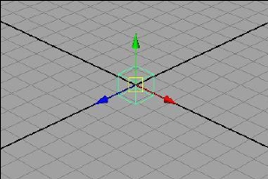
FreePointTriadManip
© 2009 Autodesk
5

Slide 6
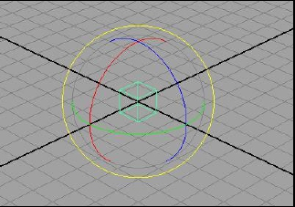
RotateManip
© 2009 Autodesk
6

Slide 7
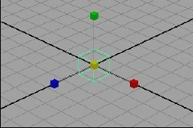
ScaleManip
© 2009 Autodesk
7

Slide 8
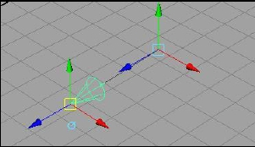
DirectionManip
© 2009 Autodesk
8

Slide 9
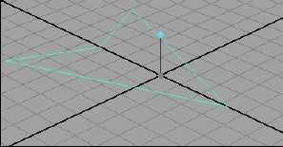
DistanceManip
© 2009 Autodesk
9

Slide 10
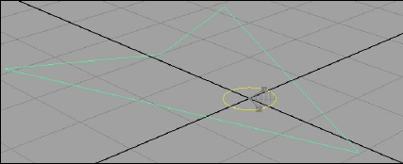
DiscManip
© 2009 Autodesk
10

Slide 11
Custom Manipulator
• Maya Standard Manipulators
• Derived from MPxManipContainer
• Container rather than a proxy manipulator
• Can contain more than one base manipulator
• Basic workflow:
• add base manipulators to container
• Set up associations between base manipulators and attributes
© 2009 Autodesk
11

Slide 12
MPxManipContainer
• Specify kManipContainer when registering the
node in initializePlugin
def initializePlugin(obj):
...
plugin.registerNode( "arrowLocatorManip", arrowLocatorManip::id, arrowLocatorManip_creator,
arrowLocatorManip_initialize, OpenMayaMPx.MPxNode::kManipContainer )
...
© 2009 Autodesk
12

Slide 13
Example: arrowLocatorManip.py
Class arrowLocatorManip (OpenMayaMPx.MPxManipContainer):
def __init__(self):
OpenMayaMPx.MPxManipContainer.__init__(self)
def createChildren(self):
def connectToDependNode(self, dependNode):
def draw(self, view, path, style, status):
fDiscManip = OpenMaya.MDagPath()
© 2009 Autodesk
13

Slide 14
MPxManipContainer
• Key functionalities:
• add base manipulators:
MPxManipContainer::createChildren()
• make associations between manipulators and attributes on
nodes:
MPxManipContainer::connectToDependNode()
• customize the drawing of your manipulator:
MPxManipContainer::draw()
© 2009 Autodesk
14

Slide 15
Add Base Manipulators
MPxManipContainer.createChildren()
def createChildren(self):
...
manipName ="angleManip"
angleName ="yRotation"
fDiscManip = self.addDiscManip(manipName,angleName)
startPoint = OpenMaya.MPoint(0,0,0)
startAngle = OpenMaya.MAngle(0.0,OpenMaya.MAngle.kDegrees)
fnDisc = OpenMayaUI.MFnDiscManip (fDiscManip)
fnDisc.setCenterPoint(startPoint)
fnDisc.setAngle(startAngle)
...
© 2009 Autodesk
15

Slide 16
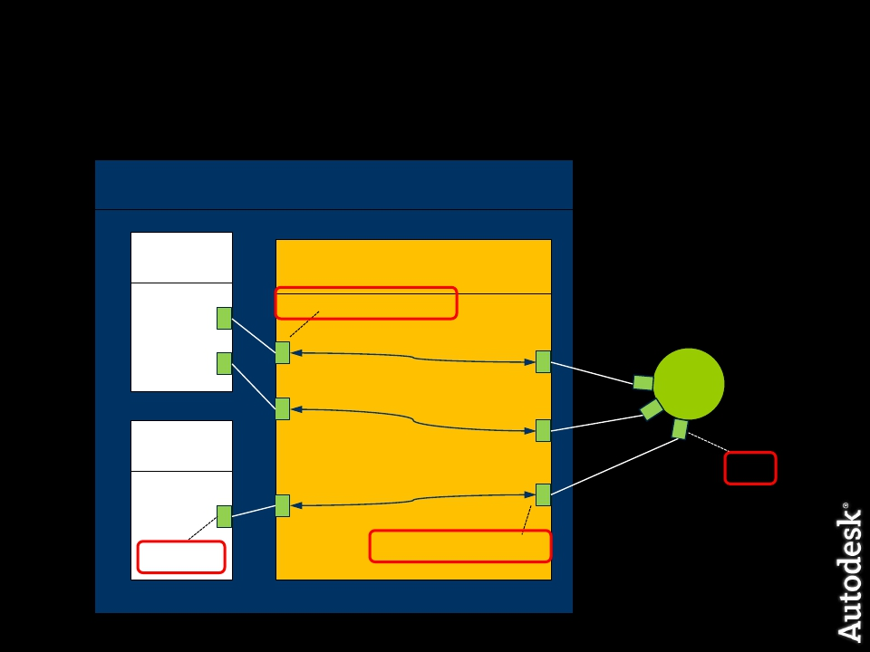
Communications between
Manipulators and Nodes
Container Manipulator
base
manip
Converter
converterManipValue items
?
node
?
base
manip
plug
?
converterPlugValue items
manipValue
items
© 2009 Autodesk
16

Slide 17
Communications between
Manipulators and Nodes
• Two types:
•
•
One-to-one association
Conversion functions
• MPxManipContainer::connectToDependNode()
© 2009 Autodesk
17

Slide 18
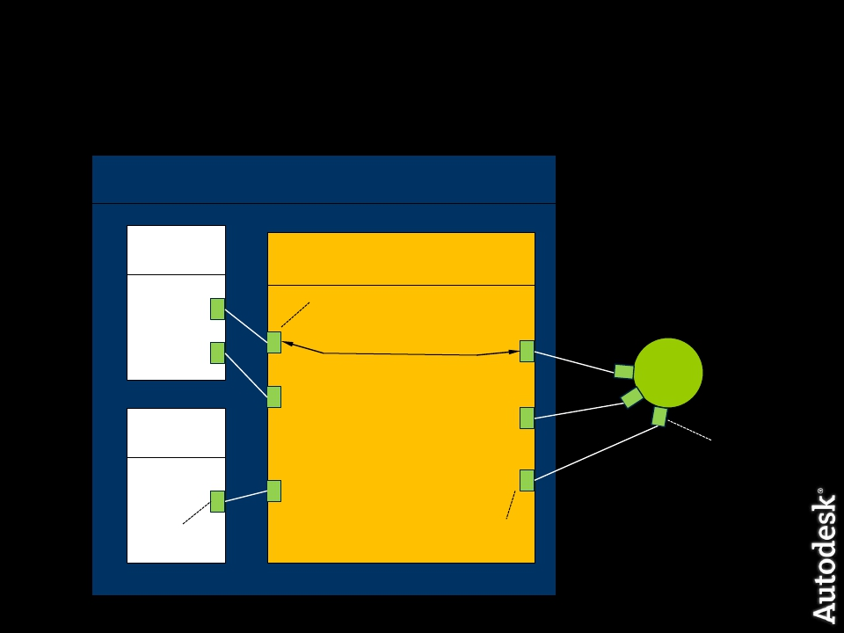
Communications between
Manipulators and Nodes
Container Manipulator
base
manip
Converter
converterManipValue items
one-to-one association
node
base
manip
plug
manipValue
items
converterPlugValue items
© 2009 Autodesk
18

Slide 19
One-to-one Association
• One-to-one associations are established through methods
on the manipulator classes derived from MFnManip3D
• Every standard manipulator has functions called
“connectTo**Plug”
•
•
•
•
•
•
•
MFnFreePointTriadManip::connectToPointPlug
MFnDirectionManip::connectToDirectionPlug
MFnDistanceManip::connectToDistancePlug
MFnPointOnCurveManip::connectToCurvePlug
…
….
MFnScaleManip::connectToScaleCenterPlug
© 2009 Autodesk
19

Slide 20
Example: arrowLocatorManip.py
def connectToDependNode(self, dependNode)
#Connect the plug with manip
fnDepNode = OpenMaya.MFnDependencyNode (dependNode)
rotationPlug = fnDepNode.findPlug("windDirection”)
fnDisc = OpenMayaUI.MFnDiscManip (fDiscManip)
fnDisc.connectToAnglePlug(rotationPlug)
OpenMayaMPx.MPxManipulatorNode.finishAddingManips(self)
OpenMayaMPx.MPxManipulatorNode.connectToDependNode(self, dependNode)
© 2009 Autodesk
20

Slide 21
Example: arrowLocatorManip.py
In this project, you will need to create a manipulator on
the arrowLocator and set up the one-to-one relationship
between the manipulator item value and the plug value on
your node.
© 2009 Autodesk
21

Slide 22

Communications between
Manipulators and Nodes
Container Manipulator
base
manip
Converter
converterManipValue items
one-to-one association
node
Conversion function
(manipToPlug)
base
manip
plug
Conversion function
(plugToManip)
converterPlugValue items
manipValue
items
© 2009 Autodesk
22

Slide 23
Conversion Functions
• Convert between manipulator values and plug values
• Implemented as callback methods
• Two kinds of conversion callbacks:
•
manipToPlug
•
addManipToPlugConversion (unsigned int manipIndex )
converterManipValues
converterPlugValues
•
plugToManip
•
addPlugToManipConversion (unsigned int manipIndex)
converterPlugValues
converterManipValues
•
The converter must be implemented in the
manipToPlugConversion() and plugToManipConversion virtual
method of these classes
• MManipData
© 2009 Autodesk
23

Slide 24
Example:arrowLocatorManip.py
def connectToDependNode(self, dependNode):
….
fnDepNode = OpenMaya.MFnDependencyNode (dependNode)
rotationPlug = fnDepNode.findPlug("windDirection")
fnDisc = OpenMayaUI.MFnDiscManip (fDiscManip)
fnDisc.connectToAnglePlug(rotationPlug)
centerPointIndex = fnDisc.centerIndex()
OpenMayaMPx.MPxManipulatorNode.addPlugToManipConversion (centerPointIndex)
….
© 2009 Autodesk
24

Slide 25
Example:arrowLocatorManip.py
def plugToManipConversion( self, manipIndex ):
try:
#Get parent transform node of the locator node
parentTransform = self.fNodePath.transform()
#Get the transform node DAG path
transformPath = OpenMaya.MDagPath()
OpenMaya.MDagPath.getAPathTo(parentTransform,transformPath)
#Retrieve world space translation
fnTrans = OpenMaya.MFnTransform(transformPath)
translation = OpenMaya.MVector()
translation = fnTrans.getTranslation(OpenMaya.MSpace.kWorld)
numData = OpenMaya.MFnNumericData()
numDataValue = numData.create(OpenMaya.MFnNumericData.k3Double)
status = numData.setData3Double(translation.x,translation.y,translation.z)
manipData = OpenMayaUI.MManipData(numDataValue)
except:
sys.stderr.write("ERROR: arrowManip.plugToManipConversion\n")
raise
return manipData
© 2009 Autodesk
25

Slide 26
MPxManipContainer::draw()
def draw(self, view, path, style, status):
OpenMayaMPx.MPxManipContainer.draw(self, view, path, style, status)
view.beginGL()
textPos = OpenMaya.MPoint (0, 0, 0)
distanceText = "Stretch Me!"
view.drawText(distanceText, textPos, OpenMayaUI.M3dView.kLeft)
view.endGL()
© 2009 Autodesk
26

Slide 27
Invoke manipulators
• Show Manipulator tool
•
•
Manipulator named after node type name
arrowLocator → arrowLocatorManip
In custom node’s initialize(), call
MPxManipContainer::addToManipConnectTable(MTypeId &id)
• Custom Context
© 2009 Autodesk
27

Slide 28
Manipulators and Contexts
MPxManipContainer::newManipulator ( const MString & manipName,
MObject & manipObject, MStatus * ReturnStatus = NULL )
MPxContext::addManipulator(const MObject &manipulator)
MPxContext::deleteManipulators()
MPxContext::toolOnSetup()
MPxContext::toolOffCleanup()
© 2009 Autodesk
28

Slide 29
Example: moveManip.py (devkit)
Id1 = OpenMaya.MCallbackId()
def toolOnSetup(self, event):
….
updateManipulators(self)
id1 = OpenMaya.MModelMessage.addCallback(OpenMaya.MModelMessage.kActiveListModified,
updateManipulators, self)
….
def toolOffCleanup(self):
...
OpenMaya.MModelMessage.removeCallback(id1)
...
© 2009 Autodesk
29

Slide 30
Example: moveManip.py (devkit)
def updateManipulators(data)
...
clientData.deleteManipulators() ...
# for each object selected
manipName ="moveManip"
manipObject = OpenMaya.MObject()
manipulator = OpenMayaMPx.MPxManipContainer.newManipulator(manipName,manipObject)
...
if manipulator is not None:
clientData.addManipulator(manipObject)
manipulator.connectToDependNode(dependNode)
...
© 2009 Autodesk
30

Slide 31
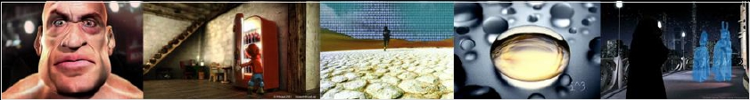
Major Limitation
Cannot create a custom manipulator that:
• Plug-in draws itself
• Maya performs selection on manipulator components
MPxManipulatorNode: openGL draw and selection
Autodesk Media & Entertainment
© 2009 Autodesk
31

Slide 32
Autodesk
© 2009 Autodesk
32

