Slide 1


Reading C++ Documentation
Kristine Middlemiss, Senior Developer Consultant
Autodesk Developer Network (ADN)
© 2012 Autodesk
1

Slide 2
Session Agenda
• Docs are written for C++
• Differences between C++ and Python API
© 2012 Autodesk
2

Slide 3

Docs are written for C++
© 2012 Autodesk
3

Slide 4
Python API Documentation
•
•
No Python-specific API class documentation
Methods not supported in Python:
•
Marked by: NO SCRIPT SUPPORT
•
In most cases, alternate forms are provided
© 2012 Autodesk
4

Slide 5
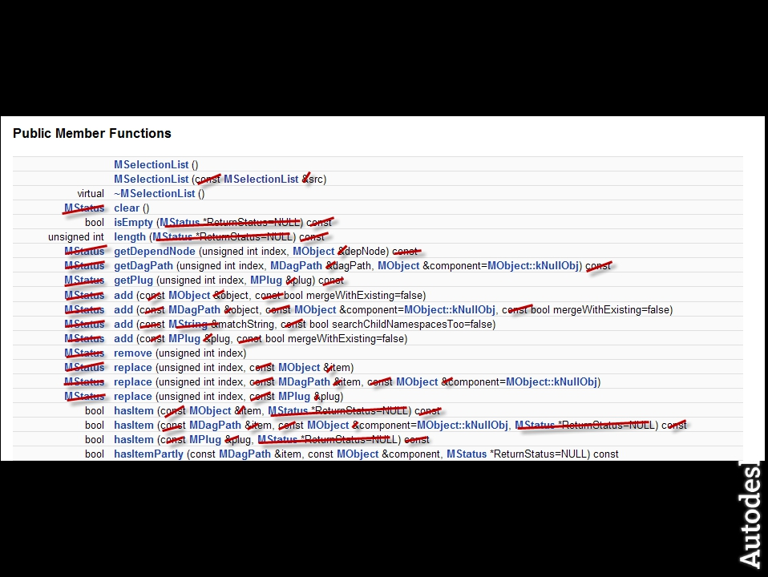
C++ Learning Curve in Docs
© 2012 Autodesk
5

Slide 6
Differences between C++ and Python API
© 2012 Autodesk
6

Slide 7
Maya Python API Plug-ins
• Several modules were constructed that expose most of
the C++ API functionality:
• OpenMaya.pyc
• OpenMayaAnim.pyc
• OpenMayaRender.pyc
• OpenMayaUI.pyc
• OpenMayaMPx.pyc
• OpenMayaCloth.pyc
© 2012 Autodesk
7

Slide 8
OpenMaya Key Points
• Parellels C++ libraries, except for maya.OpenMayaMPx
• All MPx proxy classes are collected into
maya.OpenMayaMPx for technical reasons.
• Python API is a thin wrapper around C++ API
• Full support of C++ Maya API functionality
• SWIG based bindings created from header files
• Modules: $MAYA_LOCATION/Python/lib/site-
packages/maya
© 2012 Autodesk
8

Slide 9
Python API Scripts: Example
• Most code translates readily from C++ to Python
# DG modifier to change perspective camera translateX
import maya.OpenMaya as om
sel = om.MSelectionList()
om.MGlobal.getSelectionListByName( "persp“, sel )
dagPath = om.MDagPath()
sel.getDagPath( 0, dagPath )
dagPath.fullPathName()
# Result: |persp #
mod = om.MDGModifier()
mod.commandToExecute( "setAttr persp.tx 5" )
mod.doIt()
maya.cmds.getAttr( "persp.tx" )
# Result: 5 #
mod.undoIt()
# Result: 28 #
© 2012 Autodesk
9

Slide 10
Python API vs. C++ API
• No MStatus class - use exceptions instead
try:
fnPlugin.registerCommand( “spLs", cmdCreator )
except:
sys.stderr.write( "Command registration failed")
raise
• Catch error if registerCommand() fails
© 2012 Autodesk
10

Slide 11
Python API vs. C++ API
• Detect error but allow code to keep running
try:
fnPlugin.registerCommand( “spLs", cmdCreator )
except:
sys.stderr.write( "Command registration failed")
pass
• Keyword pass used instead of raise
© 2012 Autodesk
11

Slide 12
Python API vs. C++ API
• MString and MStringArray classes have been replaced by Python
native strings and string lists
import maya.OpenMaya as om
sel = om.MSelectionList();
om.MGlobal.getSelectionListByName( "persp", sel )
path = om.MDagPath()
sel.getDagPath(0, path )
myString = path.fullPathName()
print "Path is %s" % myString
# Path is |persp #
myStrings = []
sel.getSelectionStrings( myStrings )
print myStrings
# [u'persp'] #
© 2012 Autodesk
12

Slide 13
Python API vs. C++ API
• Python does not have a concept of pointers
• Use MScriptUtils for working with pointers and
references
• Reference treated as a pointer
• MScriptUtils
• creates objects that can be passed as pointer or reference
parameters
• convenience methods for transferring values between these
objects and native Python datatypes
© 2012 Autodesk
13

Slide 14
Python API vs. C++ API
(C++)
(Python)
int MImage::getSize( unsigned int& width, unsigned int& height )
img = OpenMaya.MImage()
img.create( 512, 256 )
util = OpenMaya.MScriptUtil()
util2 = OpenMaya.MScriptUtil()
wPtr = util.asUintPtr() # creates a ptr object
hPtr = util2.asUintPtr() # creates another ptr object
OpenMaya.MScriptUtil.setUint( wPtr, 0 )
OpenMaya.MScriptUtil.setUint( hPtr, 0 )
img.getSize( wPtr, hPtr )
width = OpenMaya.MScriptUtil.getUint( wPtr ) # 512
height = OpenMaya.MScriptUtil.getUint( hPtr ) # 256
© 2012 Autodesk
14

Slide 15
Python API vs. C++ API
• MPxCommand has to use MSyntax
• In C++, it is possible to use the argument
parameter (MArgList) of MPxCommand::doIt() to
parse arguments.
• In Python, you must use the MSyntax and
MArgParser classes to support arguments within
a scripted MPxCommand.
© 2012 Autodesk
15

Slide 16
Python API Scripts: Caveats
• Careful about undo
•
•
API functionality is not automatically undoable in the same way
that MEL commands are
With Python API code operating outside of an MPxCommand-
derived class, there is no formal interface to allow you to
implement your own undo behaviour
• Careful with scripted plug-ins
•
•
Importing the .py file is not the same as loading it from the Plug-in
Manager
Will not register new commands/nodes
© 2012 Autodesk
16

Slide 17
Autodesk
© 2012 Autodesk
17

