Slide 1

Maya API Introduction
Naiqi Weng
Developer Consultant,
Autodesk Developer Network (ADN)

Slide 2
Bio
Education:
Bachelor of Computer Science, Tsinghua University
Master of Computer Science, University of Toronto
Working Experience
Contact: Naiqi.weng@autodesk.com

Slide 3
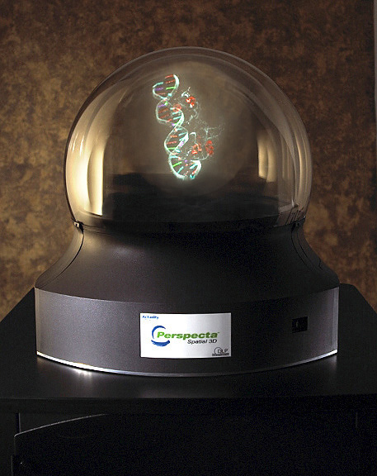

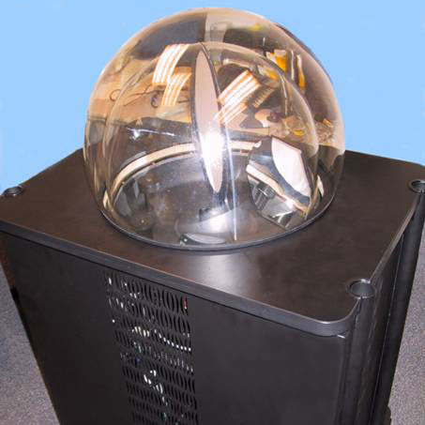
3D Computer Puppetry on Volumetric Display

Slide 4
Day One:
Morning:
Introduction to Maya API
Lab One
Introduction to Maya API (continued)
Afternoon:
Maya Nodes
Lab Two
Maya Nodes (continued)
Lab Three
Maya Commands
Lab Four

Slide 5

Day Two
Morning:
A Closer Look at Dependency Graph
Lab Five
Locator Tools
Lab Six
Devdays 2009 Maya API
Afternoon:
Maya UI API – Qt API Programming

Slide 6
Agenda
Maya Architecture Overview
Programming In Maya
Maya API Introduction
Plug-in Development

Slide 7
Maya Architecture Overview
Two vital concepts of Maya architecture
Dependency Graph
Command Architecture

Slide 8
Maya Architecture Overview
Dependency Graph

Slide 9
Dependency Graph
Example: revolving surface
Curve
Revolve
Surface

Slide 10
Dependency Graph
A collection of nodes that transmit data through connected attributes
A.a
A
B
C
B.b

Slide 11
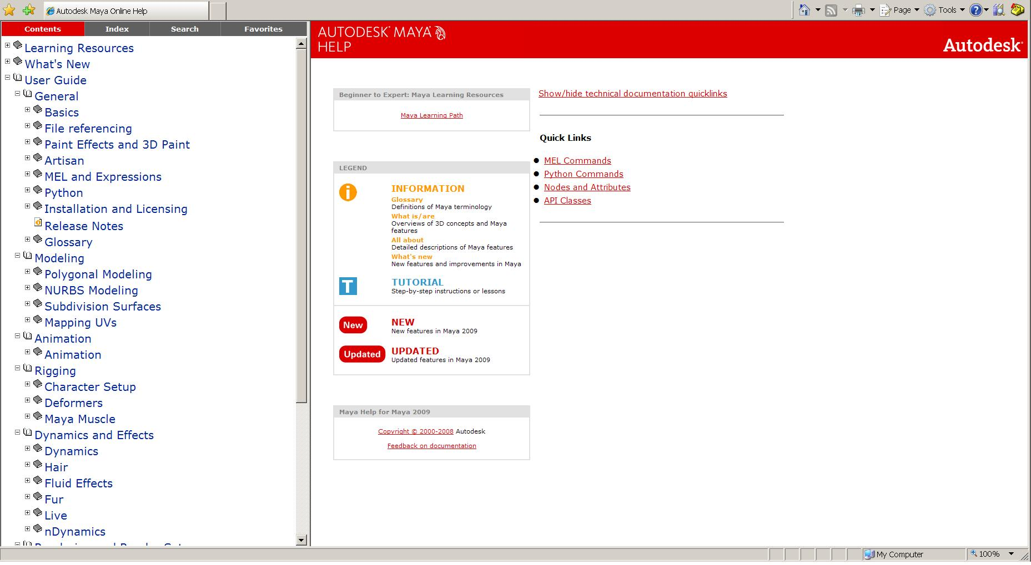
Maya Node Documentation

Slide 12
Dependency Graph

Slide 13
Maya Architecture Overview
Two vital concepts of Maya architecture
Dependency Graph
Command Architecture

Slide 14
Maya Architecture Overview
Command Architecture

Slide 15
Maya Command Architecture
Maya GUI
MEL Commands
Maya Core
OS

Slide 16
MEL Command Documentation

Slide 17
Maya Embedded Language
Maya Embedded Language (MEL) is a command based scripting language
Command framework provides a scripting interface to Maya’s internals:
Create and layout UI
Create nodes and connections
Etc.

Slide 18
MEL Command Examples
Some examples:
select –replace myCone; // Replaces selection list with myCone.
connectAttr myCone.ty mySphere.ty; // Connects translateY attributes
headsUpDisplay –s 0 –b 0 –label “myHUD” myHUD;
To view the syntax for a given command use `help`
help headsUpDisplay;
// Result:
//
// Synopsis: headsUpDisplay [flags] String
// Flags:
// -e -edit
// -q -query
// -ac -attributeChange String
// -ad -allDescendants
// … //

Slide 19
Create, Query and Edit Mode
Create Mode
Query Mode
window -query -widthHeight $window;
Edit Mode
window -edit -widthHeight 100 100 $window;
string $window = `window -title “TestWindow"
-iconName “testWnd" -widthHeight 200 55`;
showWindow $window;

Slide 20
Working with MEL in Maya
Variable declaration and Assignment
Control and looping statements
Global procedures
int $a = 5;
float $b = 3.456;
vector $v = <<1.2, 3.4, 6.5>>;
float $ar[] = {1.2, 3.4, 4.5}; // An array of floats
matrix $mtx[3][2]; // A 3x2 matrix of floats
if else if… else…
switch (…)
while ( …) {…}
for ($i = 10; $i > 0; $i--) { ...}
global proc <return type> <name>(<arg list>)
{
...
return <exp>;
}

Slide 21
Execute MEL commands
Command Line & Script Editor
Record MEL commands
Script Files: *.mel
Execute script file:
File -> Source Script
Place it in one of the script paths
Script Path: MAYA_SCRIPT_PATH
Useful Command/Directive:
whatIs: to find a global proc or internal built-in command
source: let Maya know a script has updated
rehash: let Maya rescan the script paths

Slide 22
Programming In Maya
Language Options
Maya Embedded Language (MEL)
C++
Python scripting (introduced in 8.5)

Slide 23
What do we need API for?

Slide 24
What do we need API for?
New Custom Node

Slide 25
What do we need API for?
Custom MEL Command
Maya GUI
MEL Commands
Maya API
Maya Core
OS

Slide 26
Maya API Introduction

Slide 27
What can you develop using API?
The Face Machine from Anzovin Studio
http://www.anzovin.com
Voice-O-Matic from Di-O-Matic
http://www.di-o-matic.com/

Slide 28
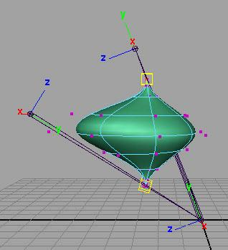

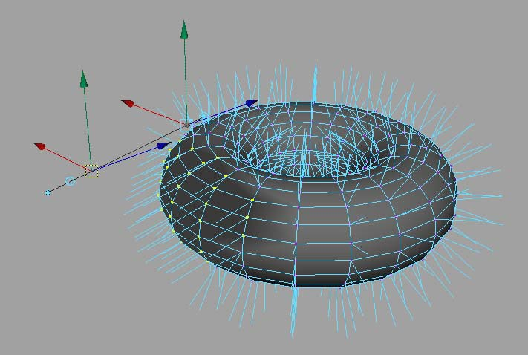
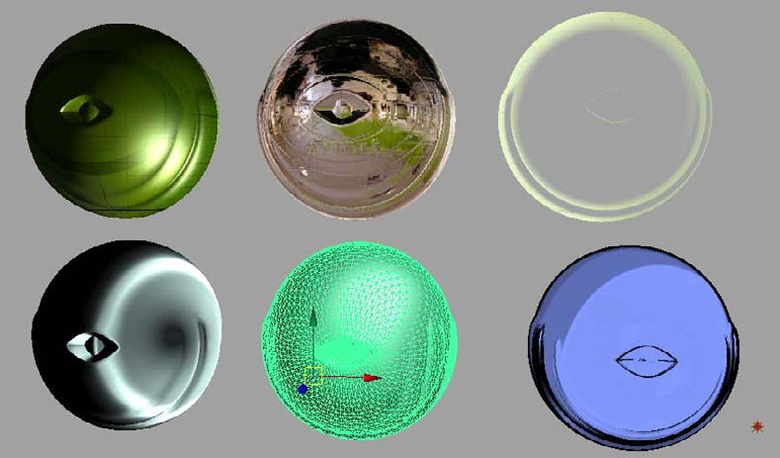
What can you develop using API?
Commands
Dependency Graph Nodes
Deformers
Shaders
Manipulators
Shapes
Etc.
Tools
File Translators

Slide 29
What can you develop using API?
Plug-in
Loads into Maya application
C++ or Python
Full Maya UI
Interact with user and Maya operations
Standalone application
Use Maya libraries to load/save Maya files
C++ or Python
No UI

Slide 30
Plug-in Development

Slide 31
Plug-in Development Environment (Maya 2009)
Operating System | Plug-in Type | Compiler
windows | .mll | Visual Studio 2005 with Service Pack 1 with Template hotfix
Linux | .so | gcc 4.1.2
Mac | .bundle | XCode 2.4.1 with gcc 4.0.1 Universal build binaries: powerPC, IntelMac
All Platforms | .py | Python 2.5.1 kernel

Slide 32
Maya Plug-in Architecture
initializePlugin() and uninitializePlugin() as entry point and exit point
Maya API
initializePlugin
uninitializePlugin
Maya
loadPlugin
unloadPlugin

Slide 33
Maya Plug-in Architecture
InitializePlugin()
UninitializePlugin()
MStatus initializePlugin(MObject obj)
{ MFnPlugin plugin(obj, “Autodesk”, “1.0”, “any”); //register command, nodes etc…
return status; }
MStatus uninitializePlugin(MObject obj)
{ MFnPlugin plugin(obj); //deregister command, nodes, etc…
return status; }

Slide 34
Deployment of plugins
Maya Plug-in Manager
Environment Variable: MAYA_PLUG_IN_PATH
Put your plug-ins into:
C:\My Documents\maya\2009\plug-ins
Add your custom plug-in path
putenv MAYA_PLUG_IN_PATH $destPluginPath;
Maya.env or userSetup.mel
string $currentPluginPath = `getenv MAYA_PLUG_IN_PATH`;
string $destPluginPath = $currentPluginPath + ";C:/My Documents";
putenv MAYA_PLUG_IN_PATH $destPluginPath;

Slide 35
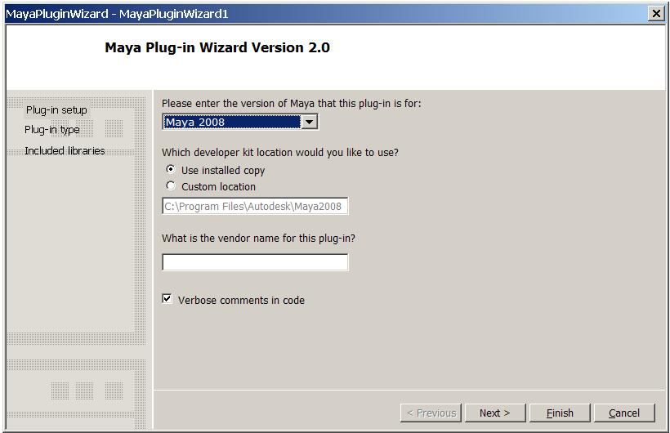
Maya Plug-in wizard
Maya_Installation_directory\devkit\pluginwizard
Manual installation
Appears in the new project section

Slide 36
Maya plug-in wizard installation (windows)
Browse to folder: C:\Program Files\Autodesk\Maya2008\devkit\pluginwizard\
Unzip the MayaPluginWizard2.0.zip file to a temporary directory.
Copy the following files:
MayaPluginWizard.ico
MayaPluginWizard.vsdir
MayaPluginWizard.vsz
to: C:\Program Files\Microsoft Visual Studio 8\VC\vcprojects\
Copy the MayaPluginWizard folder to:
C:\Program Files\Microsoft Visual Studio 8\VC\VCWizards\

Slide 37
How to set up your VS project
Link path: “project”—”XXX properties”—”Configuration Properties”—”C++”—”General”—”Additional Include Directories”
C:\Program Files\Autodesk\Maya2009\include
Library path: “project”—”XXX properties”—”Configuration Properties”—”Linker”—”General”—”Additional Library Directories”
C:\Program Files\Autodesk\Maya2009\library
Library: “project”—”XXX properties”—”Configuration Properties”—”Linker”—”Input”—”Additional Dependencies”
Foundation.lib, OpenMaya.lib…..
Output path: “project”—”XXX properties”—”Configuration Properties”—”Linker”—”General”—”Output File”
C:\My Documents\maya\2009\plug-ins

Slide 38
Demo
Plug-in wizard
A very basic plug-in that does nothing

Slide 39
Q & A

Slide 40
Autodesk

