Slide 1

Maya API Introduction
Naiqi Weng
Developer Consultant,
Autodesk Developer Network (ADN)

Slide 2

Maya API Design

Slide 3
Maya Architecture
Maya GUI
MEL Commands
Maya API
Maya Core
OS

Slide 4
API Design Overview
A tight wrapper around Maya’s internal architecture
An abstract layer, which separates Maya internal code from external plug-in developers
External
developer
Maya API
Maya core

Slide 5
Maya Libraries
OpenMaya: fundamental classes for defining nodes and commands and for assembling them into a plug-in
OpenMayaUI: classes necessary for creating new user interface elements such as manipulators, contexts, and locators
OpenMayaAnim: classes for animation, including deformers and inverse kinematics.
OpenMayaFX: classes for Autodesk® Dynamics™
OpenMayaRender: classes for performing rendering functions

Slide 6
Class Categories
Naming Convention | Logical Grouping | Examples
MPx*** | Proxy | MPxCommand MPxNode
MFn*** | Function set | MFnAttribute, MFnDependencyNode
MIt*** | Iterator | MItDependencyNodes, MItMeshEdge
M*** | Wrapper et. al | MObject, MPoint, M3dView

Slide 7
Proxy Classes
Proxy Object classes serve as base classes for your custom extensions.
Proxy Classes begin with “MPx”
Proxy Objects allow you to extend the Maya architecture through the creation of new Maya constructs (nodes, commands, etc.).
The most prevalent proxy classes include:
MPxCommand
MPxNode

Slide 8
Function Set Classes & MObject
Separate data with functionality
Classical OOP
VS.
Maya API Approach
Class A
Data class A
data
Functions Class B
Functions

Slide 9
Function Set Classes
Function Sets are classes that provide type specific APIs to the corresponding type(s) of MObjects
MFnMesh
Mesh
Node
Functions:
numVertices()
numEdges()
numPolygons()
subdivideFaces()
extrudeFaces()
split()
etc.
Transform
Node

Slide 10
Function Set Classes
MFn::Type enumeration is used throughout the API to indicate item types
MFn::Type MFnBase::type() const
Once a function set is initialized to an MObject, you can call methods to query or set values on the object
MFnBase::setObject ()
MFnMesh myMeshFn( myMeshObj );
myMeshFn.setObject( myMeshObj2 );
Some of the commonly used function sets:
MFnDependencyNode
MFnDagNode
MFnAttribute

Slide 11
Function Set Classes
MFnDependencyNode
Base class providing fundamental operators for all dependency nodes
Contains methods to query the name of a node, locate an attribute and parse connections
MFnDagNode
Derived from MFnDependencyNode
Provides methods to query or modify parent/child relationships in the DAG
MFnAttribute
Base class for Maya DG attributes
Offers methods to create an attribute or query/set properties of an attribute on a node

Slide 12
Function Set Classes & MObject
Separate data with functionality
Classical OOP
VS.
Maya API Approach
Class A
Data class A
data
Functions Class B
Functions
MObject

Slide 13
MObject
MObject is the fundamental data type that represents an object in Maya.
Maya API
MObject
Type Information
Pointer to Object
Maya
Internal
Object

Slide 14
MObject
Objects owned by Maya are accessed via an MObject
MObject = (void *) + (type information)
MObjects are handles to Maya internal objects
Maya objects are created and destroyed by Maya
Use function sets class to operate on MObjects

Slide 15
MObject & MFn::Type
Each MObject carries a type field.
MFn::Type MObject::apiType() const
This type comes from an enumerated list of all node types internal to Maya.
For a comprehensive list of all Maya node types, see MFn.h.

Slide 16
MObject & MFn::Type
MFnMesh
MObject
MFn::kMesh
Mesh
Node
Functions:
numVertices()
numEdges()
numPolygons()
subdivideFaces()
extrudeFaces()
split()
etc.
MObject
MFn::kTransform
Transform
Node

Slide 17
MObject
As a pointer to internal objects...
MObjects are not guaranteed to be valid between calls to your plug-in.
It is strongly recommended that you do not hang onto an MObject between calls to your plug-in.
MObjectHandle can be used to test the validity of an MObject.

Slide 18
Iterator Classes
Used to loop over elements of the same type
Iterators start with “MIt”
Some common iterators are
MItDag
MItDependencyNodes
MItMeshEdge
MItMeshVertex
MItMeshPolygon
MItSurfaceCV

Slide 19
Wrapper Classes
Wrapper class exist for simple classes (such as MPoint, MVector, etc…)
Fully implemented C++ classes

Slide 20
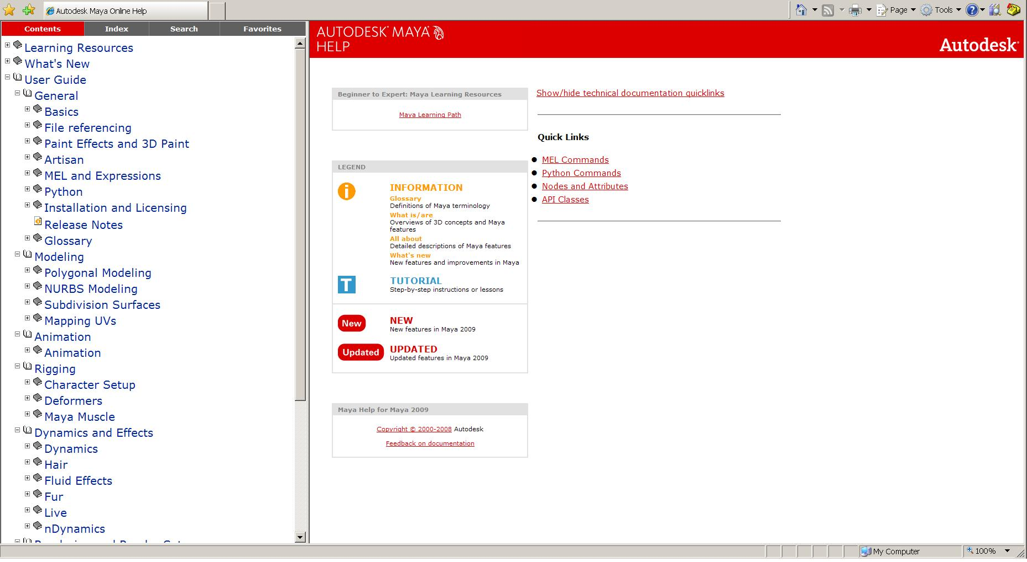
Maya Technical Resources
Including Documents on MEL, Python, Nodes and API Classes
Technical Documents

Slide 21
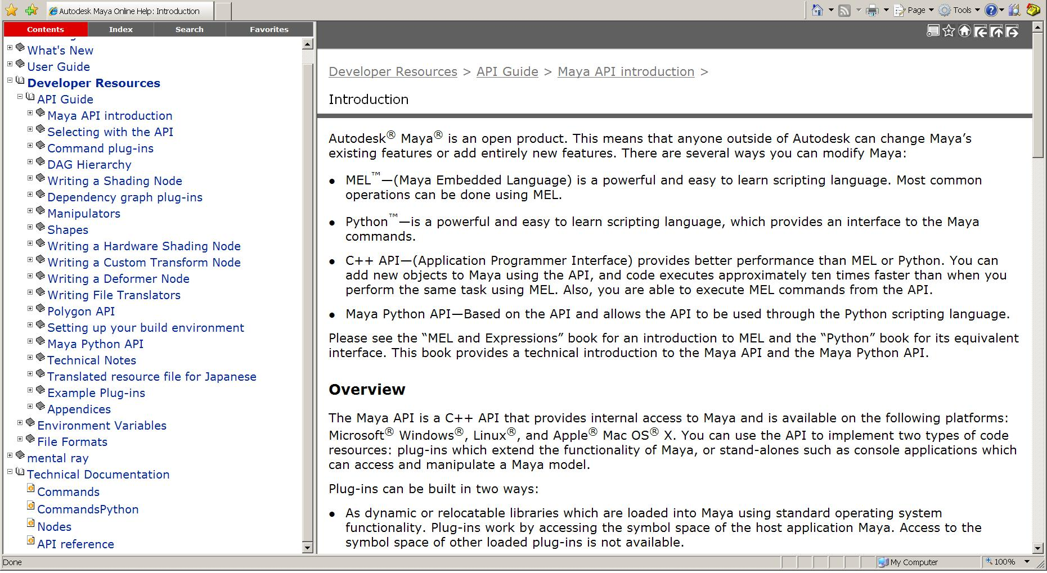
Maya API Resources
The Maya API Documentation contains a wealth of information on all aspects of the API.
API Docs
API Reference

Slide 22
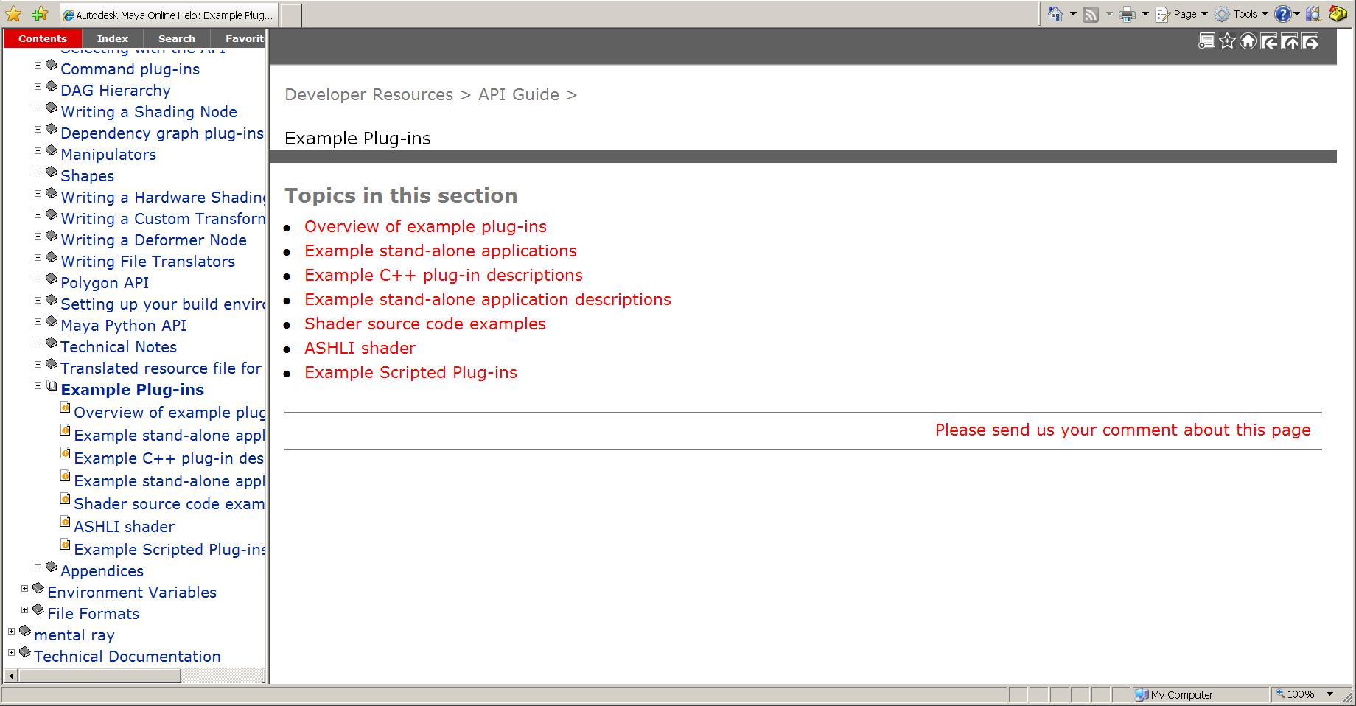
Examples
Example Docs

Slide 23
Examples
C++ Plug-in Examples:
C:\Program Files\Autodesk\Maya2009\devkit\plug-ins
C++ Standalone Application Examples:
C:\Program Files\Autodesk\Maya2009\devkit\applications
Python Examples:
C:\Program Files\Autodesk\Maya2009\devkit\plug-ins\ scripted

Slide 24
Maya API Resources
Maya API White Paper, DevTV
Discussion Forum:
http://area.autodesk.com/forum/autodesk-maya/sdk/
Developer Center:
http://usa.autodesk.com/adsk/servlet/index?siteID=123112&id=9469002
Questions and Problems: ADN
http://www.autodesk.com/adn
Recommended Maya API Programming Books:
David A. D. Gould. Complete Maya Programming, Volume 1. Morgan Kaufmann Publishers, San Francisco, 2003. ISBN:1-55860-835-4

Slide 25
Q & A

Slide 26
Autodesk

