Slide 1

Maya API Training
Naiqi Weng
Developer Consultant,
Autodesk Developer Network (ADN)
Notes:
If you have any comments or suggestions, feel free to let us know.

Slide 2



Naiqi Weng
Education:
Bachelor of Computer Science, Tsinghua University
Master of Computer Science, University of Toronto
Working Experience: Maya API , MotionBuilder and 3DsMax SDK
Contact: Naiqi.weng@autodesk.com

Slide 3
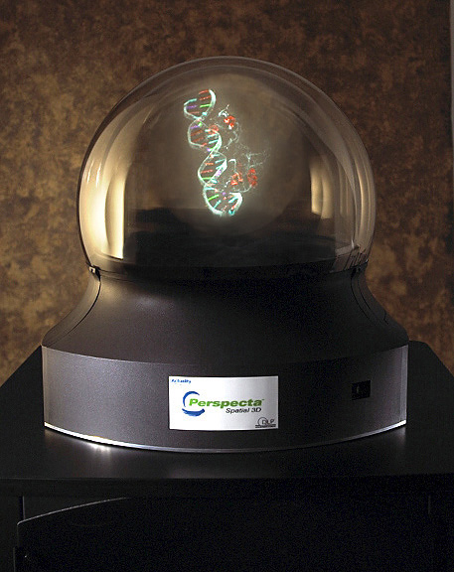

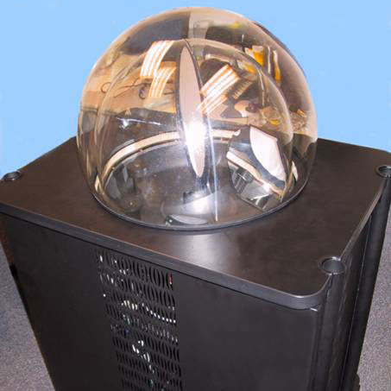
3D Computer Puppetry on Volumetric Display
Notes:
It has a 20 inch semi-transparent image plane inside. When it is turned on, this image plane rotates around its vertical axis and generates a 10 inch spherical 3D volumetric image.
Experiment with different interaction and control techniques, for example, motion capture captures hand gesture and figurine posture to control the animation on this display.
It has a refresh rate of 24 frame/second. It can be viewed from any position around the hemispherical dome, without requiring the user to wear any hardware.

Slide 4
Day One:
Morning:
Maya Programming Introduction
Maya API Overview
Lab One
Maya API Classes
Afternoon:
Maya Custom Nodes
Lab Two
Maya Custom Nodes (continued)
Lab Three
Difference between Python and C++ API
Notes:
Due to time constrains and the level of different attendees, we set the level of this training class to be introductory to intermediate level,
if you are interested to learn those advanced topics, you can tell us in the feedback survey at the end of the training
the language difference between python and C++

Slide 5
Day Two
Morning:
Maya Custom Commands
Lab Four
A Closer Look at Dependency Graph
Lab Five
Afternoon:
Miscellaneous Tools
Lab Six
Maya Manipulators
Lab Seven

Slide 6

Maya Programming Introduction
Naiqi Weng
Developer Consultant,
Autodesk Developer Network (ADN)

Slide 7
Agenda
Programming v.s. Not Programming
Programming in Maya: Language Options
Python in Maya
Help Documentation
Logging Bugs and Suggestion Features
Available Resources

Slide 8
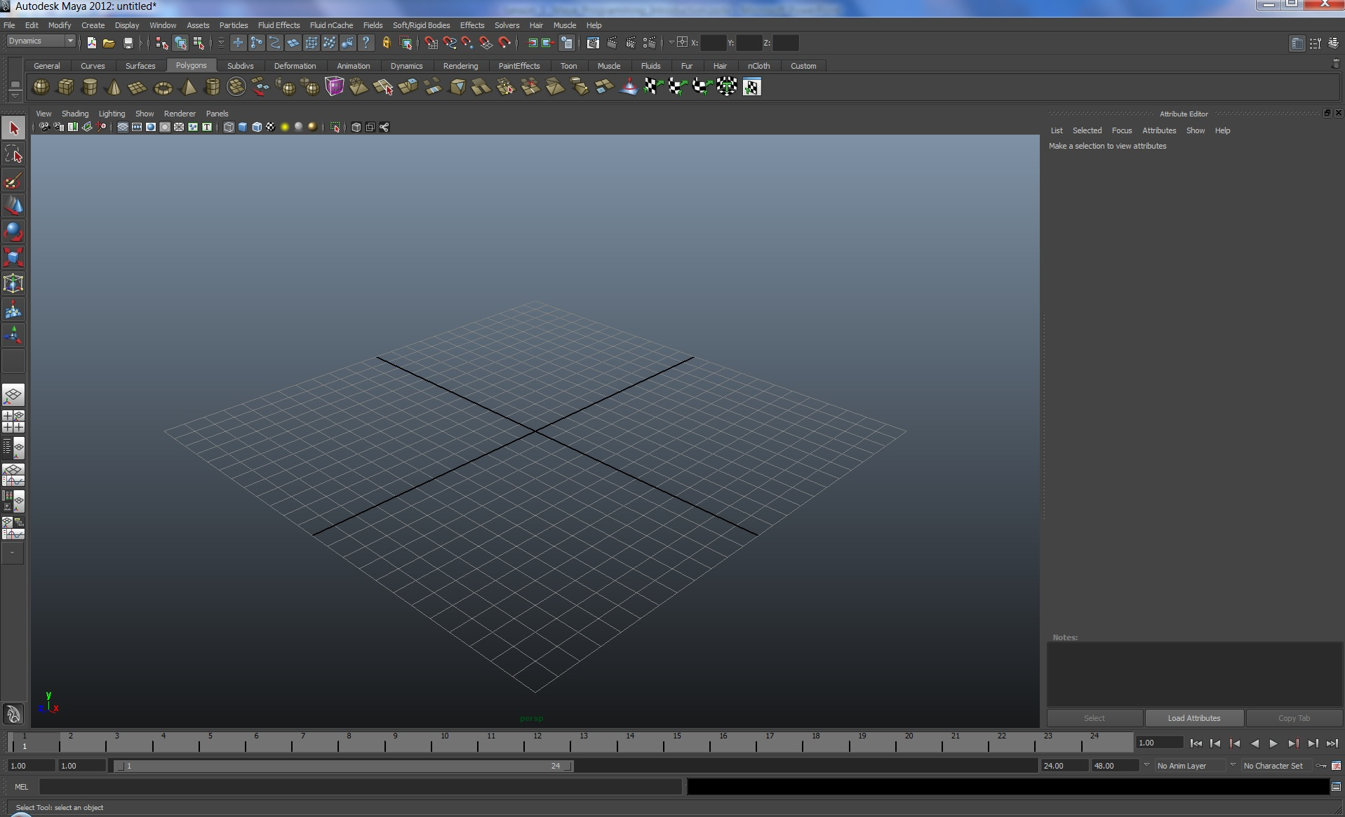
Autodesk Maya 2012

Slide 9
Why use programming in Maya?
Automate repetitive, time-consuming tasks and extend features
Uses popular, easy-to-use Python scripting language
The C++ and Python APIs to create custom tools and features that plug directly into Maya
Create project-specific functionality, for specific workflows and requirements.

Slide 10
Programming In Maya
Language Options
Maya Embedded Language (MEL)
C++
Python scripting (introduced in 8.5)
Notes:
MEL is - (C like syntax)

Slide 11
MEL Scripting
MEL™ (Maya Embedded Language) is a scripting language at the heart of Maya.
Maya’s user interface is created using MEL, and MEL provides an easy way to extend the functionality of Maya.
Everything you can do using Maya’s graphical interface can be automated and extended using MEL.
Familiarity with MEL can deepen your understanding of and expertise with Maya.

Slide 12
Maya C++ API
The Maya API increases Maya’s power, customizing and extending Maya in many ways that you never thought possible.
It provides functionality for querying and changing the Maya model along with the ability to add new Maya objects to the Maya model.
You can use the Maya API to implement two types of code resources: plug-ins which extends the functionality of Maya, and standalones such as console applications which can access and manipulate a Maya model.

Slide 13
Python Scripting & API
Python™ is a powerful and popular object-oriented scripting language.
With the introduction of Python into Maya 8.5, we now provide Python support for calling the Maya commands.
In addition, we support the Maya Python API which allows developers to write Maya plug-ins and stand-alone applications without having to learn C++.
This integration of Python in Maya empowers production facilities to better integrate Autodesk Maya into your production pipeline.

Slide 14
Advantages of Scripting
Easier learning curve
No resources needed to start developing, such as Visual Studio
Quick prototyping for tools
Platform Independent
Tons of free modules (Python)
Easily move between API and Scripting capabilities in Maya all with in the same plug-in or script (Python)
Notes:
Pros and Cons

Slide 15
Advantages of C++ API
Compiled, no source code disclosure
Can be 10+ faster than Python
More classes and function exposed
More detailed manipulation of lower level core
More devkit samples and resources

Slide 16
Python in Maya: Motivation
Scripting language, rapid prototyping
Objective-oriented programming
Flexible and Versatile
Server framework
System programming
Database tools
Open Source: large number of shared standard libraries
Cross Platform
Notes:
Disadvantages
Slower than a fully compiled language like C++
Discloser

Slide 17
Usages of Python in Maya
Maya Python scripts
access standard "Maya commands" from Python
like MEL scripts written in Python
Maya Python API Scripts
write scripts that access functionality previously available only through the C++ API
Maya Python API Scripted Plug-ins
define new commands, nodes, etc using Python
like C++ plug-ins written in Python
Maya Python Standalone Apps
like MLibrary-based C++ applications, but written in Python
Non UI

Slide 18





Python Scripting in Maya
Image courtesy of Johan Vikström, Shilo, Ool Digital, Mikros Image

Slide 19
Executing Python Script
Script Editor
Shelf
Command Line
Plug-in Manager
Python modules of Maya from a standalone Python interpreter

Slide 20
Maya’s Python Modules
maya | Top-level module
maya.cmds | Maya commands (e.g. sphere, getAttr) and plug-in commands
maya.utils | Utilities not specific to API or Maya commands
maya.standalone | Initialization routine for standalone Python
maya.OpenMaya* | OpenMaya API modules
maya.app.* | Python code used to implement Maya
maya.mel.* | Utility for executing MEL commands

Slide 21
Some Useful Standard Python Modules
os | process management, environment variables, etc
os.path | file path routines: join, split, etc.
sys | shell arguments (argv), python globals
re | regular expressions
urllib2 | URL access
pickle | object archiving
getopt | command line argument parsing
math | assorted math routines and constants

Slide 22
Python Modules
All Python functionalities are contained in modules
Modules may have hierarchy (e.g os.path)
Import modules to access their functionality
“import” adds a module to the namespace of your code
“import” searches sys.path
Similar to “include” in C++

Slide 23
Importing Modules
Three forms of import:
Import a module using full namespace
Import a module using full namespace, but choose a new name
Import an item from anther module into your global namespace
import maya.cmds
maya.cmds.sphere()
import maya.cmds as cmds
cmds.sphere()
from maya.cmds import *
sphere()

Slide 24
Script Modules
Module is used to define closely related functionality
Use Python "import" command to bring in modules
import myModule
myModule.myFunction()
# Result: 1 #
“reload" command updates module:
reload( myModule )
Module must be available in system path

Slide 25
Python Path
sys.path
Can be modified after Python is initialized
PYTHONPATH environment variable
Read when Python initializes
Stored in sys.path

Slide 26
Adding Modules to Your Python Path
Append to sys.path in your userSetup.py or other script once Maya is running.
import sys
sys.path.append( '/Users/nweng/maya/Scripts' )
Set PYTHONPATH in your Maya.env file, or in your environment before you run Maya

Slide 27
Maya Environment Variable
Text file: Maya.env
Recommended approach of setting environment variable
Syntax:
PYTHONPATH = C:\Users\wengn\Documents\test
Save it to
C:\Users\wengn\Documents\maya\2012\Maya.env

Slide 28
Set Up Custom Python Environment
userSetup.py
Create a userSetup.py in
C:\My Documents\maya\2012\scripts
Put commands you want Maya to run on start up
import maya.cmds as cmds
It is executed during initialization and setup phase of Maya
Notes:
The userSetup.py script is executed during the initialization and setup phase of Maya; therefore, only commands which set up your working environment and have no dependencies on Maya functionality can be successfully run in this script.

Slide 29
Exploring the Programming Docs
Image courtesy of Johan Vikström, Shilo, Ool Digital, Mikros Image

Slide 30
Maya Documents
Online documentation:
http://download.autodesk.com/global/docs/maya2012/en_us/index.html
Download Link:
http://usa.autodesk.com/adsk/servlet/index?siteID=123112&id=16278314&linkID=10809894
Image courtesy of Johan Vikström, Shilo, Ool Digital, Mikros Image
Notes:
This is first time that Maya 2012, Max 2012 and MotionBuilder 2012 documentation become an online documentation

Slide 31
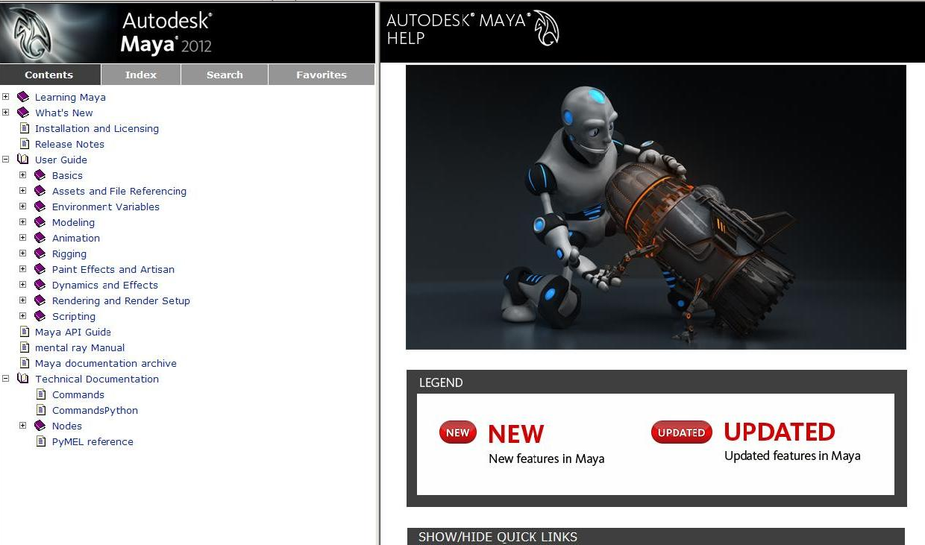
Technical Documents

Slide 32
Maya 2012 API Documentation
Online version: http://download.autodesk.com/global/docs/mayasdk2012/en_us/index.html
Download Link
http://usa.autodesk.com/adsk/servlet/item?siteID=123112&id=16707768
Image courtesy of Johan Vikström, Shilo, Ool Digital, Mikros Image

Slide 33
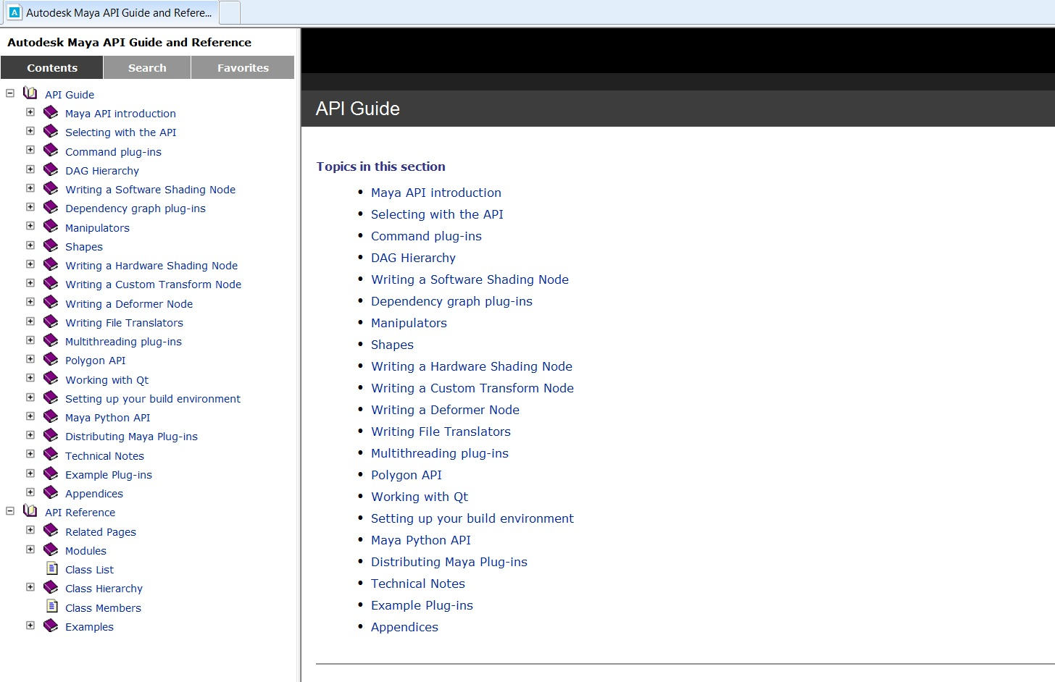
Maya API Documentation
The Maya API Documentation contains a wealth of information on all aspects of the API.
Notes:
API Guide is like a tutorial style
API reference: the reference for all the API classes from different perspective

Slide 34
Python API Documentation
Introduction documentation in API Guide
Class reference share the same documentation with C++ API
Python API Introduction
Python API

Slide 35
Python API Documentation
No Python-specific API class documentation
Methods not supported in Python:
Marked by: NO SCRIPT SUPPORT
In most cases, alternate forms are provided

Slide 36
Examples
C++ Plug-in Examples:
C:\Program Files\Autodesk\Maya2012\devkit\plug-ins
C++ Standalone Application Examples:
C:\Program Files\Autodesk\Maya2012\devkit\applications
Python Examples:
C:\Program Files\Autodesk\Maya2012\devkit\plug-ins\ scripted
C:\Program Files\Autodesk\Maya2012\devkit\applications\scripted

Slide 37
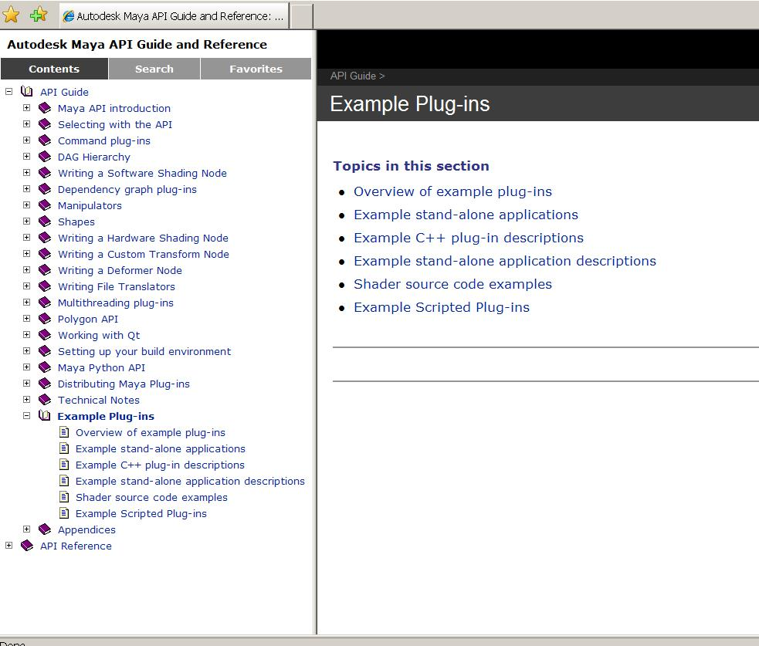
Examples
Example Docs

Slide 38
Let us know!
Let us know about Maya defects or Wish list items:
Log software defects here:
www.autodesk.com/maya-bugreport
Log software wish list items here:
www.autodesk.com/maya-sug

Slide 39
Others who use Python
Other Autodesk Products:
MotionBuilder: real-time animation product.
FBX: Autodesk File Format
Wiretap: access to media managed on Autodesk® Stone® file systems without the need to convert files or copy media across the network.
Non-Autodesk:
Youtube, Google, NASA and Air Canada's reservation management system.

Slide 40
Maya API Resources
Maya Developer Center
http://www.autodesk.com/developmaya
Maya API White Paper’s (provided)
DevTV (Webcast)
Questions and Problems: ADN
http://www.autodesk.com/adn
Recommended Maya API Programming Books:
David A. D. Gould. Complete Maya Programming, Volume 1. Morgan Kaufmann Publishers, San Francisco, 2003. ISBN:1-55860-835-4
The AREA || 3D Community Forums

Slide 41
Q & A

Slide 42
Autodesk

