Slide 1

Maya API Training
Naiqi Weng
Developer Consultant,
Autodesk Developer Network (ADN)

Slide 2

Maya API Overview
Naiqi Weng
Developer Consultant,
Autodesk Developer Network (ADN)

Slide 3





Agenda
Maya Architecture Overview
Maya API Introduction
Plug-in Development
Image courtesy of Johan Vikström, Shilo, Ool Digital, Mikros Image

Slide 4
Maya Architecture Overview
Two vital concepts of Maya architecture
Dependency Graph
Command Architecture

Slide 5
Maya Architecture Overview
Dependency Graph
Image courtesy of Johan Vikström, Shilo, Ool Digital, Mikros Image
Notes:
Dependency Graph is the controlling structure inside of Maya, is the core that makes the whole system work, for example, when I execute anmiation, build models, or I run particle simulation, the DG is the thing inside Maya that’s doing the work for me.

Slide 6
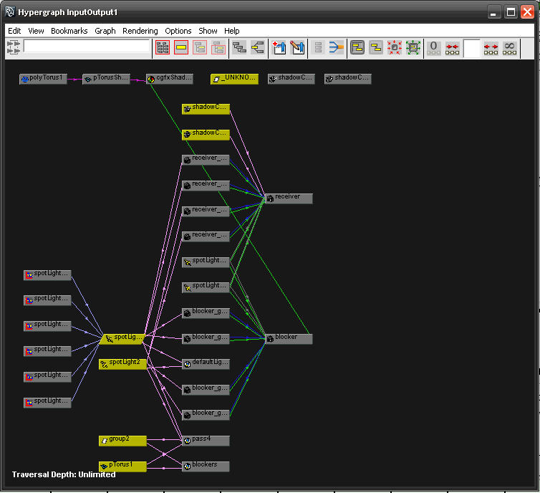
Maya Hypergraph
Menu: “Window”– “Hypergraph:Connections”
Nodes
Node
Connections
Attributes
Connections

Slide 7
What is the Dependency Graph?
Control system of Maya
Patented technology: US Patent #5,808,625 US Patent #5,929,864
A collection of nodes that transmit data through connected attributes
A.a
A
B
C
B.b

Slide 8
Dependency Graph
Example: revolving surface
Curve
Revolve
Surface
Notes:
It is a graphical representation of the relationship between objects in current Maya scene.

Slide 9
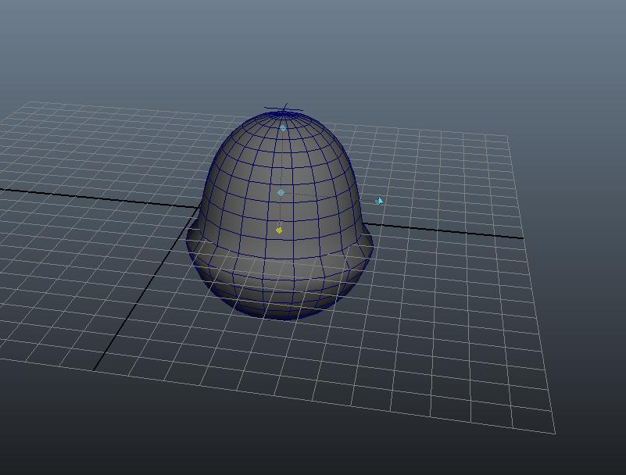
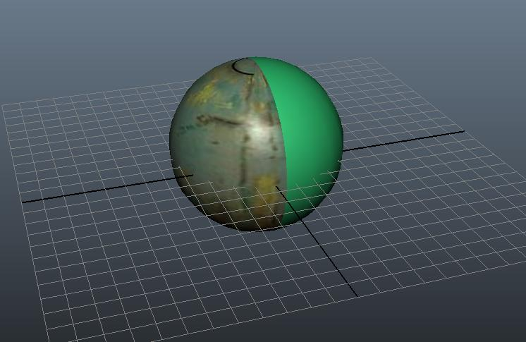
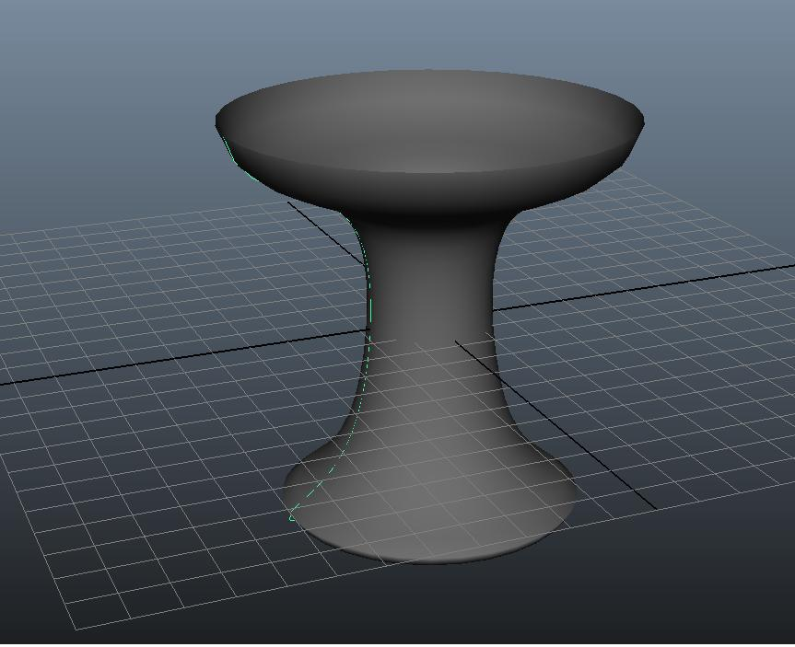
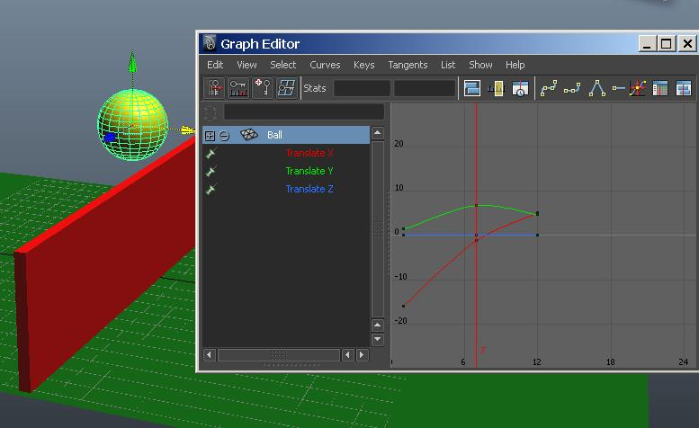
Dependency Graph
Everything in Maya 3D space maps to DG Nodes
Anything you do in the UI will affect DG
File
Texture
Phong
Shader
Shading
Group
Anim
Curve
Revolve
Transform
Surface
Poly
poly
Curve
Time
deformer

Slide 10
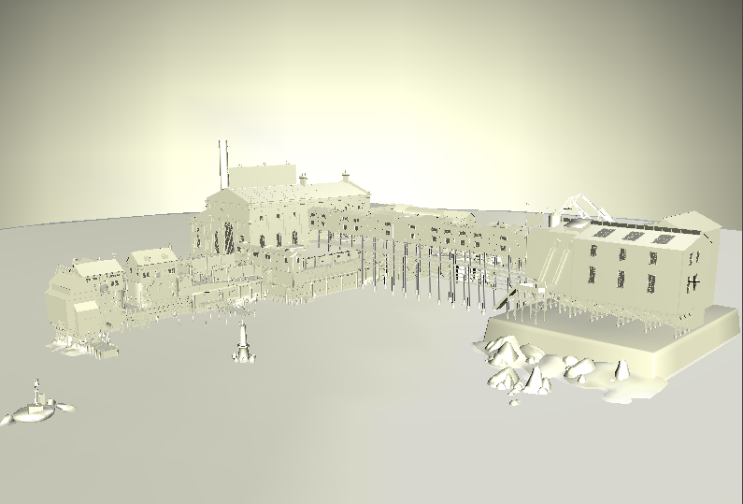
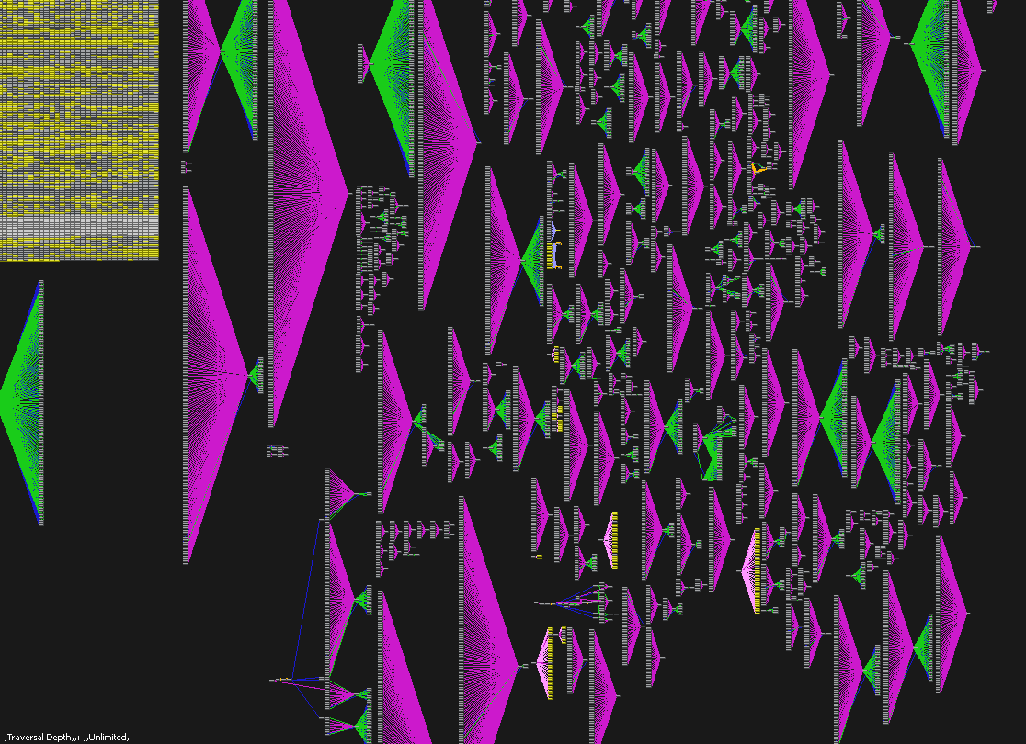
Dependency Graph
© 2009 WET, Artificial Mind and Movement (now Behaviour Interactive)
© 2009 Bethesda Softworks. Image courtesy of Behaviour Interactive

Slide 11
Dependency Graph
Notes:
Every node takes care of its own operations

Slide 12
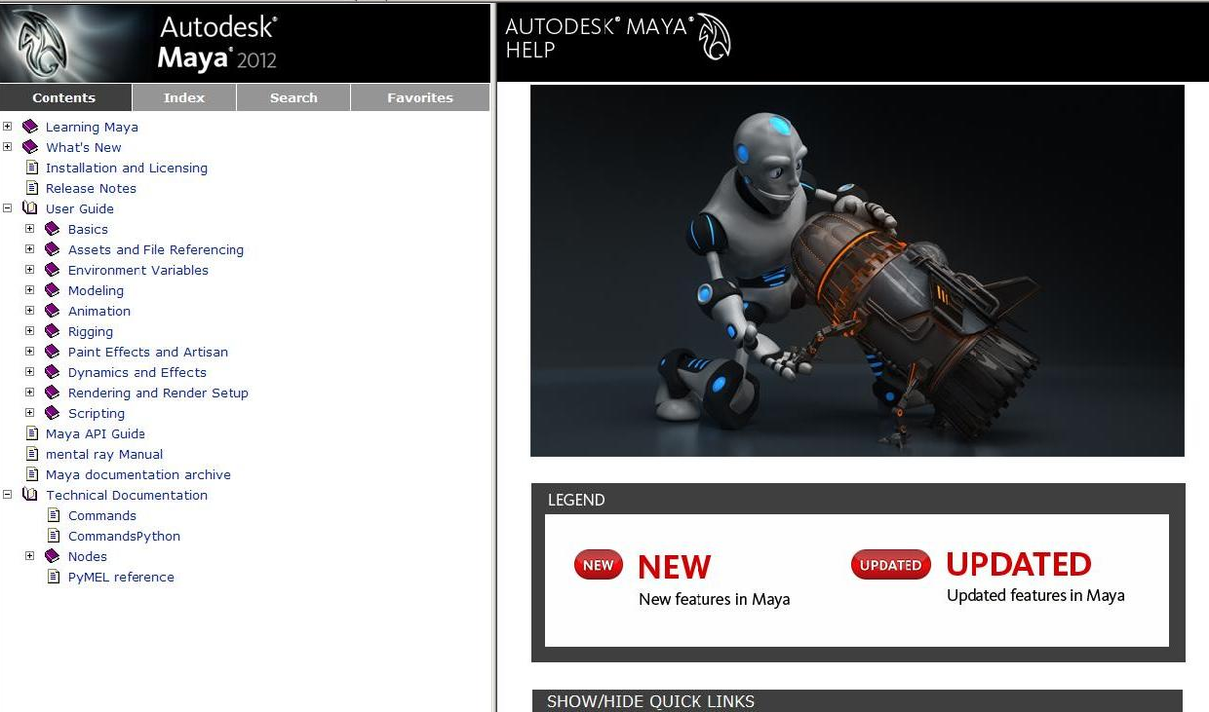
Maya Node Documentation
Notes:
There are over 600 built-in nodes shipped with Maya.

Slide 13
Maya Architecture Overview
Two vital concepts of Maya architecture
Dependency Graph
Command Architecture
Image courtesy of Johan Vikström, Shilo, Ool Digital, Mikros Image

Slide 14
Maya Architecture Overview
Command Architecture
Image courtesy of Johan Vikström, Shilo, Ool Digital, Mikros Image

Slide 15
Maya Command Architecture
Maya GUI
MEL Commands
Maya Core
OS
Notes:
Most of the time you are using this layer to work with Maya. Actually 98% of Maya User Interface is made with MEL.

Slide 16
Maya Embedded Language
Maya Embedded Language (MEL) is a command based scripting language
Command framework provides a scripting interface to Maya’s internals:
Create and layout UI
Create nodes and connections
Etc.
Notes:
As a language, MEL is descended from UNIX shell scripting. This means MEL is strongly based on executing commands to accomplish things (like executing commands in a UNIX shell).
Maya’s whole user interface is created using MEL, you can customize your Maya interface.
Write scripts and procedure to bypass the user interface and manipulate the DG , also make tasks automatic and Speed up your production
learning MEL will open up new worlds to you, allowing you produce effects and save time in ways impossible using the graphical interface.

Slide 17
MEL Command Examples
Some examples:
select –replace myCone; // Replaces selection list with myCone.
connectAttr myCone.ty mySphere.ty; // Connects translateY attributes
headsUpDisplay –s 0 –b 0 –label “myHUD” myHUD;
To view the syntax for a given command use `help`
help headsUpDisplay;
// Result:
//
// Synopsis: headsUpDisplay [flags] String
// Flags:
// -e -edit
// -q -query
// -ac -attributeChange String
// -ad -allDescendants
// … //

Slide 18
MEL Command Documentation
Notes:
Maya comes with over 900 commands that let you do all kinds of operations in maya.

Slide 19
Create, Query and Edit Mode
Create Mode
Query Mode
window -query -widthHeight $window;
Edit Mode
window -edit -widthHeight 100 100 $window;
string $window = `window -title “TestWindow"
-iconName “testWnd" -widthHeight 200 55`;
showWindow $window;

Slide 20
Working with MEL in Maya
Variable declaration and Assignment
Control and looping statements
Global procedures
int $a = 5;
float $b = 3.456;
vector $v = <<1.2, 3.4, 6.5>>;
float $ar[] = {1.2, 3.4, 4.5}; // An array of floats
matrix $mtx[3][2]; // A 3x2 matrix of floats
if else if… else…
switch (…)
while ( …) {…}
for ($i = 10; $i > 0; $i--) { ...}
global proc <return type> <name>(<arg list>)
{
...
return <exp>;
}

Slide 21
Execute MEL commands
Command Line & Script Editor
Record MEL commands
Script Files: *.mel
Execute script file:
File -> Source Script
Place it in one of the script paths
Script Path: MAYA_SCRIPT_PATH
Useful Command/Directive:
whatIs: to find a global proc or internal built-in command
source: let Maya know a script has updated
rehash: let Maya rescan the script paths
Notes:
If you change a script after sourcing it, the change is not automatically picked up by Maya. You need to re-run the script with File > Source Script.
Source and rehash are all derivatives, not commands
Script nodes are a way of storing a MEL script in a Maya scene file.
You can set a script node to execute its “payload” in response to various events:
1. When the node is read from a file.
2. Before or after rendering a frame.
3. Before or after rendering an animation.
4. When a file is closed or de-referenced.
A script node has three attributes: Before, After, and Type. Depending on the Type of script, the Before and After attributes specify when the script executes.

Slide 22
What do we need API for?

Slide 23
What do we need API for?
New Custom Node

Slide 24
What do we need API for?
Custom MEL Command
Maya GUI
MEL Commands
Maya API
Maya Core
OS
Notes:
The Key role: API can add new features onto Maya, extend Maya’s functionality.
Also, the API has a wider access to data compared to MEL.

Slide 25
Maya API Introduction
Image courtesy of Johan Vikström, Shilo, Ool Digital, Mikros Image

Slide 26
What is an API?
Application Programming Interface that interconnects internal core source code and external application
External Application
API
Maya Core
1. Source code 2. Static library
3. DLL 4. EXE

Slide 27
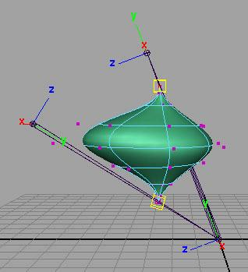

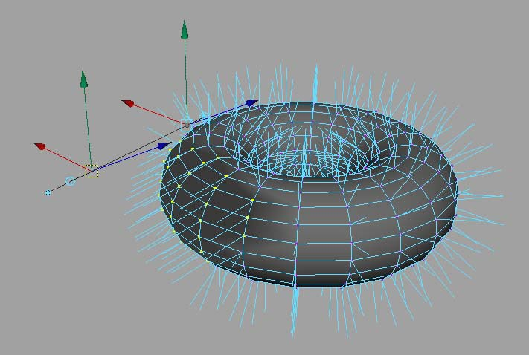
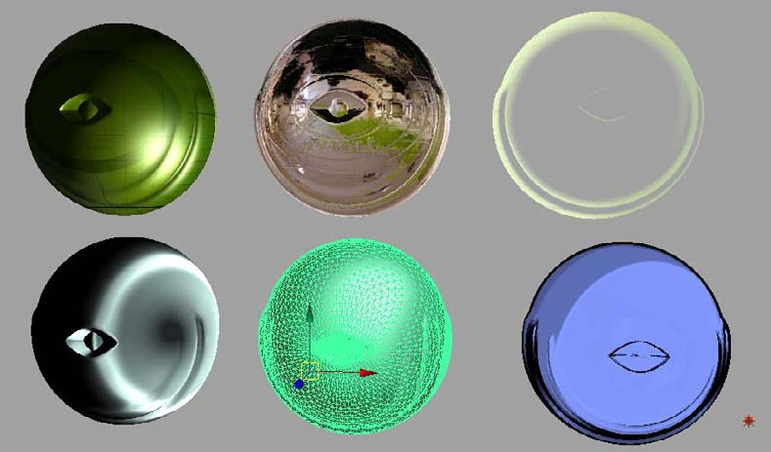
What can you develop using API?
Commands
Dependency Graph Nodes
Deformers
Shaders
Manipulators
Shapes
Etc.
Tools/Contexts
File Translators
Notes:
Hardware shaders are very popular in game developers because they can see exactly what their shader will look like in the real-time engine.
File translators is also very useful: you can define your own file translator/or file format for transmitting data.

Slide 28
What can you develop using API?
Plug-in
Loads into Maya application
C++ or Python
Full Maya UI
Interact with user and Maya operations
Standalone application
Use Maya libraries to load/save Maya files
C++ or Python
No UI
Notes:
////////////////////////////////////////
To build either a plug-in or standalone API application, certain environment variables must be set.
Standalone API applications have an additional requirement for running. These types of applications must know where Maya is installed along with the location of Maya’s libraries. The environment variable MAYA_LOCATION along with the platform specific library path environment variable is used for this. More details on these environment variables will be provided in the sections that follow.

Slide 29
Language of Choice
C++ API
Python API

Slide 30
Plug-in Development
Image courtesy of Johan Vikström, Shilo, Ool Digital, Mikros Image

Slide 31
Plug-in Development Environment
Operating System | Plug-in Type | Compiler
windows | .mll | Visual Studio 2008 SP1
Linux | .so | gcc 4.1.2
Mac | .bundle | Leopard 10.5.6+, Xcode 3.1.2
All Platforms | .py | Python 2.6.4 kernel

Slide 32
Maya Python API Plug-ins
Load/Unload Plug-in commands extended for Python
Python plug-in read into a dictionary
Searches for entry points
Action runs scripts
Required entry points
initializePlugin
uninitializePlugin

Slide 33
Maya Plug-in Architecture
initializePlugin() and uninitializePlugin() as entry point and exit point
Maya API
initializePlugin
uninitializePlugin
Maya
loadPlugin
unloadPlugin

Slide 34
Maya Python API Plug-ins
Define a Python plug-in module containing initializePlugin(), uninitializePlugin() functions
import necessary modules
def initializePlugin()
def uninitializePlugin()
class implementations
Creator functions

Slide 35
Import Necessary Modules
Classically we import what we want at the top of the module
import maya.OpenMaya as OpenMaya
import maya.OpenMayaMPx as OpenMayaMPx
import sys

Slide 36
initializePlugin() Function
Scripted plug-in initialization
# Initialize the script plug-in
def initializePlugin(mobject):
mplugin = OpenMayaMPx.MFnPlugin(mobject)
try:
mplugin.registerCommand( “foo”, cmdCreator )
except:
sys.stderr.write( "Failed to register command: %s\n" % kPluginCmdName )
raise

Slide 37
uninitializePlugin() Function
Scripted plug-in uninitialization
def uninitializePlugin(mobject):
mplugin = OpenMayaMPx.MFnPlugin(mobject)
try:
mplugin.deregisterCommand( “foo” )
except:
sys.stderr.write( "Failed to unregister command: %s\n" % kPluginCmdName )
raise

Slide 38
Class Implementations and Creator Function
Class implementation
Creator Function
return an instance of the derived proxy class to Maya
class scriptedCommand(OpenMayaMPx.MPxCommand):
def __init__(self):
….
def doIt(self,argList):
….

Slide 39
Deployment of plug-ins
Maya Plug-in Manager
Environment Variable: MAYA_PLUG_IN_PATH
Put your plug-ins into:
C:\My Documents\maya\2009\plug-ins
Add your custom plug-in path
putenv MAYA_PLUG_IN_PATH $destPluginPath;
Maya.env or userSetup.mel
string $currentPluginPath = `getenv MAYA_PLUG_IN_PATH`;
string $destPluginPath = $currentPluginPath + ";C:/My Documents";
putenv MAYA_PLUG_IN_PATH $destPluginPath;

Slide 40
Loading the Plug-in
Load from Plug-in Manager or loadPlugin command
maya.cmds.loadPlugin( "foo.py" )
maya.cmds.unloadPlugin("foo.py" )

Slide 41
Demo
A very basic plug-in that prints out “Hello World!”

Slide 42
Q & A

Slide 43
Autodesk

