Slide 1

Maya API Training
Naiqi Weng
Developer Consultant,
Autodesk Developer Network (ADN)

Slide 2

Maya Custom Nodes
Naiqi Weng
Developer Consultant,
Autodesk Developer Network (ADN)

Slide 3





Agenda
Dependency Graph
Components of Maya Node and API classes
Building Maya Custom Node with MPxNode
Image courtesy of Johan Vikström, Shilo, Ool Digital, Mikros Image

Slide 4
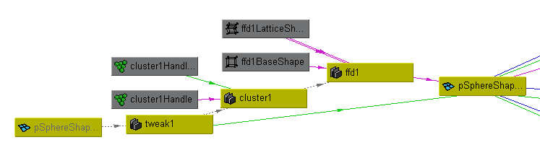
What is the Dependency Graph?

Slide 5
What is the Dependency Graph
Control system for Maya
Glue that holds together disparate operations and lets them work together seamlessly
Foundation of the Maya file format
Image courtesy of Johan Vikström, Shilo, Ool Digital, Mikros Image

Slide 6
Foundation of Maya File Format
Example: 02-spaceSaucer_02.ma
A bunch of MEL commands:
createNode
setAttr
connectAttr
Image courtesy of Johan Vikström, Shilo, Ool Digital, Mikros Image

Slide 7
Dependency Graph
Notes:
In a dependency graph, you will have all different types of nodes connected together.
Nodes are the basic element that compose the DG, and they are the engines which drive the dependency graph. So what does a node do
/////////////////////////////////////////////////////////////////////////////////
Little subgraphs are understandable; DG makes sure they all work together

Slide 8
What does a node do?
Know its own attributes
Store data efficiently in “datablocks”
Accept input, compute, generate output
Connect with other nodes through connections
Image courtesy of Johan Vikström, Shilo, Ool Digital, Mikros Image

Slide 9
What does a node do?
Accept input data, compute output data
input attributes
output attributes

Slide 10
Maya Node Structure
Maya Node
Attributes
DataBlock DataHandle
Plugs
Notes:
Attributes are conceptural definition of data in a node
Plugs are instantiations of attributes, and they are handles to get specific data. we will talk about it in a minute.
Datablock is where data are actually stored

Slide 11
Attributes
Maya Node
Attributes

Slide 12
Attributes
Describe data that belongs to nodes of a given type
Smiley Node Attribute
Float “rotation” Float “diameter”
Int32 “numEyes”

Slide 13
Attributes
Attributes are shared among nodes of the same type and all derived node types
Node A
Smiley Node Attribute
Float “rotation” Float “diameter”
Int32 “numEyes”
Node B

Slide 14
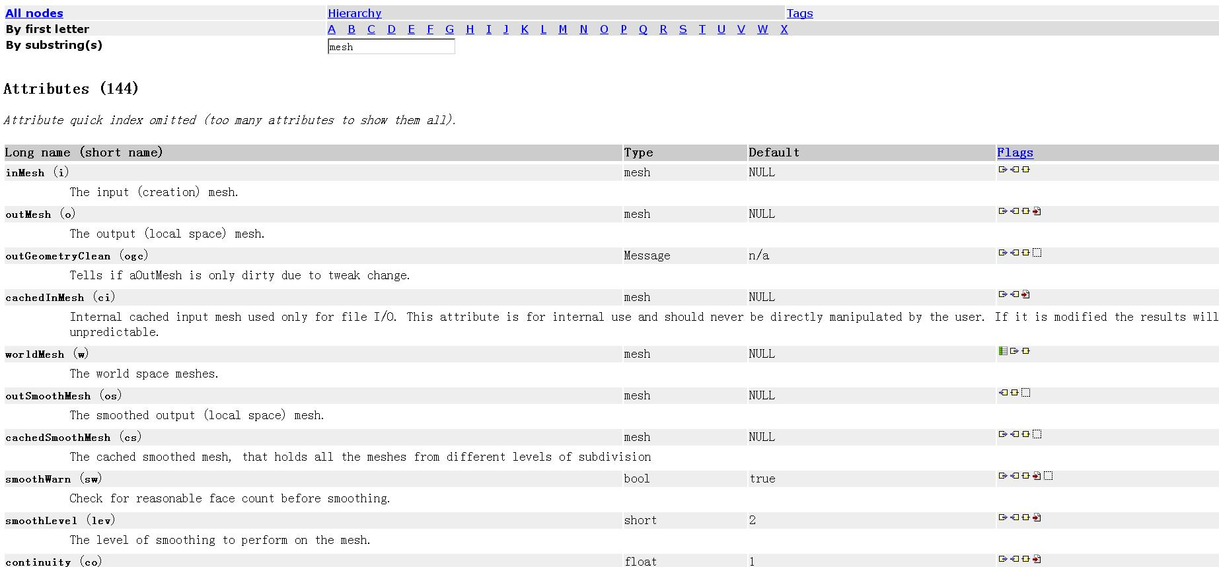
Node and Attributes
Name
Data Type
Structure
Property
Notes:
An attribute declaration usually includes
Here it is a screen snap shot of a “mesh” node documents and it attributes

Slide 15
Attributes
Define the interface of the node including
Names of the inputs and outputs
Data Type accepted by the inputs and outputs
Structure of the inputs and outputs
Properties of the inputs and outputs
Image courtesy of Johan Vikström, Shilo, Ool Digital, Mikros Image

Slide 16
Attribute Data Types
Basic
Numeric (float, int32,etc.)
String
Matrix
Etc.
Complex
Mesh
NurbsSurface
Generic (accepts more than one type)
Etc.

Slide 17
Attribute Structures
Simple
handles a single piece of data
Example: polySphere1.radius
Compound
1 or more attributes grouped under a parent attribute
Example: translate is a compound with children (tx, ty, tz)
t
tx
ty
tz
Notes:
Compound attributes are pretty much like “structures” in C, useful for grouping data together

Slide 18
Attribute Structures
Array (also referred to as a Multi)
An array of simple data
Example: pSphereShape1.face
face
0
1
2
...
n-1
n

Slide 19
Attribute Structures
Compound array
An array of compound data
Example: mesh colors with children (colorR, colorG, colorB, colorA)
And so on...
colors
0
1
2
...
n-1
n
colorR
colorG
colorB
colorA

Slide 20
Attribute Properties – Read/Write
Readable
Attribute can be connected as a source
Example: polyCylinder1.output
Writable
Attribute can be connected as a destination
Example: pCylinderShape1.inMesh
Read/Write
Attribute can be connected as both a source and a destination
Example: pCylinder1.tx

Slide 21
Attribute-Affects Relationship
Attributes can affect other attributes
Once created on a node, an “attributeAffects” relationship can be setup to denote a dependency
D
radius
volume
setAttr D.radius 5
attributeAffects(radius,volume)
Notes:
ON a Maya node, some attributes can have an influence on other attribute’s value, how does that work? It’s done by “attributeAffects” relationship.
For Maya internal nodes, the affecting relationship are already set up and they are fixed , you can use “affects” command to check. The information here is more applicable when you develop your own plug-in node.

Slide 22
API Classes for Attributes
Maya Node
Attributes
MFnAttribute

Slide 23
API Classes for Attributes
Base Class: MFnAttribute
Most Common Used Classes
MFnNumericAttribute
MFnCompoundAttribute
MFnTypedAttribute
MFnMatrixAttribute
MFnGenericAttribute

Slide 24
MFnAttribute
Base of attribute function set classes
Take care of all the common aspect of an attribute on node
Readable/writable
Connectable
Storable
Keyable
Dynamic

Slide 25
MFnNumericAttribute
Function set for simple numeric value attribute
import maya.OpenMaya as OpenMaya
nAttr = OpenMaya.MFnNumericAttribute()
simpleNode.input = nAttr.create( "input", "in", OpenMaya.MFnNumericData.kFloat, 0.0 )
nAttr.setWritable(True)
nAttr.setStorable(True)
nAttr.setKeyable(True)
Notes:
Supposing this node class name is simpleNode

Slide 26
Plugs
Maya Node
Attributes
Plugs
MFnAttribute

Slide 27
Plugs
Pointer to an attribute on a specific node (ie. a specific instance of an attribute)
Node type definition
Actual instance of a node
myNode1
myNode2
myNode
myPlug1(myNode1, myAttr)
myAttr
myPlug2(myNode2, myAttr)
Notes:
Attribute is just an conceptual interface/discription, while plugs are the real tangible handles for attribute on specific instance of a node

Slide 28
Plugs
Plugs can be used to:
query a value
set a value
create a connection
remove a connection
query connection(s)
Does not store attribute data

Slide 29
API Classes for Plugs
Maya Node
Maya Node
Attributes
Plugs
MFnAttribute
MPlug

Slide 30
API Class for Plug: MPlug
Attribute and Node Operations:
MPlug::MPlug (const MObject &node, const MObject &attribute)
MObject MPlug::attribute ( MStatus * ReturnStatus)
MObject MPlug::node ( MStatus * ReturnStatus)
Operations for Compound Attribute and Connections:
MPlug MPlug::parent ( MStatus * ReturnStatus)
MPlug MPlug::child (unsigned int index, MStatus *ReturnStatus)
bool MPlug::connectedTo ( MPlugArray & array, bool asDst, bool asSrc, MStatus * ReturnStatus = NULL )
Manipulation of Data
MStatus MPlug::getValue ( double & val, MDGContext & ctx )
MStatus MPlug::setValue ( double val )

Slide 31
Datablocks
Maya Node
Attributes
Datablock Datahandle
Plugs
MFnAttribute
MPlug

Slide 32
Datablocks
Node stores data for every attribute (arrays are special, more details later)
Attributes
Node
Datablock
Notes:
From a user point of view, you don’t usually deal with datablock directly. This concept is only useful when you use API
Conceptually, data objects are flowing through the connections in the dependency graph. Then how do they get stored on a node?
Every node in the dependency graph has a data block associated with it.
The data block holds the data objects for all of the node's attributes.

Slide 33
Datablocks & Datahandles
Datablock is the actual storage for the input and output data of a node
For every non-array attribute, datablock stores:
Data
Dirty/clean status
Data handles are lightweight pointers into the data in the datablock

Slide 34
Datablocks
Nodes hold an array of datablocks
One datablock for a normal evaluation (using current time)
More datablocks for timed contexts (specified times)
Normal
t=4
t=12

Slide 35
Maya Node Structure: API Classes
Maya Node
Attributes
Datablock Datahandle
Plugs
MFnAttribute
MDataBlock
MDataHandle
MPlug

Slide 36
API Classes for Datablock
MDatablock
only valid during compute()
Pointers to data block should not be retained after compute()
MDataHandle
a smart pointer for information contained in data block
double & MDataHandle::asDouble ( )
void MDataHandle::setDouble ( double )
MStatus MPxNode::compute(const MPlug& plug, MDataBlock& dataBlock)
MDataHandle MDataBlock::inputValue(const MPlug & plug, MStatus * ReturnStatus)
MDataHandle MDataBlock::outputValue ( const MPlug & plug, MStatus * ReturnStatus)
MStatus MDataBlock::setContext (const MDGContext & ctx )
Notes:
Outside of compute() function, there is no way that you can access datablock.
The data block is only valid during the compute method of the depend node. Pointers to the data block should not be retained after the compute method.

Slide 37
Maya Node Structure: API Classes
MPxNode
Maya Node
Attributes
Datablock Datahandle
Plugs
MFnAttribute
MDataBlock
MDataHandle
MPlug
Notes:
We have talked about all aspects of a Maya DG node and their API classes, so how to implement a custom Maya DG node, With API classes? We need to derive our class from MPxNode, in the following presentation, we will show complete steps to implement a custom node.

Slide 38

Custom Node Implementation
Image courtesy of Johan Vikström, Shilo, Ool Digital, Mikros Image

Slide 39
Maya Python API Plug-ins
Define a Python plug-in module containing initializePlugin(), uninitializePlugin() functions
import necessary modules
def initializePlugin()
def uninitializePlugin()
class implementations…
creator function

Slide 40
Import Necessary Modules
Classically we import what we want at the top of the module
import maya.OpenMaya as OpenMaya
import maya.OpenMayaMPx as OpenMayaMPx
import sys

Slide 41
InitializePlugin() Function
Scripted plug-in initialization
def initializePlugin(mobject):
# Code to register your custom node
…..

Slide 42
UninitializePlugin() function
Scripted plug-in uninitialization
def uninitializePlugin(mobject):
# Code to deregister your custom node
….

Slide 43
Custom DG Nodes in Maya
Entirely new operations
MPxNode
Extend existing Maya node types
MPxDeformerNode
MPxFieldNode
MPxEmitterNode
MPxSpringNode
MPxIkSolverNode
MPxHardwareShader

Slide 44
MPxNode Registration
Every node requires a unique identifier.
OpenMaya.MTypeId(0x80001);
For plug-ins that you intend to share between sites
Will require a globally unique ID issued to you by Autodesk.
IDs are allocated in blocks of 64/128/256/512.
Contact ADN M&E for unique global IDs.
0 – 0x7ffff (524288 ids)
0x80000 – 0xfffff
0x100fff – 0xffffff
Internal Use
DevKit Examples
Global IDs
Notes:
We reserved some block of IDs for Maya internal node, and also some for devkit examples, for your commerical plug-ins, you need to request the Ids allocated to you.
////////////////////////////
These node identifiers are critical to the Maya binary format.

Slide 45
MPxNode Registration
Register custom node in initializePlugin function
kPluginNodeTypeName = "simpleNode"
simpleNodeId = OpenMaya.MTypeId(0x80001)
def initializePlugin(mobject):
mplugin = OpenMayaMPx.MFnPlugin(mobject)
try:
mplugin.registerNode( kPluginNodeTypeName, simpleNodeId, nodeCreator, nodeInitializer )
except:
sys.stderr.write( "Failed to register node: %s" % kPluginNodeTypeName )
raise
Notes:
In here, I am registering a command, the name of the command is “foo”, I am also providing a creator function, whose name is cmdCreator()

Slide 46
MPxNode Registration
Deregister custom node in uninitializePlugin() function
def uninitializePlugin(mobject):
mplugin = OpenMayaMPx.MFnPlugin(mobject)
try:
mplugin.deregisterNode( simpleNodeId )
except:
sys.stderr.write( "Failed to deregister node: %s" % kPluginNodeTypeName )
raise

Slide 47
Class Implementations
Class Implementation
Parameter: “self” same as “this” in C++
class simpleNode(OpenMayaMPx.MPxNode):
def __init__(self):
OpenMayaMPx.MPxNode.__init__(self)
def compute(self,plug,dataBlock):
.…
def nodeCreator():
….
def nodeInitializer():
…..

Slide 48
Creator Function
The Creator function is called to return a new instance of the node
Pass Python function to MFnPlugin methods
…
mplugin.registerNode( kPluginNodeTypeName, simpleNodeId, nodeCreator, nodeInitializer )
…
Ownership is important
Notes:
Creator functions are used to return an instance of the derived proxy class to Maya.
In python plug-in, It is very similar to the C++ plug-in with the only difference being that you need to set ownship when the object is created by the creator function.

Slide 49
Creator Function
OpenMayaMPx.asMPxPtr() transfer ownership of newly-created command or node objects to Maya
class simpleNode(OpenMayaMPx.MPxNode):
….
def nodeCreator():
return OpenMayaMPx.asMPxPtr( simpleNode() )
Notes:
///////////////////////////
Program errors will occur if you do not make this call since Python can unreference this object and destroy it. This will leave a dangling pointer in Maya.

Slide 50
Initialize Function
Implement this method to define the attribute interface for your node.
create attributes
set the attribute’s flags
add attributes to the node
define attribute relationships
Inherit attributes if necessary

Slide 51
Attribute Operations
MStatus MPxNode::addAttribute ( const MObject & attr )
MStatus MPxNode::attributeAffects ( const MObject & whenChanges, const MObject & isAffected )
MStatus MPxNode::inheritAttributesFrom ( const MString & parentClassName)
MPxNode
Custom Node A
Custom Node B

Slide 52
Initialize Function
myNode
myOutput
myInput
myOutputTwo
def nodeInitializer():
nAttr = OpenMaya.MFnNumericAttribute()
simpleNode.myInputAttr = nAttr.create( "myInput", “mi", OpenMaya.MFnNumericData.kFloat, 1.0 )
nAttr.setStorable(True)
simpleNode.myOutputAttr = nAttr.create(“myOutput”, “mo”, OpenMaya.MFnNumericData.kFloat, 1.0)
nAttr.setStorable(True)
simpleNode.myOutputAttrTwo = nAttr.create(“myOutputTwo”, “motwo”, OpenMaya.MFnNumericData.kFloat, 1.0)
nAttr.setStorable(True)
simpleNode.addAttribute( simpleNode.input )
simpleNode.addAttribute( simpleNode.myOutputAttr)
simpleNode.addAttribute( simpleNode.myOutputAttrTwo)
simpleNode.attributeAffects(simpleNode.myInputAttr, simpleNode.myOutputAttr);
MPxNode::addAttribute()
MPxNode::attributeAffects()
Notes:
In C++, it has be to named as “intialize()”, but in python, it is okay to name it as you want, because it is not a member function, it is a global function.

Slide 53
MPxNode
MPxNode::compute()
called when the node is asked to evaluate an output
def compute( self, plug, dataBlock):
if ( plug == simpleNode.myOutputAttr):
# your compute algorithm for output1
if (plug == simpleNode.myOutputAttrTwo):
# your compute algorithm for output2
getAttr myNode1.myOutput;
myNode
myOutput
myInput
myOutputTwo

Slide 54
MPxNode
MPxNode::compute()
def compute(self,plug,dataBlock):
# …
if( plug == simpleNode.myOutputAttr ):
inputHandle = dataBlock.inputValue( simpleNode.myInputAttr )
inputValue = inputHandle.asFloat()
outputHandle = dataBlock.outputValue( simpleNode.myOutputAttr )
outputHandle.setFloat(inputValue * 2 );
dataBlock.setClean( plug )
return
if (plug = = simpleNode.myOutputAttrTwo):
#…
return OpenMaya.kUnknownParameter
myOutput = myInput * 2;
myNode
myOutput
myInput
myOutputTwo

Slide 55
Example: simpleNode
In this example, we implement a custom node with two attributes: “input”, ”output”. Whenever the “input” attribute value changes, the “output” attribute will always be the input value multiplied by 2.

Slide 56
Q & A

Slide 57
Autodesk

